Slide 1

ECB1204 – ANALOG INTEGRATED CIRCUIT DESIGN LISTENING BUG CIRCUIT
Presented by:
MATHESH.M - 2303811710621063
MOTHIS.S - 2303811710621071
SANJAI.M - 2303811710621095
Under the Guidance of
Mrs.G.KEERTHANA, M.E .,
ASSISTANT PROFESSOR
ECE

Slide 2
OUTLINE
ABSTRACT
INTRODUCTION
PROBLEM STATEMENT
OBJECTIVE
HARDWARE MODULE
RESULTS AND DISCUSSION
ADVANTAGES AND APPLICATIONS
CONCLUSION
FUTURE ENHANCEMENT

Slide 3
ABSTRACT
The Listening Bug Circuit is a compact audio surveillance device designed to capture and transmit sound from the audio jack connected to it . It employs a sensitive microphone, amplification stages, and a transmitter module to relay audio signals to a remote receiver. This circuit is commonly used in applications requiring covert audio monitoring, such as security, wildlife observation, or educational demonstrations of audio transmission technology. While showcasing the principles of sound capture and wireless communication, the circuit's design emphasizes simplicity and efficiency. Proper legal and ethical considerations must guide its usage to ensure compliance with privacy regulations.

Slide 4
INTRODUCTION
A listening bug circuit is a compact device designed to capture recieve sound and transmit it to a receiver. It combines a microphone, amplifiers, and a transmitter to achieve efficient audio monitoring. These circuits are used in surveillance, environmental monitoring, and educational applications. While they demonstrate key principles of audio capture and wireless communication, their usage must adhere to strict legal and ethical guidelines to ensure privacy and responsible application.

Slide 5
PROBLEM STATEMENT
The increasing need for audio surveillance and monitoring in applications such as security systems, crime investigations the development of a reliable and efficient listening device. Traditional solutions are often bulky, power-intensive, or lack sufficient sensitivity to capture clear audio signals. This project aims to design and implement a compact listening bug using an operational amplifier (op-amp), capable of amplifying faint sound signals for effective audio monitoring. The system should ensure high sensitivity to weak signals, low power consumption, and minimal noise interference. It should also include provisions for long-distance transmission of audio signals or storing them for later analysis.

Slide 6
OBJECTIVE
Listening devices, or "bugs," are compact tools for surveillance, capturing faint sounds for analysis, transmission, or recording. Advancements in electronics have enabled their miniaturization and improved functionality. Op-amps are widely used in audio applications, especially in preamplifiers, due to their high gain and low distortion. Listening bug circuits prioritize sensitivity, low noise, and power efficiency, often incorporating filters for enhanced performance. This project focuses on designing a robust op-amp-based listening bug circuit, addressing challenges like noise reduction, signal amplification, and compactness for reliable covert audio monitoring.

Slide 7
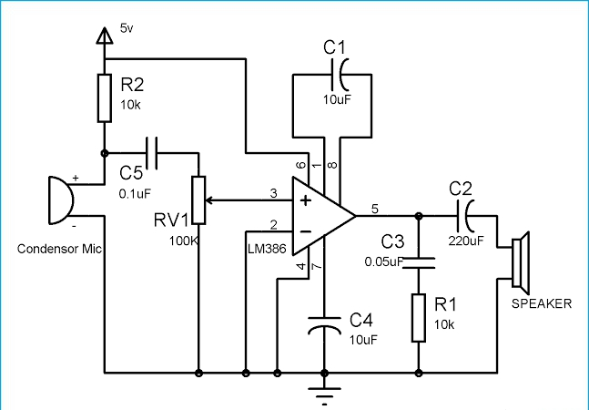
HARDWARE MODULE
Resistor : 10k ohm(2), 100k ohm(1)
Variable Resistance :100k ohm (1)
Capacitors : 10uf(3), 0.05uf(1), 0.1uf(1)
IC LM386(1)
Audio Jack wire (1)
Speaker 4ohm (1)
Bread board(1)
Connecting wires(As required)
Input

Slide 8
RESULTS AND DISCUSSION
The listening bug circuit is a compact system designed to capture, amplify, and transmit audio signals, typically for surveillance purposes. It begins with a microphone that converts sound waves into a weak electrical signal. The microphone's diaphragm vibrates in response to sound, generating a tiny electrical signal that needs amplification. This signal is sent to an operational amplifier (often an IC LM386), which boosts its voltage while preserving the signal’s integrity. The gain is adjustable, typically controlled by feedback resistors or a potentiometer, ensuring the audio is amplified to the correct level without distortion.

Slide 9
ADVANTAGES AND APPLICATIONS
The listening bug circuit is used in surveillance for monitoring audio, in research for acoustic studies, and in education to teach amplification and transmission concepts. It also has applications in entertainment, such as toys and gadgets, where it enables audio playback or recording, showcasing its versatility in different fields
Covert Surveillance:
The listening bug is small and easily concealed, allowing for discreet monitoring of conversations or activities without detection.
Long-Distance Monitoring:
When combined with wireless transmission, the listening bug enables long-distance audio monitoring, making it ideal for remote surveillance.

Slide 10
CONCLUSION
The listening bug circuit provides a practical and versatile solution for audio surveillance, offering the ability to capture, amplify, and output or transmit audio in a variety of environments. While the circuit can be easily miniaturized and concealed, making it ideal for covert applications, it also faces challenges related to power consumption, signal interference, and audio quality. Despite these limitations, its wide range of applications—ranging from security to wildlife monitoring—demonstrates its value. Future advancements in wireless transmission, miniaturization, and digital processing could further enhance the functionality and usability of the listening bug circuit, making it an even more effective tool for audio surveillance.

Slide 11
FUTURE ENHANCEMENT
Future limitations include potential detection by advanced security systems, stricter legal and ethical regulations restricting its use, and challenges in keeping up with modern communication technologies. Traditional designs may become outdated, requiring upgrades to match new standards in audio quality, power efficiency, and wireless transmission capabilities.

Slide 12
THANK YOU

