Slide 1


SRI SHAKTHI INSTITUTE OF ENGINEERING AND TECHNOLOGY
(AN AUTONOMOUS INSTITUTION)
DEPARTMENT OF COMPUTER SCIENCE AND ENGINEERING (CYBER SECURITY)
21CY411- ENGINEERING EXPLORATION - V
TITLE : SENTINELAI X — MCP-ENABLED COPILOT & ML THREAT ENGINE FOR FASTER SOC INVESTIGATION
DOMAIN : CYBER SECURITY
PRESENTED BY,
TEAM NUMBER: 25
MATHESH.T(714024149059)
JEEVITHKUMAR.P(714024149043)
B.E-CSE (CYBER SECURITY)
GUIDED BY,
Ms. DHIVYA K
ASSISTANT PROFESSOR
CSE (CYBERSECURITY)

Slide 2
Problem Statement
Security Operations Centers (SOCs) face severe alert fatigue, processing thousands of endpoint and network telemetry alerts daily. Modern SOC analysts must navigate disparate tools (SIEM, threat intelligence feeds, malware sandboxes, vulnerability databases), manually correlating IOCs across disconnected web portals. This manual swivel-chair investigation causes high cognitive load, missed critical alerts, and extended Mean Time to Detect (MTTD) and Respond (MTTR).
Furthermore, traditional SIEMs rely on static threshold rules that miss stealthy zero-day attacks and lack real-time Machine Learning anomaly scoring. The proposed project addresses these challenges by developing SentinelAI X: an enterprise AI Security Copilot integrating real Wazuh SIEM v4.14.7, 16 Model Context Protocol (MCP) tools (featuring 6 zero-cost free intelligence feeds), and scikit-learn ML Anomaly Detection into a unified cyber operations platform.
SRI SHAKTHI INSTITUTE OF ENGINEERING AND TECHNOLOGY

Slide 3
Abstract
The increasing volume and sophistication of cyberattacks have made Security Operations Centers (SOCs) critically dependent on rapid alert triage and automated investigation workflows. However, SOC analysts spend significant time navigating disconnected security platforms, incurring expensive API license fees, and manually correlating threat indicators across fragmented tool silos.
This project presents SentinelAI X, an enterprise-grade AI-powered Security Copilot built on FastAPI and React 18 with an authentic Cyber Black & Matrix Green operations interface. The platform establishes a live telemetry bridge to Wazuh SIEM v4.14.7 via sub-second JSON log ingestion and persistent multi-layer caching. It incorporates 16 Model Context Protocol (MCP) tools, featuring 6 zero-cost free feeds (abuse.ch MalwareBazaar & URLhaus, CISA KEV, IP-API, CIRCL CVE, and MITRE ATT&CK). Additionally, an enterprise Machine Learning Engine (IsolationForest & RandomForest) evaluates behavioral baseline drift and scores zero-day anomalies (0–100). Integrated SOAR active defense delivers one-click firewall IP blackholing and host isolation, significantly accelerating end-to-end incident response.

Slide 4
Existing System
• Fragmented Security Architecture: Analysts switch across disconnected SIEMs, threat portals, and sandboxes manually.
• High Analyst Alert Fatigue: Static threshold rules generate massive false positives with zero ML prioritization.
• Expensive Operational Costs: Heavy ongoing reliance on costly proprietary threat intelligence API subscriptions.
• Delayed Active Containment: Firewall blocking and host quarantine require disconnected manual operational steps.
Our System — SentinelAI X
• Autonomous MCP Tool Bus: Standardized AI interface orchestrates 16 forensic tools and feeds concurrently.
• Real Wazuh SIEM Telemetry: Live sub-second JSON log ingestion backed by instant 0ms persistent dual cache.
• Machine Learning Threat Engine: IsolationForest anomaly scoring (0–100) & RandomForest severity triage.
• 100% Free Public SOC Feeds: abuse.ch, CISA KEV, IP-API, and CIRCL integration with zero API license fees.
• Automated SOAR Containment: One-click gateway firewall drop rules and host subnet isolation with audit logs.

Slide 5
Proposed Solution
Step 1: Real-time Telemetry Ingestion — Monitored Windows & Linux endpoints stream security events (Event ID 4624/4625, FIM, Defender) to Wazuh SIEM.
Step 2: Sub-Second Log Parsing & Caching — FastAPI backend tails alerts.json and maintains in-memory RAM and disk caches for zero-lag triage.
Step 3: Machine Learning Threat Scoring — IsolationForest calculates behavioral anomaly risk (0–100), while RandomForest predicts incident severity.
Step 4: Autonomous MCP Tool Dispatch — AI Copilot extracts IOCs (IPs, Hashes, CVEs) and queries free intelligence feeds (MalwareBazaar, CISA KEV, IP-API, CIRCL).
Step 5: MITRE ATT&CK & STIX Mapping — Security events are dynamically mapped to adversary TTPs (T1059, T1110, T1486) and synthesized into forensic reports.
Step 6: Conversational Security Copilot — Natural language chat in plain English or Tamil/Tanglish assists analysts with deep contextual forensics.
Step 7: Automated SOAR Containment — One-click mitigation rules (Netsh firewall IP blackholing, host network isolation) execute with complete audit trails.
SRI SHAKTHI INSTITUTE OF ENGINEERING AND TECHNOLOGY

Slide 6
Modules
1. Cyber SOC Command Center (React 18 & Matrix Green UI)
2. Asynchronous Security API Engine (FastAPI & Uvicorn)
3. Real Wazuh SIEM Telemetry Bridge & Parser (Continuous JSON Ingestion)
4. Model Context Protocol (MCP) Multi-Tool Gateway (16 Integrated Tools)
5. Enterprise Machine Learning Threat Engine (IsolationForest & RandomForest)
6. Zero-Key Free Threat Intelligence Feeds (abuse.ch, CISA KEV, IP-API, CIRCL)
7. SentinelAI Security Copilot (Hero Conversational Chatbot)
8. SOAR Active Defense & Automated Network Containment (1-Click Mitigation)
9. Persistent Dual-Layer Cache System (RAM + Disk + localStorage)
10. Forensics Audit & Executive Report Generator (PDF & Markdown Synthesis)

Slide 7
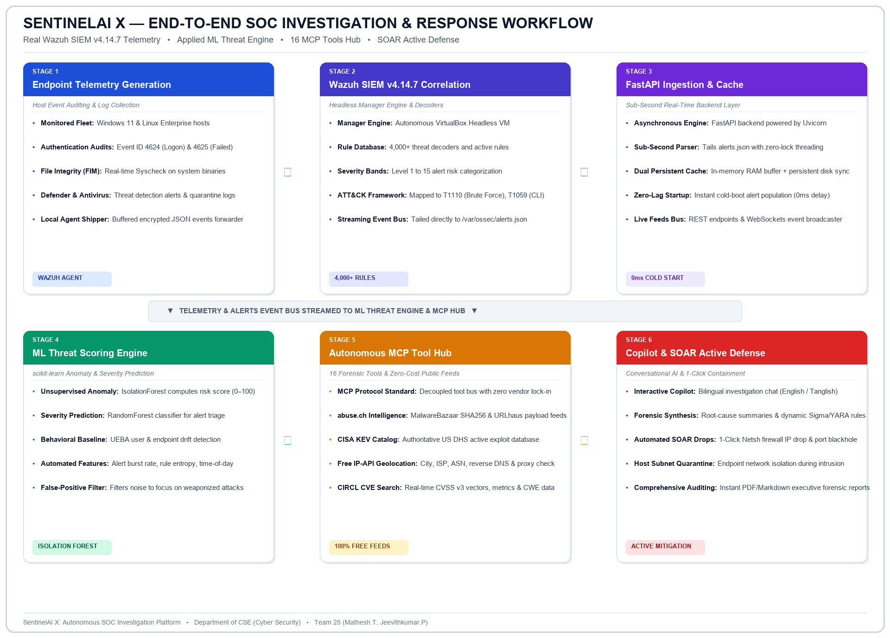
Workflow

Slide 8
Tools Required
Backend Architecture: Python 3.11, FastAPI, Uvicorn & AsyncIO (Sub-second Log Processing)
Frontend Operations: React 18, Vite 5 & TailwindCSS (Cyber Black & Matrix Green Theme)
Protocol Standard: Model Context Protocol (MCP Standardized Multi-Tool Interface)
SIEM & Telemetry: Wazuh SIEM v4.14.7 Manager, VirtualBox Headless Guest Engine
Machine Learning Engine: scikit-learn (IsolationForest Anomaly & RandomForest Classifier)
Malware Intelligence: abuse.ch MalwareBazaar (SHA256) & URLhaus (C2 Payload Feeds)
Vulnerability Catalogs: CISA KEV (Known Exploited Catalog) & CIRCL / OSV CVE Search
Network Geolocation: Free IP-API (City, Country, ISP, ASN & Proxy Reverse DNS)
Tactical Matrix: MITRE ATT&CK Enterprise Framework v15 (Adversary TTPs)
Active Defense (SOAR): Windows Netsh Firewall, Linux iptables & Host Network Isolation
SRI SHAKTHI INSTITUTE OF ENGINEERING AND TECHNOLOGY

Slide 9
Reference
    M. Kim et al., "Enhancing Security Operations Center: Wazuh Security Event Response with Retrieval-Augmented-Generation-Driven Copilot (SERC)," Sensors, vol. 25, no. 3, 2025.
    Anthropic, "Model Context Protocol (MCP) Specification & Architecture," 2024–2025. https://modelcontextprotocol.io
    Cybersecurity and Infrastructure Security Agency (CISA), "Known Exploited Vulnerabilities (KEV) Catalog," US DHS, 2025–2026.
    abuse.ch, "MalwareBazaar & URLhaus Public Threat Intelligence Feeds," 2025. https://bazaar.abuse.ch
    MITRE Corporation, "MITRE ATT&CK Enterprise Matrix v15," https://attack.mitre.org
    F. Pedregosa et al., "Scikit-learn: Machine Learning in Python," Journal of Machine Learning Research.
    Wazuh Documentation, "Wazuh v4.14 Open Source Security Platform," https://documentation.wazuh.com

Slide 10
Conclusion
  The proposed project introduces SentinelAI X, an enterprise-grade AI-powered Security Operations platform designed to dramatically accelerate modern SOC operations. By converging Real SIEM Telemetry (Wazuh v4.14.7), 16 Model Context Protocol (MCP) tools, and Applied Machine Learning (IsolationForest & RandomForest), the system eliminates tool-switching, eliminates costly API licensing through free public feeds, and automates active containment.
  This work demonstrates the practical application of autonomous AI agents in enterprise cybersecurity defense, slashing Mean Time to Detect (MTTD) and Mean Time to Respond (MTTR) while establishing a solid foundation for future autonomous cyber defense systems.
SRI SHAKTHI INSTITUTE OF ENGINEERING AND TECHNOLOGY

Slide 11

SRI SHAKTHI INSTITUTE OF ENGINEERING AND TECHNOLOGY​

