Slide 1
Dataspark : Illuminating Insights for Global Electronics
-BY
MATHESH M

Slide 2
Problem Statement
As part of the Global Electronics data analytics team, the goal is to conduct a comprehensive Exploratory Data Analysis (EDA) to uncover valuable insights from the company’s data. The aim is to provide actionable recommendations that enhance customer satisfaction, optimize operations, and drive overall business growth.

Slide 3
Business Use Cases
By analyzing customer, product, sales, and store data, this project focuses on:
Enhancing marketing strategies based on customer insights.
Optimizing inventory management by analyzing product demand.
Improving sales forecasting and planning store expansions.
Leveraging currency exchange rates to refine international pricing strategies.

Slide 4
Tools Used
Jupyter Notebook for analysis.
Python (Pandas, Matplotlib, Seaborn) for data cleaning and EDA.
MySQL for storing and retrieving cleaned data.
Power BI for data visualization.
Datasets
Customer data (Customers.csv): Demographic details such as gender, D.O.B, and location.
Sales data (Sales.csv): Transaction details, including product quantities, dates, and store IDs.
Products data (Products.csv): Product information including categories, unit prices, and costs.
Stores data (Stores.csv): Store locations, operational attributes, and sales performance.
Currency exchange rates data (Exchange_Rates.csv): Historical exchange rates for financial analysis.

Slide 5
Approach
Data Cleaning and Preparation
Handling missing values and converting data types (e.g., dates, numerical values).
Merging datasets where necessary for analysis (e.g., linking sales data with product and customer data).
Data Loading
Inserting cleaned data into a MySQL database by creating relevant tables for each dataset.
Power BI Visualization
Connecting SQL to Power BI, importing the data, and creating interactive dashboards.
SQL Queries and Calculations
Formulating SQL queries to extract insights and perform calculations in Power BI.

Slide 6
Analysis Steps
Customer Analysis
Demographic Distribution: Analyze gender, age, and location.
Purchase Patterns: Frequency of purchases, preferred products, and customer behavior.
Segmentation: Segment customers based on demographics and purchasing behavior.
Sales Analysis
Sales by Product and Store: Evaluate top-selling products and store performance.
Order Volume Trends: Examine sales history over time (month and year).
Product Analysis
Product Popularity: Identify top-selling products and categories.
Profitability: Compare unit cost and unit price for profitability analysis.
Store Analysis
Store Performance: Evaluate store performance based on sales and operational data.
Geographical Analysis: Analyze sales by store location to identify top-performing regions.

Slide 7
Findings and Recommendations
Customer Demographics
Balanced gender distribution: Products appeal equally to both men and women.
Older customer base: Most customers are aged 60 and above, with fewer younger customers.
Regional dominance: North America is the largest customer base, especially cities like Toronto, Montreal, and Atlanta.
Product and Sales Insights
Universal product appeal: Products like computers, cell phones, and entertainment content are popular across all demographics.
Top brands: Contoso leads the market, followed by Wide World Importers and Adventure Works.
Top products: Desktop computers, particularly from the "Adventure Works Desktop" and "WWI Desktop" series, are bestsellers.
Sales and Delivery Trends
Seasonal trends: Sales peak in December and decline in April annually.
Growth trend: Sales saw an upward trend from 2017 to 2020, with a slight dip after April 2020.

Slide 8
Store analysis
In the analysis of store performance, we identified several stores with no recorded orders, particularly those over 12 years old. This indicates they may not be in active use. To address this, we recommend conducting a thorough evaluation of these stores to determine the most appropriate action. Options include:
Renovation: For stores in good condition, consider updates to attract new customers and tenants.
Demolition: For stores that are beyond repair or in less favorable locations, demolishing them could pave the way for new developments. This strategy aims to enhance overall retail performance and adapt to changing consumer needs.
AT RISK customer
During our analysis, we identified a segment of at-risk customers who exhibit signs of disengagement from our services. This finding is crucial for maintaining customer loyalty and ensuring sustained business growth.
Recommended Actions:
Personalized Outreach: Develop targeted communication strategies to reach out to at-risk customers. Personalize messages based on their purchase history and preferences.
Incentives and Promotions: Offer tailored promotions or discounts to encourage these customers to return and engage with our products or services.
Feedback Mechanism: Implement a feedback system to understand their concerns or reasons for disengagement. Use this information to improve service offerings.

Slide 9
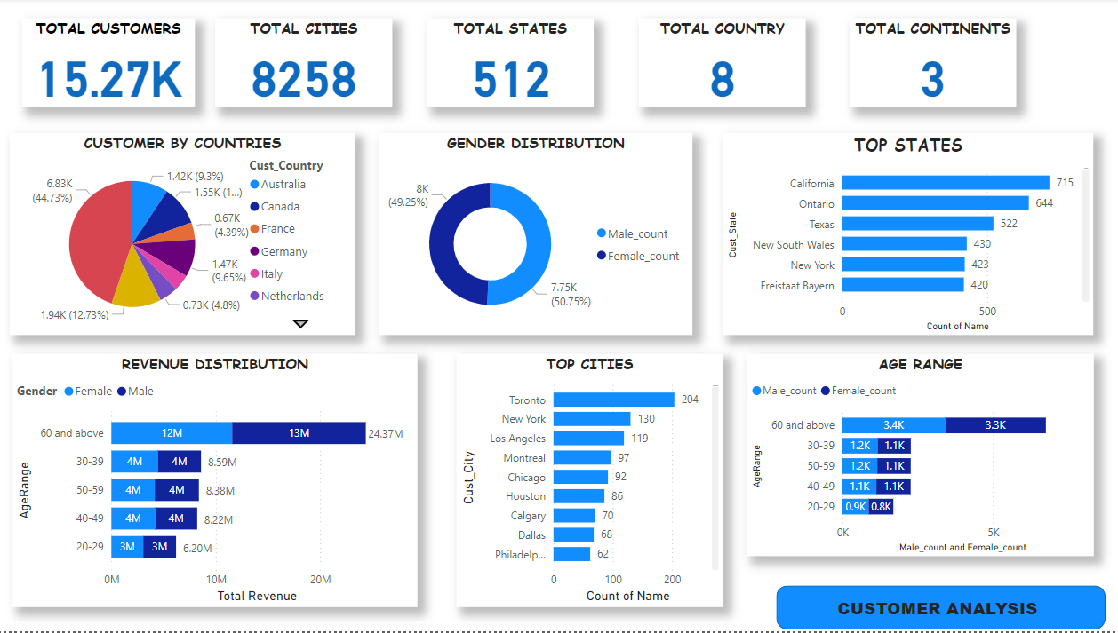

Slide 10
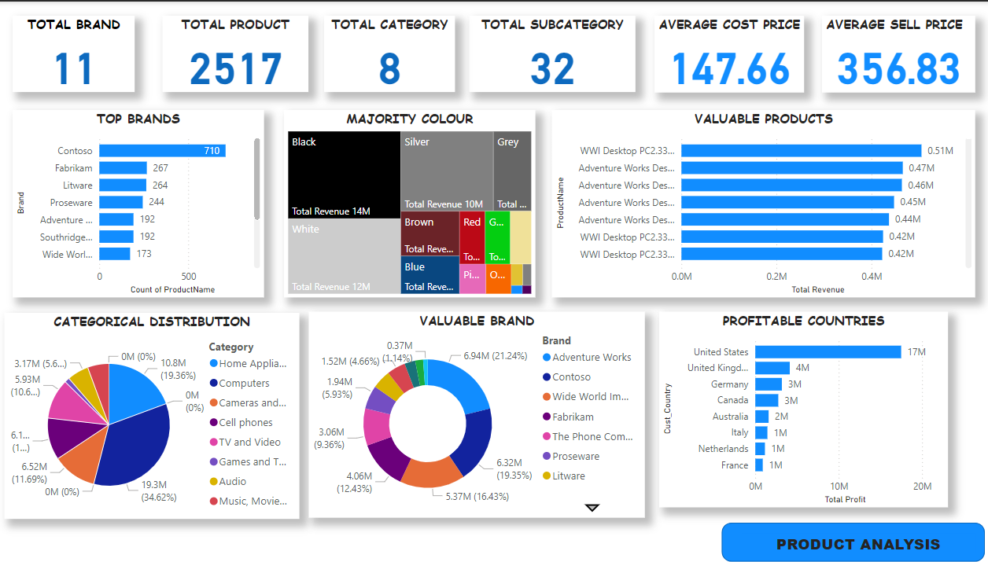

Slide 11
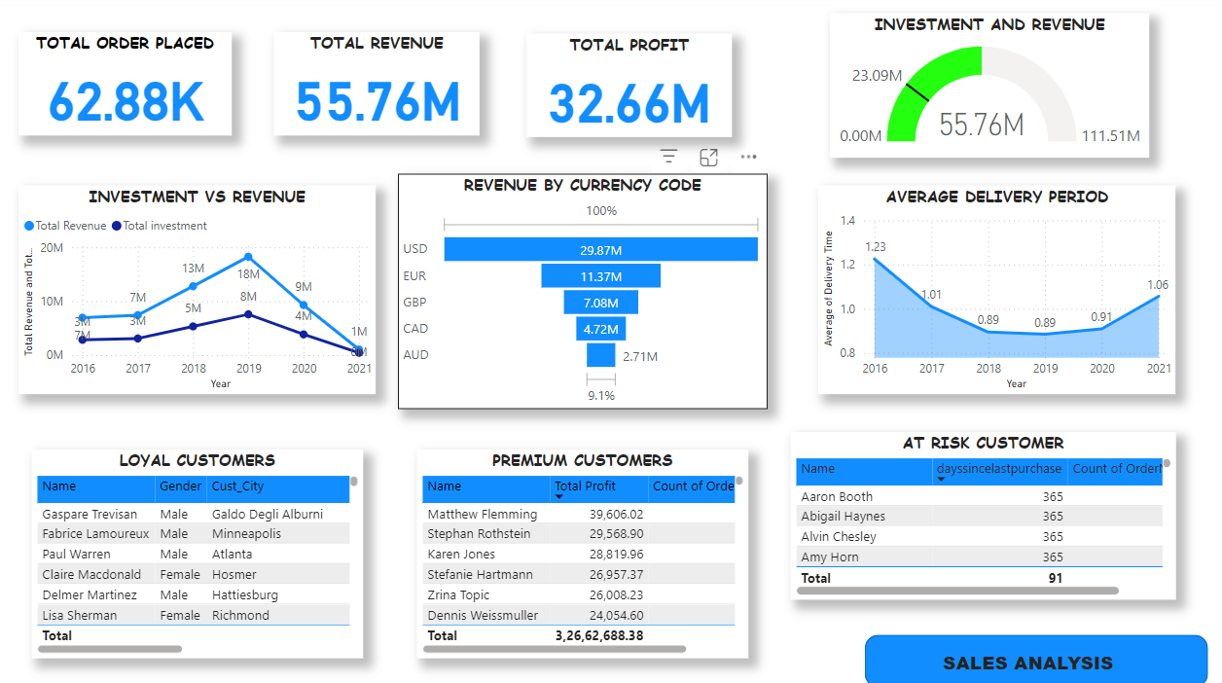

Slide 12
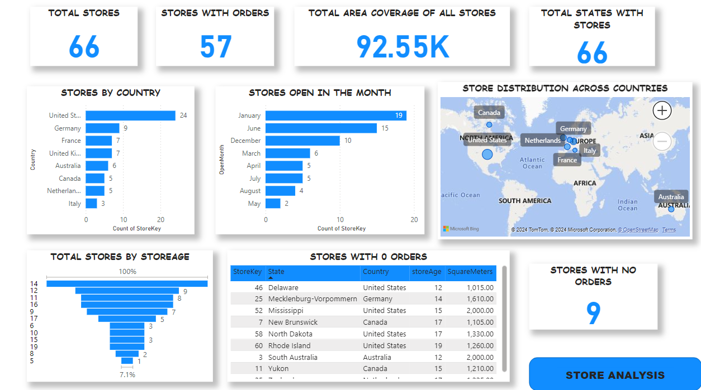

Slide 13
Conclusion
The analysis provides insights that can guide Global Electronics in refining their marketing strategies, improving product offerings, and optimizing store operations. Addressing the preferences of a diverse customer base and considering currency exchange impacts can further drive business growth.

