Slide 1


Software Engineering Project
COS 301
September 2016
Team:
Matheu Botha u14284104
Renton McIntyre u14312710
Emilio Singh u14006512
Gerard van Wyk u14101263

Slide 2
What is SwarmViz?
Optimisation Problems
  Black Box Problems → know the range/domain but not specifics
  Approximate solution → Swarm approach
    Define Particles: Units that have the problem variables
    Use simple behaviour to move Particles in problem space
    Iterations: a single update of all particle positions
SwarmViz
  Visualisation system:
    See the landscape or problem domain
    See the particles move through the space
    Educate students about optimisation problems

Slide 3
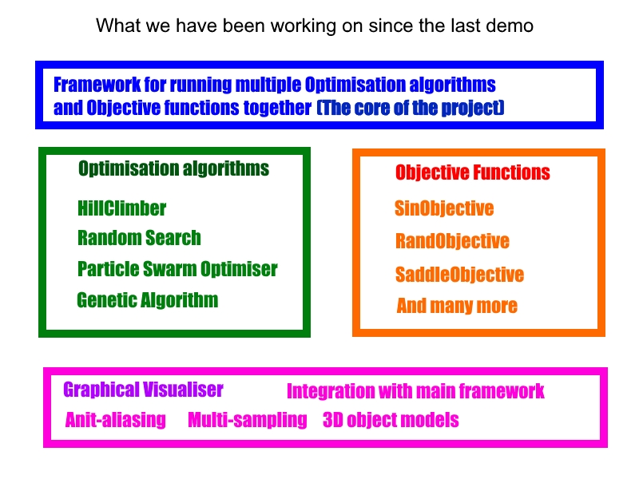

Slide 4
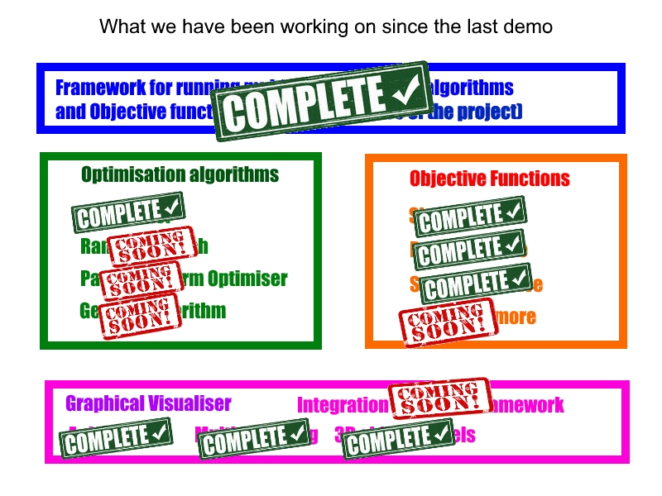

Slide 5
Wow Factor(s)
Real time 3D graphics processing
Sophisticated problem solving algorithms

Slide 6
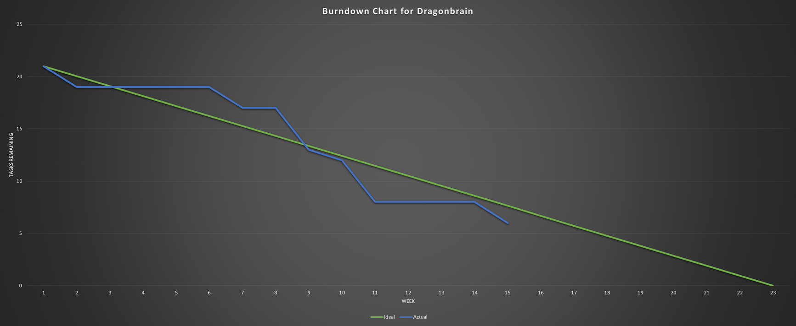

Slide 7
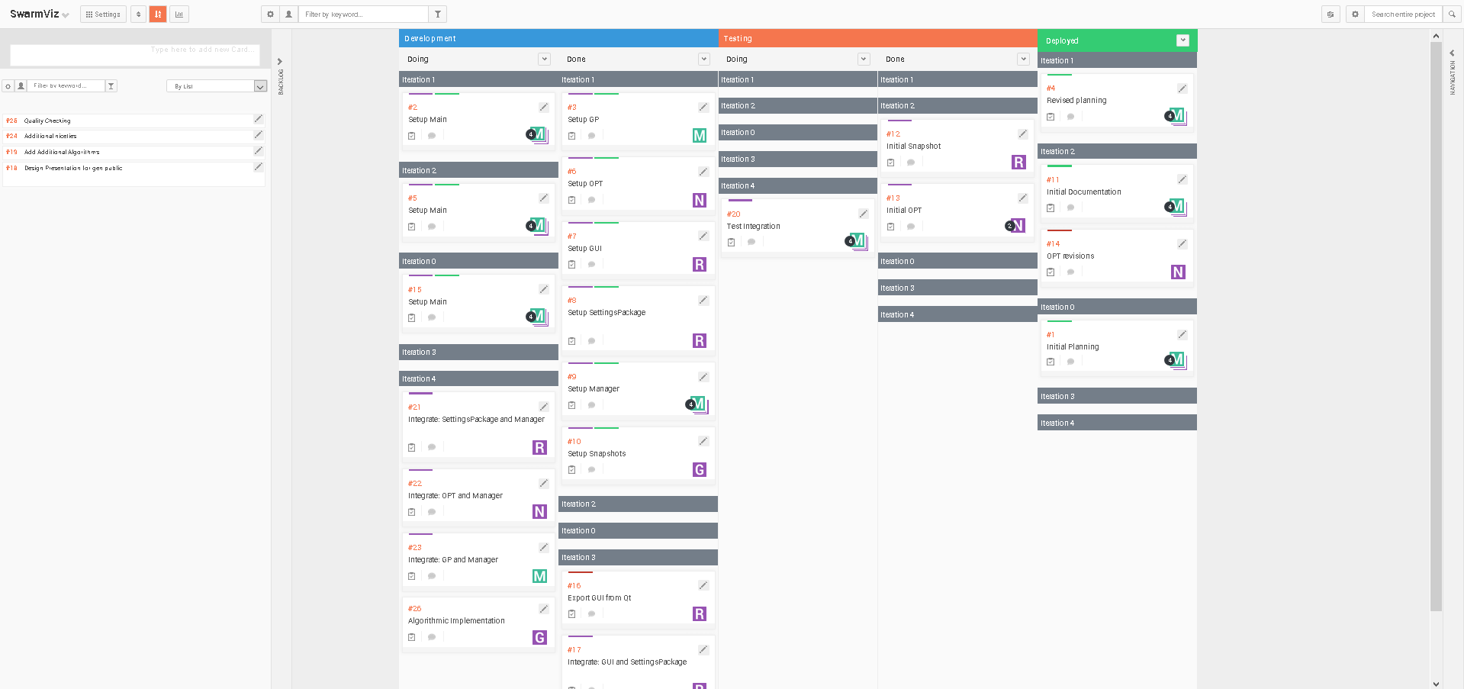
Scrum Board

