Slide 1


Software Engineering Project COS 301 September 2016
Team:
Matheu Botha u14284104
Renton McIntyre u14312710
Emilio Singh u14006512
Gerard van Wyk u14101263

Slide 2
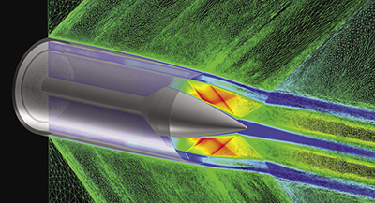
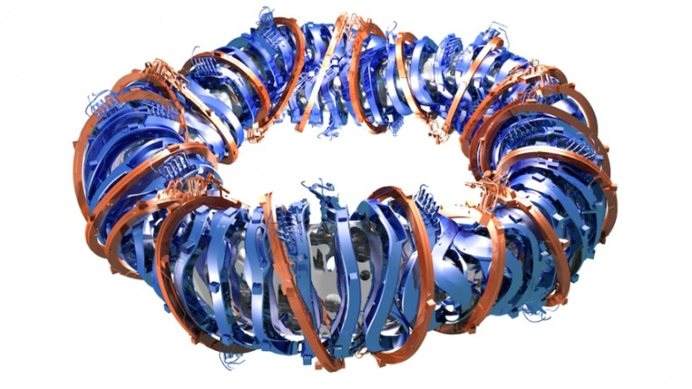
What is SwarmViz?
SwarmViz is a software tool to visualise the functioning of multiple types of optimisation algorithms, for educational and research purposes.
Optimisation algorithms are a type of Artificial Intelligence used in engineering, computer science, and other sciences to find solutions to problems that are too hard for human brains alone.
Optimisers are like simple automated designers that find the best solution for a given problem.
With the right objective function an optimiser can solve problems such as fine-tuning the thousands of parameters that make up the design of a jet engine, or finding the best shape for a nuclear fusion reactor to contain heat and magnetic fields.
How does the performance of different optimisation algorithms compare to one another? What are their weaknesses? How do they find good solutions? With SwarmViz we hope to enable anyone to find out.

Slide 3
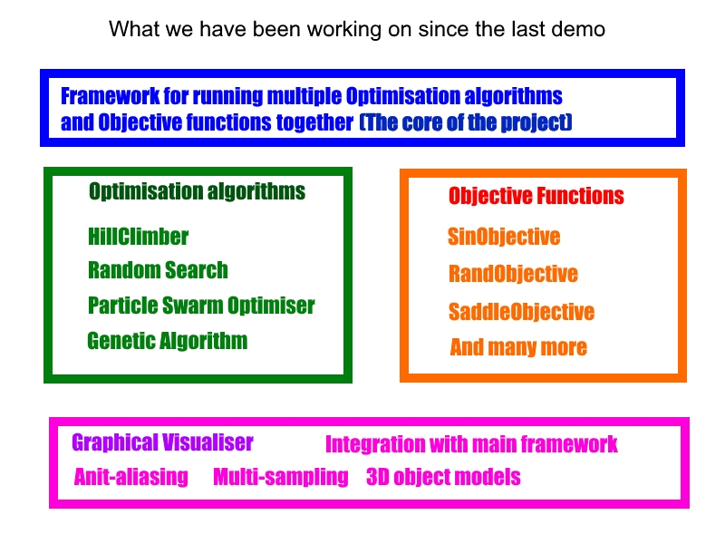

Slide 4
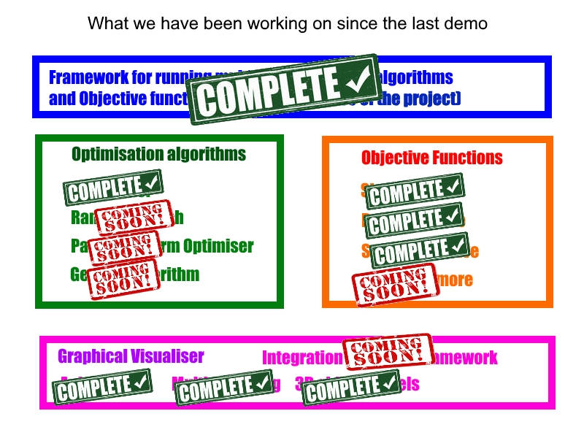

Slide 5
Our project’s wow factor
Our project’s wow factor is to see how optimisation algorithms do their magic; seeing it search to find the highest points in a fitness landscape, and letting you play around with the optimiser’s parameters to see how it affects its performance.
We are not there just yet.
We have a GUI, the core system that performs the optimisation process, and the graphical visualiser, now we just need to integrate them all, flesh them out, fix bugs, and add some general polish.

Slide 6
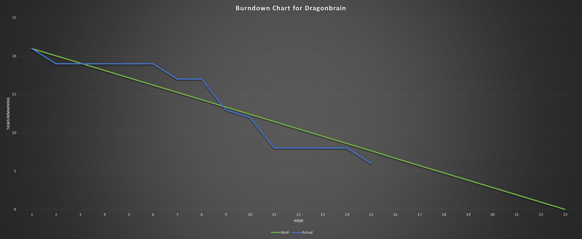

Slide 7
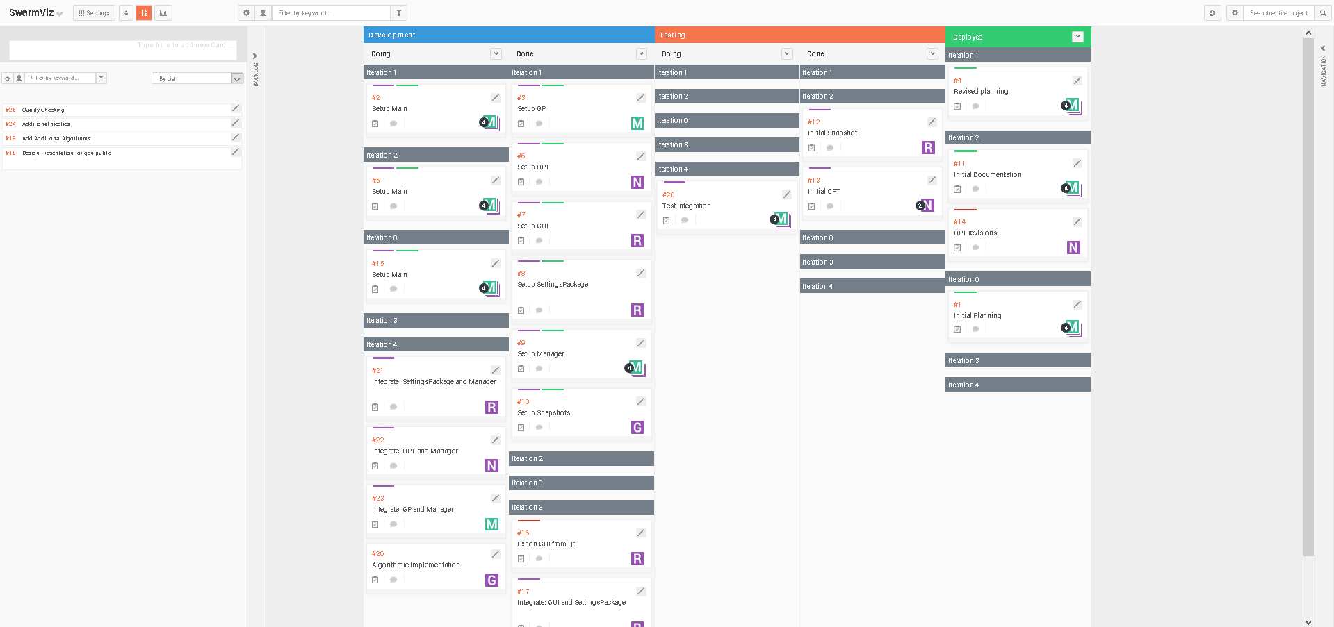
Scrum Board

