Slide 1

(De)generative AI
Artificial Intelligence and Society
Catarina Monteiro – 202105279
Diogo Mendes - 202108102
Guilherme Vaz - 202106775
Gonçalo Brochado - 202106090
Matheus Bissacot - 202106708

Slide 2
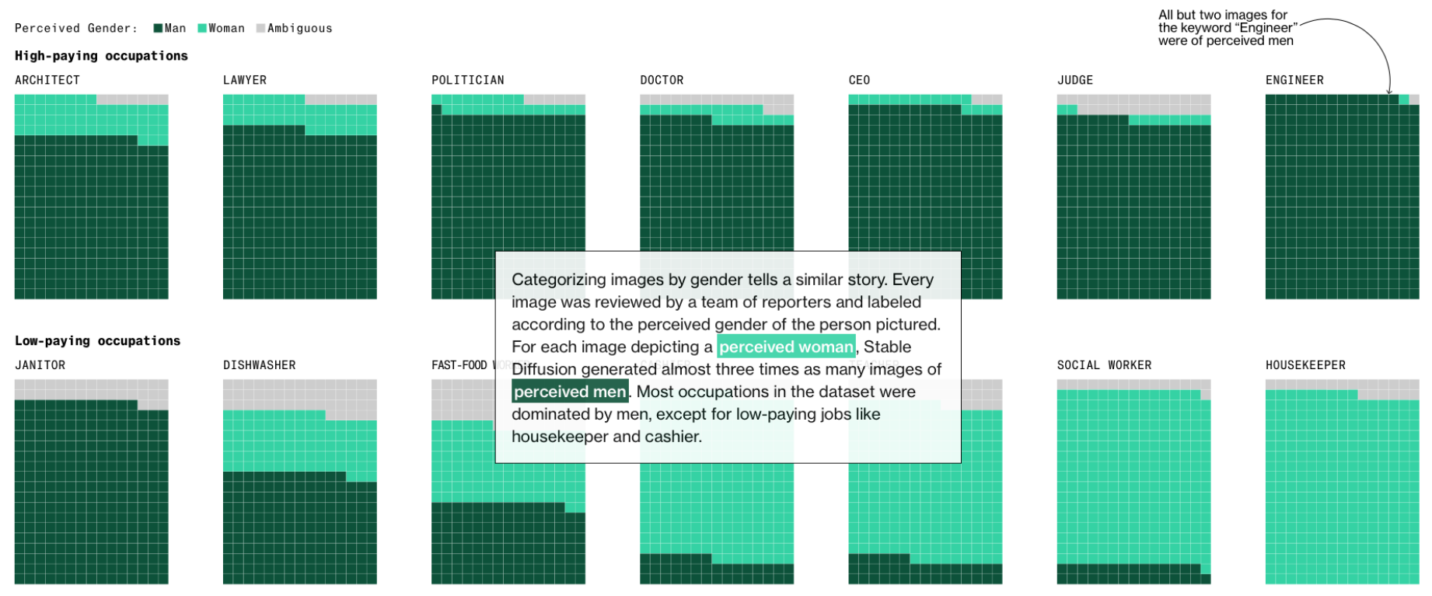
Case study
Notes:
MATHEUS
Source of Bias:
Class Imbalances in training data.
Underrepresentation of certain groups leads to skewed outputs.
Dominant groups disproportionately reflected.
Societal Impact
Raises critical concerns about:
Ethics and Accountability.
Developers’ and researchers’ responsibility.
Objective of the case study: Foster fair and inclusive AI technologies.

Slide 3
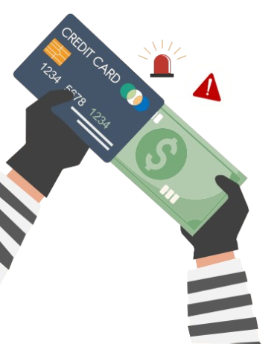
Our approach
Train models on raw data to observe imbalance effects
Apply resampling techniques to address class imbalance
Compare model performance before and after resampling
Analyze imbalances in dataset structure
Notes:
MATHEUS
Data: Credit Card Fraud Detection dataset
Transactions: 284,807 (two hundred eighty-four thousand eight hundred seven)
Fraudulent Cases: 492 (~0.172% of total)
Highly imbalanced dataset.
Features:
28 anonymized numerical features (via PCA).
Non-transformed: Time, Amount.
Target variable: Class (1 = Fraudulent, 0 = Non-Fraudulent).
Goals:
Analyze imbalances in dataset structure.
Train models on raw data to observe imbalance effects.
Apply resampling techniques to address class imbalance.
Compare model performance before and after resampling.

Slide 4
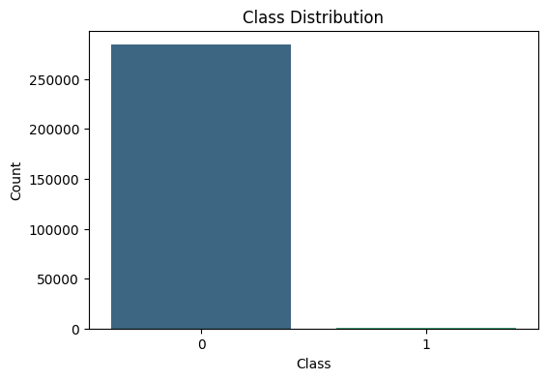
Data analysis – class distribution
Notes:
CATARINA
Class Skewness:
Class 0 (Non-Fraudulent)
Class 1 (Fraudulent)
The count of non-fraudulent transactions (class 0) is in the range of hundreds of thousands, while fraudulent transactions (class 1) are nearly negligible in comparison, barely visible on the chart. This imbalance is typical for fraud detection datasets, as fraudulent activities represent a small fraction of all transactions.

Slide 5
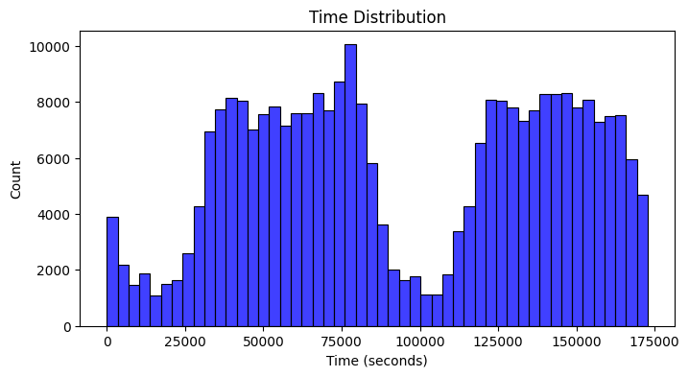
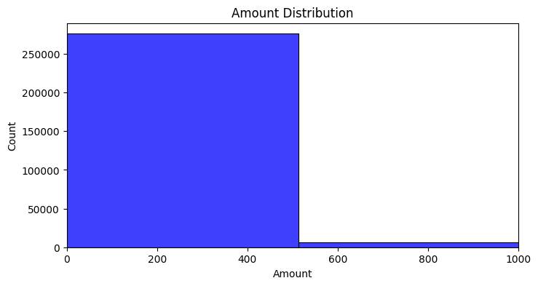
Data analysis – features distribution
TIME ATTRIBUTE
AMOUNT ATTRIBUTE
Notes:
CATARINA
The Time attribute, which measures the elapsed time since the first transaction in the dataset, is spread across the day without evident clustering. In contrast, the Amount attribute shows a sharp decline in frequency, indicating that most transactions involve smaller values

Slide 6
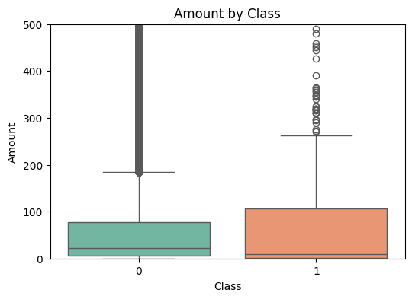
Feature analysis – amount by class
Notes:
CATARINA
Amount Attribute (Class Comparison):
Class 0 (Non-Fraudulent):
Median amount: Near zero.
Significant outliers with amounts up to 500.
Class 1 (Fraudulent):
Higher median and interquartile range (IQR).
Numerous outliers, indicating high variability.
Conclusion:
Despite these observations, the overlap and variability in transaction amounts between the two classes indicate that the Amount feature alone is insufficient for distinguishing fraud from non-fraud and must be complemented by other features.

Slide 7
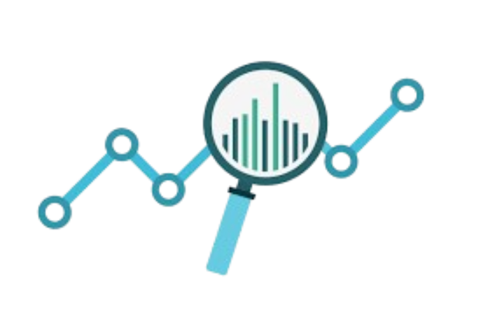
Performance metrics
Precision
Recall
F1 Score
Accuracy
AUPRCC
Notes:
CATARINA
Key Metrics Explained
Precision:
Proportion of correctly identified fraud cases out of all flagged cases.
Focus: Minimize false positives.
Importance: Avoid unnecessary customer intervention or dissatisfaction.
Recall (True Positive Rate):
Proportion of actual fraud cases correctly identified.
Focus: Minimize false negatives.
Importance: Ensures most fraud cases are detected.
F1 Score:
Harmonic mean of Precision and Recall.
Balances trade-offs between false positives and negatives.
Suitable for imbalanced datasets.
Accuracy:
Proportion of all correct predictions (fraudulent and non-fraudulent).
Limitation: Misleading in imbalanced datasets.
AUPRCC (Area Under the Precision-Recall Curve):
Evaluates precision-recall trade-offs across thresholds.
Importance: Highlights model consistency in imbalanced scenarios.

Slide 8

Classification algorithms
Random Forest
Robust to imbalanced data
XGBoost
Reliable and adaptable to various techniques
Notes:
CATARINA
1. Random Forest
Overview:
Ensemble learning method using bagging.
Builds multiple decision trees, final output based on majority voting.
Advantages:
Robust to imbalanced data.
Supports class weights, feature importance, and sampling strategies.
Effectiveness in similar research scenarios.
2. XGBoost (Extreme Gradient Boosting)
Overview:
Builds decision trees sequentially, each correcting errors of the previous.
Optimizes a loss function (e.g., log loss) with regularization to prevent overfitting.
Advantages:
Reliable and adaptable to various techniques.

Slide 9

Balancing techniques
Oversampling
Random
SMOTE
Undersampling
Random
Hybrid Techniques
SMOTEENN
Hybrid tomek link BCBSMOTE
B-SMOTE
ADASYN
SMOTE-Tomek
Class Weights
Notes:
VAZThese techniques are used to address class imbalance in datasets. This helps ensure that the minority class is well represented.
The main goals are to reduce bias and improve model performance across all classes.
There are several key approaches:
Oversampling: This involves generating new data for the minority class.
Undersampling: Here, we remove data from the majority class.
Hybrid Techniques: These combine both oversampling and undersampling methods.
Each of these approaches helps us deal with class imbalance effectively.

Slide 10
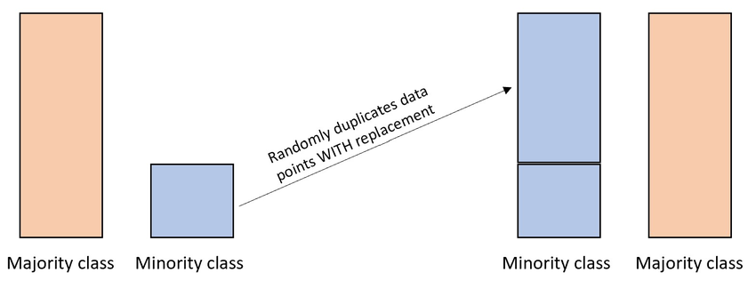
Random oversampling
Notes:
VAZ Next, let's discuss Random Oversampling.
This technique duplicates instances from the minority class.
The main advantage is that it's quick and simple to implement.
However, it has a downside. It can increase the risk of overfitting because we are using duplicate data.
it's a good technique to start…

Slide 11
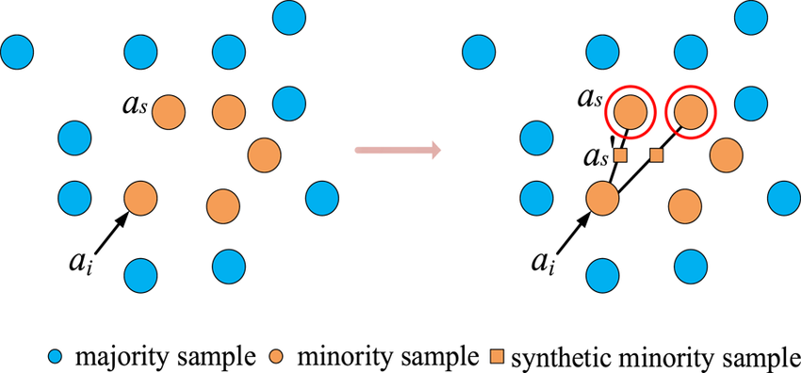
smote
Notes:
VAZ
let's look at SMOTE, which stands for Synthetic Minority Over-sampling Technique.
SMOTE generates synthetic samples for the minority class by using k-nearest neighbors to create diverse data points.
Steps:
Identify k-nearest neighbors.
new samples between existing instances.
The advantage of SMOTE is that it reduces overfitting and adds variability to the dataset. However, it doesn't address overlapping data points near decision boundaries

Slide 12
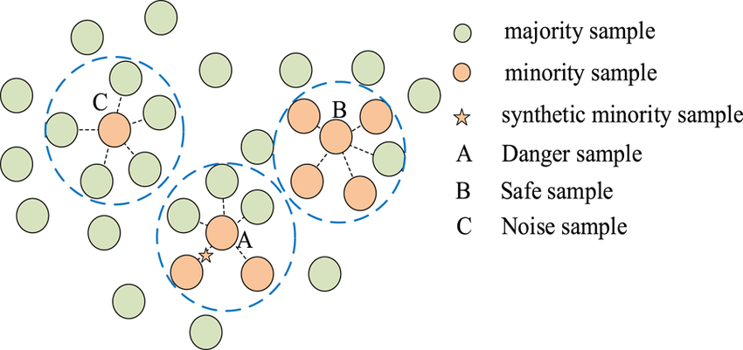
B-smote
Notes:
VAZ
B-SMOTE, or Borderline-SMOTE.
This technique focuses on the minority class near decision boundaries.
-The advantage of B-SMOTE is that it targets critical areas that are prone to misclassification, helping to improve accuracy in these challenging zones

Slide 13
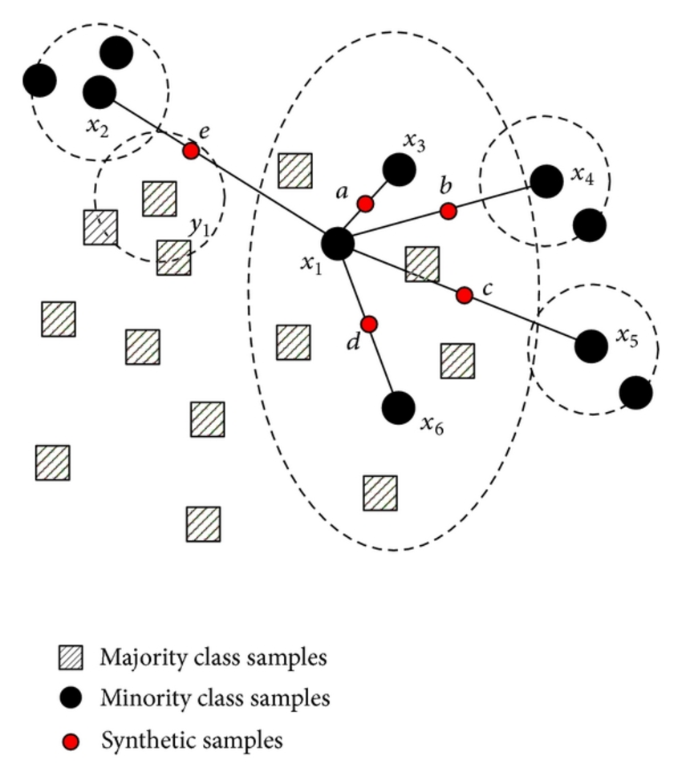
adasyn
Notes:
VAZ
ADASYN:
ADASYN focuses on generating synthetic data adaptively for hard-to-classify areas.
The main benefit is that it prioritizes challenging regions, leading to better performance in those areas.

Slide 14
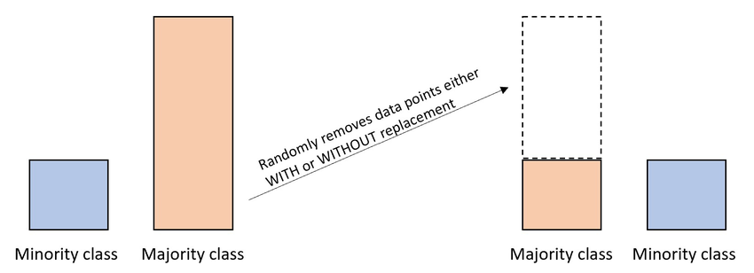
Random undersampling
Notes:
VAZ
This method removes instances from the majority class.
The main advantage is that it reduces imbalance without creating duplicates. However, it may discard useful information from the majority class.
Random Undersampling is effective when the minority class has a sufficient number of examples

Slide 15
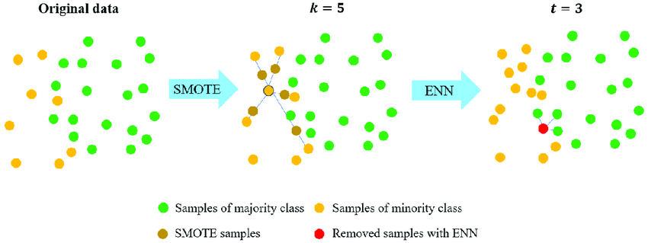
smoteenn
Notes:
BROCHADO
SMOTEENN:
Combines SMOTE with Edited Nearest Neighbors (ENN).
Steps:
SMOTE generates synthetic samples.
ENN removes noisy and ambiguous data.
Pros: Balances data while cleaning noise at decision boundaries.

Slide 16
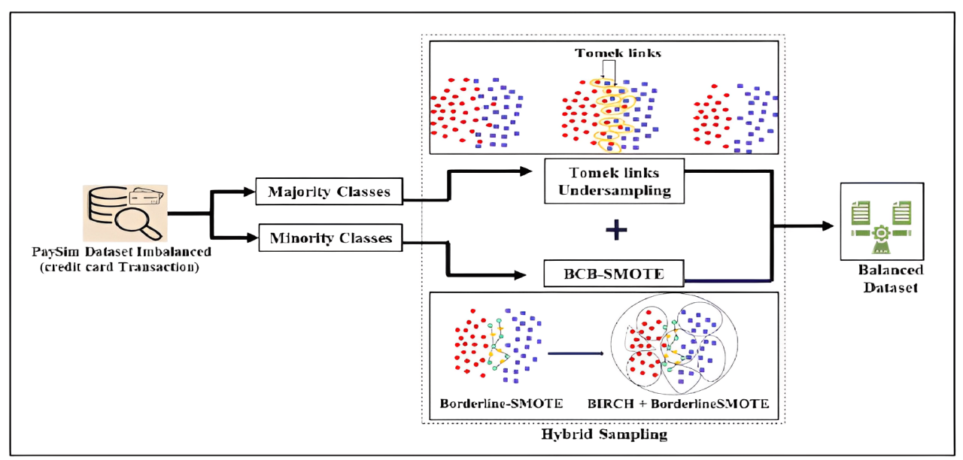
Hybrid tomek link bcbsmote
Notes:
BROCHADO
What It Is:
Combines Borderline-SMOTE and Tomek Links.
Generates synthetic samples for challenging areas.
Removes noisy majority class samples close to decision boundaries.
Pros:
Improves decision boundary clarity.
Balances dataset effectively.
Cons: More computationally intensive

Slide 17
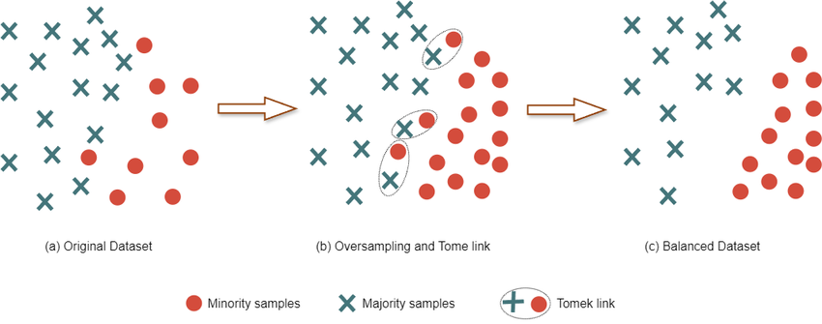
Smote – tomek
Notes:
BROCHADO
SMOTE-Tomek:
Combines SMOTE (oversampling) and Tomek Links (undersampling).
Steps:
Generate synthetic samples.
Remove overlapping majority class samples near minority class.
Pros: Enhances class separability.

Slide 18
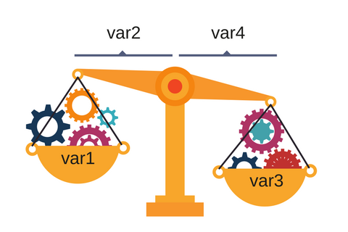
Class weights
Notes:
BROCHADO
What It Is: Adjusts training weights for minority and majority classes.
How It Works:
Higher weight for the minority class to reduce misclassification.
Lower weight for majority class.
Pros: Integrated into training; no data duplication.
Cons: Requires algorithm support

Slide 19
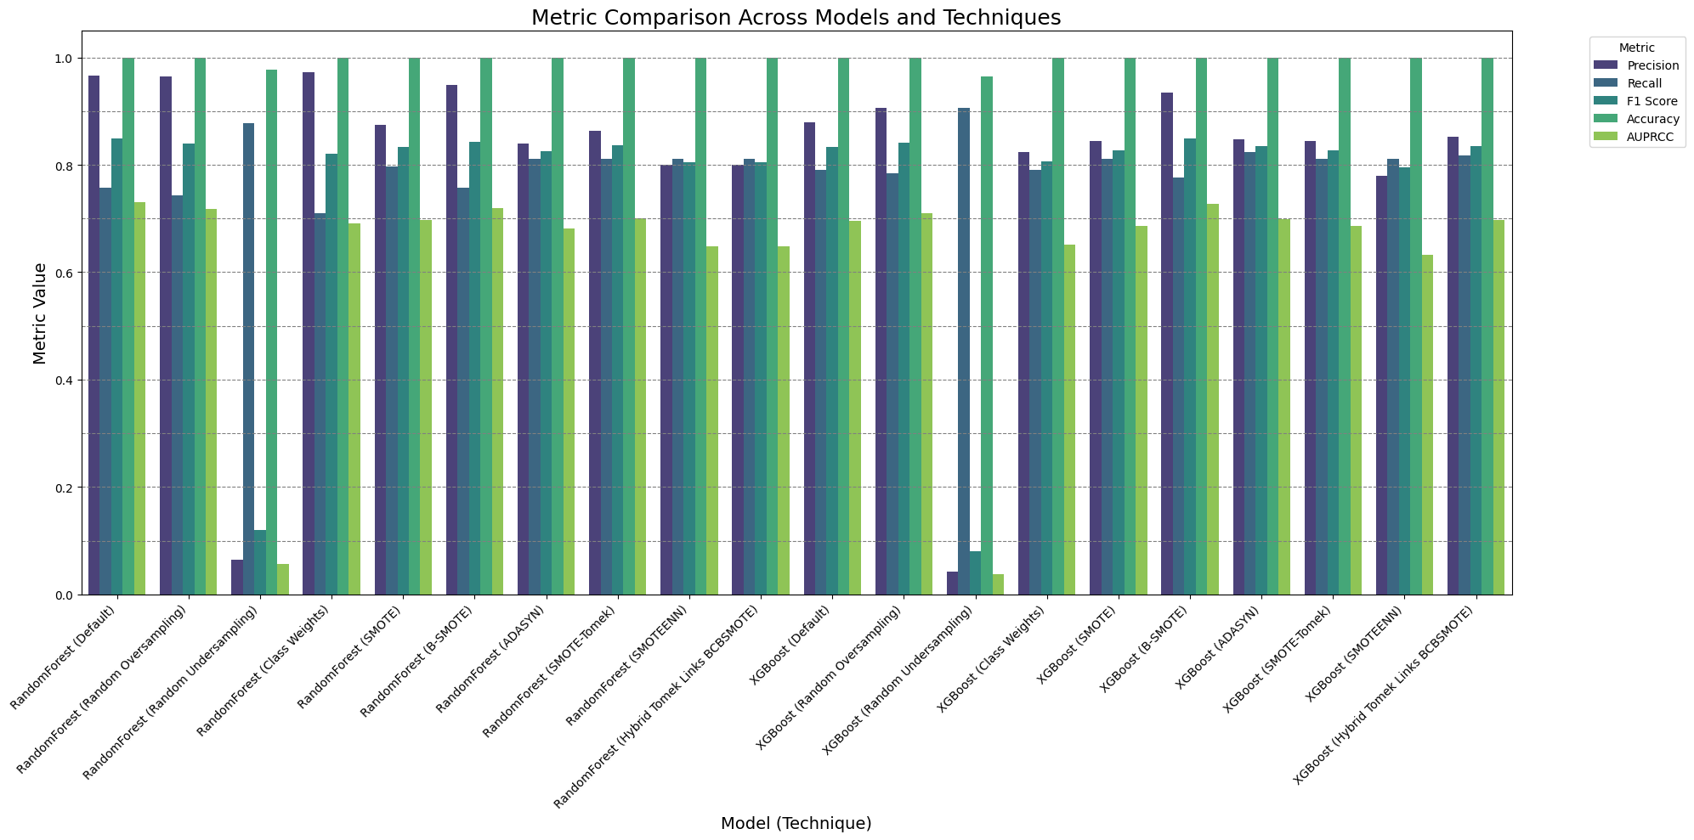
Results overview
Notes:
DIOGO

Slide 20
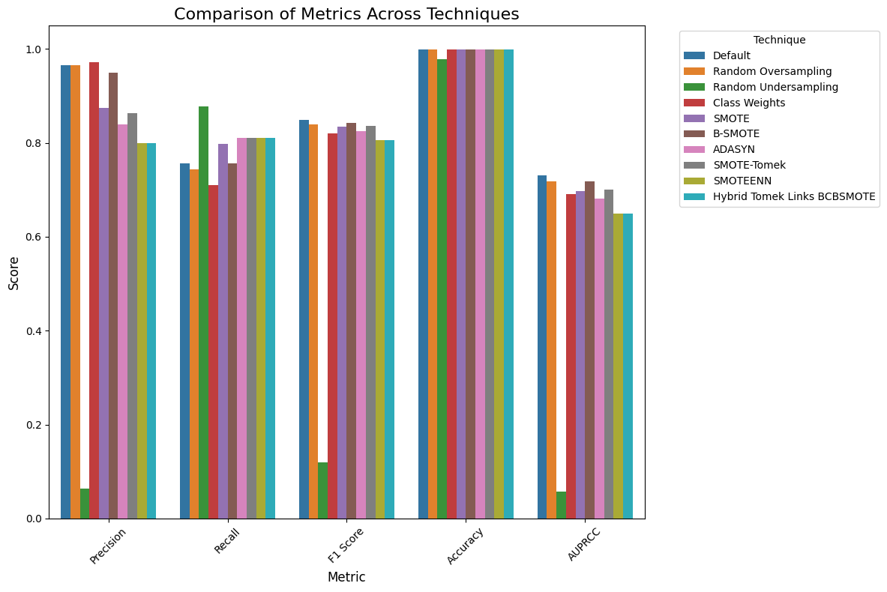
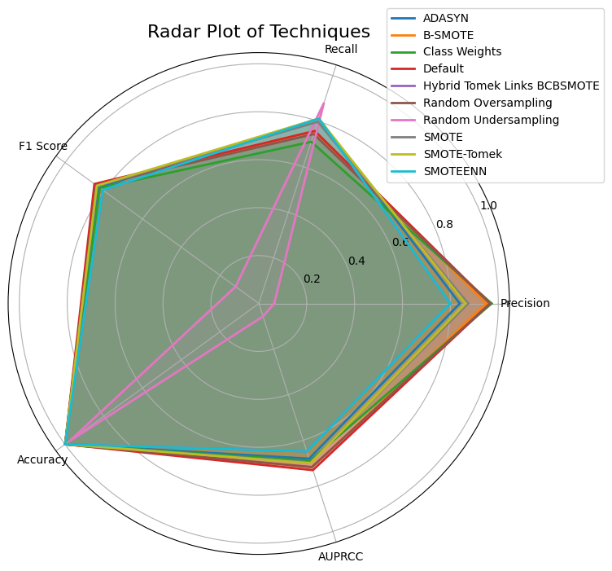
Random forest – results
Notes:
DIOGO
Baseline Performance:
Standard Random Forest achieved high accuracy but struggled with minority class representation.
Impact of Balancing Techniques:
Precision:
Improved with B-SMOTE and Random Oversampling.
Slight decline with SMOTE and SMOTEENN (potential noise introduction).
Recall:
Significant gains using SMOTE, B-SMOTE, and ADASYN.
F1 Score:
B-SMOTE and Random Oversampling balanced precision and recall effectively.
SMOTEENN underperformed due to trade-offs.
Accuracy:
Consistently high across all methods, reflecting majority class dominance.
AUPRCC:
Best with Standard Random Forest.
B-SMOTE, ADASYN, and SMOTE-Tomek closely followed.
Performance Comparison:
Radar plot of metrics (Precision, Recall, F1 Score, Accuracy, AUPRCC).
Bar graph illustrating metric variations across techniques.
Key Takeaway:
Balancing methods significantly enhanced Recall and F1 Score for Random Forest, but introduced trade-offs in Precision and AUPRCC.

Slide 21
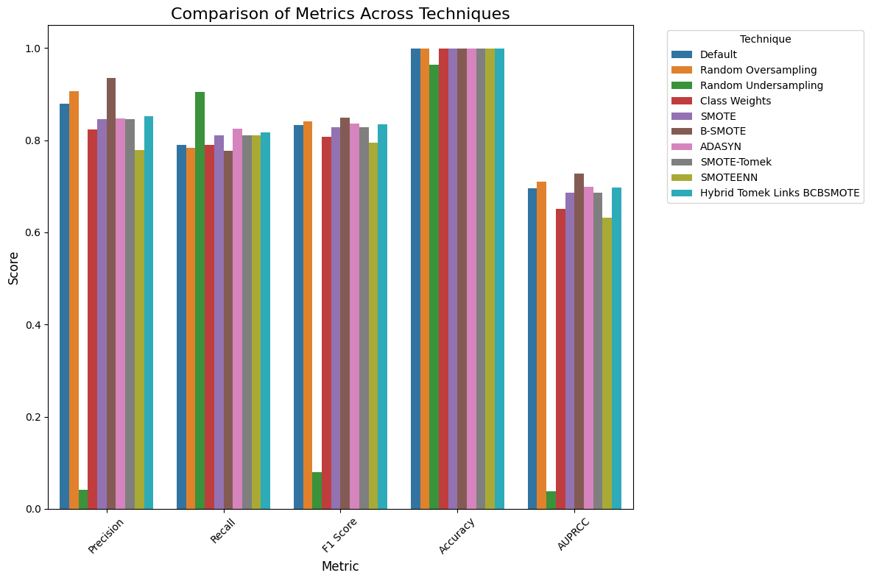
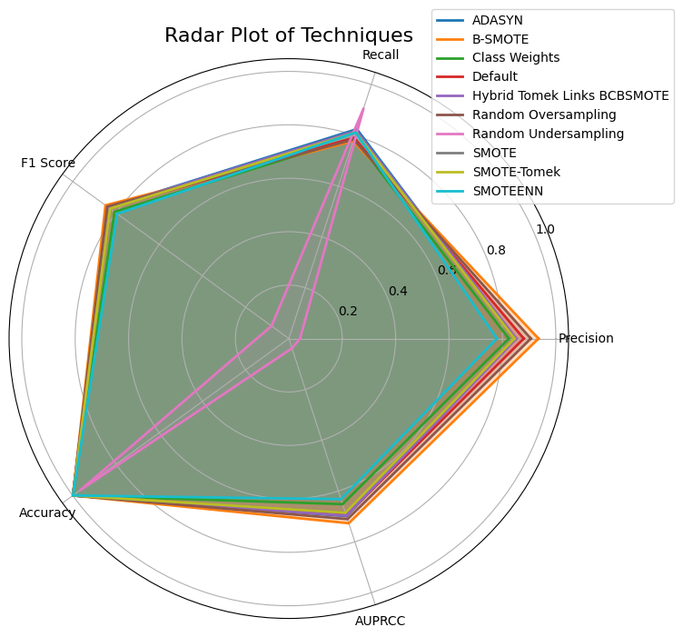
XGBoost – results
Notes:
DIOGO
Baseline Performance:
Standard XGBoost showed robust precision and accuracy but required balancing to improve minority class handling.
Impact of Balancing Techniques:
Precision:
Marginal improvements with Random Oversampling and B-SMOTE.
Recall:
Substantial gains using SMOTE, SMOTEENN, and B-SMOTE.
F1 Score:
Balanced performance with ADASYN, SMOTE, and B-SMOTE.
Promising results with SMOTEENN.
Accuracy:
Consistently high across all methods, showing minimal variations.
AUPRCC:
Boosted by B-SMOTE, SMOTE, and Random Oversampling.
Slight dip with SMOTEENN.
Performance Comparison:
Radar plot of metrics (Precision, Recall, F1 Score, Accuracy, AUPRCC).
Bar graph highlighting metric changes across balancing techniques.
Key Takeaway:
Balancing techniques notably improved Recall, F1 Score, and AUPRCC for XGBoost, ensuring better minority class detection without compromising overall performance.

Slide 22
Random forest vs xgboost
RANDOM FOREST
XGBOOST
Notes:
DIOGO
Slide 6: Results Recap – Random Forest vs. XGBoost
Metric Comparisons:
Precision: Higher stability in XGBoost; Random Forest showed variability.
Recall: Both models benefitted from balancing, with larger gains for XGBoost.
F1 Score: B-SMOTE emerged as a top performer for both models.
Accuracy: High and consistent for both models, not a critical metric for imbalanced datasets.
AUPRCC: Slight edge for Random Forest in Standard configuration; improved with balancing for both.
Visual:
Side-by-side radar plots for Random Forest and XGBoost.
Summary table comparing best-performing techniques for each metric.
Slide 7: Insights and Recommendations
Key Insights:
Balancing Methods:
Critical for improving Recall and F1 Score in both models.
Techniques like B-SMOTE and ADASYN performed consistently well.
Model-Specific Findings:
Random Forest: Sensitive to noise; balancing improved Recall at the cost of Precision.
XGBoost: More robust, showing consistent gains in Recall and AUPRCC.
Recommendations:
Prioritize B-SMOTE and ADASYN for fraud detection tasks.
Combine multiple metrics (F1, AUPRCC) for a comprehensive evaluation.
Use XGBoost for robust performance in imbalanced datasets.

Slide 23
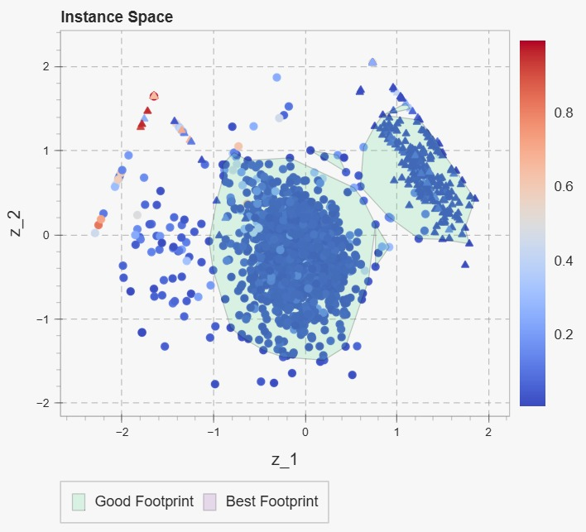
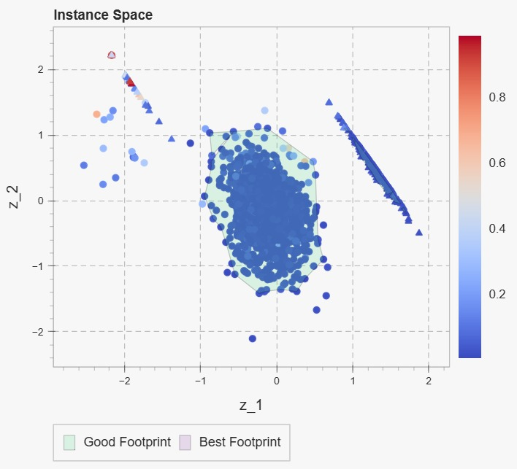
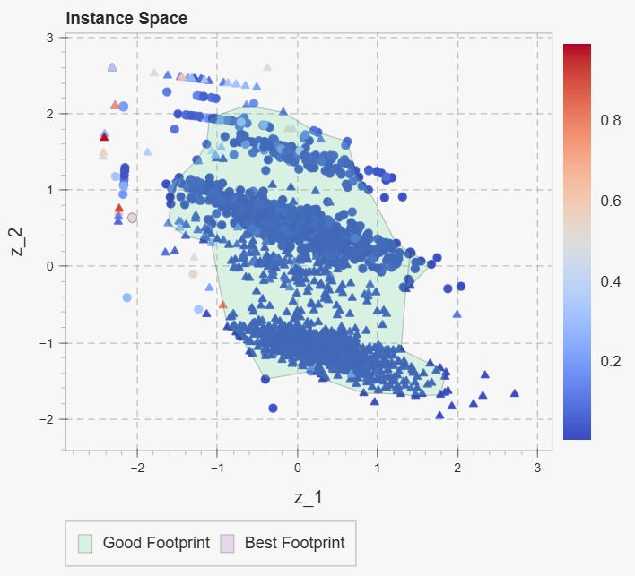
Pyhard analysis
ORIGINAL
AFTER BCBSMOTE
AFTER TOMEK LINKS
Notes:
MATHEUS
Objective:
Examine dataset instance difficulty using PyHard metrics.
Assess the impact of BC-SMOTE and Tomek Links on dataset quality and model performance.
Key Concepts:
Hardness Analysis:
Identifies difficult-to-classify instances.
Focus on borderline cases, especially for fraudulent transactions.
Observations from Original Dataset:
Clusters and Challenges:
Two clear separable clusters identified.
Scattered challenging points outside clusters likely represent borderline fraudulent cases.
Visualization:
Figure 11: Hardness of the Original Dataset (Scatter plot showing clusters and sparse challenging regions).
Insight:
Fraudulent transactions are harder to classify due to their similarity with legitimate ones.
Changes Observed with bcbsmote:
Expansion of Minority Class:
Minority class "footprint" expanded into borderline areas, improving representation in challenging regions.
Reduced Sparsity:
Increased density in sparse areas (e.g., upper-left, center-right sections).
Synthetic samples enhanced minority class visibility.
Improved Decision Boundaries:
Denser representation facilitated better class separability for hard-to-classify instances.
Visualization:
Figure 12: Hardness of the Dataset with BC-SMOTE (showing denser regions and expanded minority class representation).
Key Insight:
BC-SMOTE effectively strengthened the representation of difficult cases, improving model learning potential.
Changes Post Tomek Links:
Improved Class Separation:
Cleaner, more distinct boundary regions between classes.
Reduced ambiguity caused by overlapping points.
Refined Clusters:
Compact clusters with less noise along edges.
Better class separability and data quality.
Persistent Hard Instances:
Some challenging points remained along minority class edges, indicating inherent difficulty in specific cases.
Balanced and Cleaned Dataset:
Emphasized meaningful data points while reducing noise, improving generalization.
Visualization:
Figure 13: Hardness of the Dataset with BC-SMOTE and Tomek Links (showing compact clusters and reduced noise).
Key Insight:
Combining BC-SMOTE and Tomek Links enhanced balance and dataset quality while preserving focus on challenging cases.
Slide 5: PyHard Analysis Summary
Key Takeaways:
BC-SMOTE:
Improved minority class representation, particularly in challenging regions.
Enhanced decision boundaries through synthetic sample generation.
Tomek Links:
Refined dataset by removing noisy, overlapping samples.
Improved cluster compactness and class separability.
Integrated Approach:
Balance between oversampling (BC-SMOTE) and cleaning (Tomek Links).
Focused on improving performance for minority class while mitigating noise and overfitting risks.
Performance Implications:
Potential for improved Precision and Recall, particularly for the fraudulent (minority) class.

Slide 24

tutorial

Slide 25
Conclusions and future work
Imbalanced Datasets:
Present unique challenges for machine learning models.
Require targeted balancing techniques to improve performance.
Balancing Techniques:
Enhanced Precision, particularly for Random Oversampling and B-SMOTE.
Improved Recall with SMOTE, B-SMOTE, and ADASYN.
Key Metrics:
F1 Score: Balancing techniques achieved better Precision-Recall balance.
Accuracy: Consistently high but insufficient to measure performance in imbalanced scenarios.
Impact on Random Forest:
Standard Random Forest:
Strong baseline performance.
Outperformed others in AUPRCC (minority class focus).
With Balancing Techniques:
Notable improvements in Recall and F1 Score.
B-SMOTE, Random Oversampling, and SMOTE-Tomek boosted model robustness.
Impact on XGBoost:
Showed significant performance improvements with balancing methods.
Techniques like Hybrid Tomek Links BC-SMOTE refined predictions and enhanced decision boundaries.
Future Directions:
Further research into hybrid methods to reduce noise while maintaining balance.
Explore dataset-specific optimizations to enhance model generalizability.
Notes:
MATHEUS
Core Insights:
Imbalanced Datasets:
Present unique challenges for machine learning models.
Require targeted balancing techniques to improve performance.
Balancing Techniques:
Enhanced Precision, particularly for Random Oversampling and B-SMOTE.
Improved Recall with SMOTE, B-SMOTE, and ADASYN.
Key Metrics:
F1 Score: Balancing techniques achieved better Precision-Recall balance.
Accuracy: Consistently high but insufficient to measure performance in imbalanced scenarios.
Impact on Random Forest:
Standard Random Forest:
Strong baseline performance.
Outperformed others in AUPRCC (minority class focus).
With Balancing Techniques:
Notable improvements in Recall and F1 Score.
B-SMOTE, Random Oversampling, and SMOTE-Tomek boosted model robustness.
Impact on XGBoost:
Showed significant performance improvements with balancing methods.
Techniques like Hybrid Tomek Links BC-SMOTE refined predictions and enhanced decision boundaries.
Choosing Balancing Techniques:
Dataset-specific strategies are crucial for optimal results:
Random Forest: Resilient but enhanced by methods like B-SMOTE.
XGBoost: Requires careful calibration with advanced techniques.
Broader Implications:
Importance of evaluating models beyond Accuracy, using metrics like:
F1 Score (Precision-Recall trade-off).
AUPRCC (minority class sensitivity).
Contributions to Machine Learning:
Reinforced the importance of balancing techniques in:
Equitable representation of minority classes.
Enhancing predictive capabilities for imbalanced datasets.
Provided valuable insights into the effectiveness of specific strategies like:
BC-SMOTE, ADASYN, and Hybrid Tomek Links BC-SMOTE.
Future Directions:
Further research into hybrid methods to reduce noise while maintaining balance.
Explore dataset-specific optimizations to enhance model generalizability.

