Slide 1
ECE 18-649
Final Project Report
Dec 4, 2013
Group # 16
Sally Stevenson - ststeven
Sri Harsha Koppaka - skoppaka
Jiangtian Nie - jnie
Yue Chen - yuechen

Slide 2
Overview
Project Statistics
DoorControl Design Process
  Use Case: triggering a door reversal
  Scenarios, Sequence Diagrams
  Requirements
  Statecharts
  Code
  Testing
Lessons Learned & Suggestions
Open Issues
Yue Chen

Slide 3
Project Statistics
 | Mid-semester | Now
Sequence Diagrams | 19 | 19
Sequence Diagram Arcs | 149 | 167
Lines of requirements | 41 | 56
Non-Comment LOC | 1631 | 3444
Statecharts | 7 | 7
Total States | 29 | 26
Total Transition Arcs | 19 | 44
Test Files Written | 36 | 38
Revisions | 9 | 18
Peer Reviews | 57 | 100
Peer Review Defects | 28 | 35
Peer Review Defects Fixed | 28 | 35
Test/Other Defects | 0 | 8 (Fixed)
Yue Chen

Slide 4
DoorControl: Use Case and Scenario
U5: Passenger Triggers Door Reversal
Scenario 5A: Passenger attempts to enter the car as the doors begin to close.
  Pre-Conditions:
    Passenger is outside the car.
    Car is stopped at passenger's floor f and hallway b.
    At least one door[b,r] is open.
    A door reversal has already been triggered at least twice while the car was at this floor.
  Scenario:
    Door[b,r] starts closing.
    Passenger attempts to enter into the elevator triggering DoorReversal[b,r].
    DoorMotor[b,r] commanded to Open.
    Doors finish Opening.
    Passenger gets into the car.
    Door[b,r] starts to nudge.
  Post-Conditions:
    Passenger is in the elevator.
    At least one door[b,r] is open.
Yue chen

Slide 5
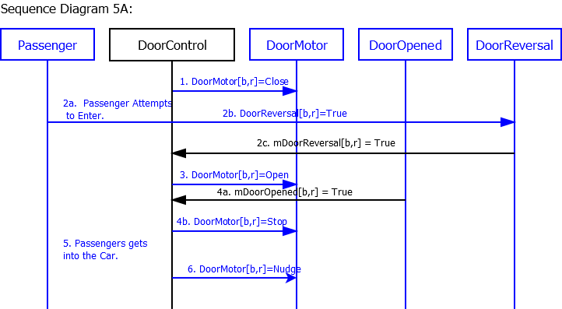
DoorControl: Scenario Diagram
High Level Requirements R-T10
Yue Chen

Slide 6
DoorControl: Requirements
15 Requirements total
5.8 If mDoorClosed[b, r] is True, then
5.8.1 DoorMotor[b,r] should be commanded to Stop.
5.8.2 ReversalCount shall be set to 0.
5.10 When CountDown <= 0 and ReversalCount is greater than three, DoorMotor[b,r] should be commanded to Nudge.
5.15 If any mDoorReversal[b,r] is true,
5.15.1 DoorMotor[b,r] shall be commanded to Open.
5.15.2 ReversalCount shall increment.
Above requirements tested in Scenario 5A in arcs 2b, 2c, 3, 4a, 4b, 5, 6.
Sally Stevenson

Slide 7
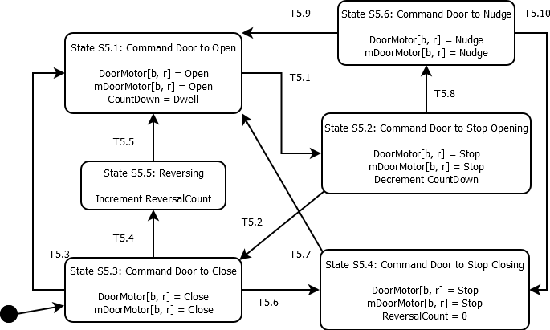
DoorControl: Statechart
Sally Stevenson

Slide 8
DoorControl: Code
case STATE_NUDGE:
// state actions for 'DOOR NUDGE'
localDoorMotor.set(DoorCommand.NUDGE);
mDoorMotor.set(DoorCommand.NUDGE);
//#transition 'T5.9'
if (mAtFloor.get(index).getValue()) {
checkReopen();
}
//#transition 'T5.10'
if (mDoorClosed.getValue()) {
newState = State.STATE_STOP_CLOSING;
}
break;
State Action
SC to Code Traceability
Transition
Implementation
Jiangtian Nie

Slide 9
DoorControl: Code
private void checkReopen() {
if ((mDriveSpeed.getSpeed() == Speed.STOP) &&
((mCarWeight.getValue() >= Elevator.MaxCarCapacity) ||
mCarCall.get(indexCarCall).getValue())) {
newState = State.STATE_OPEN;
}
else if ((mDriveSpeed.getSpeed() == Speed.STOP) &&
((direction == Direction.STOP) ||
(direction == Direction.UP)) &&
mHallCall.get(indexHallCallUp).getValue()) {
newState = State.STATE_OPEN;
}
else if ((mDriveSpeed.getSpeed() == Speed.STOP) &&
((direction == Direction.STOP) ||
(direction == Direction.DOWN)) &&
mHallCall.get(indexHallCallDown).getValue()) {
newState = State.STATE_OPEN;
}
}
Jiangtian Nie

Slide 10
DoorControl: Unit Test
1 Unit Test for DoorControl which tests all states
;trigger reversal multiple times
+0.01s I 0s N DOOR_OPEN_SENSOR_[FRONT][LEFT]_CAN_ID Bit = false
+0.1s I 0s N DOOR_REVERSAL_SENSOR_[FRONT][RIGHT]_CAN_ID Bit = true
;T5.9
;state S5.6 'DOOR_NUDGE'
+5s A S DoorControl[FRONT][LEFT] : STATE == STATE_NUDGE
+0s A F DoorMotor FRONT LEFT : command == NUDGE
+0s A N DOOR_MOTOR_COMMAND_[FRONT][LEFT]_CAN_ID DoorMotorCommand FRONT LEFT : getDoorCommand == NUDGE
SC to Test Traceability
Injections
for
Guard
Condition
Assertions
for
State
Output
Jiangtian Nie

Slide 11
Integration and Acceptance Testing
19 integration tests (at least 1 per controller)
  SD5A integration test transition T5.8
Acceptance Tests
Tests test T5.8 → door starts to nudge
13 Acceptance Tests in total.
All tests pass
  4 tests which test regular behavior.
  8 tests which test Up peak and Down peak conditions
  One 100 customer test written by us for Proj 8.
  Total of 1763 passengers in all tests, all delivered.
Sri Harsha Koppaka

Slide 12
Lessons Learned & Suggestions
Taking our time when we were writing the requirements and statecharts helped us avoid issues once we started writing code/tests
Process is important and doing multiple checks before submission.
Starting work early is very important. We had a complete working elevator by Proj 9 after which only minor modifications were done.
In person peer reviews are really effective, they help find most of the bugs.
Plan your dispatcher early. It takes time and is definitely not easy to complete in 1 or 2 tries.
Do complete testing of design using the overnight testing code samples provided on project page. They will confirm that your elevator is working properly.
Working together is more productive than working alone.
Sri Harsha Koppaka

Slide 13
Open Issues
Performance Optimization
In Project 13 acceptance tests, the elevator is always full in a particular direction to pick up some passengers. So the passenger waits for 5 or 6 times and eventually gets on the elevator.
Need to take car weight into account before stopping at a floor to service hall calls when there are no car calls at that floor.
Sri Harsha Koppaka

Slide 14
Any Questions?
Team 16
Sally Stevenson - ststeven
Sri Harsha Koppaka - skoppaka
Jiangtian Nie - jnie
Yue Chen - yuechen

