Slide 1
ECE 18-649
Mid-Term Project Report
Oct 30, 2013
Group # 16
Sally Stevenson - ststeven
Sri Harsha Koppaka - skoppaka
Jiangtian Nie - jnie
Yue Chen - yuechen

Slide 2
Overview
Project Statistics
DoorControl Design Process
  Use Case: triggering a door reversal
  Scenarios, Sequence Diagrams
  Requirements
  Statecharts
  Code
  Testing
Lessons Learned
Open Issues
Yue Chen

Slide 3
Project Statistics
19 scenarios/sequence diagrams
  149 sequence diagram arcs
41 lines of requirements
7 Statecharts
  19 states
  29 transition arcs
36 test files written
9 revisions (change log entries)
57 peer reviews; 28 defects found via review; 28 peer review defects fixed
0 defects found via test & other
Yue Chen

Slide 4
DoorControl: Use Case and Scenario
U5: Passenger Triggers Door Reversal
Scenario 5B: Passenger attempts to exit the car as the doors begin to close.
  Pre-Conditions:
    Passenger is inside the car.
    Car is stopped at passenger's floor f and hallway b.
    At least one door[b,r] is open.
  Scenario:
    Door[b,r] starts closing.
    Passenger attempts to exit the elevator triggering DoorReversal[b,r].
    DoorMotor[b,r] commanded to Open.
    Doors finish opening.
    Passenger gets out of the car.
  Post-Conditions:
    Passenger is out of the elevator.
    Doors[b,r] are completely open.
Yue chen

Slide 5
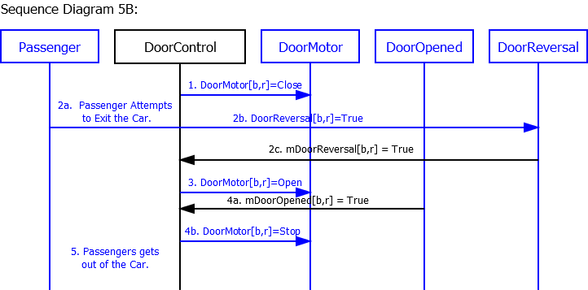
DoorControl: Scenario Diagram
Tests Requirements 5.7 and 5.14
Yue Chen

Slide 6
DoorControl: Requirements
10 Requirements total
5.7 If mDoorOpened[b, r] is True, then
5.7.1 DoorMotor[b,r] shall be commanded to Stop.
5.7.2 CountDown shall be decremented.
5.9 When CountDown <= 0, DoorMotor[b,r] should be commanded to Close.
5.14 If any mDoorReversal[b,r] is true, DoorMotors[b,r] where r = {Left, Right} shall be commanded to Open.
Above requirements tested in Scenario 5B in arcs 2b, 2c, 3, 4a, 4b.
Sally Stevenson

Slide 7
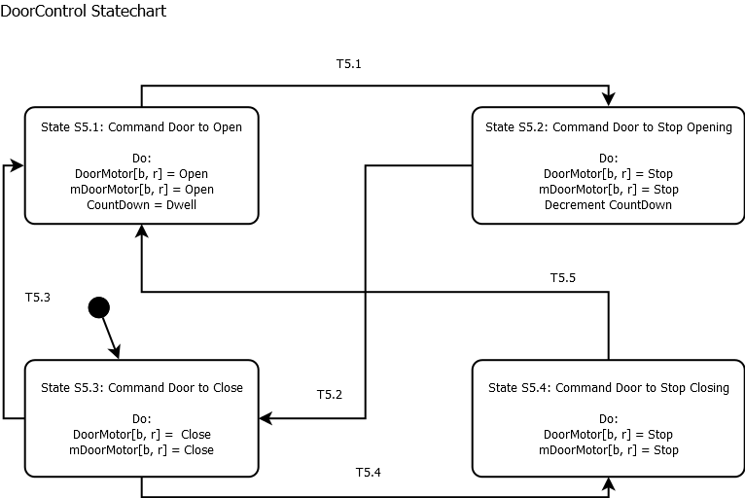
DoorControl: Statechart
Sally Stevenson

Slide 8
DoorControl: Code
case STATE_CLOSE:
// state actions for 'DOOR NOT CLOSED'
localDoorMotor.set(DoorCommand.CLOSE);
mDoorMotor.set(DoorCommand.CLOSE);
//#transition 'T5.3‘
if(mAtFloor.get(index).getValue()){
if ((mDoorReversal.getValue() || DoorReversalOpp.getValue() ||
(mCarWeight.getValue() >= Elevator.MaxCarCapacity) ||
mHallCall.get(indexHallCall).getValue() ||
mCarCall.get(indexCarCall).getValue()) &&
(mDriveSpeed.getSpeed() == Speed.STOP)){
newState = State.STATE_OPEN;
}
} //#transition 'T5.4'
if (mDoorClosed.getValue()) {
newState = State.STATE_STOP_CLOSING;
}
break;
State Action
SC to Code Traceability
Transition
Implementation
Jiangtian Nie

Slide 9
DoorControl: Unit Test
1 Unit Test for DoorControl which test all states
;set conditions for T5.3
5.41s I 0s N DOOR_REVERSAL_SENSOR_[FRONT][LEFT]_CAN_ID DoorReversal FRONT LEFT = true
;T5.3
;check that door is opening
5.61s A S DoorControl[FRONT][LEFT] : STATE == STATE_OPEN
5.61s A F DoorMotor FRONT LEFT : command == OPEN
5.61s A N DOOR_MOTOR_COMMAND_[FRONT][LEFT]_CAN_ID DoorMotorCommand FRONT LEFT : getDoorCommand == OPEN
SC to Test Traceability
Injections
for
Guard
Condition
Assertions
for
State
Output
Jiangtian Nie

Slide 10
Integration and Acceptance Testing
19 integration tests (at least 1 per controller)
  SD5A and SD5B integration test transition T5.3
Acceptance Tests
Tests test T5.3 → customers trigger door reversal
All tests pass
  One 18-customer test which test regular behavior.
  Two 51-customer tests which test Up peak and Down peak conditions
Sri Harsha Koppaka

Slide 11
Lessons Learned
Taking our time when we were writing the requirements and statecharts helped us avoid issues once we started writing code/tests
Process is important and doing multiple checks before submission.(lost points due to silly submission mistakes).
Sri Harsha Koppaka

Slide 12
Open Issues
No open issues
Anticipated challenges moving forward
  The smart dispatcher design
Sri Harsha Koppaka

Slide 13
Any Questions?
Team 16
Sally Stevenson - ststeven
Sri Harsha Koppaka - skoppaka
Jiangtian Nie - jnie
Yue Chen - yuechen

