Slide 1
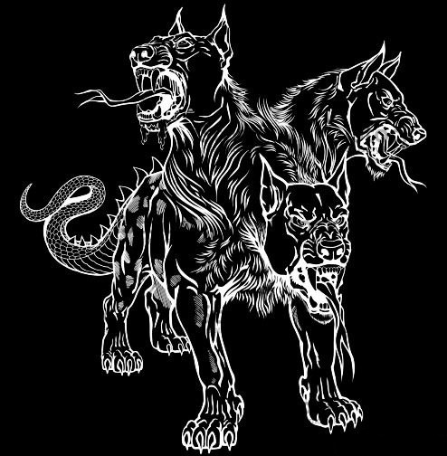
HELL HOUND
Performance Wheels

Slide 2
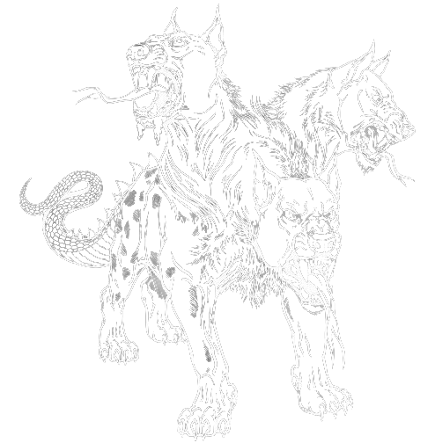
HELL HOUND
Performance Wheels

Slide 3


Slide 4


Slide 5



Slide 6
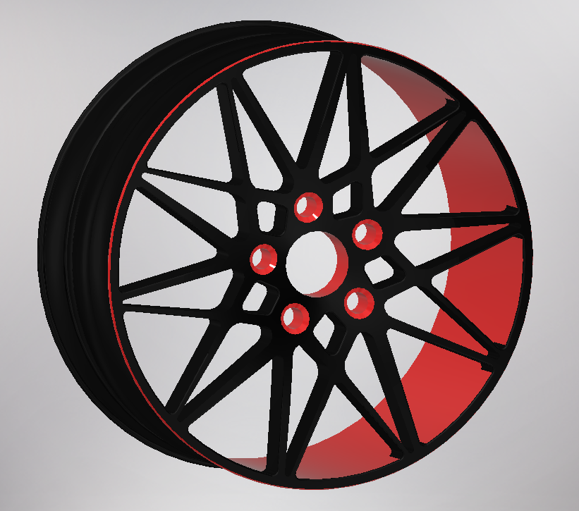
HH06 - Inferno

Slide 7
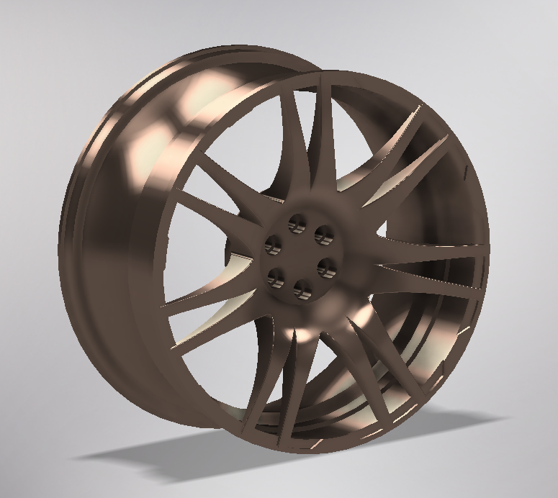
HH07 – Dragon’s Claw

Slide 8
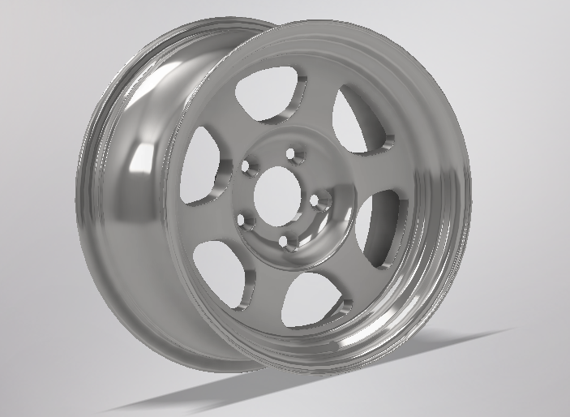
HH08 – Silver Paladin

