Slide 1






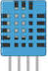

Grãos
Sylo
Node.JS
Server
Internet
MS Azure
Site
Sensor
(DHT11)
Arduino
EndPoints
BackEnd
Internet
Storage
FrontEnd

Slide 2



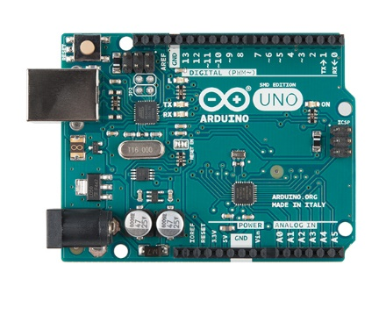




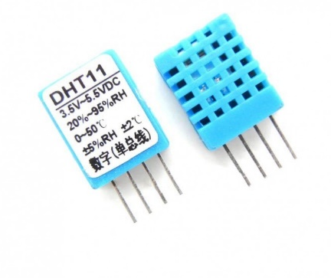

HLD
Node.JS
COM
WIFI
INTERNET
ARDUINO UNO
ANALOG
WIFI/3G/4G
WEB
INTERNET
SENSOR DHT 11
FAZENDEIRO

