Slide 1
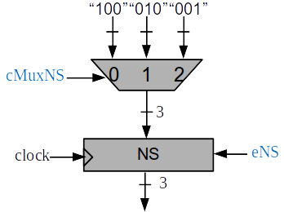


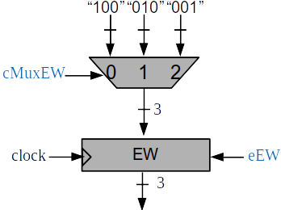
ecktimer
saisomatime
rstcktimer
cktimer
26
saicktimer
saimuxNS
“1”
8
s1
26
rsttime
= 50.000.000?
clock
time
etime
sairegNS
.
.
.
saitime
.
8
26
“1”
saisomacktimer
8
8
= 45 ?
.
.
.
saimuxP
s45
= 50 ?
= 55 ?
s55
s50
= 100 ?
= 105 ?
= 110 ?
sairegP
s105
s100
s110
= 135 ?
= 140 ?
8
s140
s135
saimuxEW
sairegEW

