Slide 1
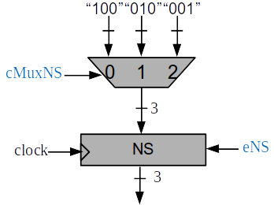


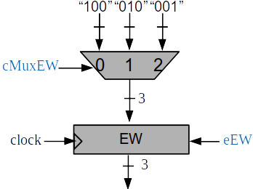
ecktimer
cktimer
rstcktimer
8
rsttime
26
clock
time
etime
s1
= 50.000.000?
.
.
.
.
8
“1”
8
8
= 45 ?
.
.
.
s45
= 50 ?
= 55 ?
s55
s50
= 100 ?
= 105 ?
= 110 ?
s105
s100
s110
= 135 ?
= 140 ?
8
s140
s135

