Slide 1
time
eP
8
2
time
ctime
clock
P
cP
clock
8
2
P
eEW
3
clock
EW
cEW
3
eNS
EW
3
NS
cNS
clock
3
NS

Slide 2
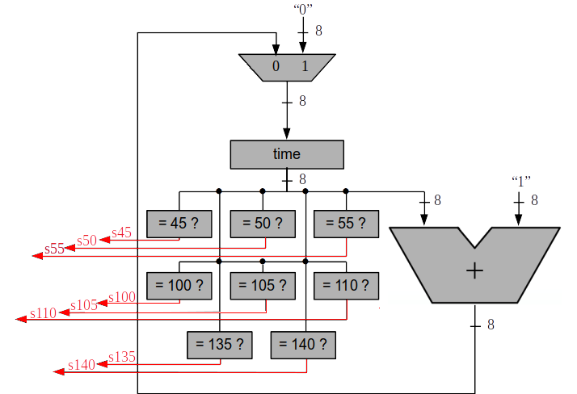
ssom
clock
ctime

