Slide 1
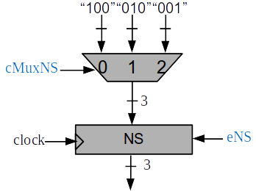


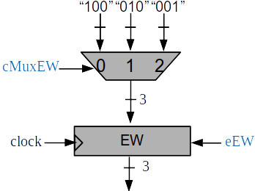
contadorclock
26
s1
= 50000000?
ecktimer
cktimer
rstcktimer
8
26
time
rsttime
etime
.
.
.
.
s1
8
“1”
= 50000000?
8
8
= 45 ?
= 50 ?
= 55 ?
s50
s45
.
.
.
s55
s55
= 100 ?
= 105 ?
= 110 ?
s105
s100
s110
8
= 135 ?
= 140 ?
s140
s135

