Slide 1
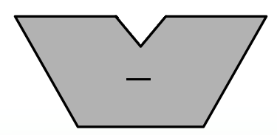
time
scont
0
1
6
ccont
cont
6
“1”
6
6
= 0 ?
6

