Slide 1
Mathew Kamande Macharia
Web Tech Summer 2025 Final Exams

Slide 2
Mathew Macharia is developing a data‑powered website to help small market vendors (“mama mbogas”) in Kenya track credit sales and customer debts, so they stop losing money to forgotten or poorly recorded credit.

Slide 3
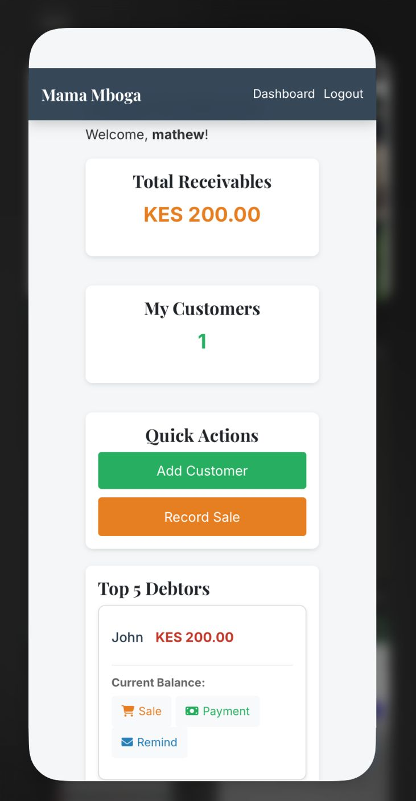
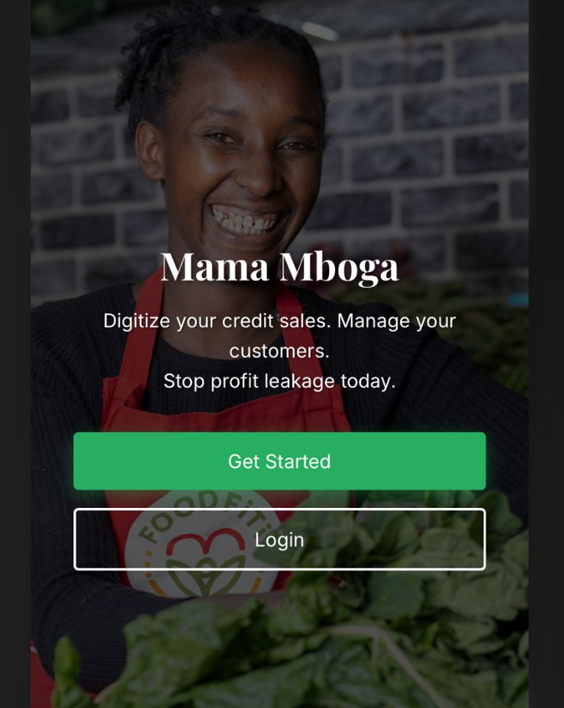


Project Title
ddd
PROBLEM:
Today, these vendors record debts in notebooks or memory. Pages get torn or lost, entries are messy, and they can’t quickly see who owes what. This leads to forgotten debts, disputes with customers, and poor visibility into total money outstanding.
PAYOFF:
The website gives each vendor a clear dashboard showing total receivables, number of customers, and a ranked list of top debtors, plus per‑customer history of sales and payments. This makes it easy to follow up on debts, plan cash flow, and send professional email reminders.
PERSONA(s)
Small informal grocery and vegetable vendors in local markets who regularly allow trusted customers to buy on credit. Many run one‑person stalls, keep paper notebooks, and have limited time or technical training.
FINISH
Vendors are better off because debts are organized, easy to find, and harder to forget. They spend less time hunting through notebooks, recover more money they are owed, and present a more professional experience to their customers.

Slide 4
User / Customer
The website is designed for small grocery and produce vendors (“mama mbogas”) who operate stalls in local markets. Their main “product” is perishable food items sold daily to neighborhood customers, often on informal credit. The purpose of the site is to give them a simple digital tool to record credit sales, track who owes them money, and follow up on repayments.
Roles of users
- Vendor – Logs in to manage their own customers, record credit sales and payments, and see dashboards and send reminders.
- Admin – Logs in to oversee all vendors, view system‑wide metrics, and manage vendor accounts (activate/deactivate and update vendor details).

Slide 5
Main Functions of the Website
Customer Management – Add and edit customers with name, phone number, and optional email; maintain a running balance for each customer.
Credit Sales & Payments – Record new credit sales and repayments; automatically update customer balances and vendor total receivables.
Dashboards & Reporting – Show vendor dashboards (total receivables, number of customers, top debtors) and admin dashboards (number of vendors, total customers, system‑wide debt).
Email Payment Reminders – Allow vendors to send individual or bulk email reminders to customers with outstanding balances, using a professional SendGrid email template.

Slide 6
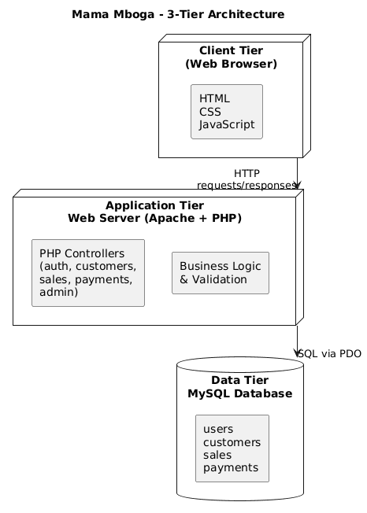
Architecture

