Slide 1

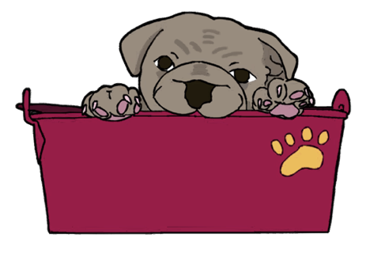
Product Team
By: Amara Auguste,
Brian Cheung,
Shradha Luintel,
Vivian Tom

Slide 2
What is bulldog buckets?
A websites for CUNY Brooklyn College CIS students
Find, create, and collaborate on projects
A way to network and join/create study groups or other non code “projects”
Functions like a “mini-GitHub” for BC students

Slide 3

Features of the Projects
List of projects (sortable by various categories)
Team members that are working on it
Project status: is the project still complete/ongoing/active/inactive/etc
See what help a project is looking for
Suggestion box for ideas (could be for projects, website features, etc)

Slide 4
Features as a member
Membership Feature
Personal profiles showing past project experience(s) and skills they have, interests as well
Link to github (user/project/multiple levels)
Status (mark) of whether someone is online currently
Chatbox: real-time chat to a specific project upon approval
A person/user can be part of multiple projects
A person/user can be part of multiple teams

Slide 5
STORYBOARDS/PAGE LAYOUTS
USER STORIES

Slide 6
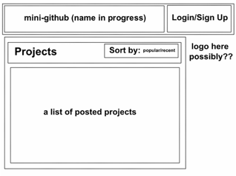
HOMEPAGE
This is a layout of the homepage.
The logo and name is at the top followed by login/sign up button.
There will be a list of projects that members are currently working on (with minimal description) with a sorting feature.

Slide 7
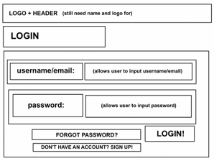
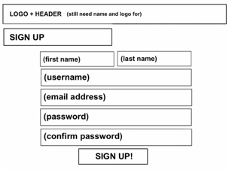
LOGIN/SIGN UP
Here is a basic layout of a login/sign up page.
A sign up page (accessed by both the sign up button on the home page and the link at the bottom of the login page that reads: "Don't have an account? Sign up!")
A user after either logging in or signing up, will be presented with a modified homepage (pretty much the same as the original one except with the user's name at the top and that user's projects, etc.)

Slide 8
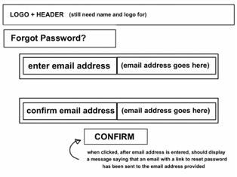
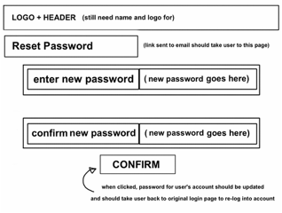
FORGOT PASSWORD/RESET PASSWORD
Here are the layouts for the forgot password and reset password pages which will be displayed if user clicks on forgot password.
The forgot password page will be displayed where they will be able to enter their email and a link to reset their password will be sent to them.
After clicking on that link from their email, they will be brought to the reset password page where they will update their password and click confirm.
Then the user will be taken to the homepage again to sign in with their credentials to access their personalized profiles.

Slide 9
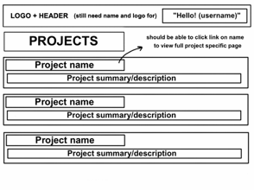
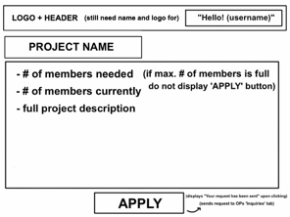
Projects Pages
Here are the layouts for the "Projects" pages. Upon viewing the Project listings, a user should be able to click the name of a project to view the full project description and then apply to work on the project (when one posts a new project, they should be able to decide the maximum number of people allowed to work on a project, if any, and when that number is reached, user's should no longer be allowed to apply).

Slide 10
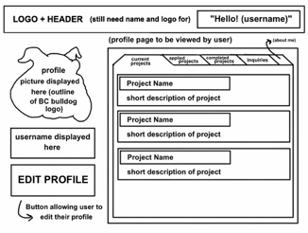
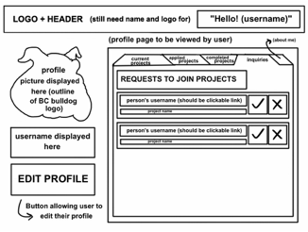
Profile Pages
Here are the layouts for the profile pages. Once someone applies to work on a project, the original poster should receive a request in the "inquiries" tab on their profile page, where they can then click on the link to the applicants profile, view their information and then choose whether to accept or reject their application. When viewing someone else's page, a user should only be able to view their profile photo, username, and "about me" information. In contrast, a user should be able to view five tabs on their own profile page:

Slide 11
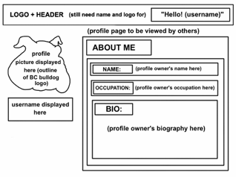
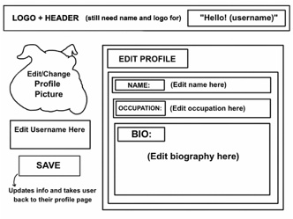
Profile Pages
current projects - a list of all the projects that they are currently working on
applied projects - projects that they have applied to but have not yet been accepted/rejected from (accepted applications move to current projects tab, rejected applications do not appear)
completed projects - projects that they worked on that have been completed, (these three tabs have very similar layouts)
inquiries - other user's requests to join a project that they have posted
about me - where the user displays their name, occupation, and bio.
The user's own page also displays an "edit profile" button, allowing them to update their information, which does not appear when view the pages of others. We have also decided that the profile picture should be displayed in an outline of the BC Bulldog logo and the site should be themed in BC colors.

Slide 12
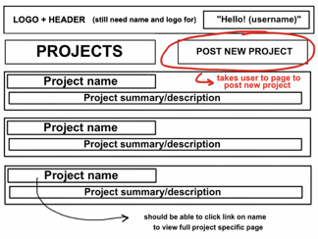
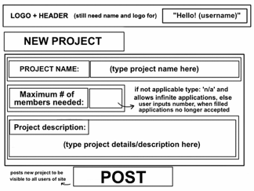
Initiate New Project
Here are the layouts for the modified general project page, post new project page, the modified specific project page, and the edit project page. The modified general project page has a "post new project" button that should allow a logged in user to click on it and take them to the post new project page where they can create a new project, by providing a project name, max # of members needed, and project description.

Slide 13
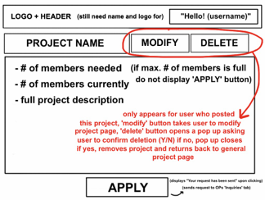
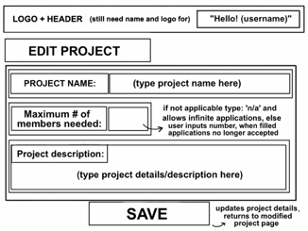
Modify Project
The modified specific project page now displays "modify" and "delete" buttons for the user who initially posted that project to use. The "modify" button should take the user to the edit project page (which looks like the post new project page with just slight alterations) and the "delete" button should open a pop up asking whether the user confirms that they want to delete the project. If so, then the project should be deleted from the listing and the user should be brought back to the general project page, else if not, the pop up should just close back on the specific project page.

Slide 14
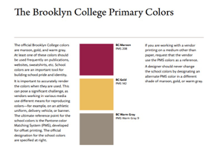


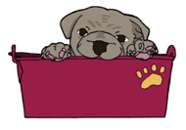
LOGOS + BRANDING
Text and Image logos for site/Product team decided on the title: ‘bulldog buckets’ (based off of the Brooklyn College bulldog mascot and the idea of storing ideas/projects collectively, in a ‘bucket’ per se)
Based off of BC colors and branding found here: https://www.brooklyn.cuny.edu/web/off_communications/Brand_Guidelines.pdf

Slide 15
What tasks did your team set out to accomplish this semester? What was done, what is left unfinished? What hasn’t started yet?
We set out to plan/design a site that allows BC students to network and find, create, and collaborate on projects. We designed a simple set of storyboard designs as an example of what the site should look like and features such as: login, sign up, and the ability to post new projects, add new members, etc.
We have pretty much completed all the main designs and features needed for the site.
In the future, we would like to add a messaging feature so that users could interact with each other on the site directly rather than via email

Slide 16

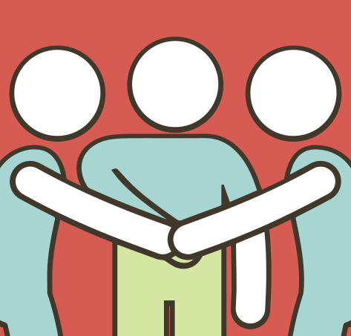

How was workload divided up, did it shift throughout the semester?
We meet up bi weekly to discuss UI/UX
Drew many mock-ups and designs on paper as well as digitally
We waited for feedback from other groups and tried to plan ahead accordingly
Notes:
We divided work load using slack and in person work
We meet up bi weekly for approximate 45-60 mins to discuss UI/UX
During meet ups we drew mockups
There were times in which we waiting on other teams to complete work, however we always discuss further plans and details

Slide 17
Obstacles
Some obstacles we faced was coming up with a name for the group project. It took us many weeks before we all came to an agreement for this name.
Another challenge we faced was how we would implement our vision into the design.

Slide 18
Tools or techniques that helped in planning / what didn’t
We tried to meetup in person to discuss almost everything, divide work and catch up.
The tools that helped us in planning and collaboration were slack, gmail, google docs, google slides. Github
We were the starting point of the project and we had to ship out designs as soon as possible, so we did black and white designs with color choices. If we had more time, we would have liked to create designs that were visually more appealing.
We would also like to hear back from users after the app was tested to create better user experience.
There weren’t any problems in collaboration, we got along very well and remained in sync with each other’s thoughts and ideas throughout this process.
We had fun!

Slide 19
Sources
https://www.google.com/url?sa=i&source=images&cd=&cad=rja&uact=8&ved=2ahUKEwidpY39w5fmAhUIc98KHUKaA68Qjhx6BAgBEAI&url=https%3A%2F%2Fwww.uhclthesignal.com%2Fwordpress%2F2019%2F05%2F29%2Fquiz-what-role-do-you-play-in-a-group-project%2F&psig=AOvVaw08HflFKNEVHKMVdmbf3uCM&ust=1575395566986296

