Slide 1
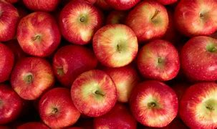
KAGGLE COMPETITION: EDSA APPLE PRICES CHALLENGE

Slide 2
Regression_AE3_DSFT
TEAM MEMBERS
Mathew van Wyk (Leader)
Rinkie Sekgobela
Tiyani Baloyi
Noxolo Ncgobo
Thato Kgoale

Slide 3
Introduction
Data science- scientific methods, processes, algorithms to extract knowledge.
Regression algorithms with the aim to accurately predict the price of a kilogram of Golden Delicious Apples, given certain parameters.
Help the Fresh Produce Industry minimise food waste.

Slide 4
Data cleaning
We filtered out all the commodities that we not relevant in our model.
Then we checked for nulls using .info()
Encoded non numeric values
Droped features we did not need

Slide 5
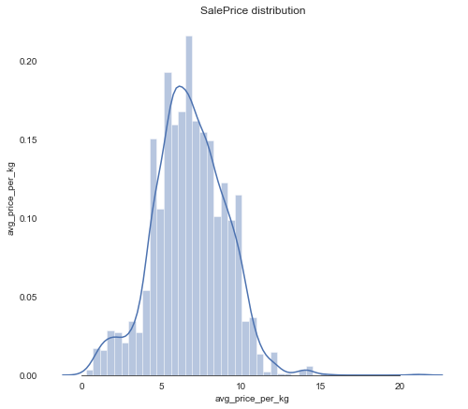
Data analysis (EDA)
Skewness: 0.082452
Kutosis: 1.042921
Avg_price_per_kg is fairly symmetrical
Kurtosis < 3

Slide 6
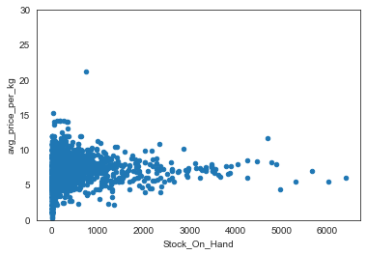
Data analysis (EDA)
Relationship between avg_price_per_kg with numerical variables
Stock_on_hand

Slide 7
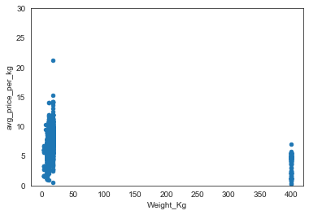
Data analysis (EDA)
Avg_price_per_kg vs. weight_kg

Slide 8
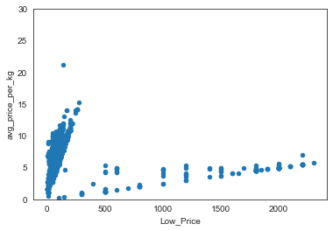
Data analysis (EDA)
Avg_price_per_kg vs. Low_price

Slide 9
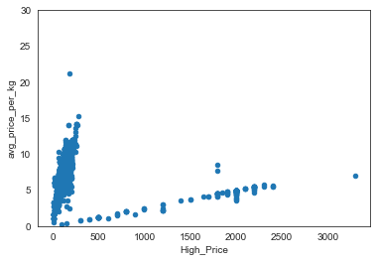
Data analysis (EDA)
Avg_price_per_kg vs. High_Price

Slide 10
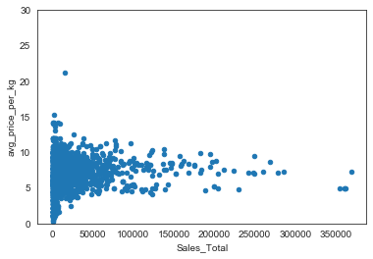
Data analysis (EDA)
Avg_price_per_kg vs. sales_total

Slide 11
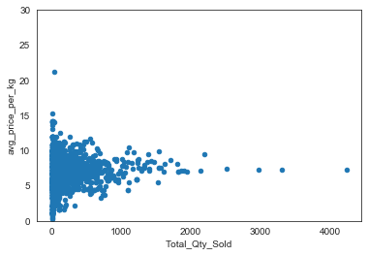
Data analysis (EDA)
Avg_price_per_kg vs. Total_Qty_Sold

Slide 12
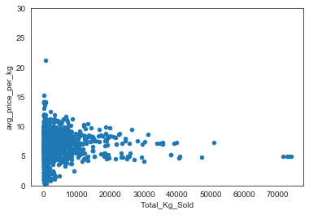
Data analysis (EDA)
Avg_price_per_kg vs. Total_kg_sold

Slide 13
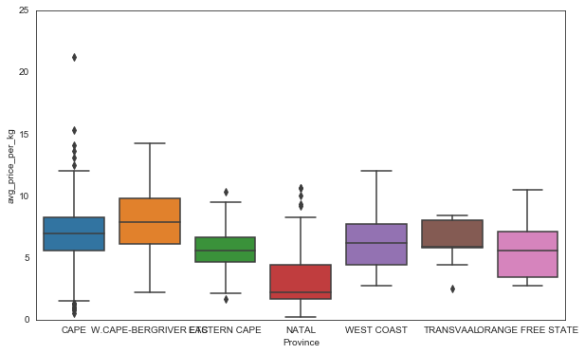
Data analysis (EDA)
Relationship between avg_price_per_kg with categorical features.
Avg_price_per_kg vs. Province

Slide 14
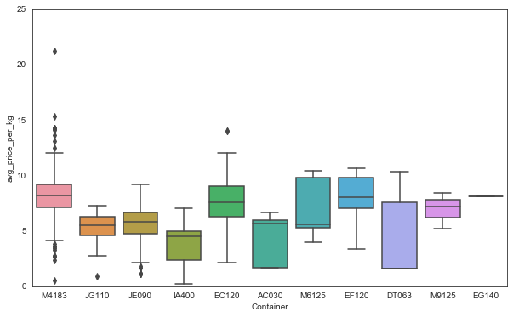
Data analysis (EDA)
Avg_price_per_kg vs. container

Slide 15
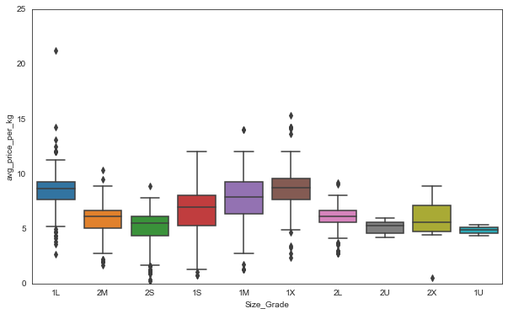
Data analysis (EDA)
Avg_price_per_kg vs. Size grade

Slide 16
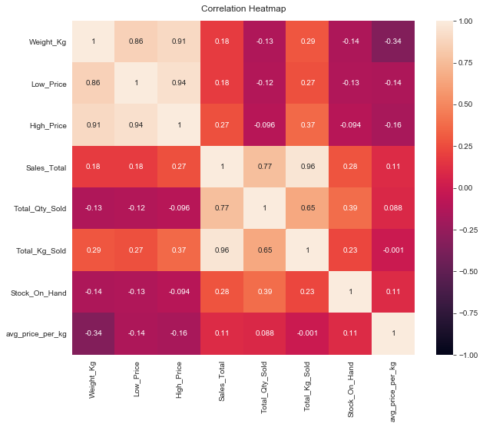
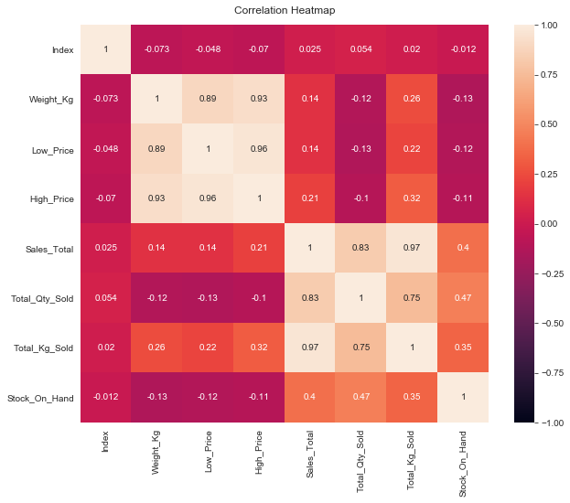
Visualization of data for correlation
Train heatmap
Test heatmap

Slide 17
Feature and variable selection
Filter the features (Apple golden delicious in commodities)
Target variable (avg_price_per_kg)

Slide 18
The models tested
XGB - XGBoost
LR – Linear Regression
RF – Random Forest

Slide 19
Results
In the form of tables and plots
Model tested | Prediction Accuracy | RSME
XGB | 99.92 | 0.4
LR | 47.69 | 1.1
RF | 98.25 | 0.7

Slide 20
Concluding remarks
The models tried and tested were Random Forest, Linear Regression and XGBoost algorithms.
It was concluded that the best model for the data sets used is XGBoost
99% accuracy
0.4 root mean error

Slide 21
Acknowledgements
Special thanks to Ali Elimam for his supervision over the team.

Slide 22
THANK YOU

