Slide 1
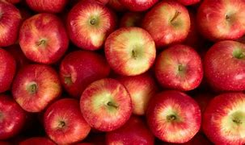
KAGGLE COMPETITION: EDSA APPLE PRICES CHALLENGE

Slide 2
Regression_AE3_DSFT
TEAM MEMBERS
Mathew van Wyk (Leader)
Rinkie Sekgobela
Tiyani Baloyi
Noxolo Ncgobo
Thato Kgoale

Slide 3
Introduction
Introduce and explain your data

Slide 4
Data cleaning
How we cleaned our data

Slide 5
Data analysis (EDA)
Images and plots

Slide 6
Feature and variable selection
Why we chose those features

Slide 7
The models tested
All the models we tested: their names and how they work

Slide 8
Results
In the form of tables and plots
(I am not sure if I should write the results of all the models we tested or..?)

Slide 9
Concluding remarks
What did we conclude based on the models we tested, which one did we chose to be the best and why.

