Slide 1

Navigating with
🐚SHELL
Notes:
Comentar sobre o evento

Slide 2
Navigating with
🐚SHELL
Notes:
Perguntar se eles estão usando o Shell , se usam em produção ou em projetos pessoais.

Slide 3





Who am I?
https://medium.com/@wendreof/como-elaborar-reposit%C3%B3rios-mais-profissionais-9aaa93373f39
@NRLCEFET
Pedro Jesus
Software eng. ArcTouch
Notes:
We make dreams come true into the shape of mobile applications.
Github image: https://medium.com/@wendreof/como-elaborar-reposit%C3%B3rios-mais-profissionais-9aaa93373f39

Slide 4
Agenda
01
Shell? 🤔
Shell structure
02
Navigation using Shell
03
Code Time
04
Conclusion and Q&A
05
Pedro Jesus
Notes:
Olhar as repostas no chat e começar a apresentação de fato

Slide 5

1
Shell?
Notes:
Comentar que os aplicativos atuais utilizam navegação através de tabbedpages e flyouts e tbm mesclam esses dois tipo de navegação.

Slide 6
Things that Shell Solved
Simplified the navigation;
Declarative structure to your application;
Very customizable;
Delivery your application much faster.

Slide 7

Navigation before and after Shell
MasterDetail before Shell
MasterDetail with Shell

Slide 8
2
Shell Structure

Slide 9
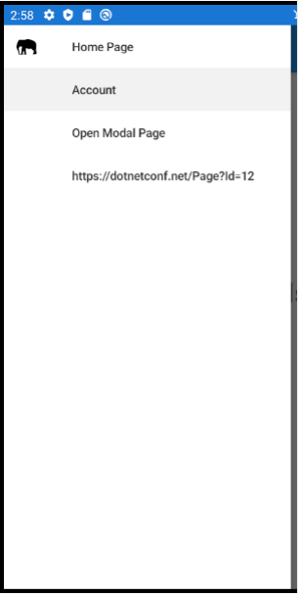
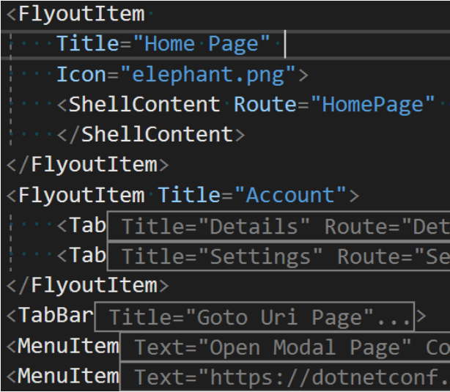
Declarative structure

Slide 10
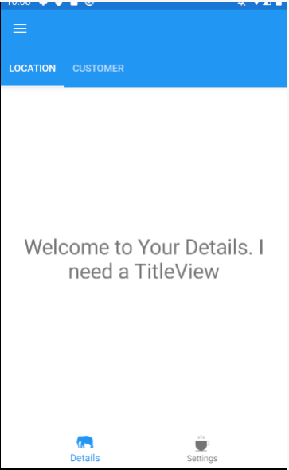
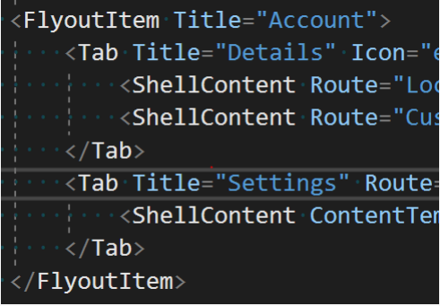
Declarative structure

Slide 11
3
Shell Navigation

Slide 12
Shell Navigation
URL navigation, it’s just 1 string❣
It’s very easy to handle with deeplink;
You can save the current navigation’s state of your app before close it, and open it again in the same place;

Slide 13
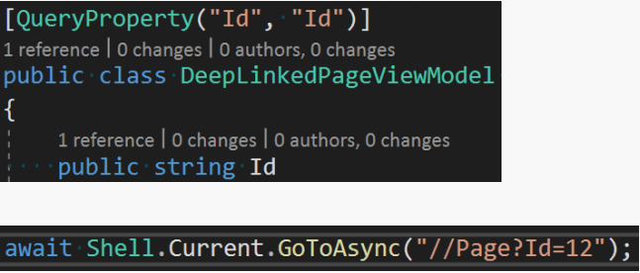
Shell Navigation – Query Parameters

Slide 14
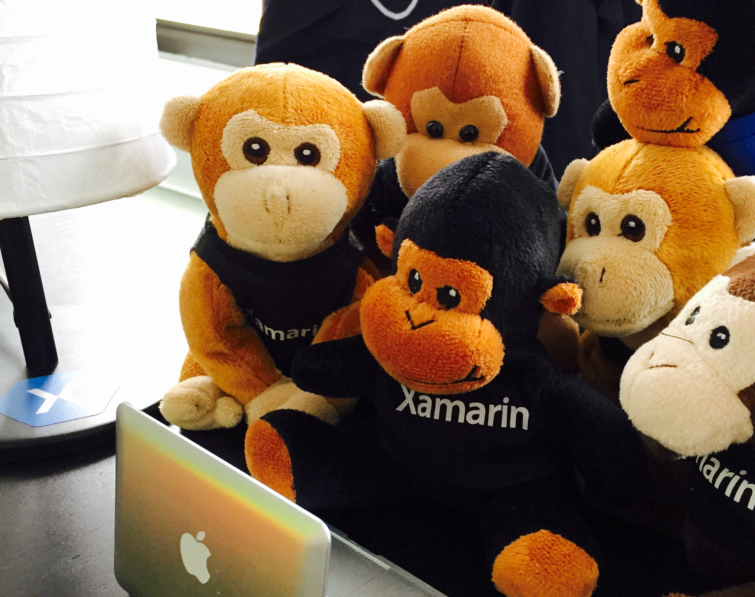
Show Time
Let’s look some code!

Slide 15
References
https://devblogs.microsoft.com/xamarin/net-conf-focus-on-xamarin-event-recap/
https://github.com/xamarin/Xamarin.Forms

Slide 16




Thank you! My contacts
Pedro Jesus
Software eng. at ArcTouch
pedrojesus.cefet@gmail.com
pj_souz
jesopas
medium.com/@pedro_jesus
jesopas

Slide 17
Recomendaciones para editar esta presentación:
No edites o cambies los estilos generales de la plantilla.
Usa la fuente de la template: Poppins (Si no la tenes instalada, la podes descargar acá: https://fonts.google.com/specimen/Poppins)
No cambies la paleta de colores.
No muevas de lugar ni edites los logos de Xamarin Assemble
Podes reemplazar y colocar imágenes en la presentación a tu gusto, combinar o reutilizar los slides que mas te convengan, agregar gráficos, etc.
Por ultimo, cuando termines de editar esta plantilla borra este slide. Exitos en tu charla ☺

