Slide 1
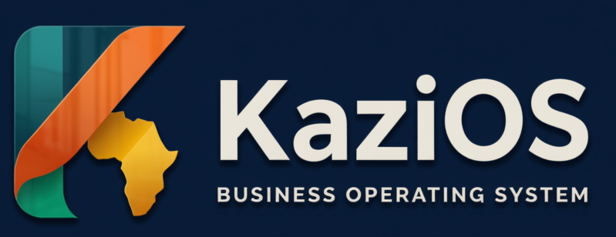
ACODev COMPETITION · 2026
The AI-native operating system for African businesses
Project presentation · Mathew Kioko · mathewtech200@gmail.com
github.com/MathewTech254/KaziOs
Notes:
Open with the one-liner: KaziOS is an operating system for African businesses — sales, stock, customers, books and payments in one connected system. I'm Mathew Kioko, founder and developer.

Slide 2
THE PROBLEM
Ten tools, ten versions of the truth
POS
Inventory
Customers
Purchasing
Invoicing
Payments
Expenses
Accounting
Reporting
BI
Stock drifts
Double entry
The sale updates the till, not the shelf.
The same sale gets re-typed into three systems.
Invisible balances
Late decisions
Who owes what lives in a notebook at the counter.
Reports arrive after the decision was due.
KaziOS · Business Operating System
2
Notes:
Most SMEs stitch together separate apps for each job. None of them talk to each other, so every sale creates reconciliation work and the numbers never agree.

Slide 3
WHY EXISTING SOFTWARE FAILS HERE
Built for a different market
Mobile money first
Multi-branch by default
M-PESA is how most customers actually pay. Global tools treat it as an afterthought — or ignore it entirely.
SMEs grow into branches, warehouses and agents. The software must model that shape from day one.
Connectivity comes and goes
Pricing that fits the market
Work must keep flowing on unreliable networks — offline tolerance cannot be a future luxury.
Foreign-currency enterprise pricing does not scale with an African SME. Plans must grow with the business.
KaziOS · Business Operating System
3
Notes:
This is the wedge: global ERPs assume card payments, one HQ and always-on internet. KaziOS starts from African market realities.

Slide 4
THE SOLUTION
One transaction — everything connected
When a sale happens, payment, stock, customer history, books and reporting update together — automatically.
Payment
Inventory
SALE
Customer
Accounting
“A business transaction should not exist in isolation.”
Reporting
— KaziOS design principle
AI Insights
KaziOS · Business Operating System
4
Notes:
This is the core architectural idea, straight from the README: one sale fans out to six systems. No re-keying, no drift, no reconciliation tax.

Slide 5
THE PLATFORM
Everything a business runs on, in one system
Core modules are live today — the deeper workflows are in active build.
Point of Sale
Products & Inventory
Customers
Sales & Invoicing
Search, cart, discounts, tax, receipts and cashier workflows.
SKUs, barcodes, categories, warehouses and stock movements.
Profiles, history, outstanding balances and returns.
Invoices, line items, partial payments and statuses.
Purchasing
Payments
Reporting
AI Insights
Supplier → purchase order → receiving → stock → balance.
Card (Paystack) and M-PESA rails, refunds and tracking.
Sales, stock, customer and financial reports.
Business intelligence grounded in your own numbers.
Multi-branch · Warehouses · Roles & permissions · Audit logging · Notifications · Settings
KaziOS · Business Operating System
5
Notes:
Walk one row only — juries skim. Point out that selling, stock, customers, purchasing, invoicing and payments are one data model, not eight apps glued together.

Slide 6
FLAGSHIP INTEGRATION
Billing that works the way Africa pays
Paystack — cards
Why it is trustworthy
Card checkout with webhook-verified confirmation and idempotent activation — a payment can never be granted twice.
Amount checked against the plan price — every time
Idempotent activation: one payment, one grant, ever
Unsigned webhook can only trigger a verification query
Rate-limit aware: undecided payments poll politely, then retry
Free plan and paid plans, monthly or annual, one engine
Billing portal: invoices, receipts, plan changes
M-PESA — Safaricom Daraja STK Push
The customer approves on their own phone with their PIN. The server then re-queries Safaricom to verify — the callback can only trigger a check, never grant access.
Both rails share one subscription engine — same plans, same limits, same billing portal.
KaziOS · Business Operating System
6
Notes:
Two rails, one engine. The M-PESA side is the story: Daraja STK Push, server-side re-query as the only source of truth, idempotency and amount checks — payments engineering, not a button.

Slide 7
BUSINESS MODEL
Freemium SaaS — paid where Africa pays
Paid plans
Free plan
Grows with you
More capacity and features. Monthly or annual billing, cancelled any time.
Start free with core features and sensible limits. The door stays wide open.
Direction: as a business adds branches and teams, its tier grows with it.
Why the model works here
Local payment methods (M-PESA) lift conversion where cards are rare
Entitlements are enforced server-side — limits stay honest, clients cannot spoof them
Annual billing rewards commitment and smooths cash flow
KaziOS · Business Operating System
7
Notes:
No invented pricing numbers — the plan table is server-configurable per market. The point: free tier for adoption, paid tiers for capacity, local rails for conversion.

Slide 8
MARKET & USERS
Kenya first — built for African markets
Who uses KaziOS
Where we start
The owner
SME retailers & wholesalers in Kenya — shops, hardware, groceries, pharmacies, distributors
Multi-branch businesses that outgrew spreadsheets and single-purpose apps
Expansion path across Africa as payment rails and tax integrations land
Cash visibility across every branch, in real time.
The cashier
A fast checkout: few clicks, receipts, less training.
The store manager
Why now
Stock truth — what moved, what is low, what was ordered.
Digital payments are becoming the default
Tax authorities are digitising invoicing
Owners demand one source of truth
The accountant
Clean books: invoices, payments and customer balances.
KaziOS · Business Operating System
8
Notes:
Kenya-first is deliberate: M-PESA rails, KRA eTIMS compliance path, English/Swahili market. Personas show we design for the people who touch the product daily.

Slide 9
WHERE WE ARE
Shipping in public
190+ passing tests
Typecheck + lint gates
Public GitHub repo
Production deployed
LIVE TODAY
IN ACTIVE BUILD
Authentication, organizations, roles & audit logging
Products, customers, invoices, payments
Branches, warehouses, settings, notifications
POS foundation and reporting foundation
Subscription plans, free tier, feature entitlements
Paystack + M-PESA payment rails, billing portal
Docs: architecture, subscriptions, M-PESA walkthrough
Complete cashier workflow & barcode scanning
Returns, refunds, split payments, cashier shifts
Inventory ledger, transfers & stocktaking
Purchasing lifecycle & supplier balances
Accounting core (GL, receivables/payables, P&L)
AI business copilot across every module
Offline POS · KRA eTIMS · WhatsApp & SMS
KaziOS · Business Operating System
9
Notes:
Honest status builds trust with a jury: the foundation and both payment rails are live and tested; the deep workflows are sequenced next. No vaporware claims.

Slide 10
TECHNOLOGY
Modern, typed, tested
WEB
API
DATA & INFRA
React 18 + TypeScript
Vite build + Tailwind CSS
TanStack Router & Query
Radix UI · Recharts charts
Jest + Testing Library
Node.js + Express
Zod request validation
JWT sessions + argon2
Rate limiting + Helmet
BullMQ background jobs
PostgreSQL (Neon)
Prisma ORM + migrations
Redis sessions & cache
Monorepo: 6 shared packages
Cloud deployment (Render)
Quality gates: typecheck · lint · 190+ unit tests · integration suite Security: RBAC · audit trail · hashed secrets · HTTPS-only callbacks
KaziOS · Business Operating System
10
Notes:
Signal engineering maturity: monorepo with shared packages, strict typing end-to-end, automated tests and gates, and payment-grade security posture.

Slide 11
ROADMAP
Now → Next → Later
NOW
NEXT
LATER
Live in production
The deep workflows
Intelligence & scale
Core platform & multi-branch ops
Paystack + M-PESA payment rails
Free & paid subscription tiers
Documentation & test suite
Complete cashier workflow & shifts
Inventory ledger, transfers, stocktaking
Purchasing lifecycle & suppliers
Accounting core (GL, AR/AP, P&L)
AI business copilot
Offline POS for intermittent networks
KRA eTIMS compliance integration
WhatsApp/SMS & pan-African expansion
→
→
KaziOS · Business Operating System
11
Notes:
The roadmap is the README checklist made visible: everything checked is live, everything unchecked is sequenced. Judges can verify by opening the public repo.

Slide 12
WHY KAZIOS
Local by design — serious under the hood
Built here, not adapted
Connected data model
Mobile money, multi-branch reality and Kenyan compliance are the default path — not future tickets on a foreign roadmap.
One sale updates six systems. No reconciliation tax, no drift between the till, the shelf and the books.
Engineering you can audit
Founder on the ground
Public repo, typed codebase, 190+ tests, and written docs for every payment rail — including the M-PESA walkthrough.
Mathew Kioko — building in Kenya, shipping in public, iterating toward what African businesses actually need.
Run your whole business on one system.
KaziOS · Business Operating System
12
Notes:
Close the argument: local-first product decisions, a connected data model, verifiable engineering, and a founder who ships. Then move to the thank-you slide.

Slide 13
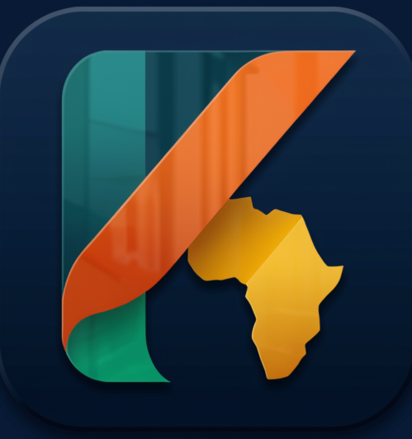
Thank you
KaziOS — the AI-native operating system for African businesses
mathewtech200@gmail.com
github.com/MathewTech254/KaziOs
Questions & demo welcome
Notes:
Thank the jury, then invite a live demo — the POS flow and the M-PESA checkout both work end-to-end in the sandbox.

