Slide 1
RAKSHAM · Amazon × IIT Delhi · Round 1 · Track 2: AI-driven scam pattern recognition
Chakravyuh
Contact
Control
Intercept the scam workflow,
not the transaction.
Extraction
Cash-out
Chakravyuh checks a UPI payment for the steps that usually come before a scam payment. It interrupts only when several of them show up together, tells the customer why, and keeps a signed record for the bank.
Decision
Mathews V Manoj B.Tech Electronics & Communication, Muthoot Institute of Technology and Science (KTU)
All results come from synthetic data we generated.
No real customer or bank data was used.
Notes:
Chakravyuh is a scam-detection engine for UPI payments. The name comes from the layered trap in the Mahabharata, which is how these scams work: the victim is walked through several steps before paying. We look at those steps, not just the payment.

Slide 2
1 · Problem
Chakravyuh
In these scams, the victim makes the payment
Most of the scam happens before any money moves. By the time the victim pays, the PIN is correct, the phone is their own and they mean to pay, so a check on the payment alone has little to go on.
Contact
₹22,845 cr
A fake “CBI officer” video-calls about a money-laundering case
Control
A payment-level check
does not see these steps
lost to cyber fraud in India in 2024
She is told to install a screen-sharing app “for verification”
36.37 lakh
Money extraction
She breaks a fixed deposit and types in a new payee
complaints filed in 2024
She pays
This is the only step
it checks
Source: Ministry of Home Affairs, reply in Lok Sabha, July 2025 (NCRP and CFCFRMS data).
₹2,50,000 to a personal UPI ID
Our idea: use the steps before the payment as evidence, not just the payment.
2 / 16
Notes:
This is a digital-arrest scam, one of the common patterns in India. The victim authorises the payment herself, so the bank sees a valid PIN on her own phone. Rules that only look at the payment either miss it or fire on genuine payments.

Slide 3
2 · Idea
Chakravyuh
A scam has four stages. We look for all of them.
01
02
03
04
Contact
Control
Extraction
Cash-out
call with an unknown number
call longer than 20 min
scam-lure SMS, checked on the phone
screen-sharing app running
app sideloaded in last 24 h
OTP opened during the call
first-time payee, typed UPI ID
more than 70% of the balance
fixed deposit broken in last 24 h
account behaves like a mule
account less than 30 days old
account on a suspect list
from the phone
from the phone
from the bank
from the receiving account
One odd signal is not enough to stop a payment. We act when several stages show up together.
A genuine payment can look odd on its own, like a new payee on rent day or a long call with a plumber. A scam is easier to spot from the sequence. All 20 signals are listed in the appendix.
3 / 16
Notes:
This is the core idea. Each stage has signals, 20 in total: 9 from the phone, 7 the bank already has, and 4 about the receiving account. We only interrupt when at least two stages are active.

Slide 4
3 · Response
Chakravyuh
Three levels of response
The more stages we see, the stronger the response. The bank chooses how many alerts per 1,000 payments it will accept at each level, and we set the thresholds to match on separate test data.
1
Log it
2
Warn and ask
3
Hold and review
When
When
When
Score above threshold 1
Score above threshold 2, and at least 2 stages active
Score above threshold 3, and 3 stages (or 2 plus a suspect-list match)
Customer sees
Customer sees
Customer sees
Nothing. The session goes to the bank’s fraud team for later review.
A warning that names the likely scam, and two questions. The customer can still pay.
The payment is held for up to 30 minutes and a bank agent calls. Two staff must approve a release.
20.4
genuine sessions per 1,000
measured on synthetic data (target 20)
2.77
genuine sessions per 1,000
measured on synthetic data (target 3)
0.07
genuine sessions per 1,000
measured on synthetic data (target 0.5)
Nothing is blocked permanently. A person decides every hold.
4 / 16
Notes:
The response grows with the evidence. Level 1 is silent. Level 2 warns and asks two questions but never blocks. Level 3 holds the payment for up to 30 minutes and a bank agent reviews it. The rates shown are measured on our synthetic test data.

Slide 5
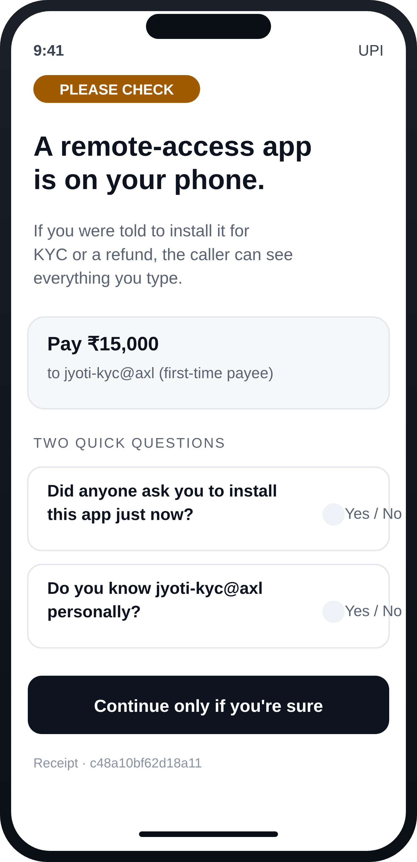
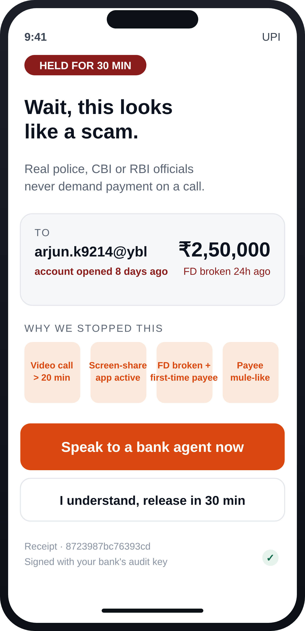
4 · Example
Chakravyuh
Example: Mrs R., 68
A made-up case based on reported digital-arrest scams.
Fake CBI video call
Remote-access app
FD broken
First-time payee
Mule-like account
₹2,50,000 payment
contact
control
extraction
extraction
cash-out
payment
Today
With Chakravyuh
The money is gone.
The payment is held.
A “new payee and high amount” rule shows a general warning. The caller tells her to ignore it and she pays. The money goes to a mule account and moves on within hours.
All four stages show up, so it goes to level 3. The screen tells her real officials never ask for money on a call, and a bank agent calls her before anything is released.
Level 2: warn and ask
Level 3: hold (her case)
5 / 16
Notes:
Five warning signs appear before the payment. Today a generic rule shows a warning the caller talks her past. With Chakravyuh all four stages are active, so the payment is held and she sees a specific message.

Slide 6
5 · Model
Chakravyuh
How the score works
20
4
≥ 2
0–3
→
→
→
yes/no signals
stage scores
stages needed
response level
9 phone · 7 bank · 4 receiving account
weighted sum per stage, with a cap
before we interrupt a payment
plus the reasons and a signed record
Score
Non-negative weights | A missing signal does not change the score, because a fraudster can always hide one.
Stage caps | A safety limit (C = 5, 5, 6, 6). It made no measurable difference on our data.
Two-stage rule | We only interrupt when at least two stages are active.
Real-world scam rate | Training data is 3.8% scams; we adjust to an assumed 1 in 5,000.
Fixed thresholds | Set on a separate dataset to meet the bank’s alert limit, then fixed.
s(x) = b + Σ_{g} min( C_{g} , Σ_{k in g} w_{k} x_{k} )
Decision
Level 2 if s ≥ τ2 and at least 2 stages are active
Level 3 if s ≥ τ3 and 3 stages are active (or 2 plus a suspect-list match)
g is one of the four stages; x is 1 when a signal is present and 0 when it is not. Weights come from a logistic regression (L2) on labelled sessions and are kept at zero or above.
6 / 16
Notes:
Each signal has a weight learned by logistic regression. Weights are summed per stage and capped. The two-stage rule is what stops one odd signal, like a new payee, from interrupting a genuine payment.

Slide 7
6 · Results
Chakravyuh
Results on synthetic data
These numbers come from 8 synthetic test sets the model never saw. They are not results from a real bank.
Scams caught vs genuine payments interrupted
92.3%
98%
Gradient boosting 96.5%
MLP 96.8%
of scam sessions reach level 2 or 3
95% confidence interval [91.7%, 93.0%]
96%
Logistic regression 96.1%
XGBoost 96.2%
2.77 / 1,000
94%
genuine sessions interrupted
95% CI [2.64, 2.92] · target 3.0
92%
Chakravyuh 92.3%
0.980
2.4
2.6
2.8
3.0
area under the precision-recall curve
genuine payments interrupted per 1,000 → fewer is better
95% CI [0.978, 0.982]
What we give up. At a similar alert rate (each tuned to ours), standard classifiers catch 96.1%–96.8% of scams, about 4 points more. 47% of that gap is collect-request scams, which only show one stage. The rule-based check (“new payee + high amount”, not shown) catches 48.1% at 9.3 per 1,000.
7 / 16
Notes:
Recall 92.3% with a 95% interval of [91.7%, 93.0%], at 2.77 interruptions per 1,000. Every model is trained, tuned and tested on the same synthetic data. The standard classifiers catch slightly more scams; the next slide shows what our two-stage rule buys in exchange.

Slide 8
7 · Why the two-stage rule
Chakravyuh
Why not just use logistic regression?
Logistic regression is also explainable and catches more scams. So we measured what our two-stage rule adds, at the same alert rate.
 | Logistic regression | Chakravyuh
Scams caught | 96.1% | 92.3%
Genuine payments interrupted per 1,000 | 2.95 | 2.77
…of which showed only one stage | 49% | 0%
A genuine payment the rule spares
₹6,750
A shopkeeper pays on a collect request from a new payee. No call, no screen-sharing, a normal receiving account. Logistic regression interrupts it. Chakravyuh sees one stage, so it only logs it.
From our synthetic test data.
The cost
Scams that only ever show one stage get through, mostly collect-request scams. We will add a specific warning for collect requests from individuals and test it in the finale.
8 / 16
Notes:
This answers the obvious question from an ML judge. At the same alert rate, logistic regression catches about 4 points more scams, but half of the genuine payments it interrupts show only one stage of a scam. Our rule never does that. The price is collect-request scams, which we will handle with a targeted warning.

Slide 9
8 · Robustness
Chakravyuh
What if the fraudster changes tactics?
Can they… | Our answer | What we found | Status
Hide their tracks? Hang up before paying, skip screen-sharing, send less. | Payment and receiving-account signals come from the bank, which the caller cannot hide. | 86.9% of these sessions still caught. Worst case, hiding the strongest signal: 62%; two: 44%. | measured
Split one payment into several? Four payments of ₹25,000 instead of one ₹1,00,000. | A signal for two or more payments to new payees within 60 minutes. | Not separately simulated yet. | design only
Use older, rented mule accounts? An old account avoids the ‘new account’ signal. | The mule score also checks how many new senders an account has and how fast money leaves it. | Mule score catches only 24% of old mule accounts; payments to them are still caught 73.6% of the time. | measured
Poison the training data? Send lots of false reports. | Retrain only on cases the bank has confirmed. | Not evaluated. | design only
We assume the fraudster has read our weights and removes the strongest signals first. Thresholds are not changed.
A scam type it has not seen
Trained without one type, tested on it: 79–93% recall.
Removing one stage
Recall without contact, control, extraction or cash-out signals: 87%, 92%, 67%, 65%.
9 / 16
Notes:
We tested what happens if the fraudster adapts. Hiding the strongest signal hurts, so we report it honestly. Two of these defences are designs we have not tested yet, and they are marked that way.

Slide 10
9 · Feasibility
Chakravyuh
Which phone signals a banking app can actually read
Android and Google Play restrict some of what an app can see. We checked each of our 9 phone signals.
Readable (5)
Restricted (4), with fallbacks
✓ | Call active and how long | phone-state permission
✓ | Video or VoIP call | audio mode, no permission
✓ | Screen-sharing or remote-control app | known app list + accessibility services
✓ | App drawing over our screen | obscured-touch flag
✓ | Payee typed in by hand | our own payment screen
Caller not in contacts | call log is restricted | use call length only
Scam SMS received | SMS access is restricted | drop on the phone
Any app sideloaded | all-apps visibility is restricted | check a fixed list of apps
OTP opened during a call | other apps’ notifications | bank checks its own OTP timing
91.5%
Recall when we retrain with only the 5 readable phone signals, at 2.87 interruptions per 1,000 (synthetic data). With all 9 it is 92.3%. Most of the evidence comes from the bank side, so losing the restricted signals costs little.
10 / 16
Notes:
Four of the phone signals need access that Google Play restricts, such as the call log and SMS. We removed them and retrained: recall only drops from 92.3 to 91.5 percent.

Slide 11
10 · Privacy
Chakravyuh
What data we use
Stays on the phone
Sent to the bank
Already at the bank
✕
Call audio
9 yes/no values, plus the amount
and a hashed payee ID
Items 1, 4, 6 and 8 are restricted on Android; see slide 10.
7 from the bank’s own data: first-time payee, amount compared with past payments, share of balance, broken fixed deposit, recent small credits.
✕
Screen frames
✕
Message text
on a call with an unknown number
call longer than 20 minutes
video call active
scam-lure SMS in last 24 h
screen-sharing app running
app sideloaded in last 24 h
app drawing over the payment screen
OTP opened during the call
payee typed in by hand
4 about the receiving account: mule score, account age, suspect-list match, collect request.
✕
Contact list
✕
OTP values
✕
App list
9 + 7 + 4 = 20 signals
Signed decision record
{ log_id, time, session, amount, signals present, score, level, scam type, active stages, action } + HMAC-SHA256
Each decision gets one ID, so the customer, the bank agent and any complaint point to the same evidence. Already built: the server accepts only the 20 known signals and rejects repeated or old (> 15 s) requests.
Designed around the DPDP Act 2023 idea of collecting only what is needed. This is a design choice, not a legal certification.
11 / 16
Notes:
No audio, screen content, messages or contacts ever leave the phone. Only nine yes/no values, the amount and a hashed payee ID. Every decision is signed so it can be checked later in a complaint.

Slide 12
11 · Deployment
Chakravyuh
How it would run in a bank
built
synthetic data
planned
Phone (inside the bank’s app)
Rollout
Signal readers
Request builder
Warning screens
Weeks 0–6
Shadow mode: score, show nothing, tune thresholds.
5 readable phone signals.
Nonce, timestamp, Play Integrity.
Level 2 and 3 screens.
Weeks 6–10
Levels 1 and 2 for customers who opt in.
Bank fraud servers
From week 10
Level 3 holds with agent review.
Scoring server
Input checks + records
Agent screen
Stages, rule, level, reasons.
Replay checks, HMAC signing.
Held payments, 2-person release.
Running cost (estimate)
Bank data and payments
Servers and storage: about ₹5 lakh a year for 30 million users.
Staff: about 1,370 genuine payments held a day, roughly 114 agent-hours. This is the real cost.
Mule score, suspect list
Payment hold
Reporting
From the bank’s own data.
Time-limited, before the PIN.
Confirmed scams to I4C / 1930.
No integration with Amazon, NPCI, I4C or any bank exists yet.
12 / 16
Notes:
The scoring server, input checks and signed records are built and tested. The phone SDK, payment hold and agent screen are planned. Running cost is small for servers; the main cost is staff reviewing held payments.

Slide 13
12 · Next steps
Chakravyuh
What we will build and show in the 48-hour finale
H+0–8
H+8–20
H+20–32
H+32–44
H+44–48
Replay harness
Android signals
Collect-request rule
End-to-end run
Security review
Run saved test sessions through the server and check the records.
Read the 5 allowed phone signals on one test phone.
Add the targeted warning, re-test, then attack our own model.
100 sessions through to agent review and release or report.
Walk through records, replay checks, two-person release, known limits.
Built so far
Not built yet
Scoring server · threshold setting · signed records with replay checks · synthetic data generator and evaluation · 8 automated tests
Android SDK · collect-request rule · payment hold · agent screen · testing on real bank data
13 / 16
Notes:
The finale plan is scoped to what we can show: the five allowed phone signals on one phone, the collect-request warning, and a 100-session end-to-end run.

Slide 14
Chakravyuh
A scam is a sequence.
We wait for the sequence before we stop a payment.
On synthetic data: 92.3% of scams caught, 2.77 genuine payments interrupted per 1,000, and, by design, no payment stopped on the evidence of one stage alone.
Thank you. Questions welcome.
Mathews V Manoj · 24ec357@mgits.ac.in
Notes:
One line to remember: a scam is a sequence, and we wait for the sequence.

Slide 15
Appendix
Chakravyuh
All 20 signals and their weights
Signal | Stage | Source | Weight | Meaning
call_unknown_active | contact | phone | +1.13 | On a call with a number not in contacts
call_long | contact | phone | +1.52 | Call longer than 20 minutes
video_call | contact | phone | +0.55 | Video/VoIP call active
sms_scam_flag | contact | phone | +1.50 | Scam-lure SMS in the last 24 h
bait_credit_7d | contact | bank | +3.00 | Small ‘profit’ credits from strangers, last 7 days
remote_access | control | phone | +1.47 | Screen-sharing app running
sideload_24h | control | phone | +2.32 | App installed outside Play Store, last 24 h
accessibility_overlay | control | phone | +1.34 | App can read and draw over the screen
otp_read_in_call | control | phone | +1.31 | OTP opened during the unknown call
first_time_payee | extraction | bank | +2.73 | Never paid this account before
Signal | Stage | Source | Weight | Meaning
amount_high | extraction | bank | +1.71 | Amount far above usual
amount_very_high | extraction | bank | +0.51 | Top 0.1% of the customer’s history
balance_drain | extraction | bank | +2.41 | More than 70% of the balance
staircase | extraction | bank | +1.19 | Several new-payee payments in 60 min
fd_broken_24h | extraction | bank | +1.93 | Fixed deposit broken or loan taken, last 24 h
vpa_typed | extraction | phone | +2.08 | Payee typed instead of scanned or picked
collect_from_p2p | extraction | receiving acct. | +4.66 | Collect request from an individual
payee_mule_high | cash-out | receiving acct. | +5.74 | Account behaves like a mule
payee_new_account | cash-out | receiving acct. | +1.00 | Account less than 30 days old
payee_registry_hit | cash-out | receiving acct. | +3.43 | Account on a suspect list
Weights from logistic regression (L2, C = 0.3) on synthetic dataset 7, kept at zero or above. Stage caps 5 / 5 / 6 / 6; a stage is active at 1.5 or more. Full methods, confidence intervals and assumptions are in the written submission PDF.
15 / 16
Notes:
Reference slide with every signal and its learned weight.

Slide 16
Appendix
Chakravyuh
Security checks
Risk | What we do | Status
Old or repeated requests | One-time nonce and a 15-second limit | built
Extra or fake fields | Only the 20 known signals are accepted | built
Edited decision records | Each record signed with HMAC-SHA256 | built
Fake or modified app | Play Integrity token tied to a hash of the request | planned
Staff misuse | Two approvers, both written into the record | planned
Record store leak | No raw content in records; identity stored apart | design only
Poisoned labels | Retrain only on bank-confirmed cases | design only
The three built checks are covered by automated tests, including one that replays a request and checks it is rejected.
16 / 16
Notes:
Reference slide for security questions.

