Slide 1
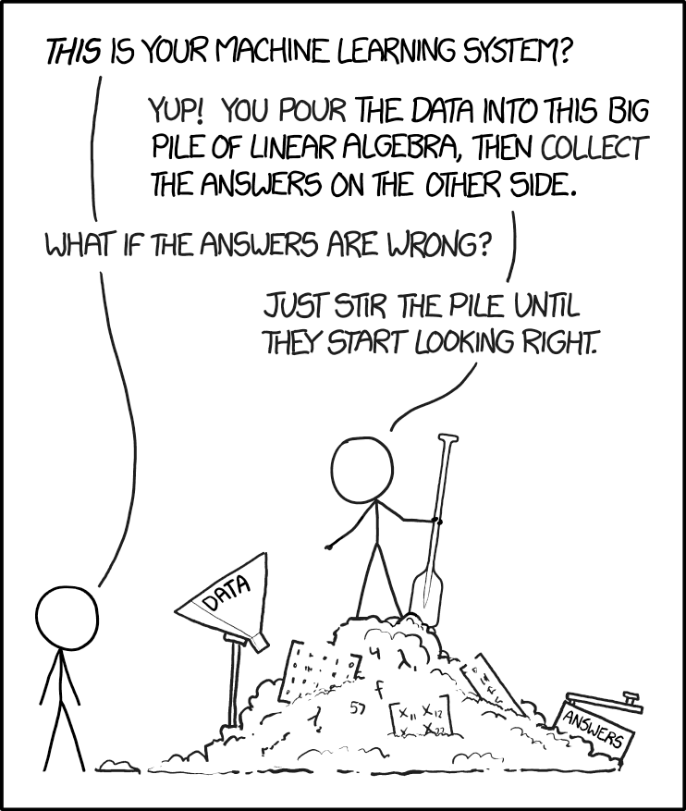
xkcd
Part 3:
Best Practices, Pitfalls & Tricks

Slide 2
An Inconvenient Truth
Deep neural networks comprise millions of parameters: we don’t know what these parameters mean
Most of the time, we don’t know what a NN learns
NN are not suitable to gain “understanding”
Neural networks are black boxes: treat them as such!

Slide 3

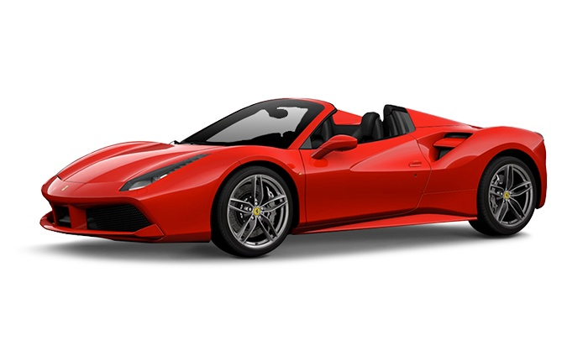
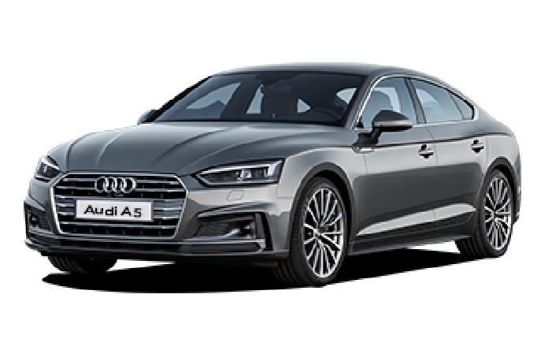
An Inconvenient Truth: Example
Audi (82%)
BMW (91%)
Ferrari (79%)

Slide 4

An Inconvenient Truth: Example
Ferrari (95%)
Ferrari (79%)

Slide 5
An Inconvenient Truth: Example
Training data selection is critical
The NN “learns” your interpretation based on the training data, including observational/operator bias (NN are not unbiased!)
If all Ferraris in the training data are red, and all other cars are not red, then all red objects must be Ferraris!

Slide 6
An Inconvenient Truth
Machine Learning is mostly based on trial-and-error
There is no recipe for good performance, only guidelines
But: more theory is (slowly) being developed

Slide 7
Pitfalls
Bias and class imbalance in training set
Overfitting
Extrapolation beyond training data range
Improper weight initialisation
Excessive learning rates

Slide 8
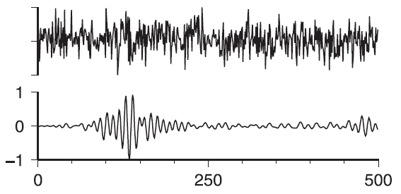
Pitfalls: Class Imbalance
Earthquake detection:
Noise
Earthquake
Valentine & Trampert (2012)

Slide 9
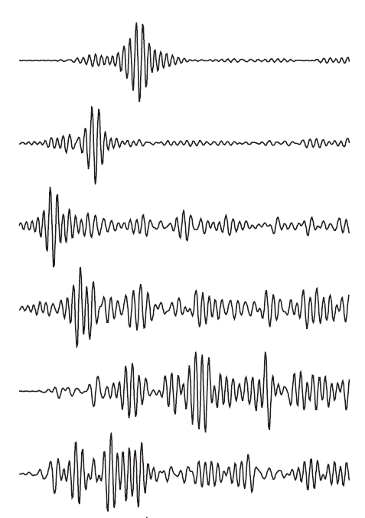
Pitfalls: Class Imbalance
Prediction: noise
Prediction: noise
Prediction: noise
Prediction: noise
Prediction: noise
Prediction: noise
Valentine & Trampert (2012)
99.9% accuracy!

Slide 10

Pitfalls: Overfitting
Good generalisation
Overfitting
Depth
Depth
Pressure
Pressure

Slide 11
Pitfalls: Extrapolation
Most NN architectures have a monotonic response
Beyond the data range the network confidence increases, whereas it should decrease!
Example: predicting large earthquakes based on small ones

Slide 12
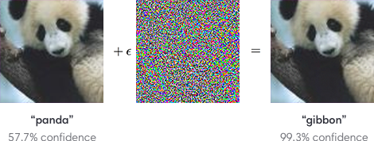
Pitfalls: Extrapolation (Adversarials)
https://openai.com/blog/adversarial-example-research/

Slide 13
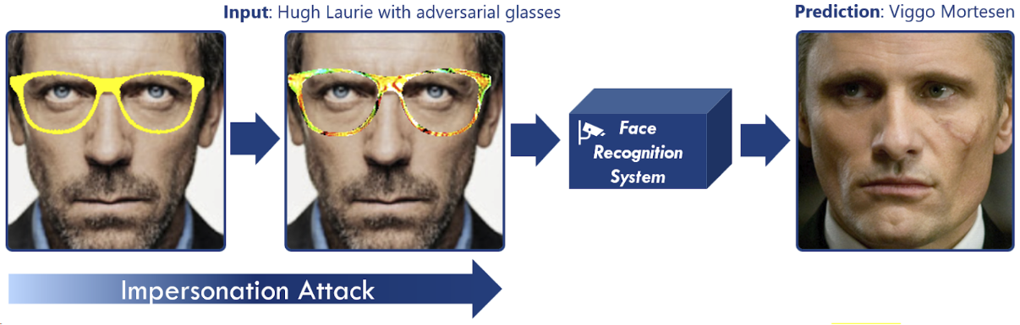
Pitfalls: Extrapolation (Adversarials)

Slide 14
Pitfalls: Initialisation
Weights are initialised by sampling from a random distribution
If variance of every layer output < 1: vanishing gradients
If variance of every layer output > 1: exploding gradients
Solution: sample from random distribution with variance inversely proportional to layer input. This depends on the activation function!
ReLU: “He Normal initialisation” (He et al., 2015)
Sigmoid/tanh: “Xavier/Glorot initialisation” (Glorot & Bengio, 2010)

Slide 15
Pitfalls: Learning Rates
Low learning rate
High learning rate
Loss
Loss
Parameter value
Parameter value

Slide 16
Guidelines
Data representation and network architecture are most important
Bigger networks require more data = manual labour
Training data should be balanced, test data should be representative for real-world application
Training a NN is like turning a key in a lock: it only works if all components fall into place

Slide 17
Best Practices (1/2)
Start with a small network architecture
Before anything else, verify that training/test data is correct!
Try overfitting your data. If that doesn’t work, something is fundamentally wrong (e.g. initialisation)
Scale/shift the input data to have zero mean and a variance of around 1 (see basic MNIST tutorial)
Monitor train/test loss: if training loss decreases but test loss increases, the network is overfitting

Slide 18
Best Practices (2/2)
Monitor training process using TensorBoard. Make quantitative comparison between different “experiments” (architectures, hyperparameters, etc.)
Use Adam’s optimiser, ReLU activation (arguable)
Experiment with regularisation: batch normalisation, layer normalisation, dropout, noise layers (not covered today)
Be patient: if the network/dataset is large, training can take days on a decent GPU

Slide 19
Resources
YouTube
Lectures by Ian Goodfellow, Andrew Ng
Conference talks: e.g. NeurIPS (previously NIPS)
Udacity course (free): “Intro to TensorFlow for Deep Learning”
Competitions: Kaggle.com, DrivenData.org

Slide 20
Time to get really dirty…

