Slide 1
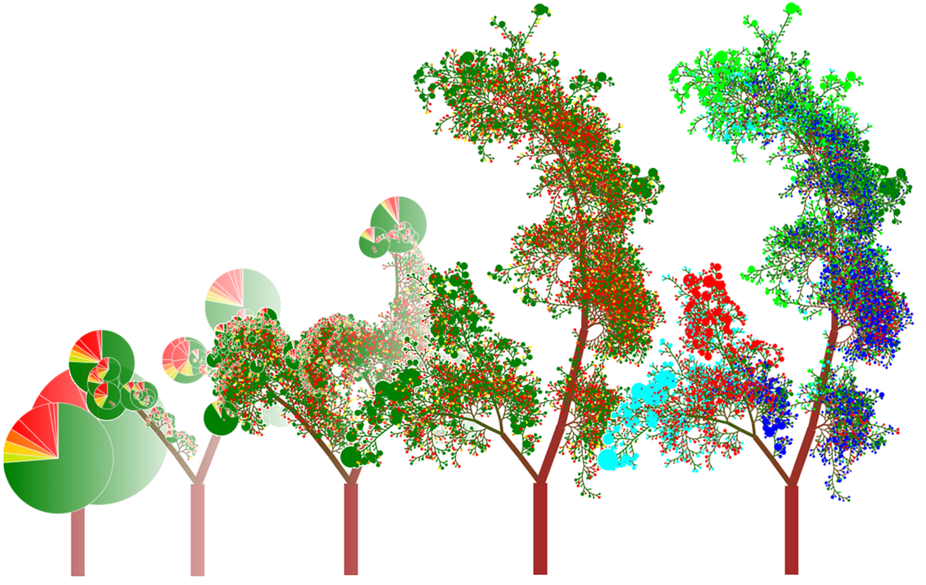
Advanced Workshop on Earthquake Fault Mechanics: Theory, Simulation and Observation (Trieste, 2019)
Random Forests
http://www.rhaensch.de/rfvis.html

Slide 2
AI vs. ML vs. DL
Artificial Intelligence (AI)
Machine Learning (ML)
Chess computers
Computer games
Robotics
Decision policies
Random Forests
Support Vector Machines
Deep Learning (DL)
Neural Networks with many
(up to hundreds) of “layers”

Slide 3
What’s the difference?
Neural Networks make decisions based on… well… something
Random Forests (RF) make decisions based on well-defined rules
RFs are easier to interpret, decision process can be visualised
… but RFs require a particular type of input

Slide 4
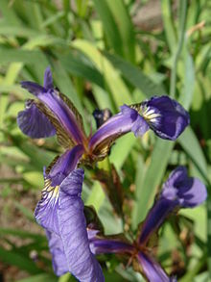
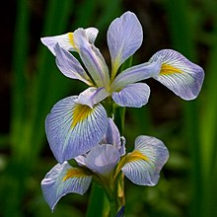

Example: Anderson’s Irises
Iris setosa
Iris virginica
Iris versicolor
Wikipedia

Slide 5
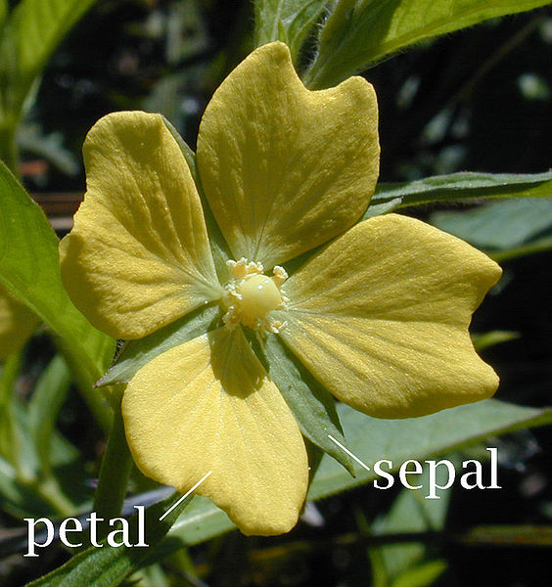
Example: Anderson’s Irises
https://en.wikipedia.org/wiki/Sepal
Sepal width
Petal width

Slide 6
Sepal width
Petal width

Slide 7
Sepal width
Is the petal width < 2 cm?
Yes
No
Petal width

Slide 8
Yes
Sepal width
No
Is the sepal width > 1 cm?
Petal width

Slide 9
Decision Trees
Yes
Is the petal width < 2 cm?
Yes
Is the sepal width > 1 cm?
No
No

Slide 10
Sepal width
Petal width

Slide 11
Sepal width
Is the petal width > 3 cm?
No
Yes
Petal width

Slide 12
Decision Trees
Yes
Is the petal width < 2 cm?
Yes
Is the sepal width > 1 cm?
No
Yes
Is the petal width > 3 cm?
No
No

Slide 13
Sepal width
Petal width

Slide 14
Sepal width
Petal width

Slide 15
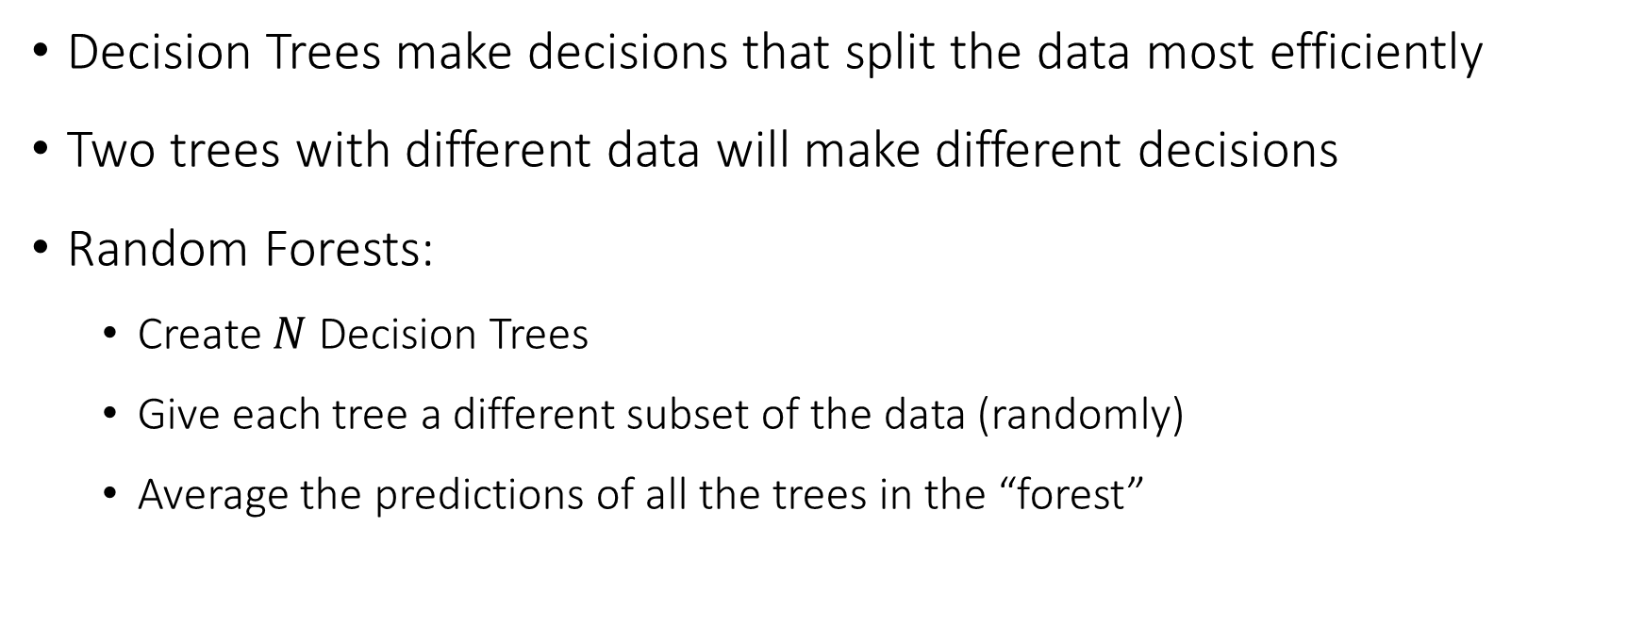
RF: Democracy of Decision Trees
Decision Trees make decisions that split the data most efficiently
Two trees with different data will make different decisions
Random Forests:
Create $N$ Decision Trees
Give each tree a different subset of the data (randomly)
Average the predictions of all the trees in the “forest”

Slide 16
Visualise feature importance
Input data has “features” (sepal width/length, petal width/length)
Which of these features is most important?

Slide 17
Sepal width
Sepal length
Petal width
Petal length

Slide 18
Visualise feature importance
Input data has “features” (sepal width/length, petal width/length)
Which of these features is most important?
With RFs it is possible to “calculate” relative importance of features

Slide 19
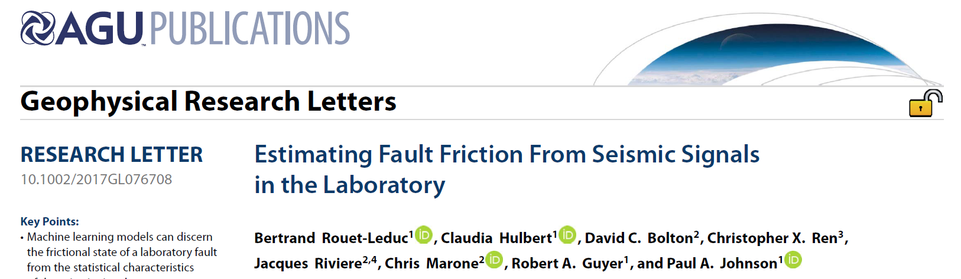
Application of RF

Slide 20
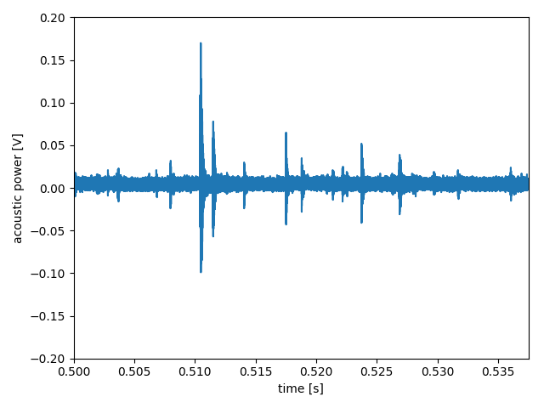
Application of RF

Slide 21
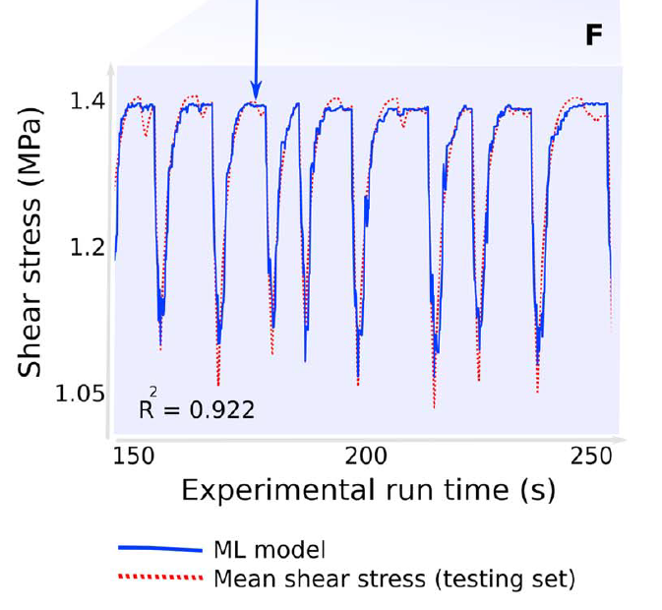
Application of RF
Rouet-Leduc et al. (2018)

Slide 22
RFs only accept “features”
RFs are not suitable to analyse time series data (seismograms, GPS) or higher-dimensional data (spectrograms, images)
Quality of predictions depends on selected features (“feature engineering”)
Interpretation of certain features not always obvious
What is the meaning of the kurtosis of the signal squared?

Slide 23
RF vs DL
Random Forests are more interpretable, and are usually easier/faster to train (+ require less data)
DL facilitates a wide range of architectures to handle different types of data, and are more flexible
Pick the right tool for the job!

Slide 24
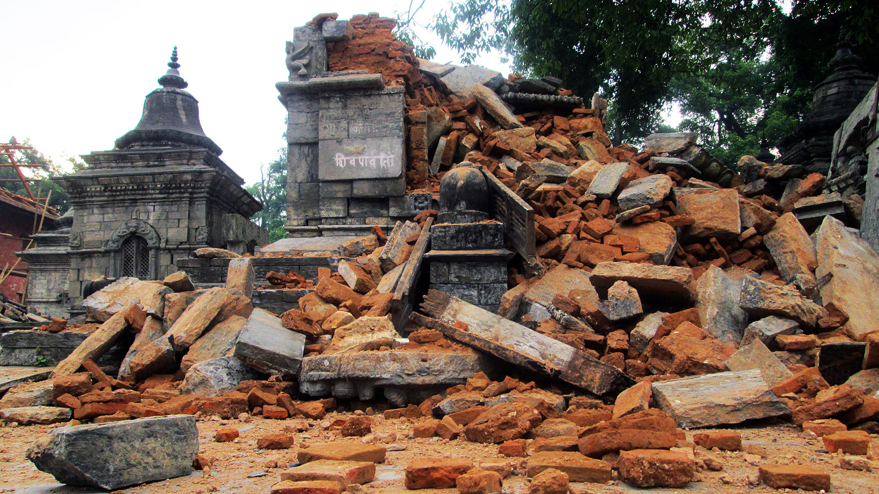
Tutorial: Estimating EQ Damage
After the 2015 Gorkha earthquake (M_{w} 7.8) the Nepalese government initiated a large survey of the structural damage across the country
For each building, the damage was classified as
No/little damage
Moderately damaged
Severely damaged
DrivenData.org

Slide 25
Tutorial: Estimating EQ Damage
In addition, various socio-economical factors were recorded:
Building’s surface area, height, number of floors
Construction materials, foundation type
Primary use (residential, governmental, educational)
Number of families
Etc.

Slide 26

Tutorial: Estimating EQ Damage
DrivenData Challenge:
Given the socio-economical factors (= features), predict the damage class of the building (1, 2, 3)

