Slide 1
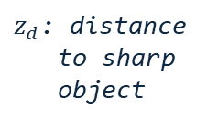

z: distance
to object
$z_{d}$: distance
to sharp
object
lens
l: aperture
f: focal length
focal plane
d: camera constant
image plane
$δ$: diameter
of coc

Slide 2
focal point
circle of confusion
camera

