Slide 1

software engineering for cyber physical systems
Warehouse robots
Ebbe Wertz, Robin Lambreghts and Mathias Houwen

Slide 2
System Architecture
Server
Webbots
Web-UI

Slide 3
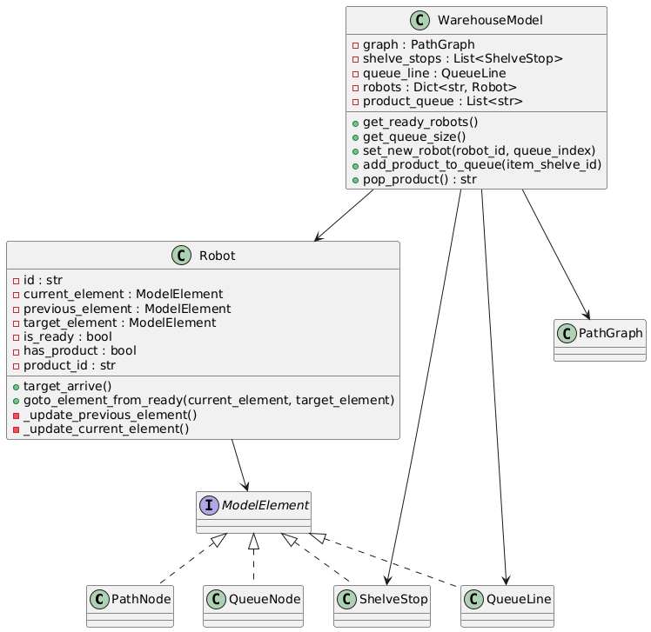
Server Logic & Architecture
Manages logic and communication with robots
Coordinates task flow and robot operations

Slide 4
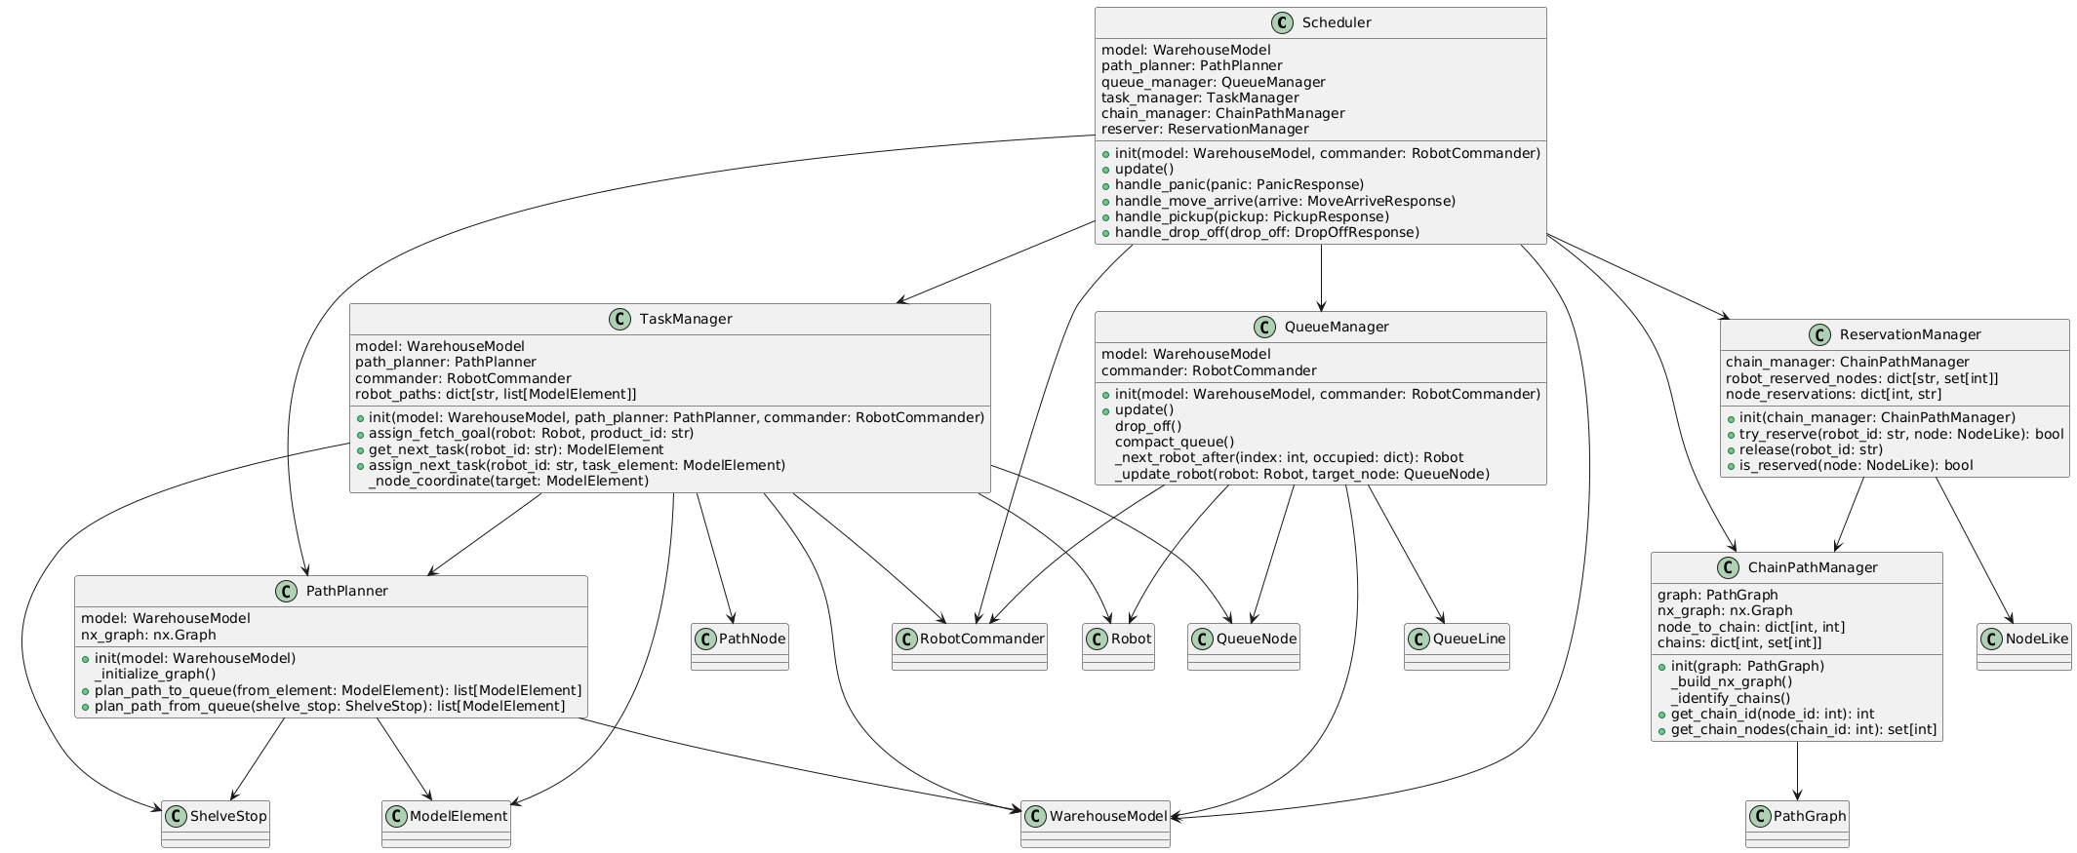
Server Components Breakdown
Scheduler: Task assignment and performance tracking

Slide 5
Server Components Breakdown
Scheduler: Task assignment and performance tracking
QueueManager: Manages queue and robot flow
TaskManager: Assigns tasks and computes paths
PathPlanner: Calculates shortest paths
ReservationManager: Avoids path conflicts
RobotCommander: Communicates with robots via MQTT
ChainPathManager: Groups unbranched path sections to avoid robot trapping and enable atomic reservation of corridors

Slide 6
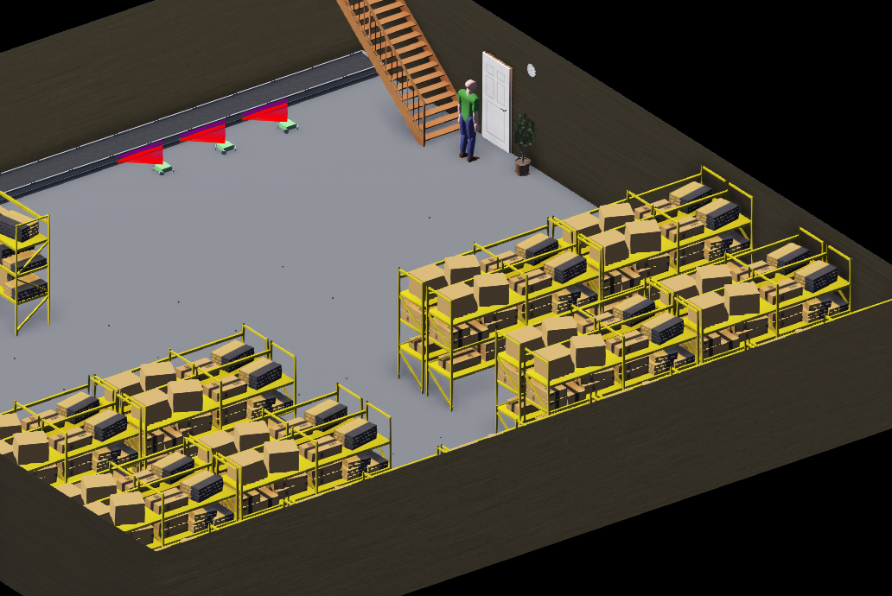

Webots Simulation
Simulates warehouse layout with node markers (black dots)
Visual computing for position correction

Slide 7
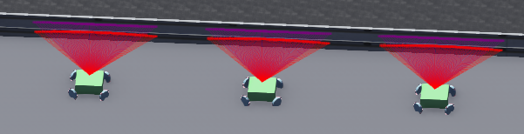
Robot Design & Features
Main platform with 4 omniwheels
Uses omniwheel kinematics to move in all directions
Lidar sensor for object detection
Color sensor for node alignment

Slide 8
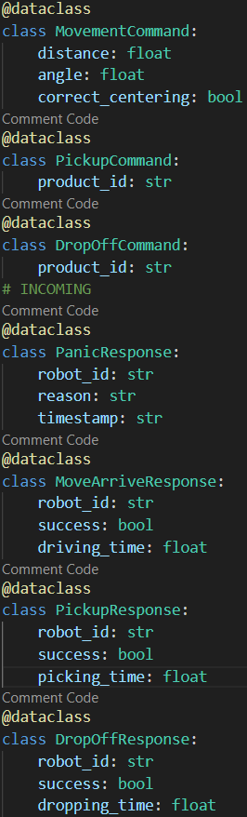
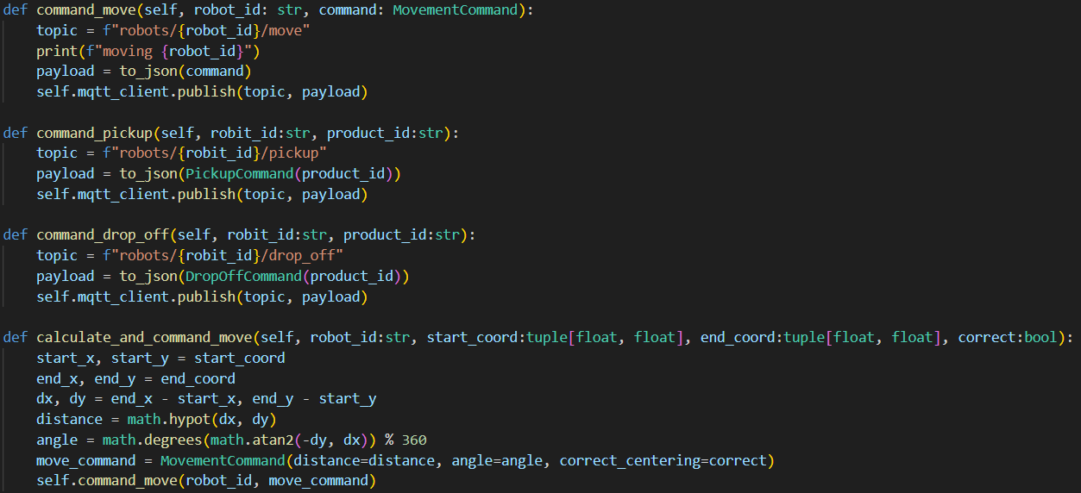
Robot Communication
RobotController subsrib es to MQTT topcis
Commands sent by RobotCOnmmander
Pani messages triggerd by robot

Slide 9
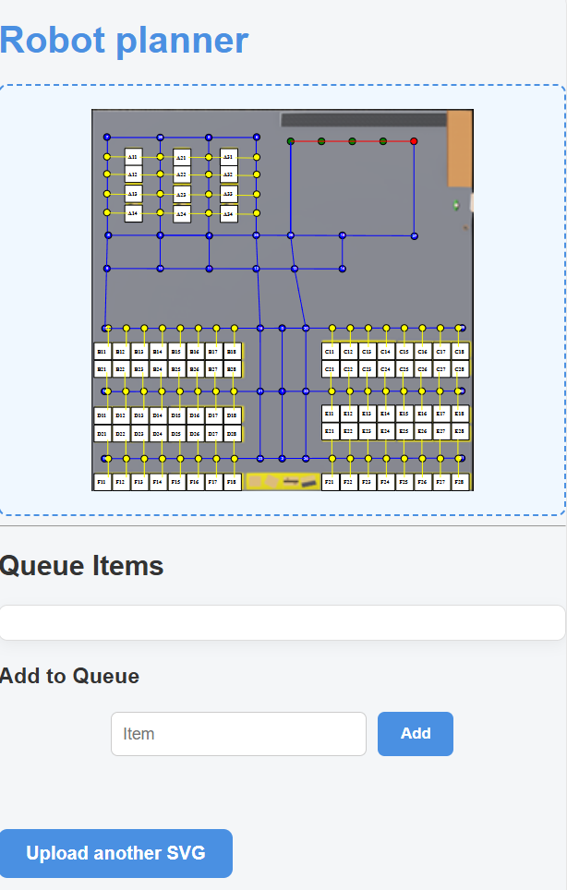
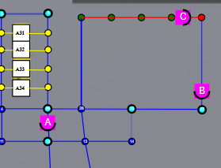
WEB-UI
Upload SVG
Display occupied nodes and edges
Add Queue items

Slide 10
Are there any questions?

