Slide 1
RESULTS
ResNet
Does the masking benefit seen for VGG transfer to residual architectures?
ResNet-18 (basic blocks) · ResNet-50 (bottleneck) · CIFAR-100 · iDLG baseline vs. layer-wise masking

Slide 2
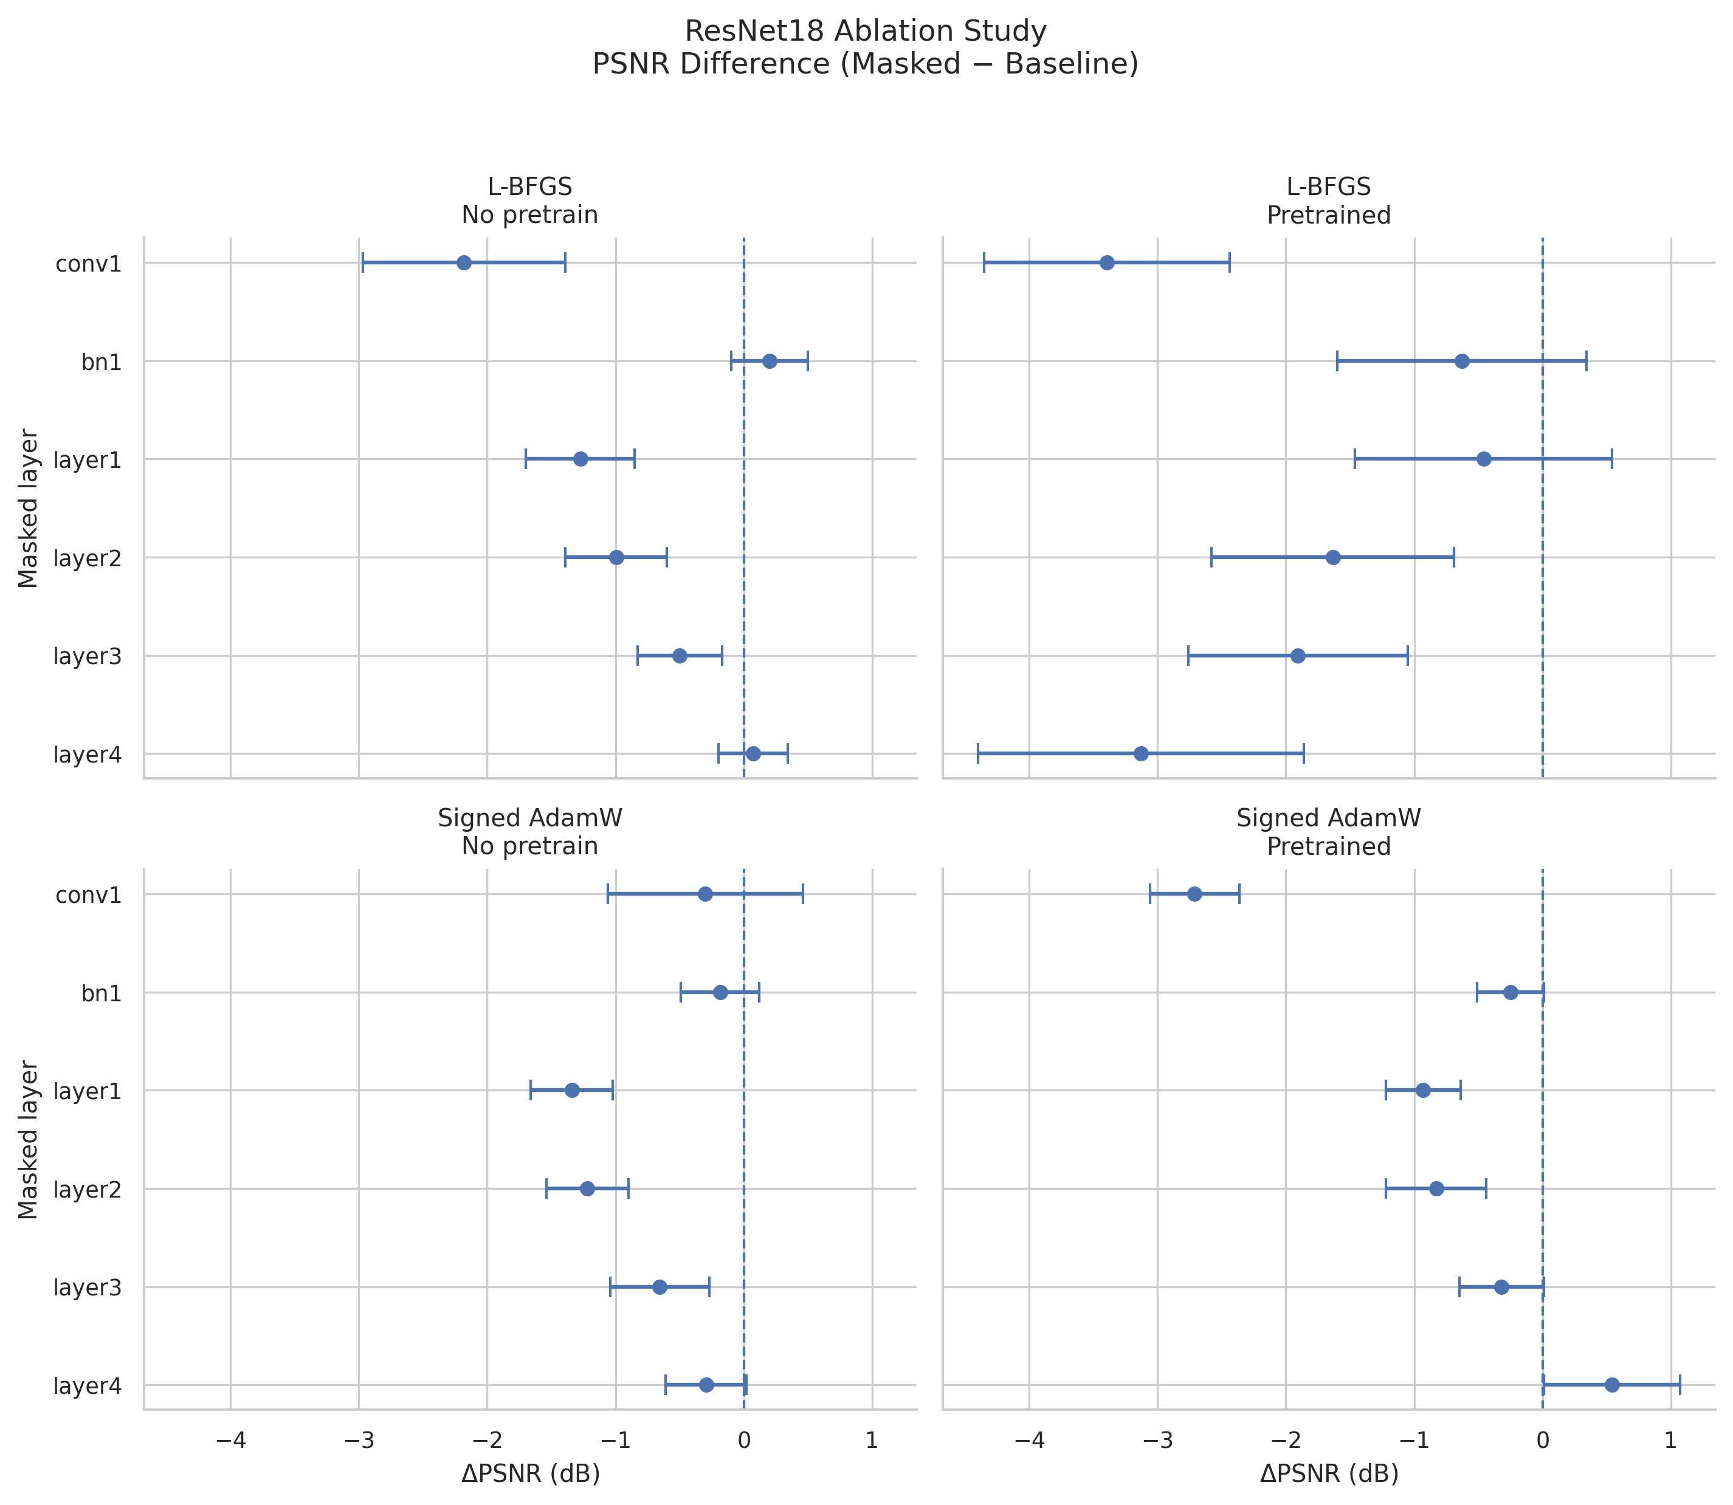
RESNET — LAYER-WISE MASKING
Masking does not help — the inverse of VGG
— Leave-one-layer-out, all four optimizer / pretraining settings.
• Non-pretrained: no single-layer mask improves reconstruction — every clear effect is a degradation.
— conv1 is the most damaging layer to mask.
• L-BFGS: PSNR 17.53 → 15.23 dB (−2.3 dB), SSIM 0.54 → 0.32 (−41%).
• bn1 stays near baseline; batch-norm is neutral at batch size 1.
— Pretraining barely shifts the pattern.
• conv1 drop deepens to −3.1 dB (17.46 → 14.41 dB).
• Only layer4 under Signed AdamW is marginally positive (15.05 → 15.43 dB) — a lone exception.
— ResNet-50 reproduces the same qualitative pattern.
ResNet-18, CIFAR-100: ΔPSNR (masked − baseline). Left of the dashed line = worse.
Stabilizing Gradient Inversion in Federated Learning · ResNet results
2

Slide 3
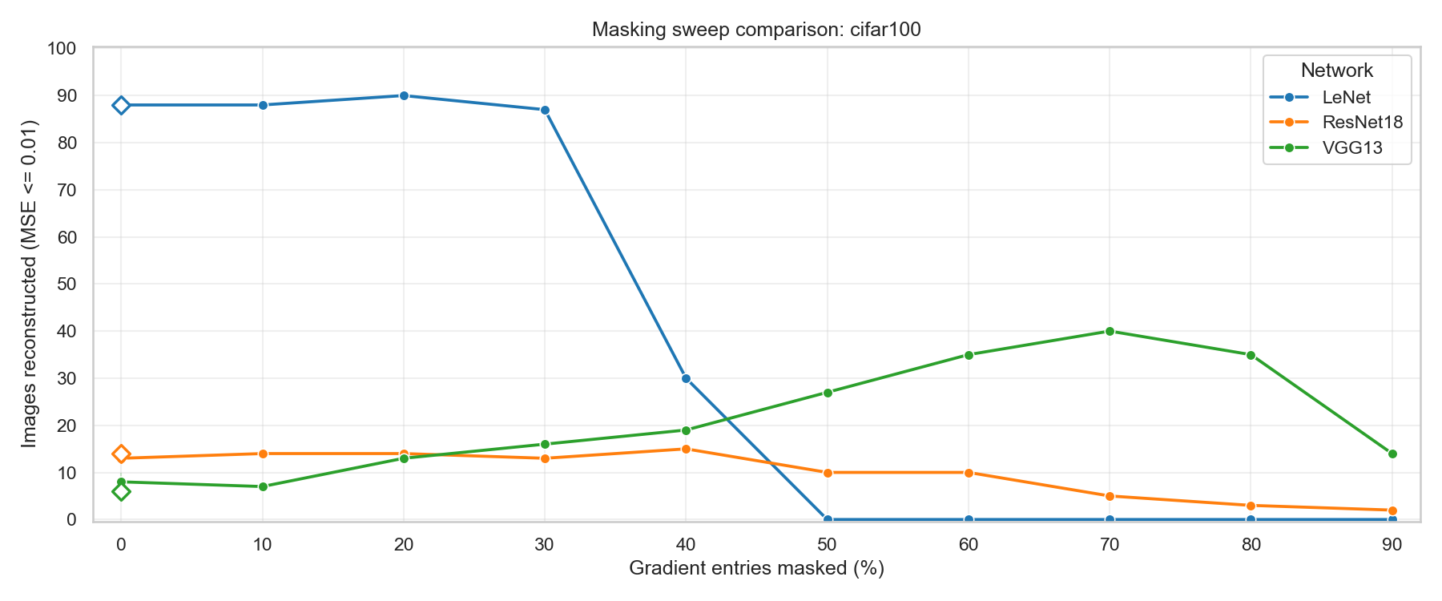
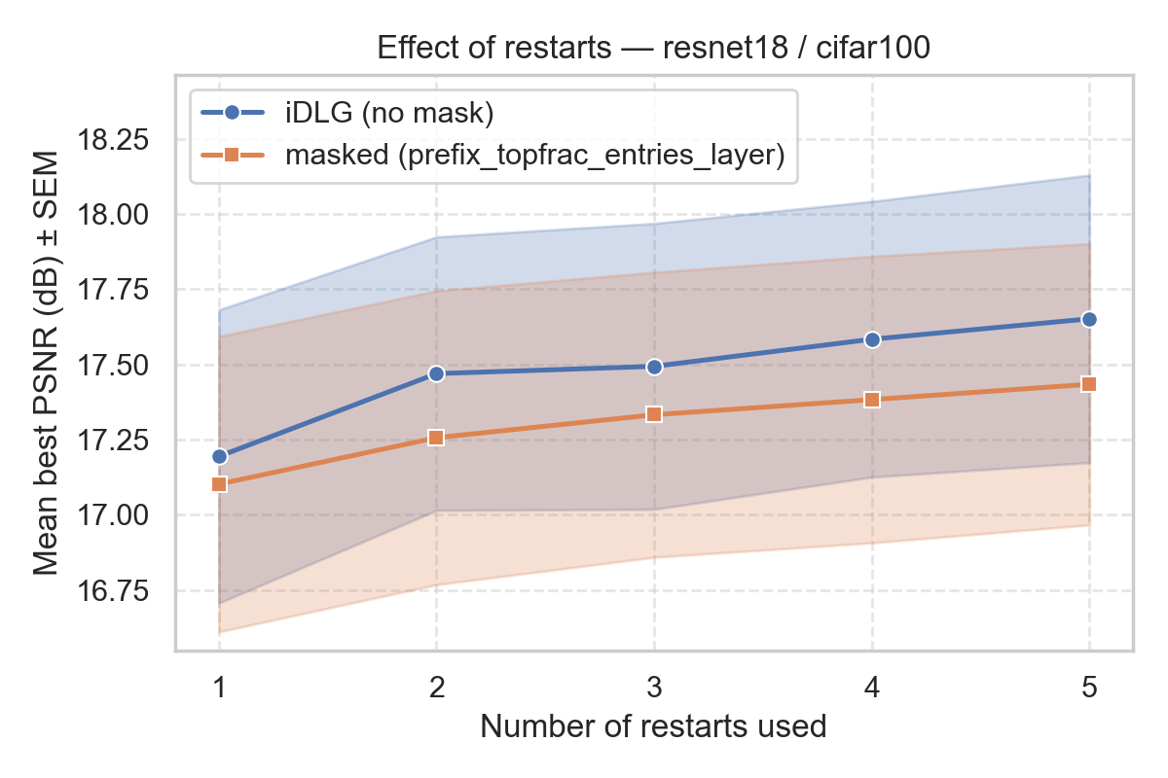
RESNET — ROBUSTNESS CHECKS
The absence of benefit is architectural
— Masking-percentage sweep (top).
• ResNet-18 stays flat and trends down — peaks at only 15 / 100 images near 40% masking.
• Contrast: VGG-13 climbs to 40 / 100 at 70% masking.
— Random restarts (bottom).
• k = 1 → 5 restarts; keep the lowest-loss run.
• Masked run never overtakes the unmasked baseline (gap 0.09 → 0.22 dB).
— So it is not a bad-initialization artifact — even with equal restart budget, masking does not win.
Stabilizing Gradient Inversion in Federated Learning · ResNet results
3

Slide 4
RESNET — INTERPRETATION
Why residual networks resist masking
— The information is present — not missing.
• ResNet-18 and ResNet-50 reach full column rank (d = 3,072) under both entry-selection modes → gradients still encode enough independent constraints on the input.
— Skip connections distribute gradient information.
• Earlier activations re-enter later blocks, spreading input-relevant signal across many residual paths. Removing a whole layer group discards useful constraints along with any poorly conditioned ones.
— It is not parameter count.
• On the convolutional backbone that constrains the pixels, the two are comparable (~9.4 M VGG-13 vs. ~11.5 M ResNet-18); ResNet just lacks VGG’s large maskable FC classifier.
Takeaway: for ResNet, masking offers no consistent benefit — but the failure reflects the difficulty of isolating disruptive components in a residual architecture, not an absence of recoverable information.
Stabilizing Gradient Inversion in Federated Learning · ResNet results
4

