Slide 1
METHODS
Gradient masking & statistical evaluation
How we remove gradient components — and how we compare reconstructions rigorously.
Within-image paired design · leave-one-layer-out ablation · Shapiro–Wilk normality testing

Slide 2
METHODS — GRADIENT MASKING
What masking is, and why it might help
— Inversion matches the observed gradient by optimization — but not all gradient entries help equally.
• Some carry useful input information; others add poorly conditioned optimization directions.
— Masking = selectively removing subsets of the gradient before reconstruction.
• Fewer gradients to match + potentially better numerical conditioning.
— The central tradeoff.
• Removing entries can ease optimization, but also removes information — masking must drop redundant / poorly conditioned entries while preserving independent constraints.
— Diagnostic use: if a smaller subset reconstructs better than the full gradient, the information was present but hard to extract.
Necessary condition
Reconstruction needs the gradient Jacobian J(x)=∂g/∂x to have full column rank (rank = d = 3,072 for 3×32×32).
n ≥ d is necessary but not sufficient — entries can be linearly dependent. Rank is verified after masking (Sec. 5.1).
So observed PSNR differences reflect optimization conditioning, not lost information.
Stabilizing Gradient Inversion in Federated Learning · Methods
2

Slide 3
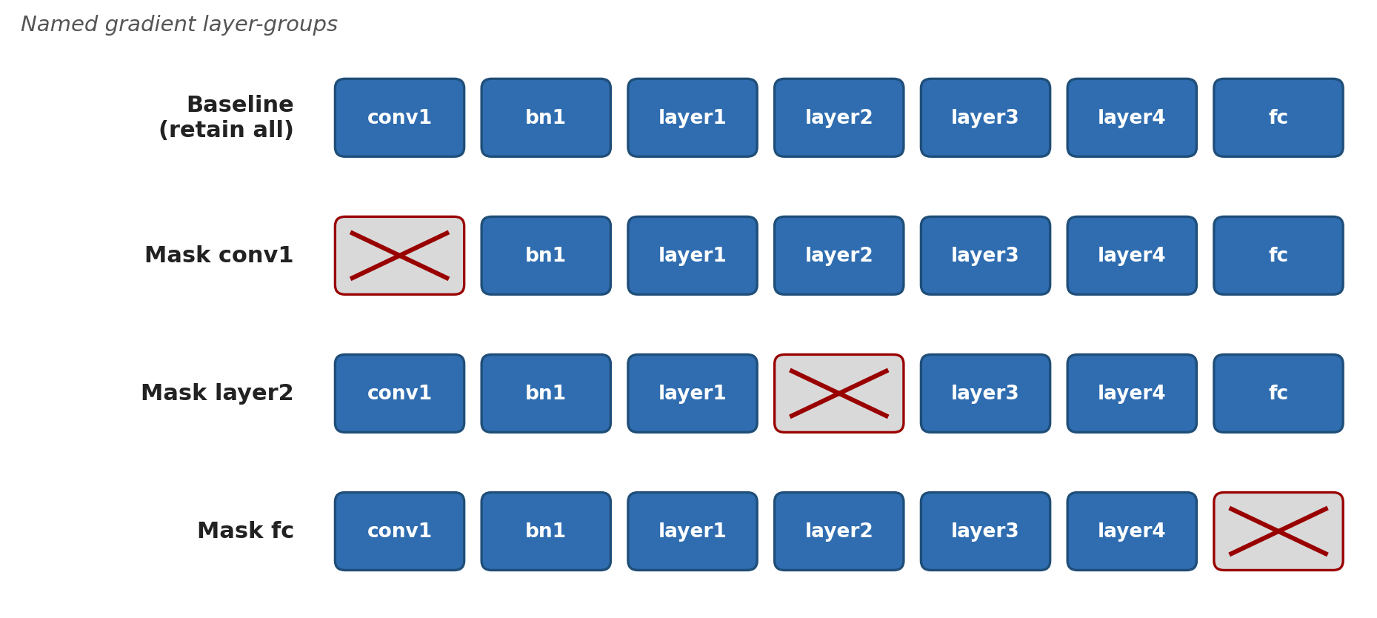
METHODS — GRADIENT MASKING
How we mask: paired design & two modes
— Paired, within-image design.
• Same image, same network init: baseline vs. masked differ only by masking. Label fixed via iDLG, batch size 1.
— Layer-wise ablation.
• prefix_topfrac_entries_layer, fraction 1.0 → binary leave-one-group-out. 30 CIFAR-100 images × 4 settings (2 loss/optimizer × 2 weight regimes).
— Masking-percentage sweep.
• gradsize_topfrac_entries_layer: keep the top fraction f of entries by |gradient| within each tensor; vary f. 100 CIFAR-100 images.
Leave-one-layer-out ablation: baseline retains all groups; each masked run excludes exactly one.
Stabilizing Gradient Inversion in Federated Learning · Methods
3

Slide 4
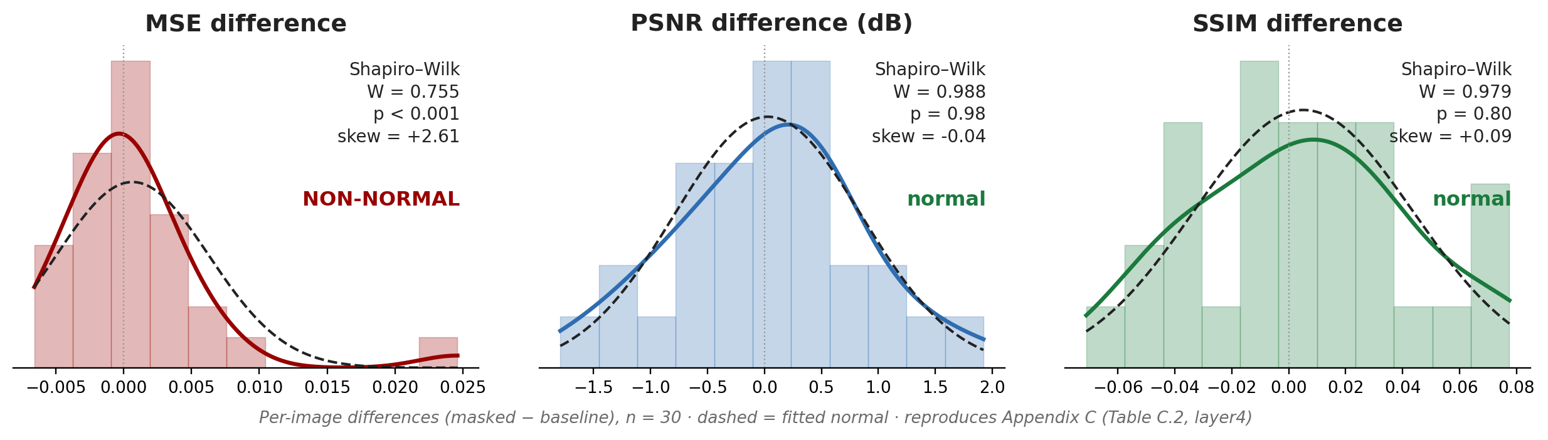
METHODS — NORMALITY TEST
Can we use parametric statistics?
— Paired per-image difference is the unit of analysis.
• dᵢ = PSNR_masked − PSNR_baseline on the same image i.
— A paired t-test would assume the dᵢ are normal — but reconstruction difficulty varies wildly across images.
• Normality is assessed, not presumed.
— Shapiro–Wilk test, α = 0.05.
• Applied to PSNR, MSE and SSIM differences per configuration; W ∈ (0,1], values near 1 = consistent with normality.
— Metric choice matters (see right).
• MSE ≥ 0 is right-skewed; PSNR’s log10 compresses the tail, so it is more likely to pass the test.
Real data: ResNet-18, mask = layer4, n = 30. Per-image differences (masked − baseline); reproduces Appendix C.
Stabilizing Gradient Inversion in Federated Learning · Methods
4

Slide 5
METHODS — NORMALITY TEST
Outcome and consequence
— Normality is rejected for almost all configurations.
• Per-condition Shapiro–Wilk p-values are tabulated in Appendix C; MSE differences fail most often (frequently p < 0.001), PSNR passes more often as expected from the log transform.
— Small samples contribute.
• With only 30 paired differences per condition, a few outlying images pull the distribution away from normality and the test has limited power against mild deviations.
— Independence holds by construction.
• Each dᵢ comes from a distinct image with an independently initialized network.
Consequence: the paired t-test assumption does not hold, so results are reported with descriptive statistics (mean ± SD) and box / violin plots rather than parametric p-values.
Stabilizing Gradient Inversion in Federated Learning · Methods
5

