Slide 1
BLACKROCK-INC-11862
BlackRock, Inc. is among the main world asset managers. At the end of 2023, the
group has 10,009 bills of assets under management distributed by type of assets
between shares (52.9%), fixed income securities (28%), multi-active investments
(8.7%), alternative funds (2.8%) and others (7.6%)., 'The geographical
distribution of the CA is as follows: Americas (66.6%), Europe (29.2%) and Asia-
Pacific (4.2%).'Capitalization, business value, turnover, EBITDA, EBIT, EBT, net
profit, net debt and cash, free cash flow, equity, total assets and CAPEX are in
millions. The benchmark of the dividend scores is made up of the following
tickers;KO,JNJ,XOM,MMM,ITW,PM,IBM,ED,O,PG,EPD,BLK,VZ,NWN

Slide 2
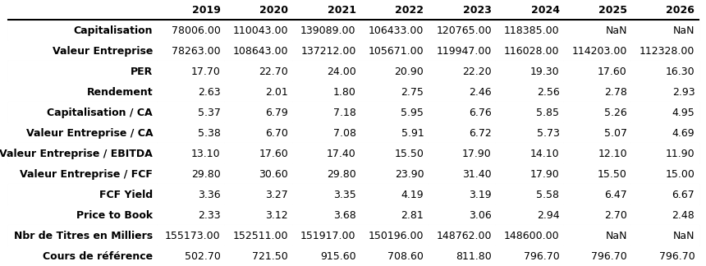
Array 1

Slide 3
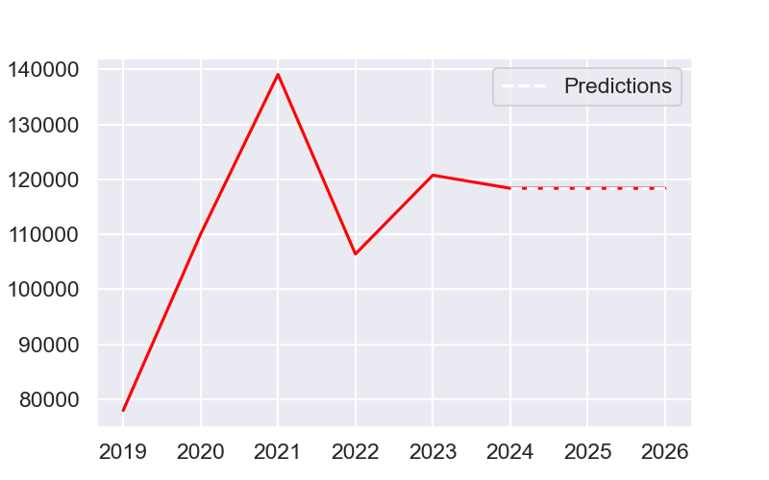
Capitalization

Slide 4

Business value

Slide 5
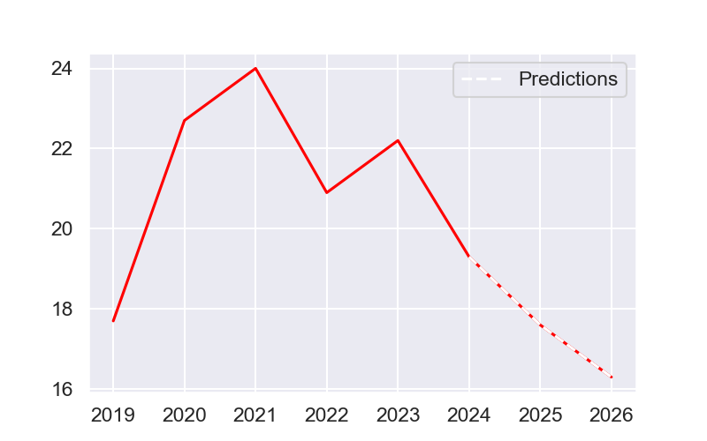
Per

Slide 6
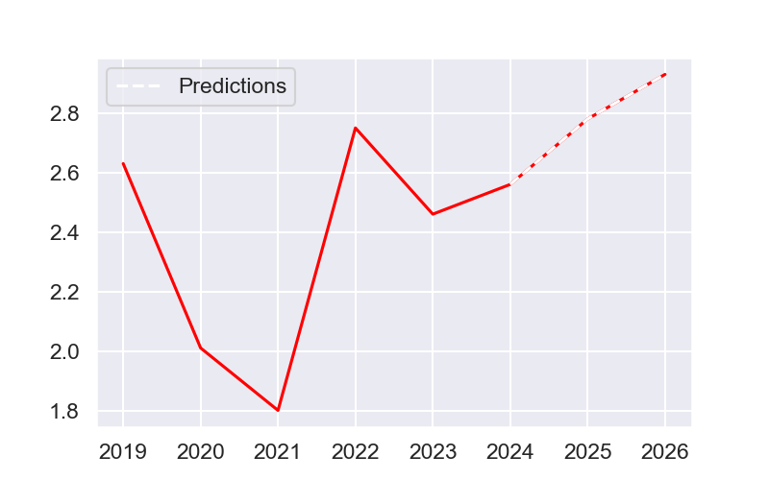
Yield

Slide 7
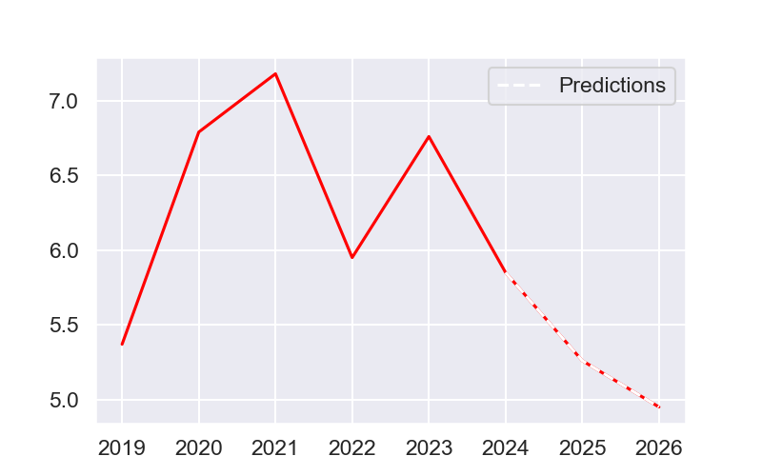
Capitalization / CA

Slide 8
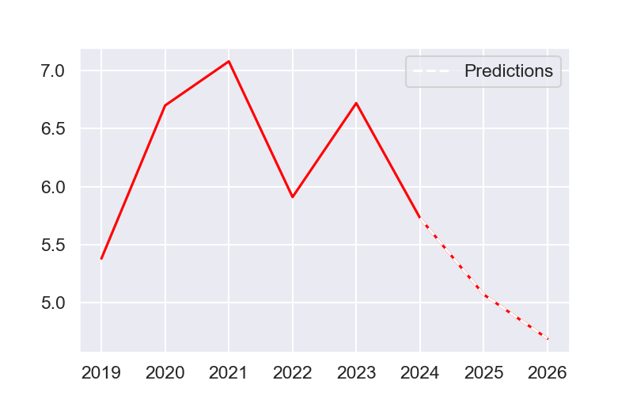
Business value / CA

Slide 9
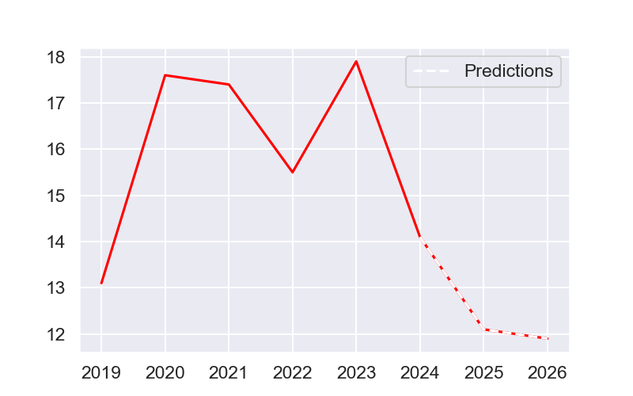
Business value / EBITDA

Slide 10
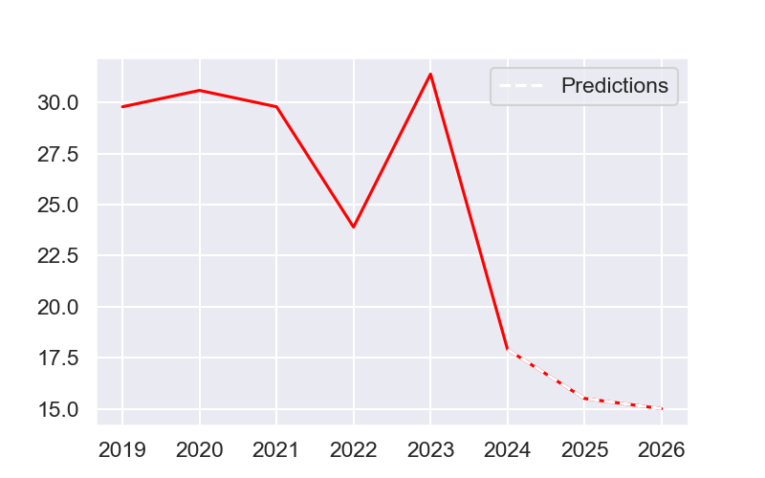
Business value / FCF

Slide 11
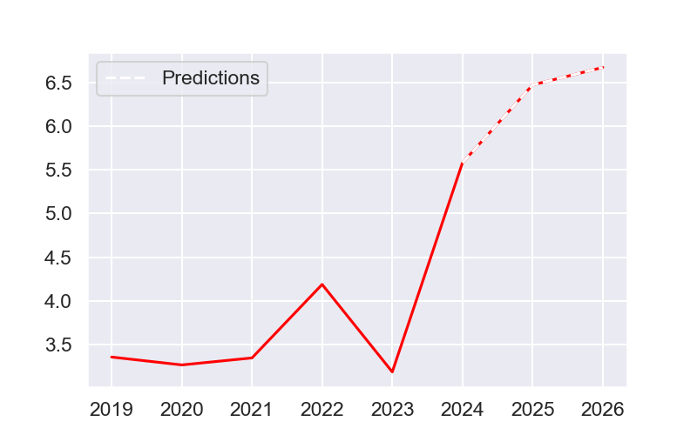
FCF Yield

Slide 12
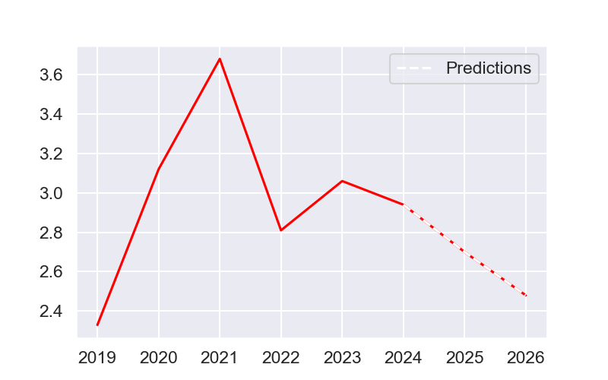
Price to book

Slide 13
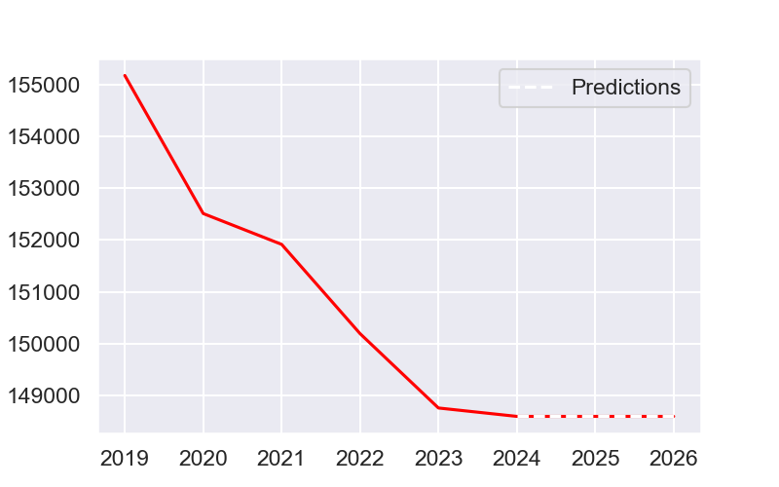
Nbr of titles in thousands

Slide 14
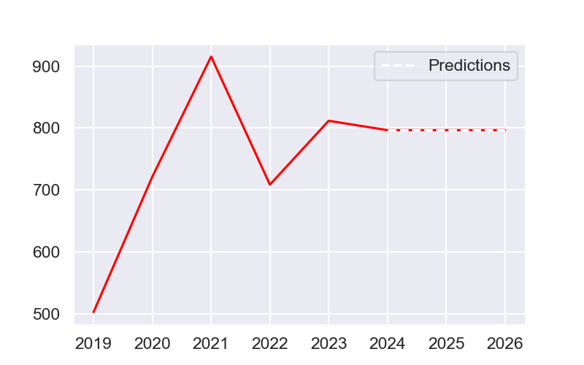
Reference course

Slide 15
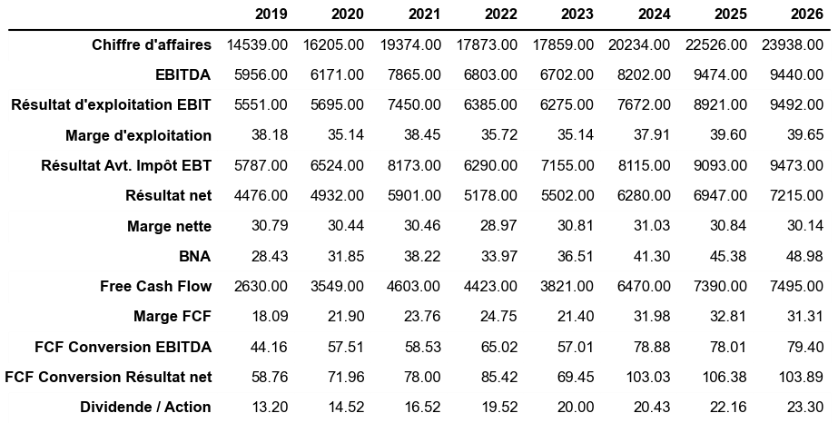
Array 2

Slide 16
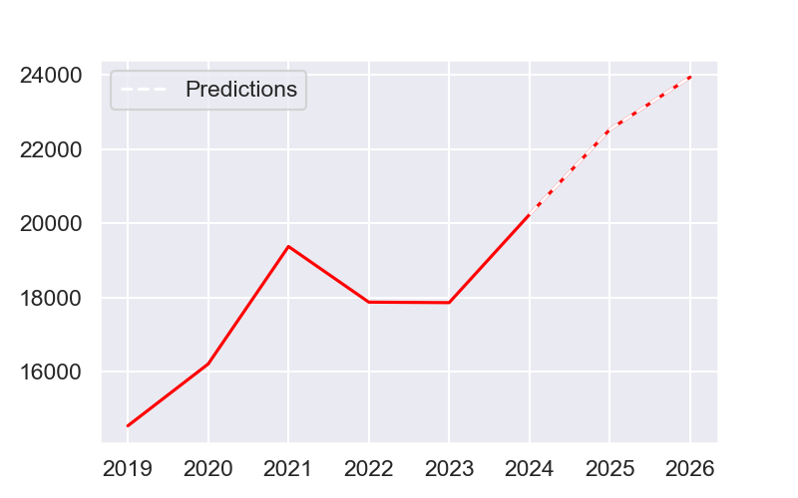
Turnover

Slide 17
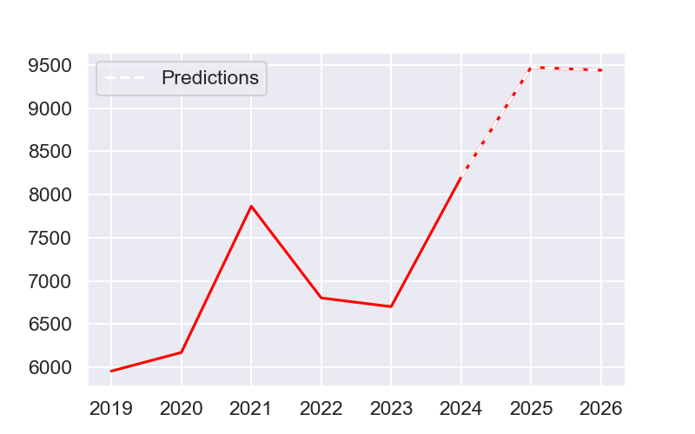
EBITDA

Slide 18
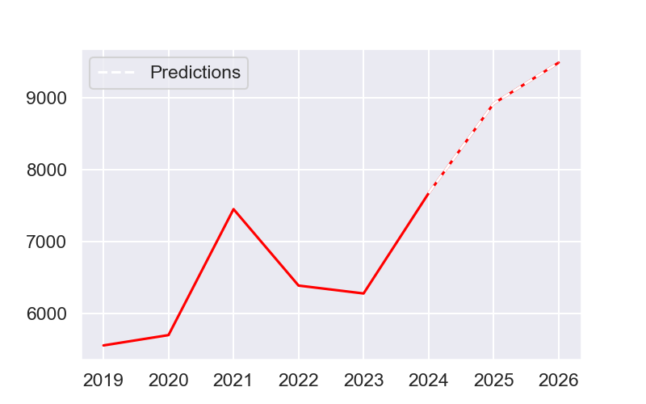
EBIT operating profit

Slide 19
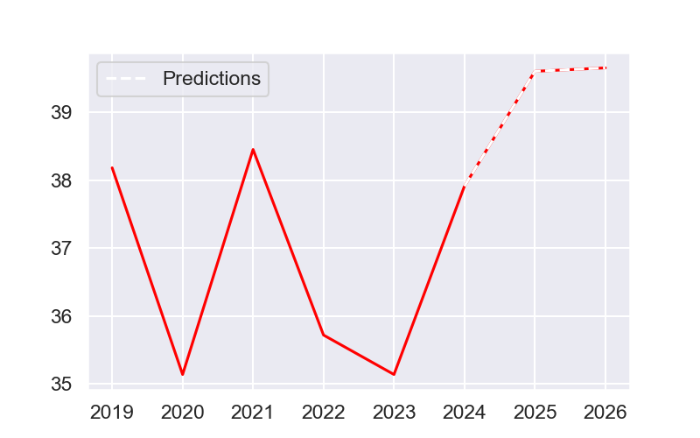
Operating margin

Slide 20
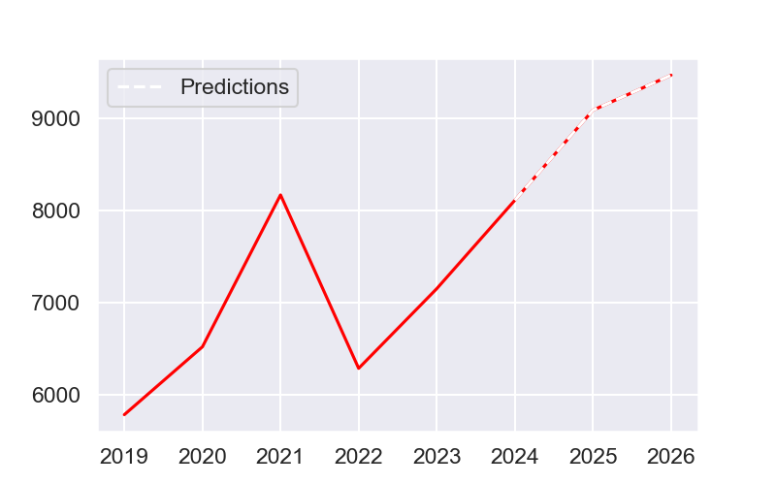
AVT result.EBT tax

Slide 21
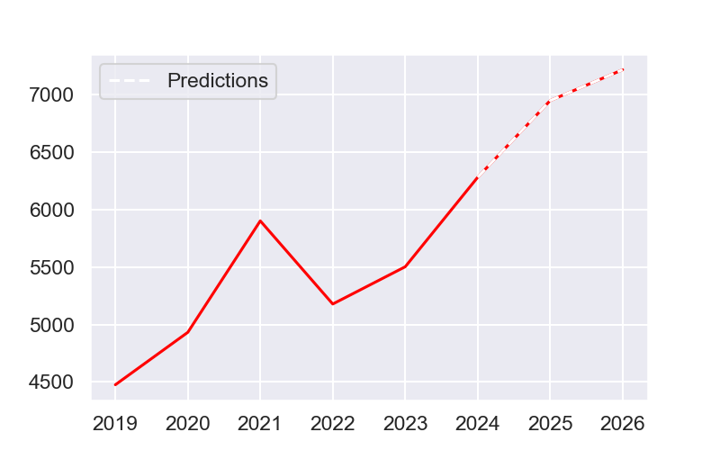
Net profit

Slide 22
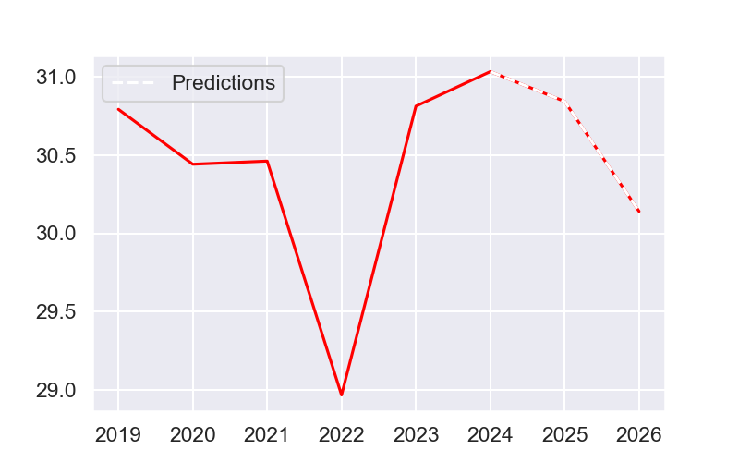
Net margin

Slide 23
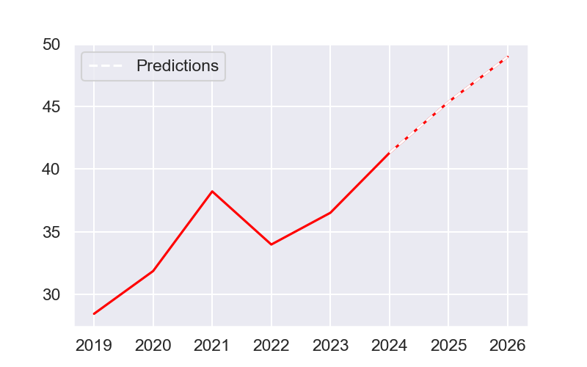
Bna

Slide 24
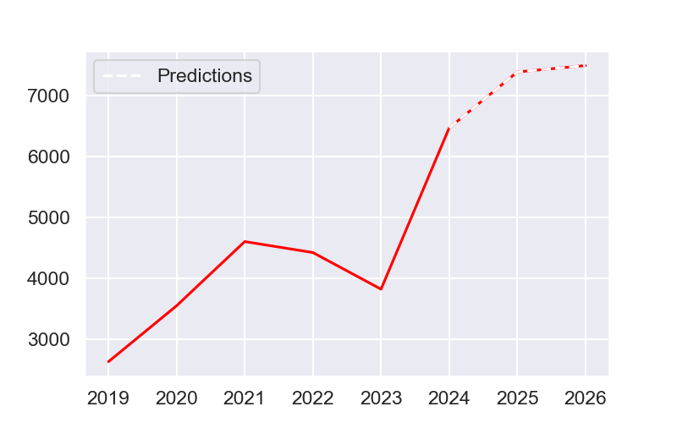
Free cash flow

Slide 25
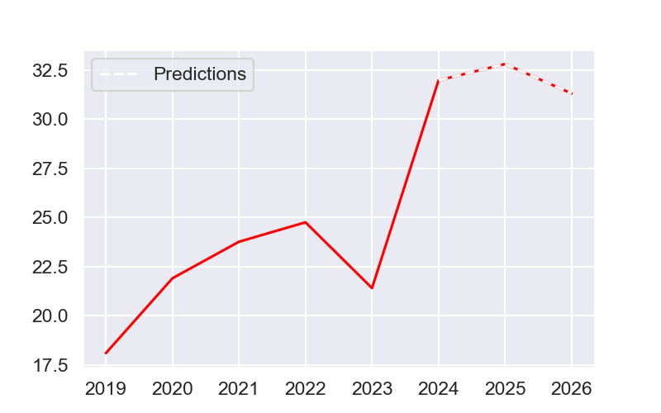
FCF margin

Slide 26
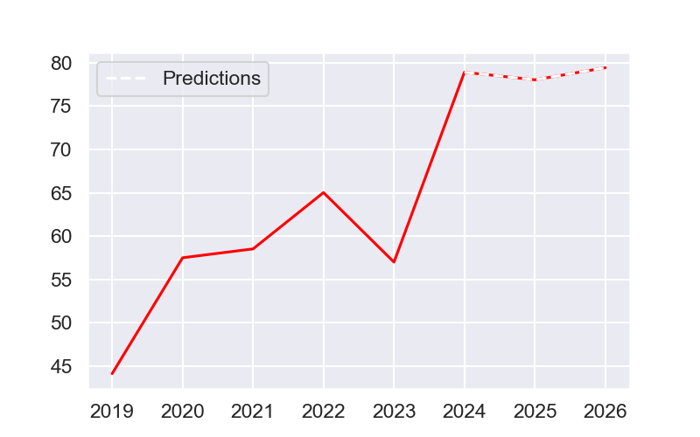
FCF Conversion EBITDA

Slide 27
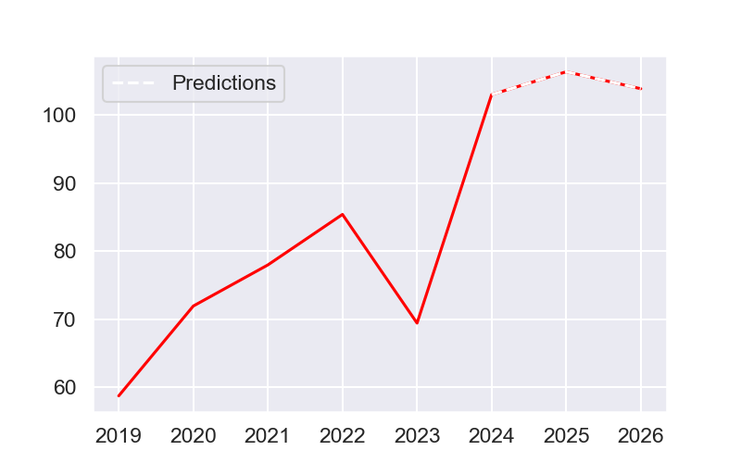
FCF Conversion Net Result

Slide 28
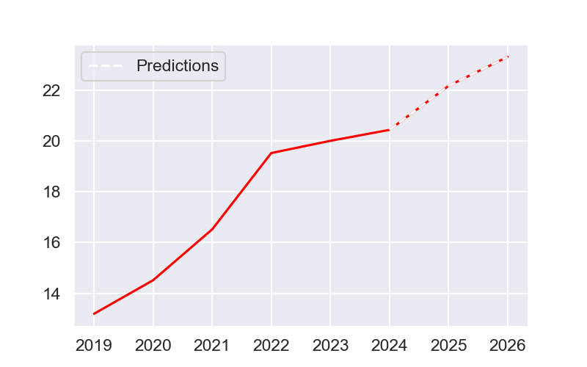
Dividend / Action

Slide 29
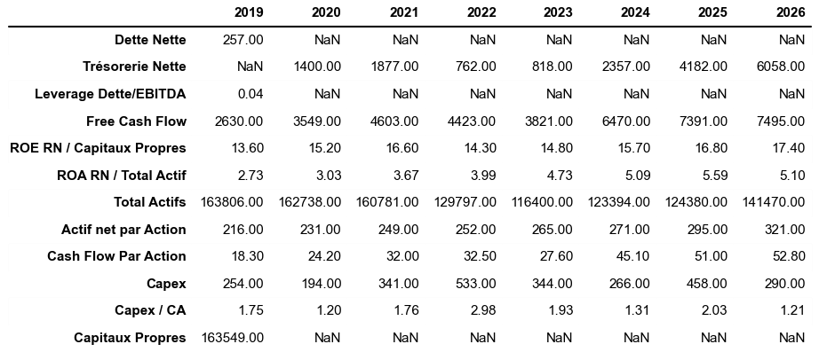
Array 3

Slide 30
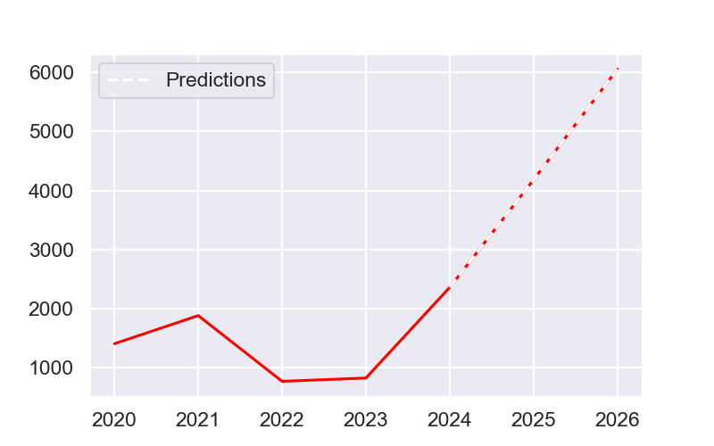
Net cash

Slide 31

Free cash flow

Slide 32
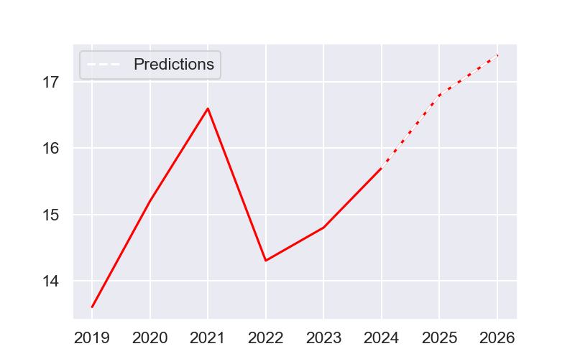
ROE RN / Equity

Slide 33
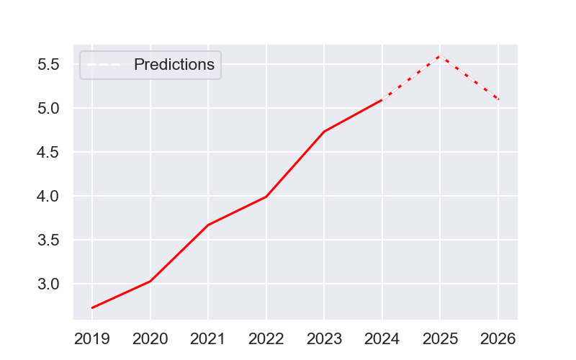
ROA RN / TOTAL Active

Slide 34
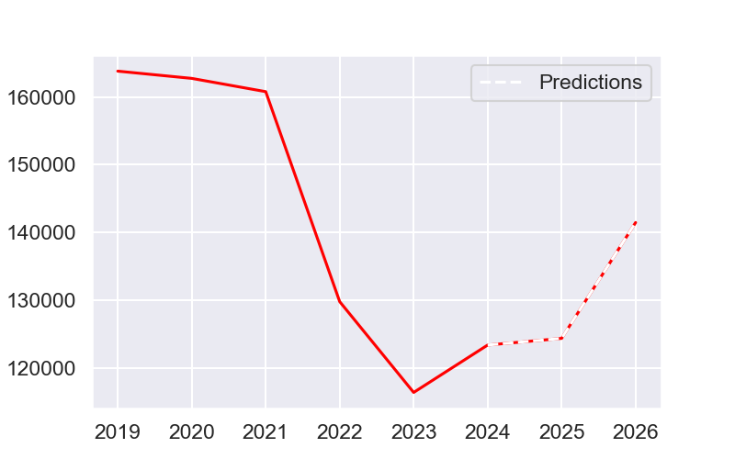
Total active

Slide 35
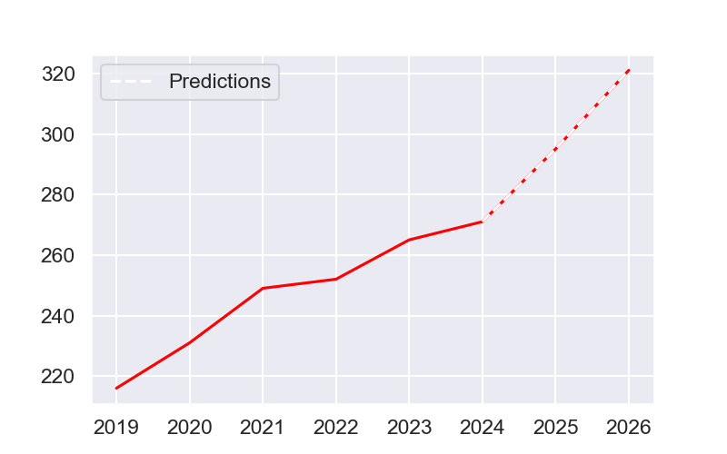
Net assets per share

Slide 36
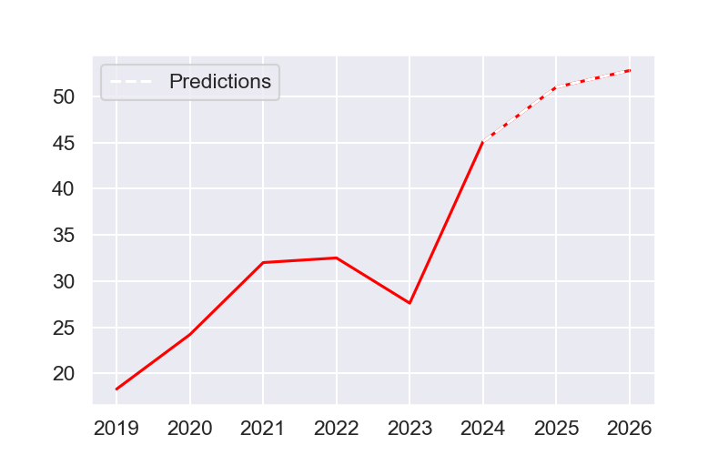
Cash flow by action

Slide 37
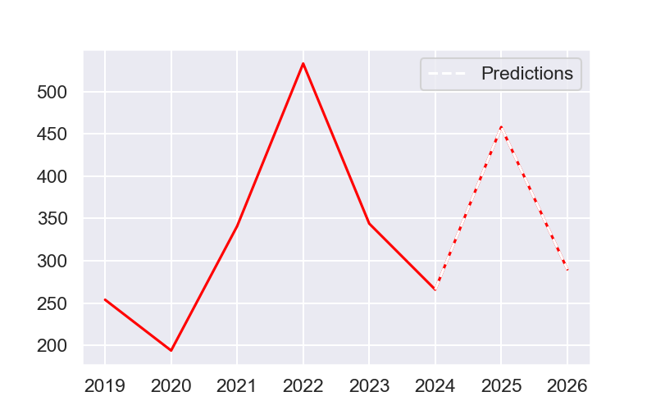
Capex

Slide 38
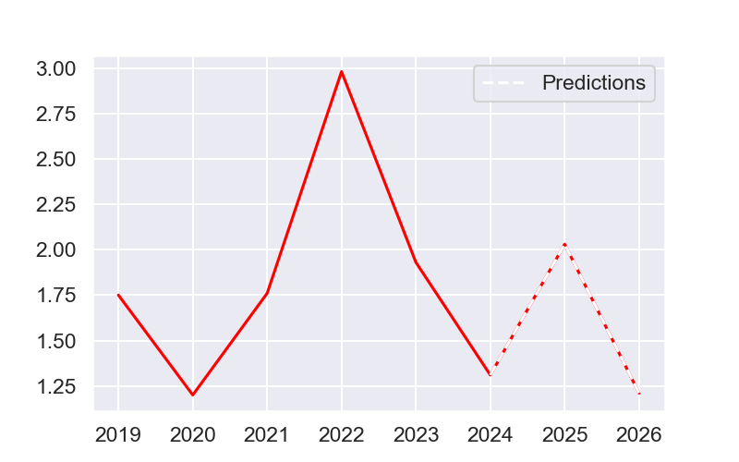
CAPEX / CA

Slide 39
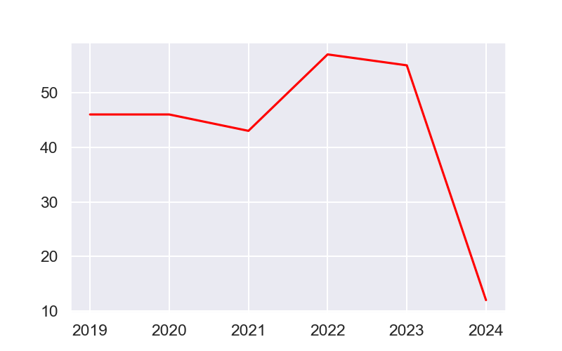
Pay out ratio

Slide 40
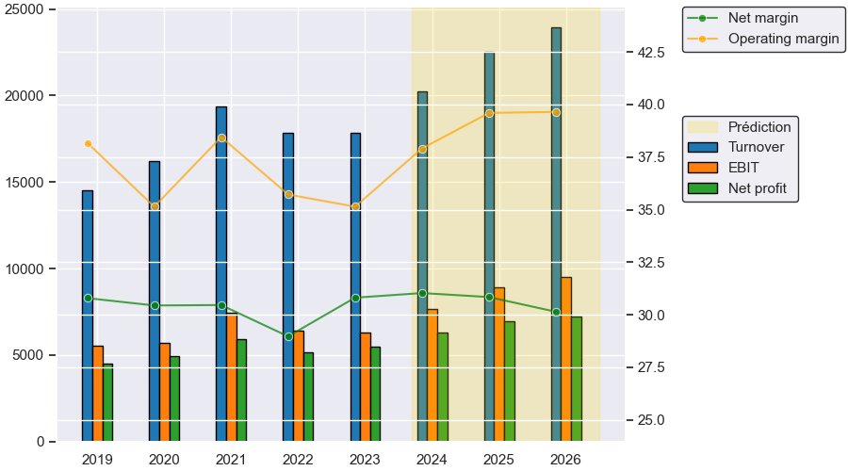
Evolution of the annual income statement

Slide 41
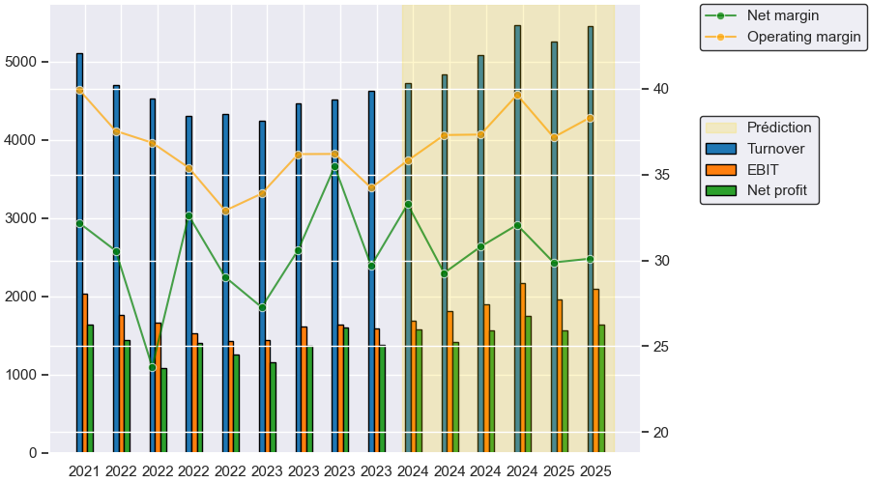
Evolution of the quarterly income statement

Slide 42
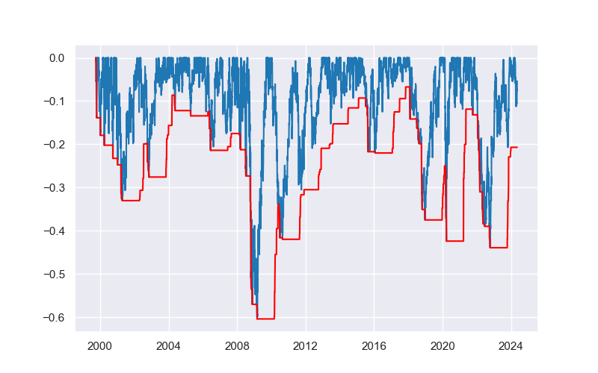
Maximum_loss.png

Slide 43
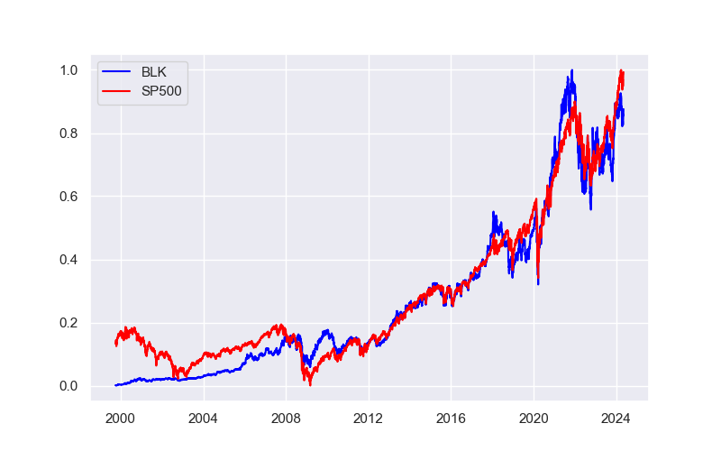
Normalized stocks price :BLK vs SP500

Slide 44
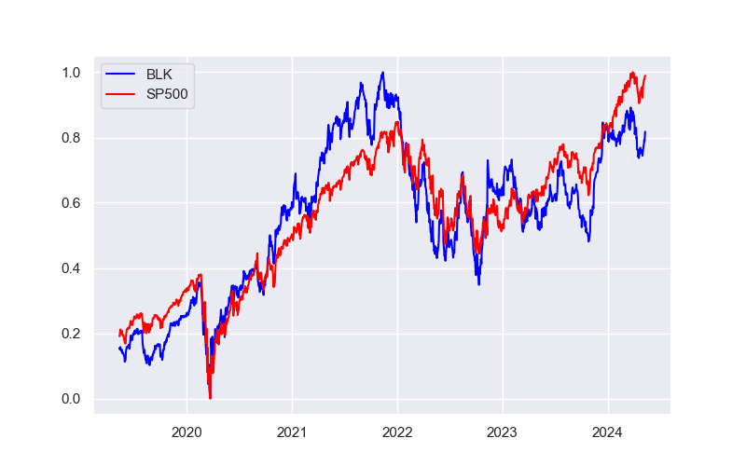
Normalized stocks price :BLK vs SP500 5 years

Slide 45
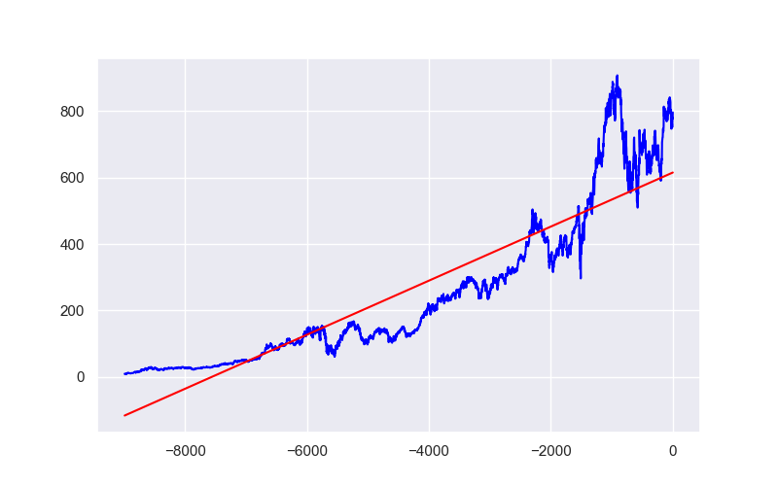
Linear regression

Slide 46
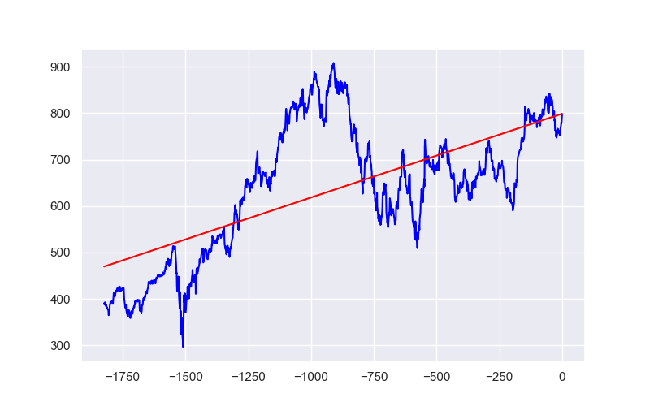
Linear regression five years

Slide 47
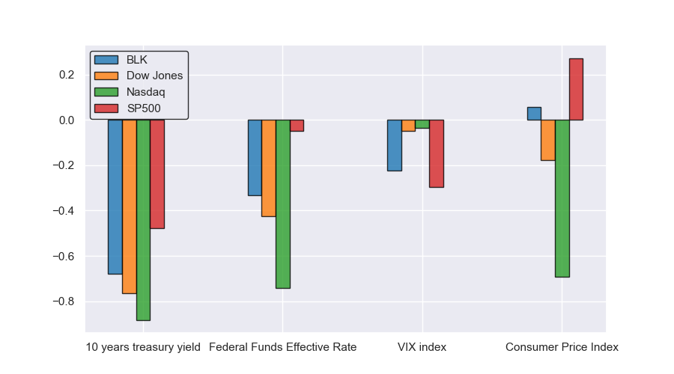
Correlations between various indexes and indicators

Slide 48
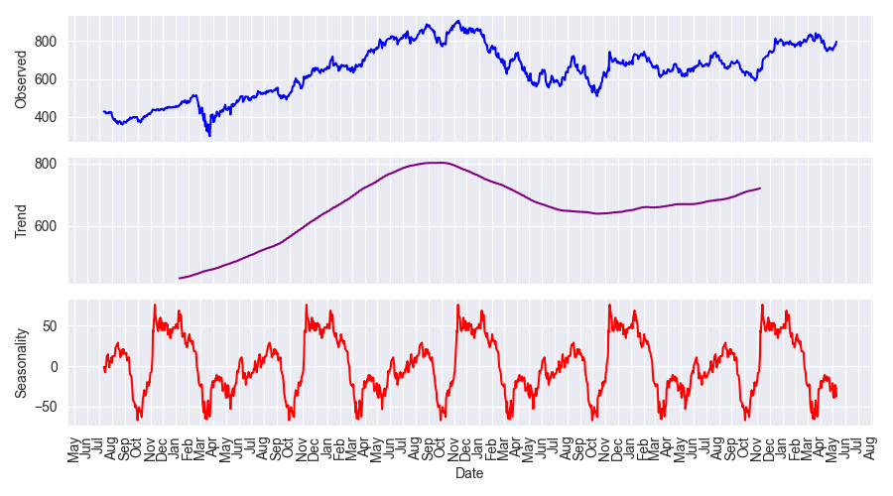
Breakdown of annual seasonality within the last years

Slide 49
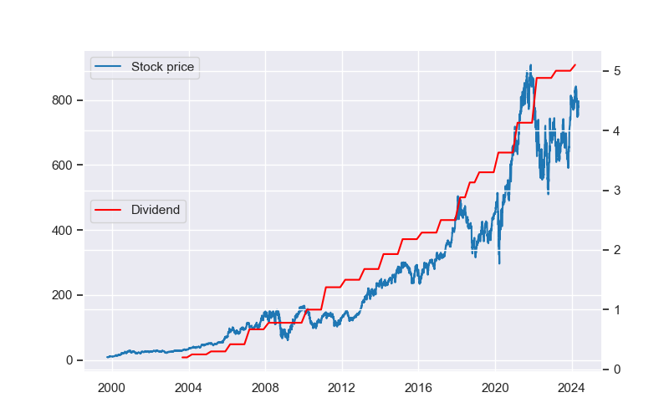
Price and dividends

Slide 50
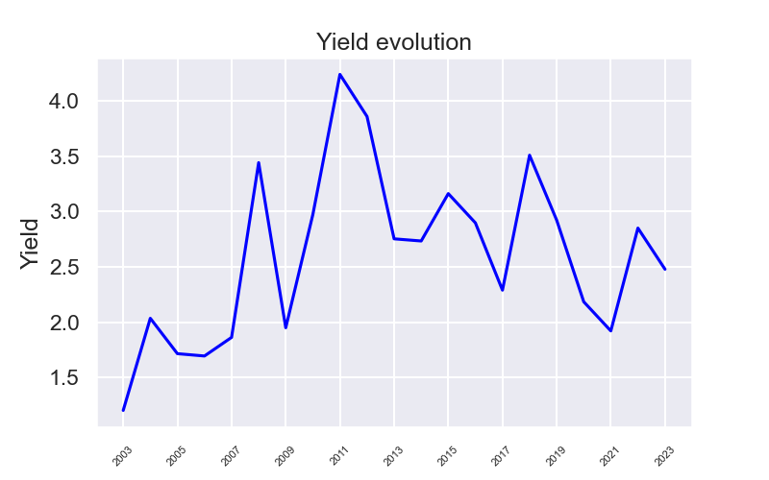
Dividend yield for BLK

Slide 51
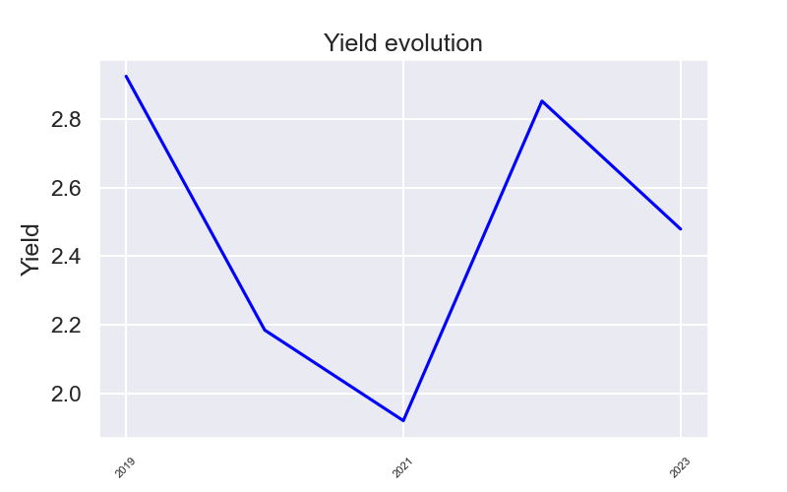
Dividend yield for BLK 5 years

Slide 52
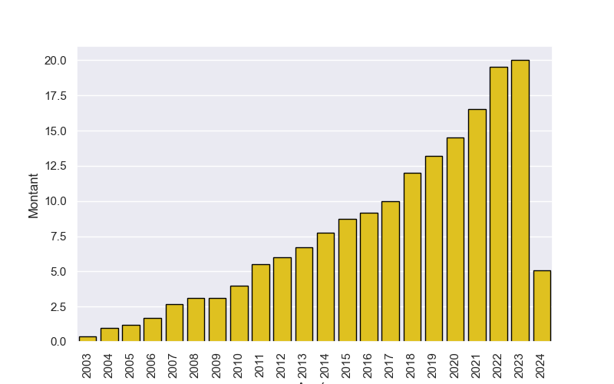
Dividend per year and per share

Slide 53
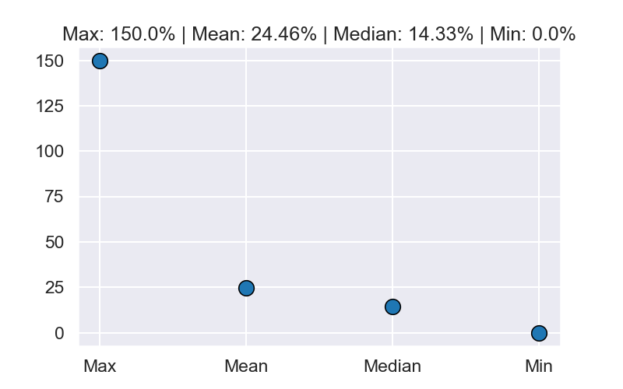
Dividend percentage changes statistics by year

Slide 54

Dividend percentage changes statistics by year (5 years)

Slide 55

Dividend scores overall

Slide 56

Dividend scores 5 years

Slide 57

Dividend Reinvestment Simulation (100 dollars invested)

Slide 58

Investor distribution

Slide 59

Market feeling analysis, based on news titles.

Slide 60
Numbers and interestings informations.
The increase in average price over 25 years is 19.76%
and 5.0% over the last 5 years.
The average standard deviation a year is 2.15
and 1.7 over the last 5 years.
The Sharpe and Sortino ratios are respectively 0.5794 and 0.0628
and 0.1858 and 0.0345 over the last 5 years.
The three main institutional investors are, in decreasing order of detention:
-Avanguard Group Inc
-BlackRock Inc.
-State Street Corporation.
Date of this report: 2024-05-12

