Slide 1
THE-COCA-COLA-COMPANY-4819
'The Coca-Cola Company is the world n ° 1 for the production and marketing of alcohol-free drinks.The CA by activity is distributed as follows: ','- Sale of concentrates of drinks and syrups (56%); ','- Bottling and sale of drinks (44%): sodas, fruit juice, drinks withtea base, waters, etc.Marketed under the Coca- Cola brands, Diet Coke, Fanta, Fresca, Schweppes Sprite, Thums Up, Aquarius, Ciel, Dasani, Ades, Del Valle, Fairlife, Innocent, Minute Maid, etc. ',' a end of 2022, the grouphas 133 production sites worldwide. ', 64.2% of the turnover is produced internationally.Capitalization, business value, turnover, EBITDA, EBIT, EBT, net profit, net debt and cash, free cash flow, equity, total assets and CAPEX are in millions.

Slide 2
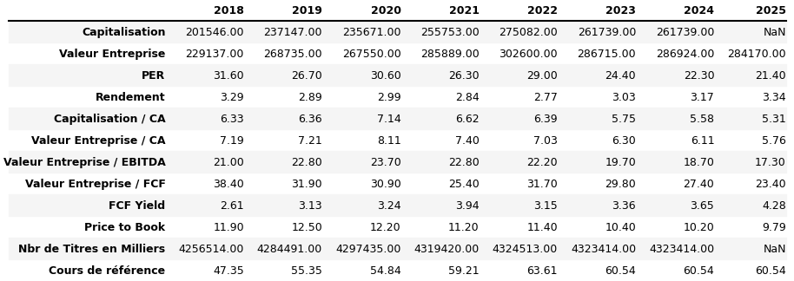
Array 1

Slide 3
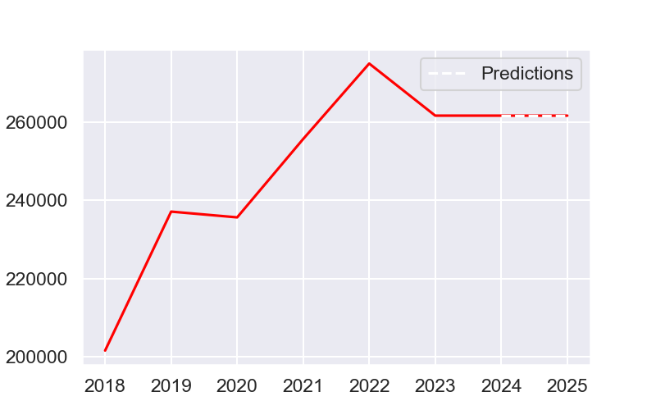
Capitalization

Slide 4
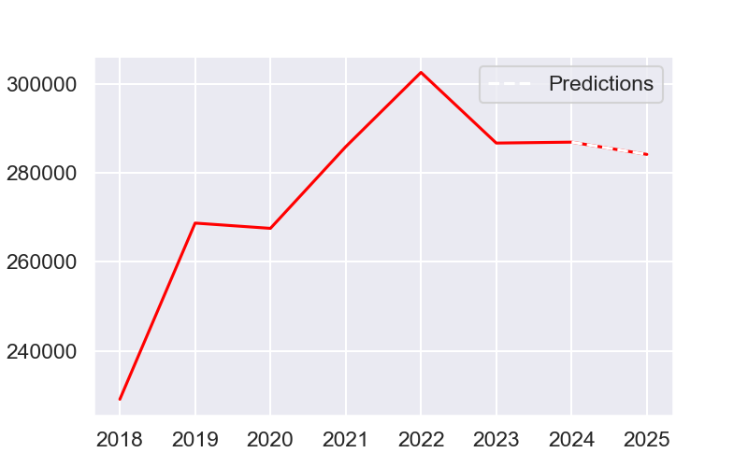
Business value

Slide 5
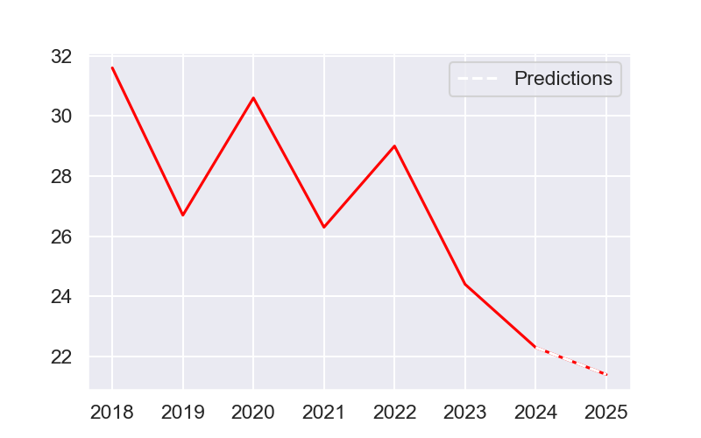
Per

Slide 6
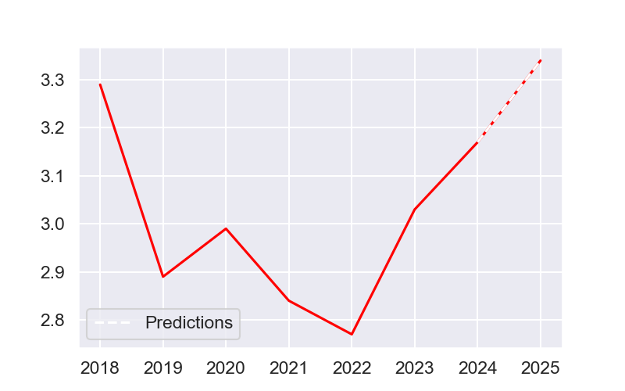
Yield

Slide 7
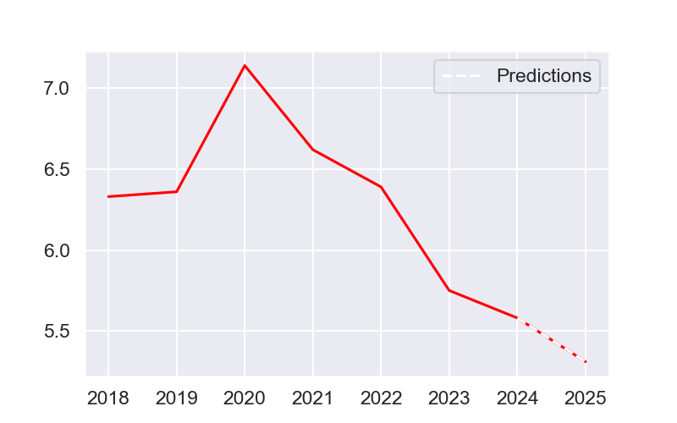
Capitalization / CA

Slide 8
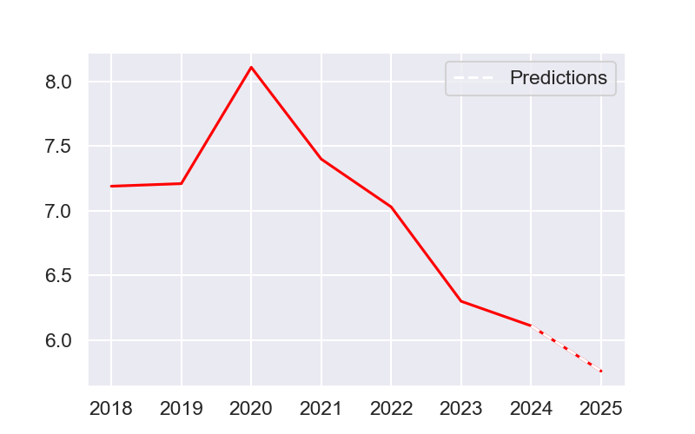
Business value / CA

Slide 9
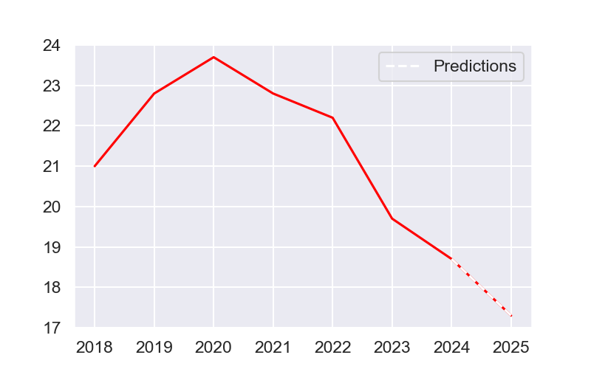
Business value / EBITDA

Slide 10
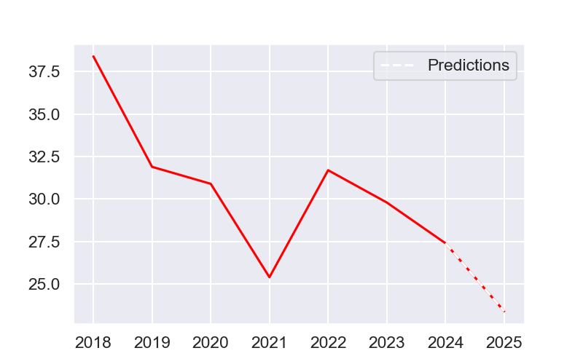
Business value / FCF

Slide 11
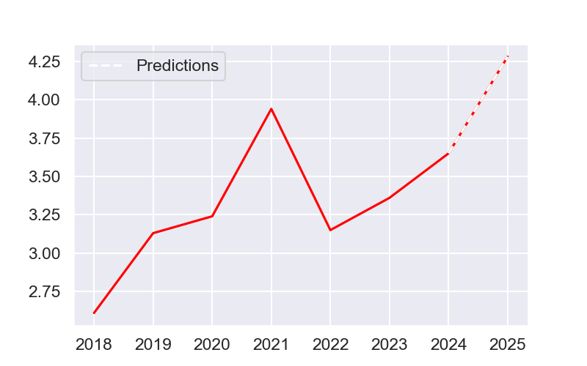
FCF Yield

Slide 12
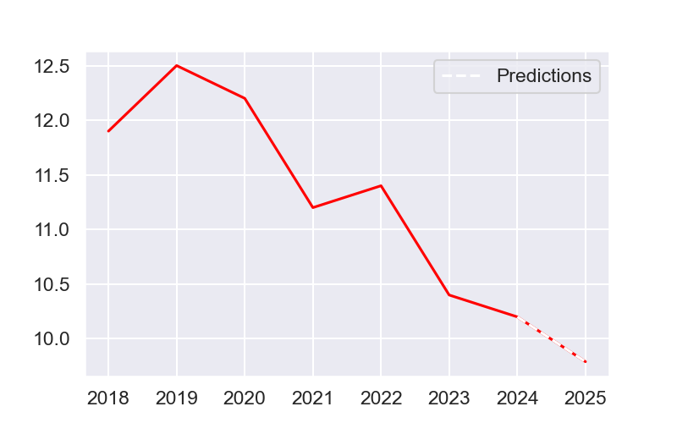
Price to book

Slide 13
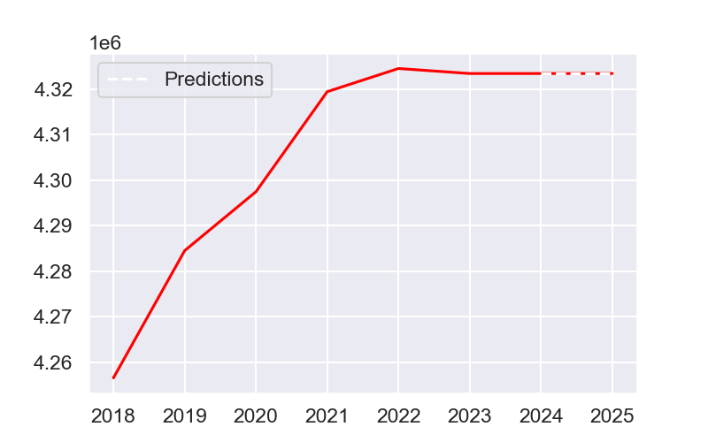
Nbr of titles in thousands

Slide 14
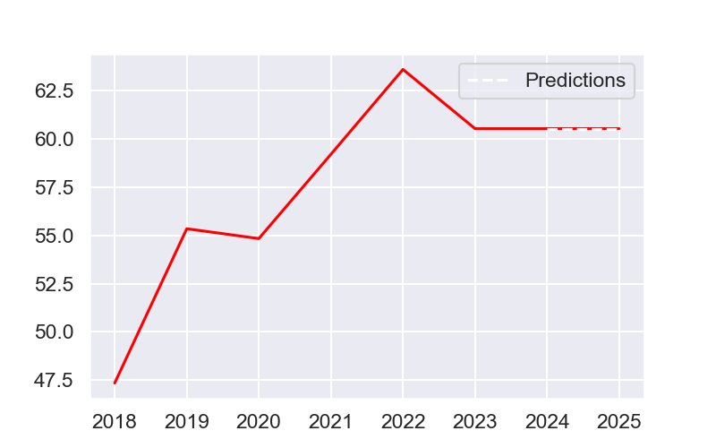
Reference course

Slide 15
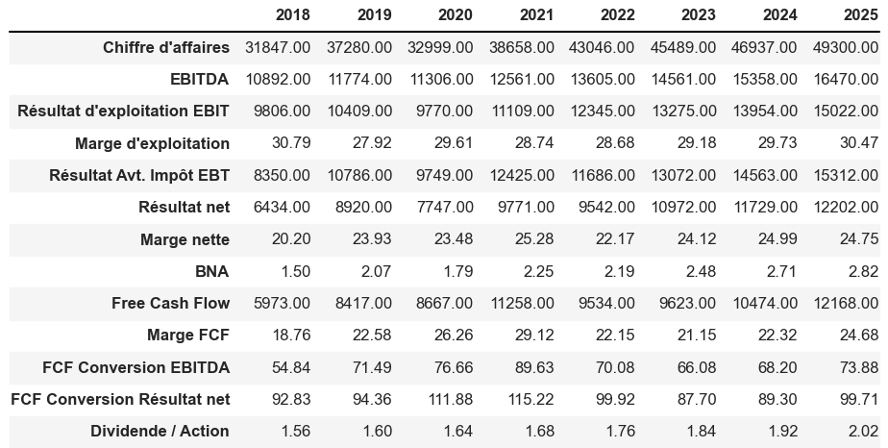
Array 2

Slide 16
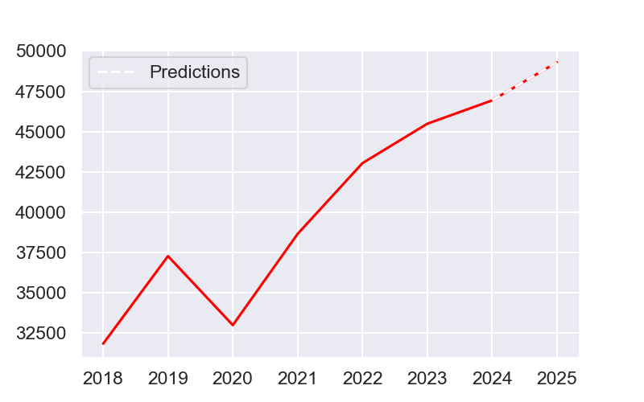
Turnover

Slide 17
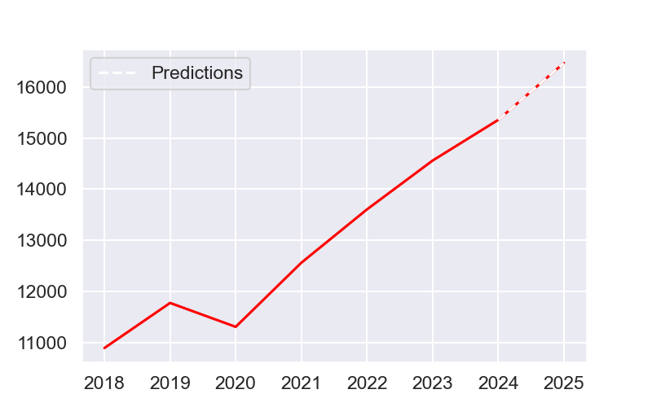
EBITDA

Slide 18
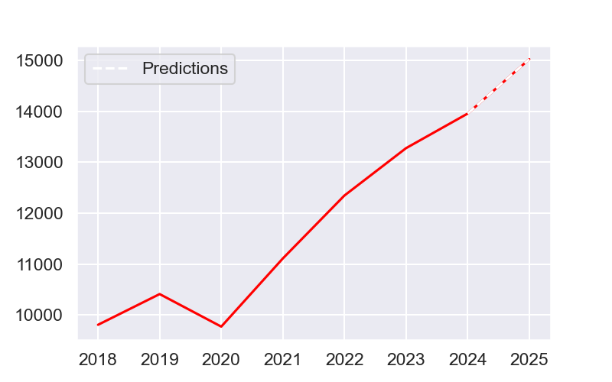
EBIT operating profit

Slide 19
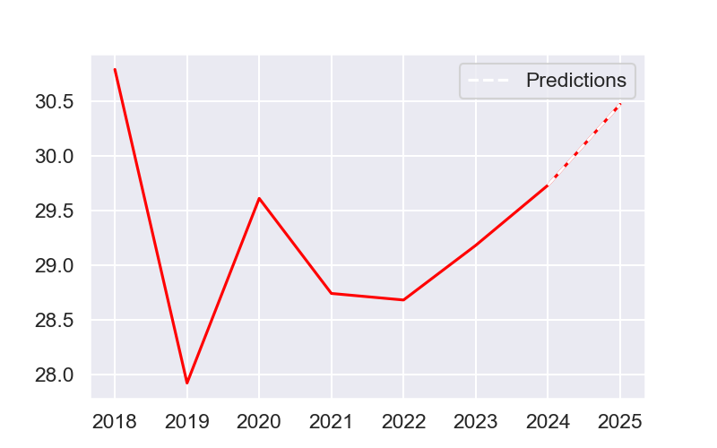
Operating margin

Slide 20
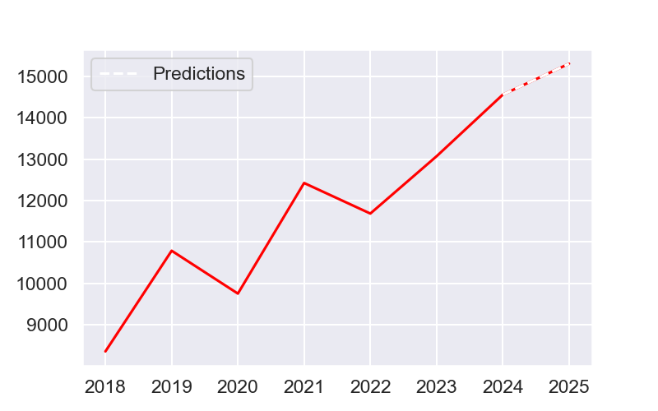
Result before.EBT tax

Slide 21
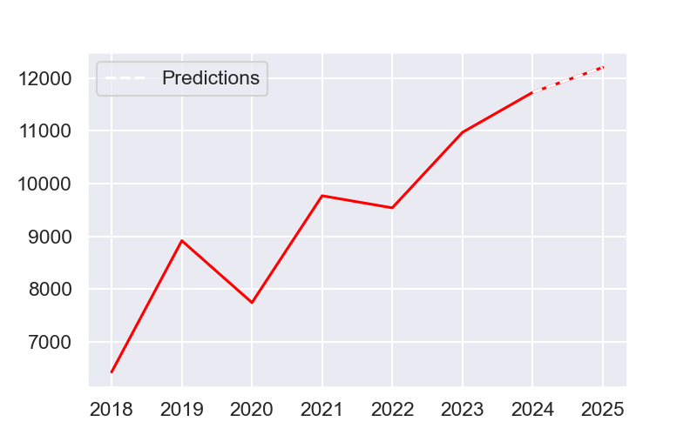
Net profit

Slide 22
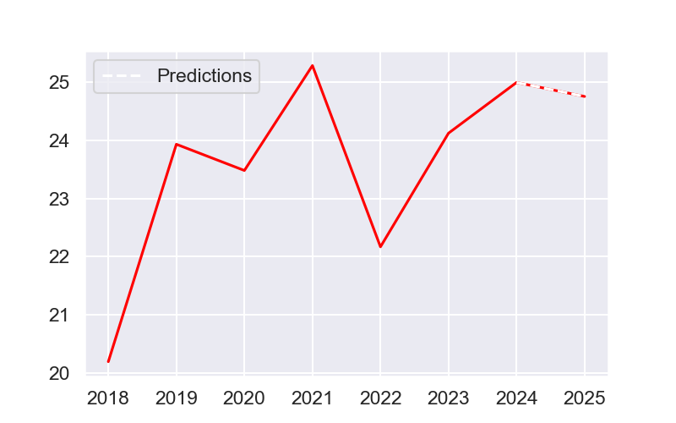
Net margin

Slide 23
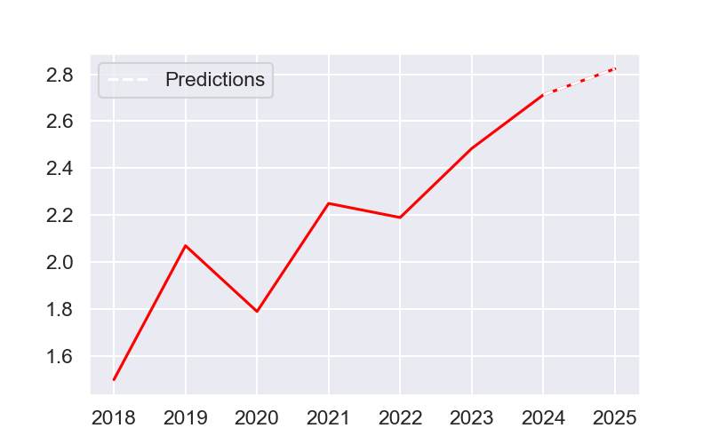
Bna

Slide 24
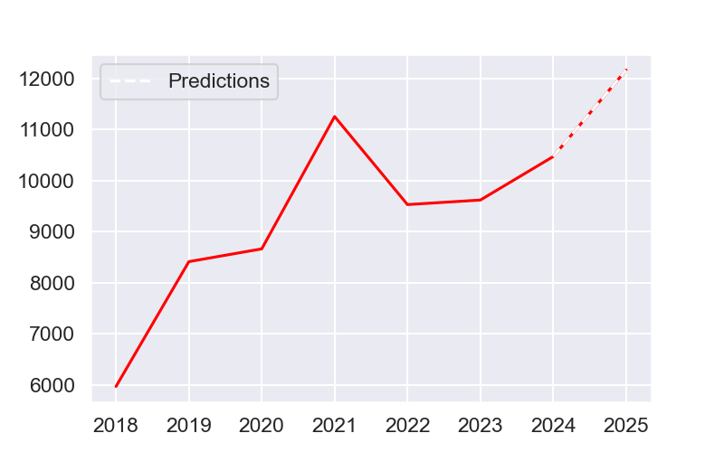
Free cash flow

Slide 25
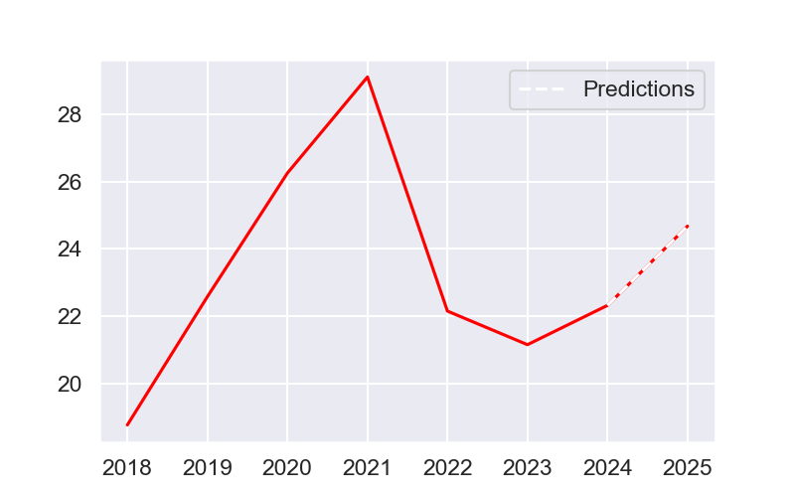
FCF margin

Slide 26
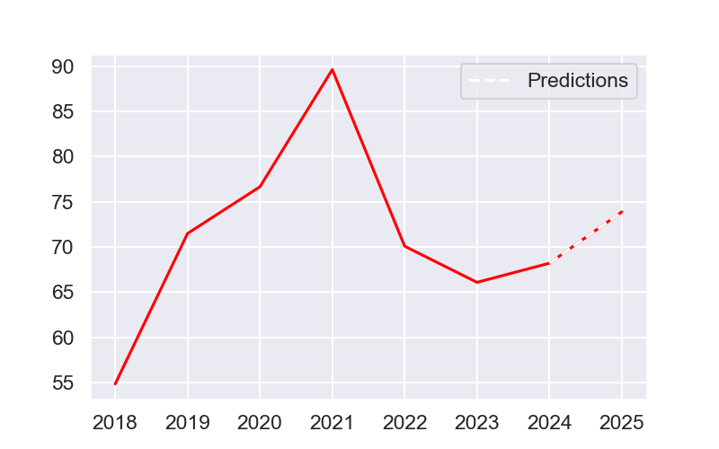
FCF Conversion EBITDA

Slide 27
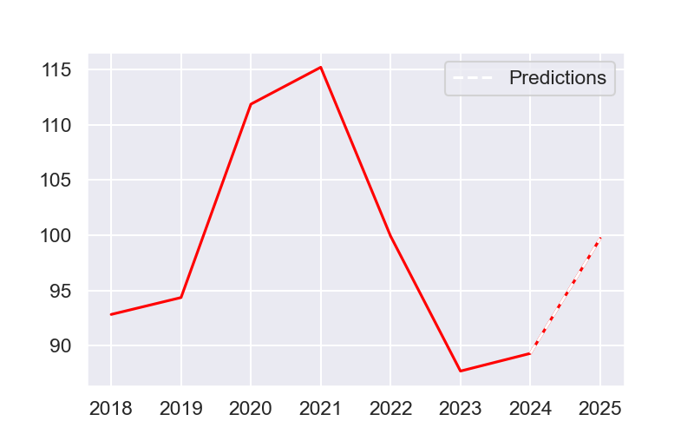
FCF Conversion Net Result

Slide 28
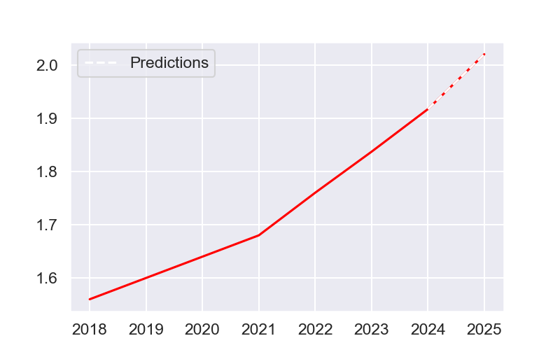
Dividend / Action

Slide 29
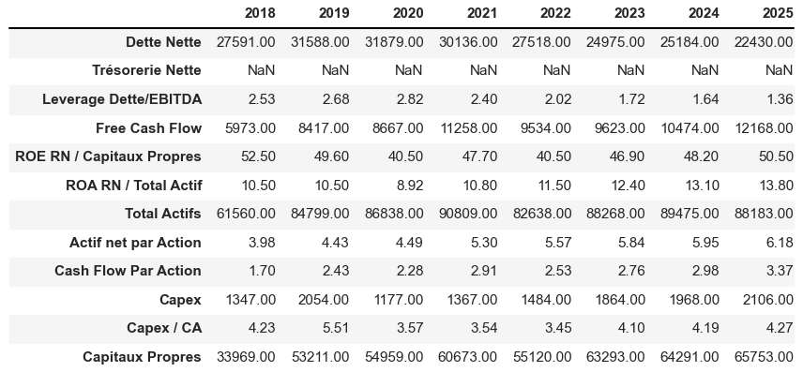
Array 3

Slide 30
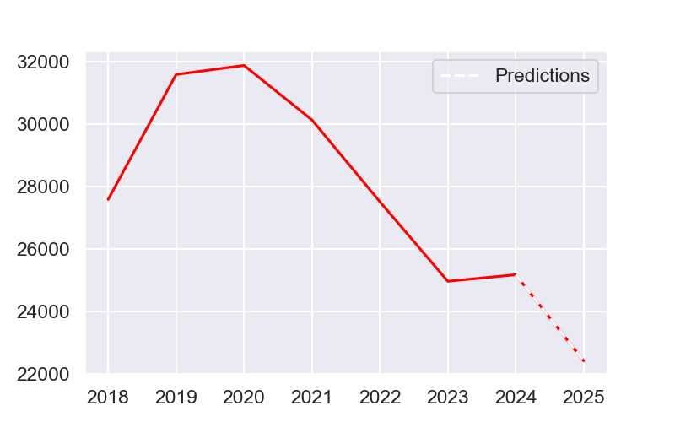
Net debt

Slide 31
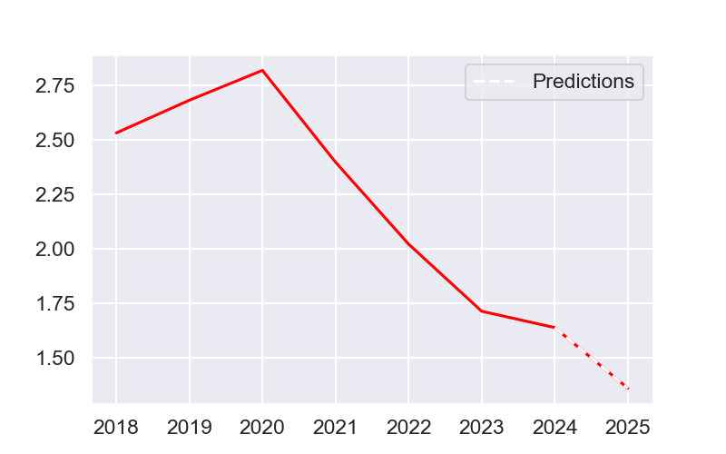
Debt/Ebitda Leverage

Slide 32
Free cash flow

Slide 33
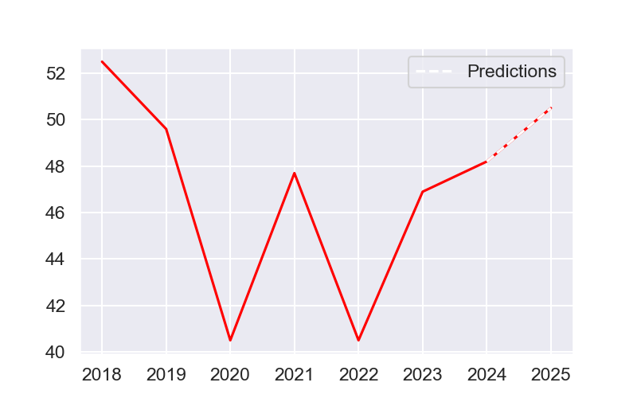
ROE RN / Equity

Slide 34
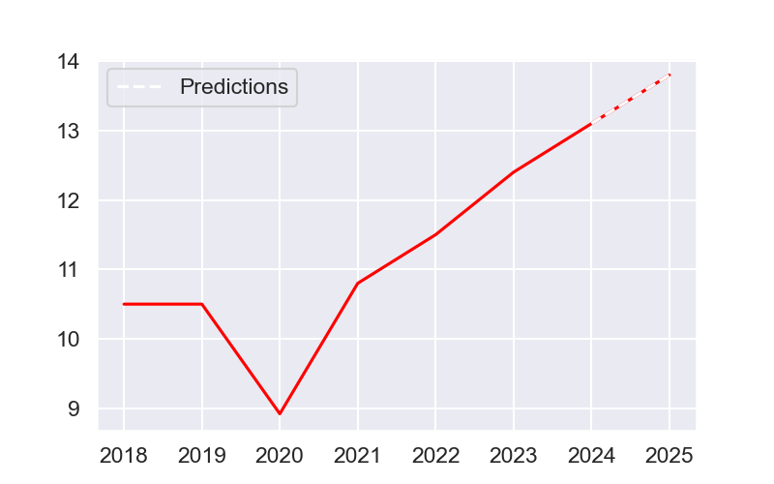
ROA RN / TOTAL Active

Slide 35
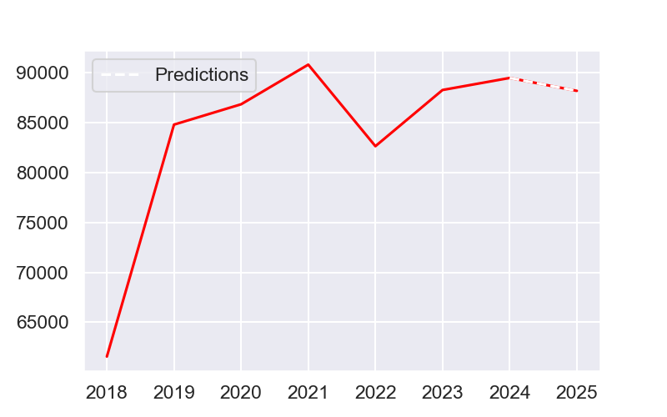
Total active

Slide 36
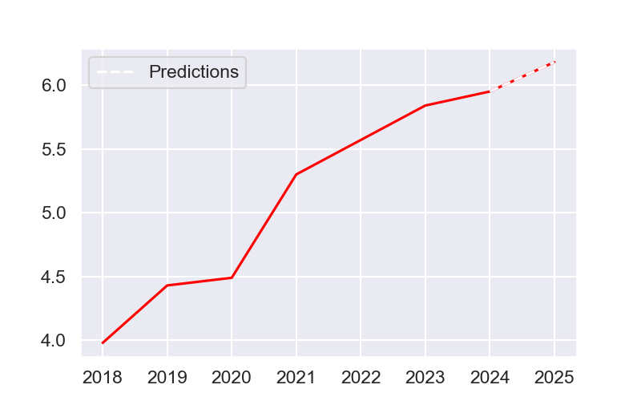
Net assets per share

Slide 37
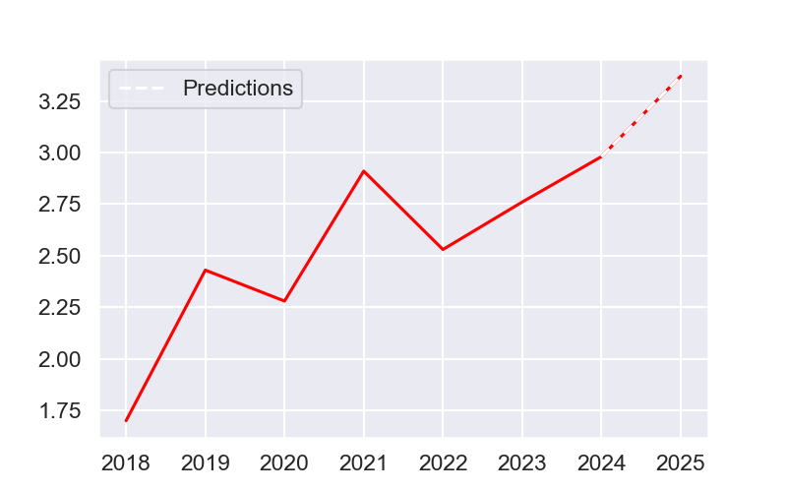
Cash flow by action

Slide 38
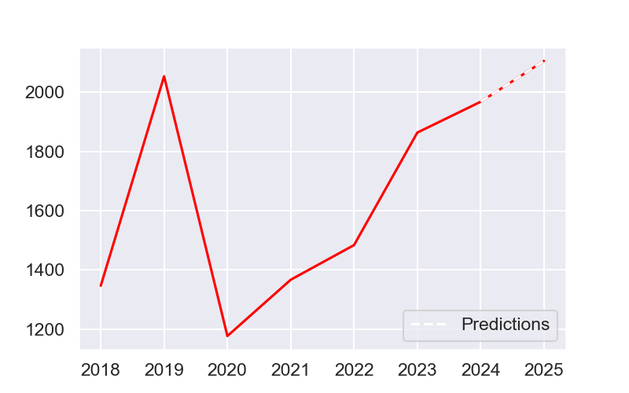
Capex

Slide 39
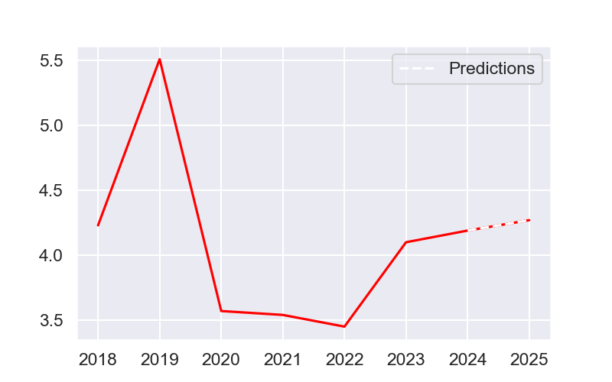
CAPEX / CA

Slide 40
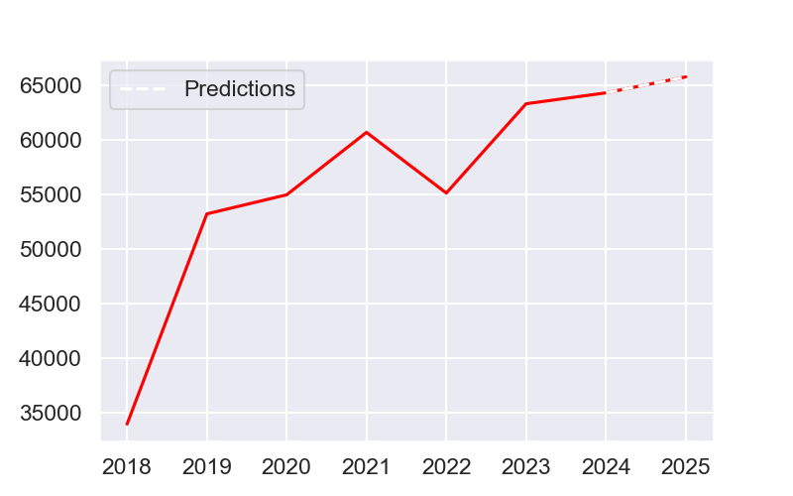
Equity

Slide 41
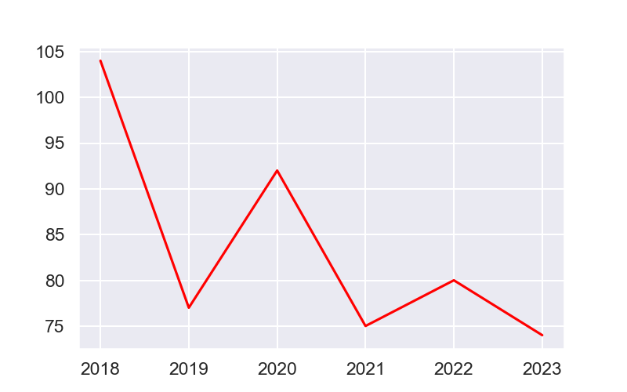
Pay out ratio

Slide 42
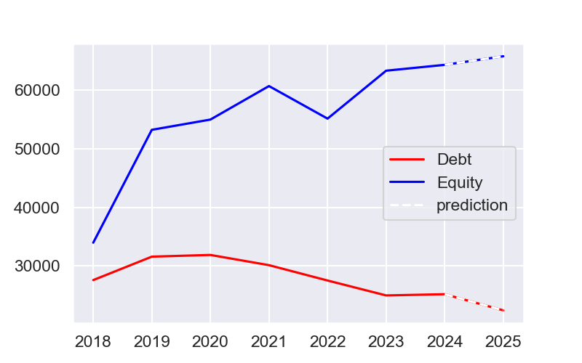
Equity versus debt

Slide 43
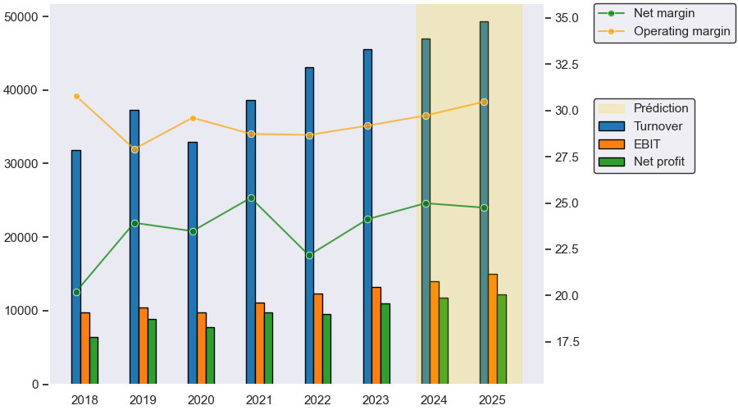
Evolution of the annual income statement

Slide 44
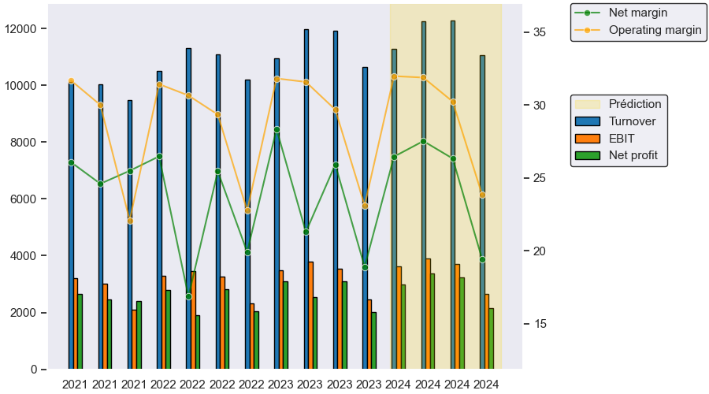
Evolution of the quarterly income statement

Slide 45
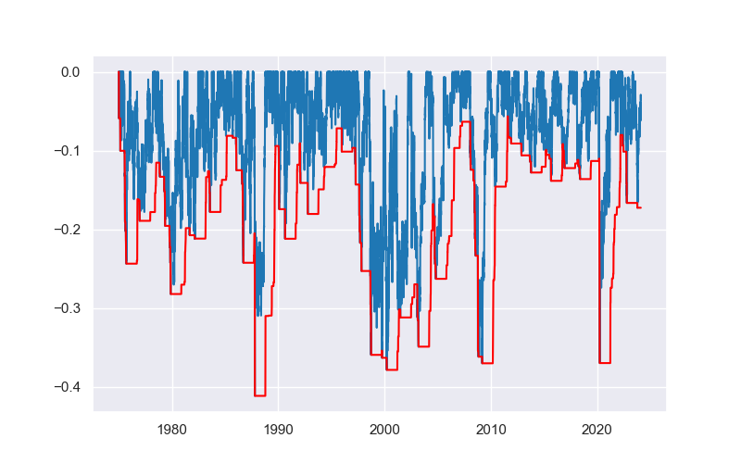
Maximum loss

Slide 46
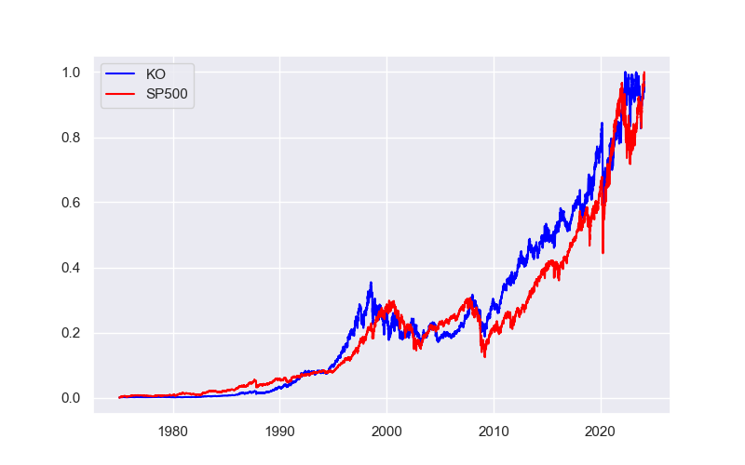
Normalized stocks price :KO vs SP500

Slide 47
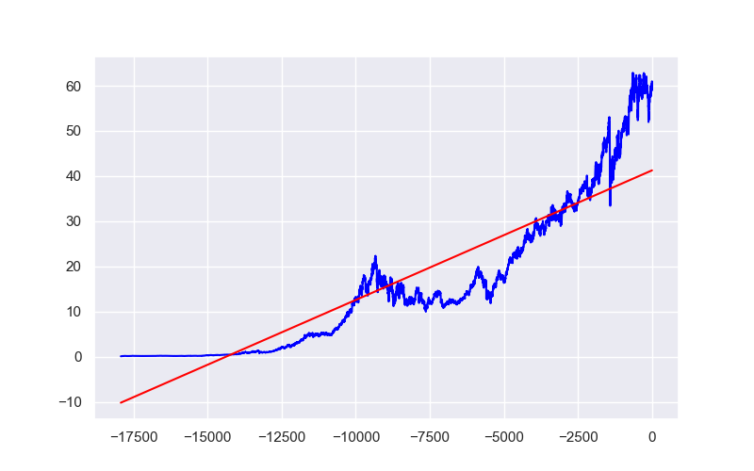
Linear regression

Slide 48
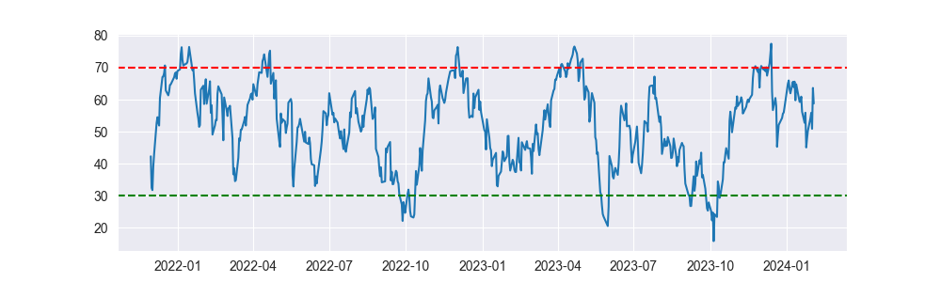
Relative Strength Index (RSI)

Slide 49
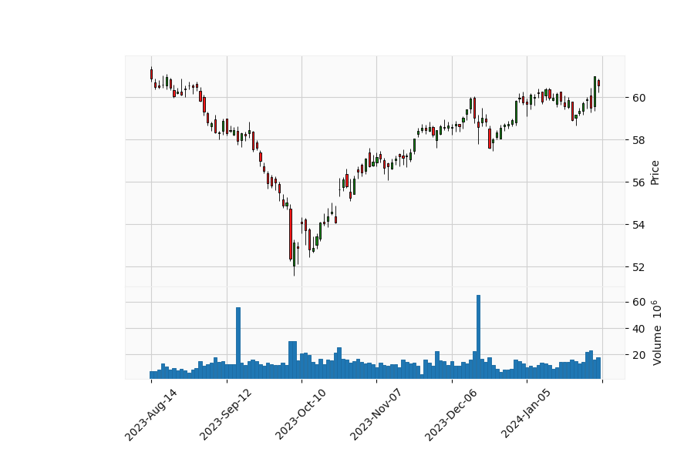
Last six months zoom

Slide 50
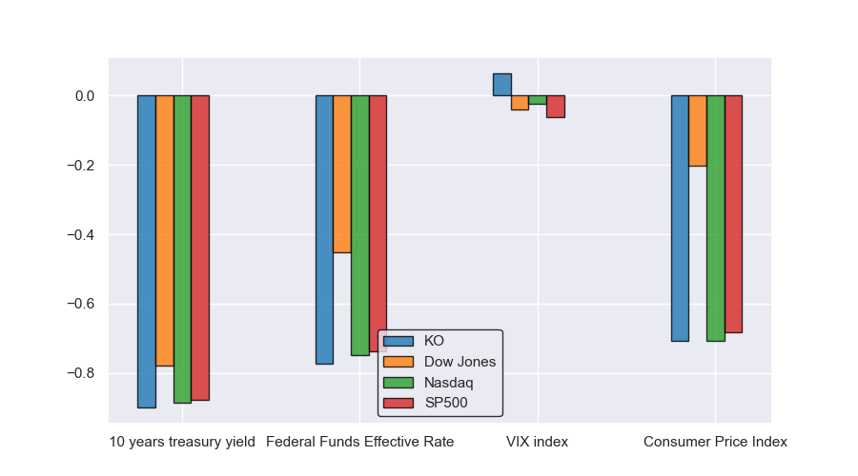
Correlations between various indexes and indicators

Slide 51
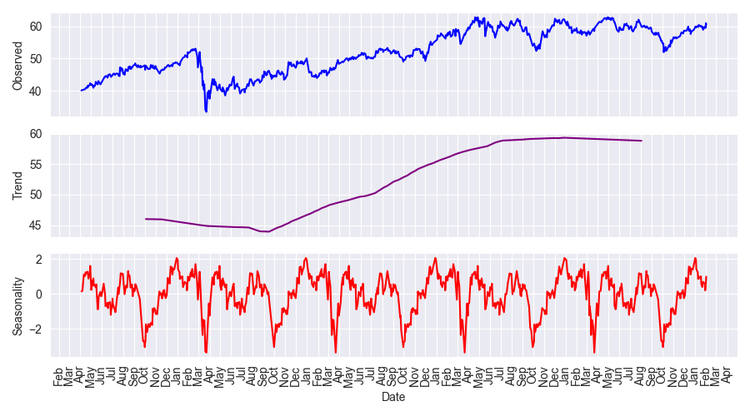
Breakdown of annual seasonality within the last years

Slide 52
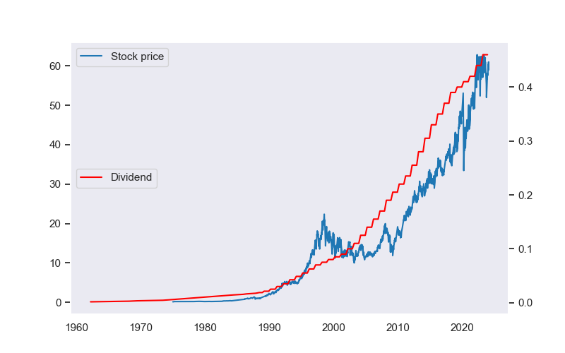
Price and dividends

Slide 53

Dividend yield for KO

Slide 54

Dividend per year and per share

Slide 55

Dividend percentage changes statistics by year

Slide 56

Dividend percentage changes statistics by year (5 years)

Slide 57

Dividend scores overall

Slide 58

Dividend scores 5 years

Slide 59

Investor distribution

Slide 60

Market feeling analysis, based on news titles.

Slide 61
Numbers and interestings informations.
The increase in average price over 49 years is 13.26% and 9.26% over the last 5 years. The average standard deviation a year is 1.46 and 1.07 over the last 5 years. The Sharpe and Sortino ratios are respectively 0.5704 and 0.058 and 0.5448 and 0.0593 over the last 5 years. The three main institutional investors are, in decreasing order of detention: -Berkshire Hathaway, Inc -Avanguard Group Inc -BlackRock Inc .. Date of this report: 2024-02-04

