Slide 1
REALTY-INCOME-CORPORATION-13868
Realty Income Corporation specializes in the detention, development and management of commercial and industrial real estate assets located in the United States and in Puerto Rico.Rental income by type of assets are distributed as follows :, '- stores (82.7%);', '- industrial premises (15%);', '- Others (2.3%): offices, factoriesAgri -foods, game establishments, etc. ', at the end of 2022, the real estate portfolio, composed of 12,237 assets of a total rental area of 22,003,659 m2, is evaluated, in accounting value, at 42.7 mdsusd.Capitalization, business value, turnover, EBITDA, EBIT, EBT, net profit, debt and net cash, free cash flow, equity, total assets and CAPEX are in millions. The benchmark of the dividend scores is made up of the following tickers;KO,JNJ,XOM,MMM,ITW,PM,IBM,ED,O,PG,EPD,BLK,VZ,NWN

Slide 2
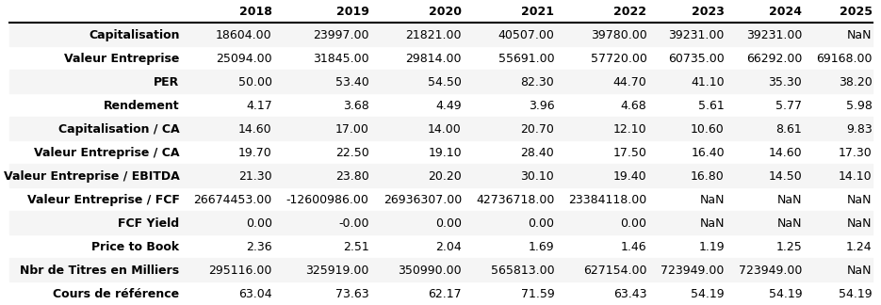
Array 1

Slide 3
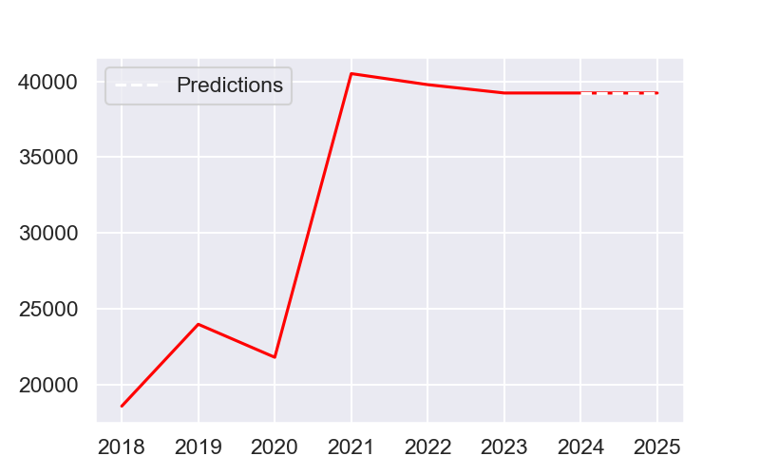
Capitalization

Slide 4
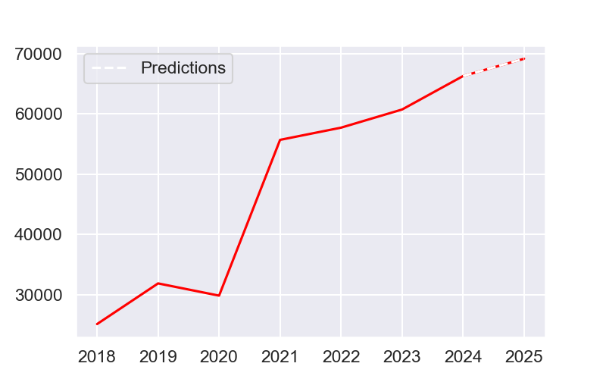
Business value

Slide 5
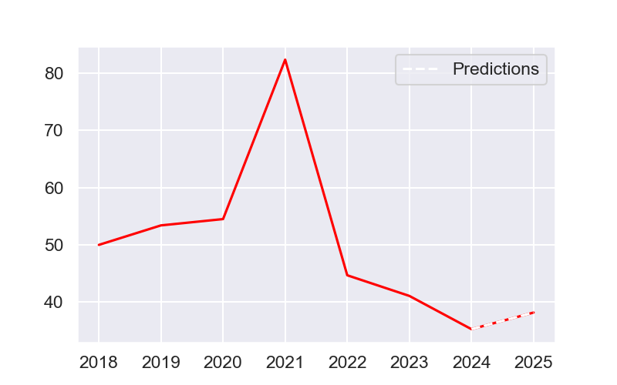
Per

Slide 6
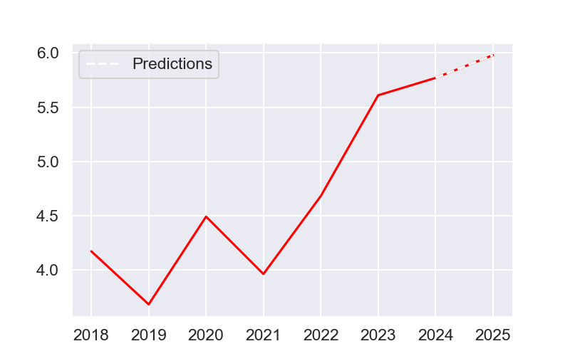
Yield

Slide 7
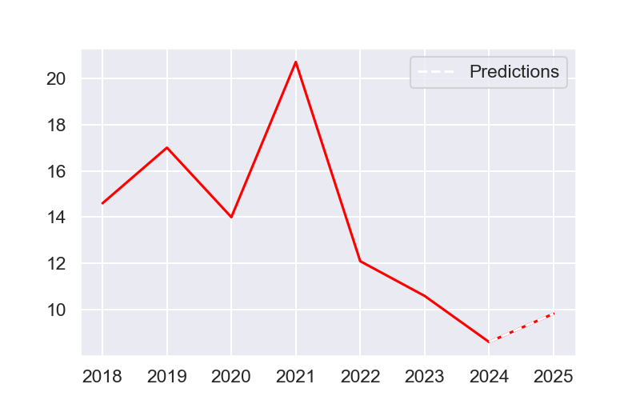
Capitalization / CA

Slide 8
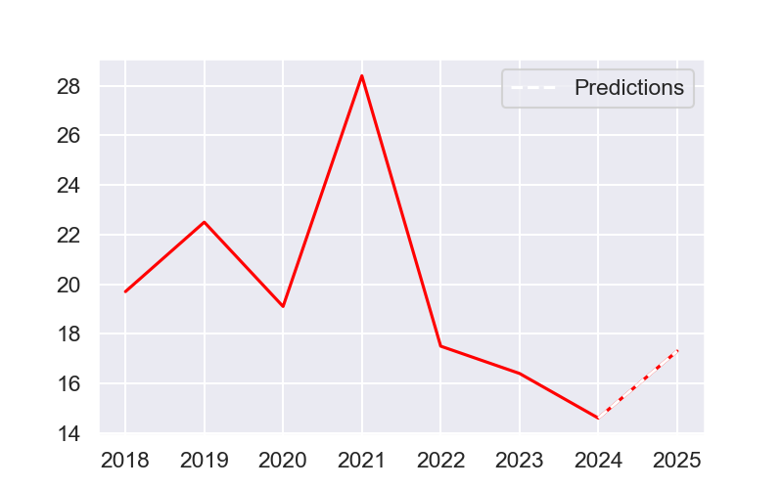
Business value / CA

Slide 9
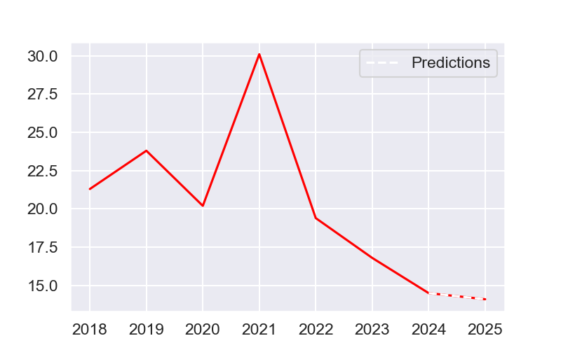
Business value / EBITDA

Slide 10
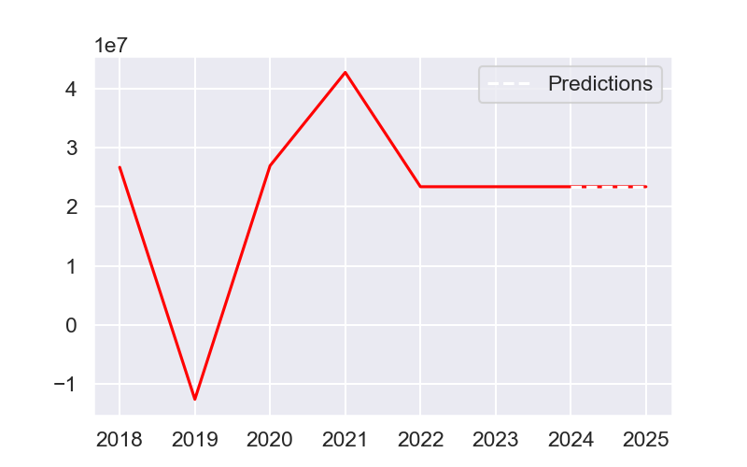
Business value / FCF

Slide 11
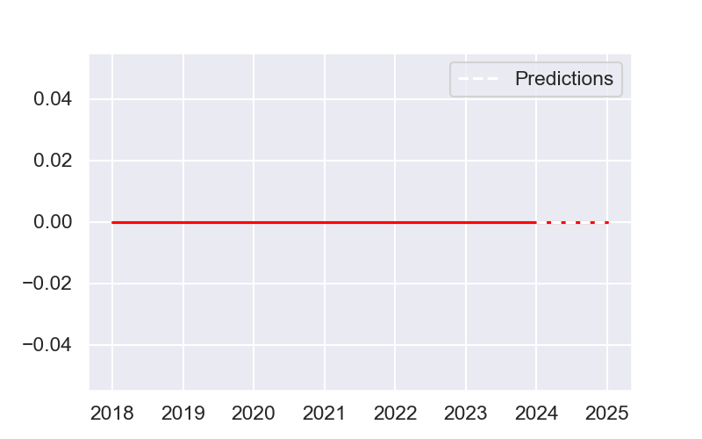
FCF Yield

Slide 12
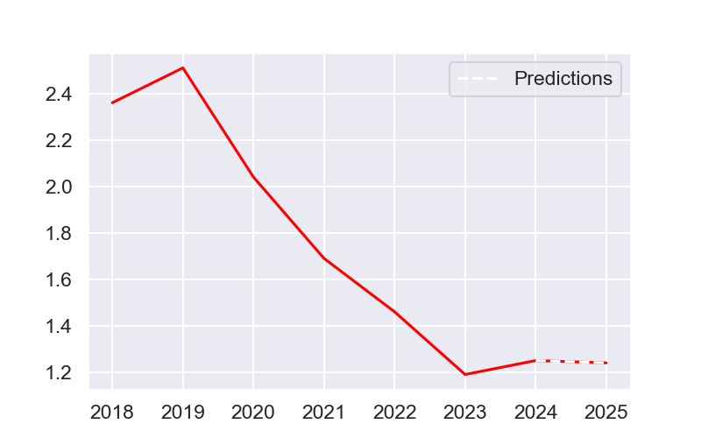
Price to book

Slide 13
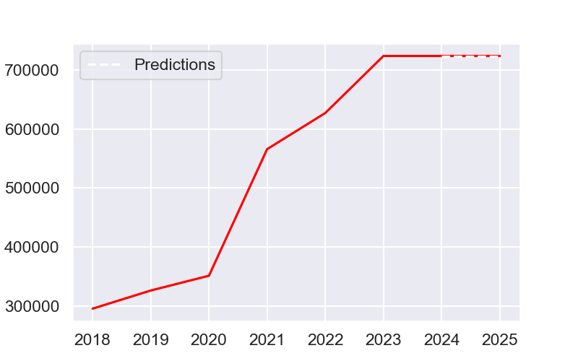
Nbr of titles in thousands

Slide 14
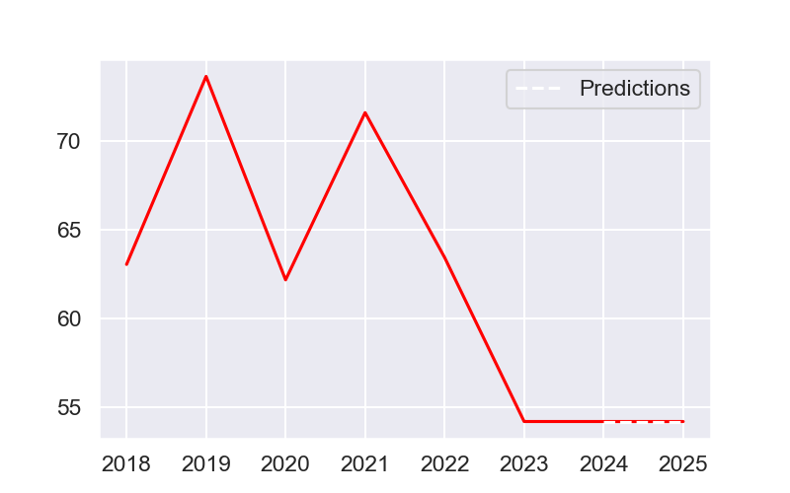
Reference course

Slide 15
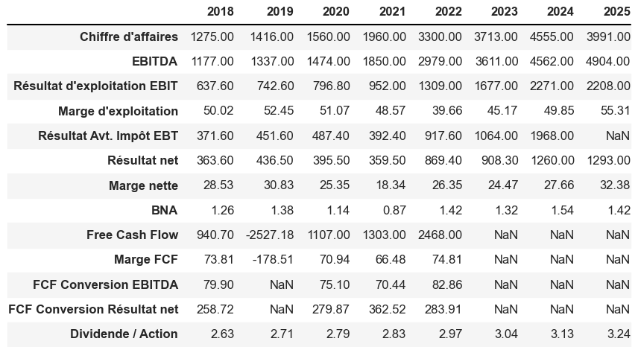
Array 2

Slide 16
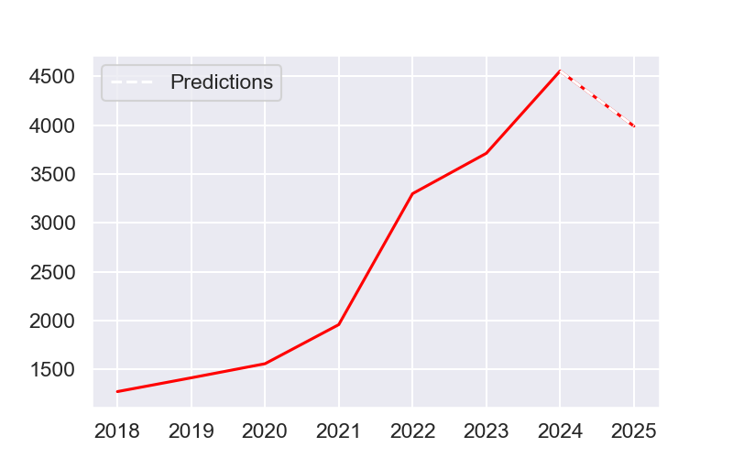
Turnover

Slide 17
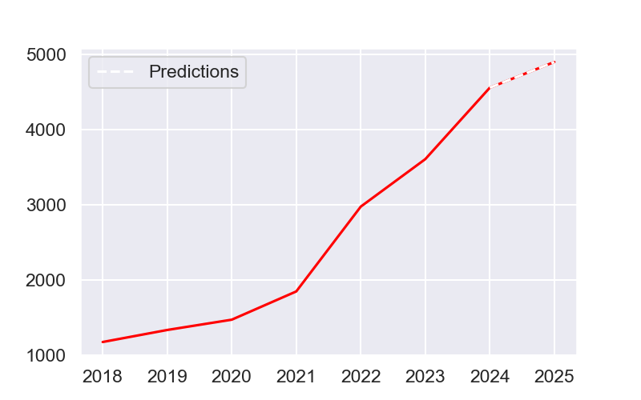
EBITDA

Slide 18
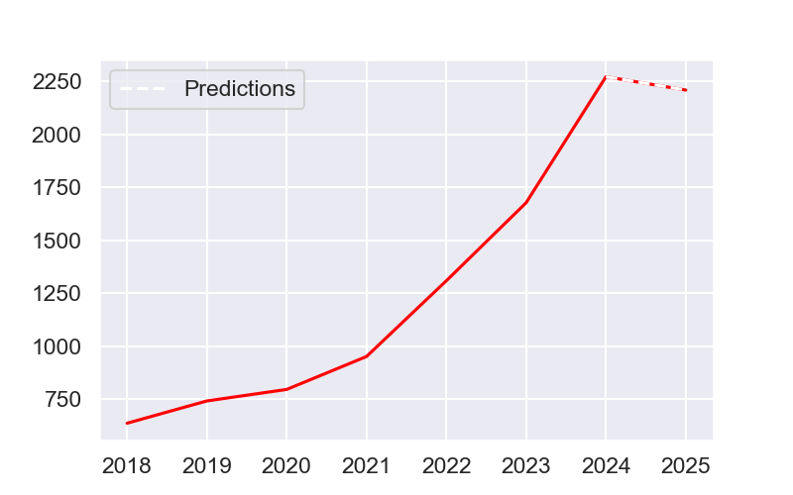
EBIT operating profit

Slide 19
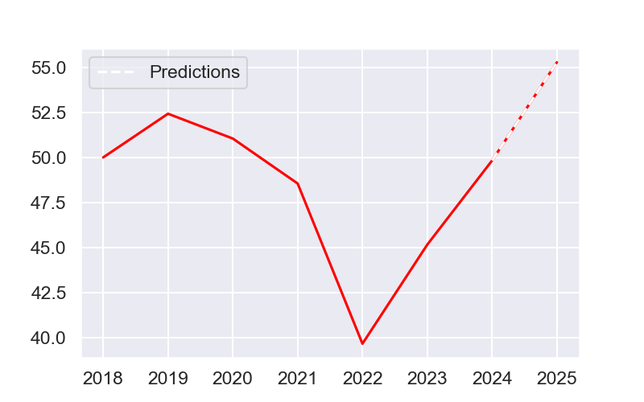
Operating margin

Slide 20
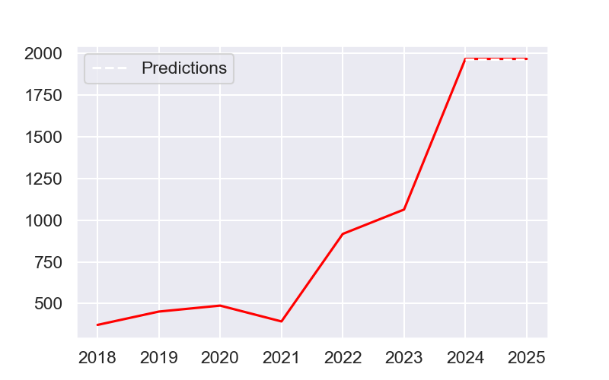
Result before.EBT tax

Slide 21
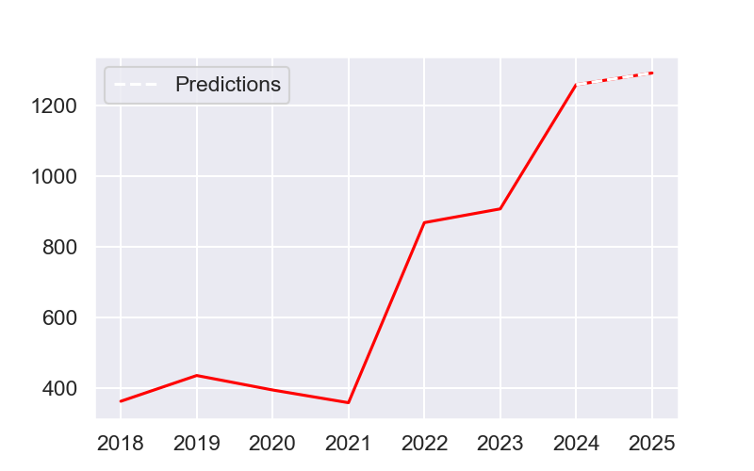
Net profit

Slide 22
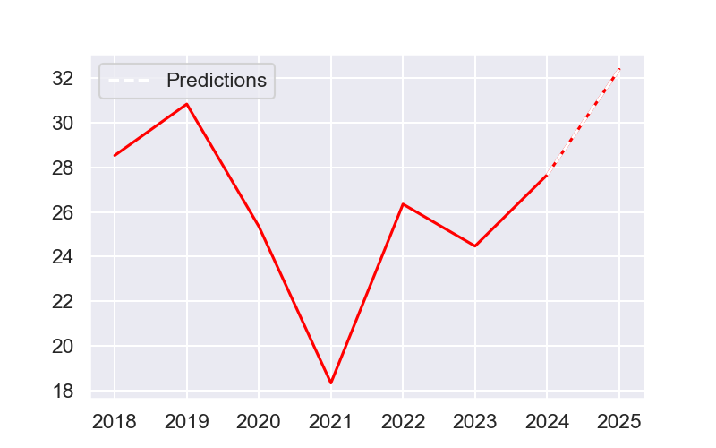
Net margin

Slide 23
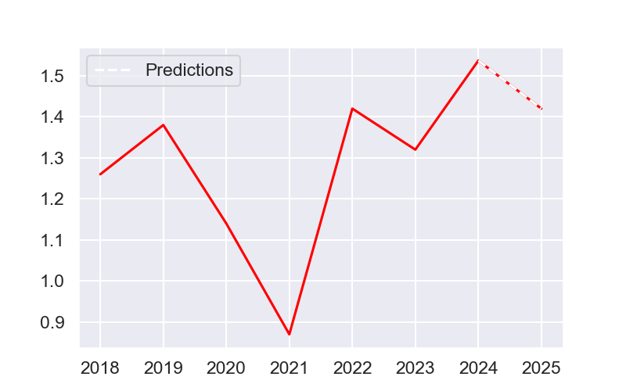
Bna

Slide 24
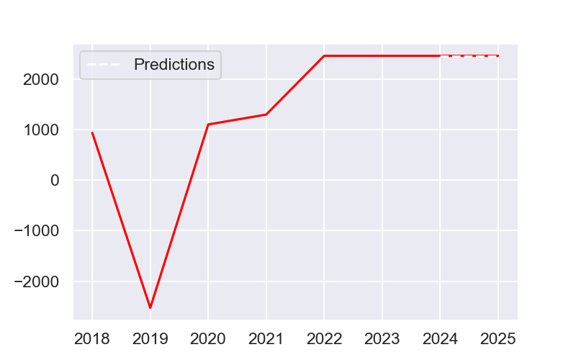
Free cash flow

Slide 25
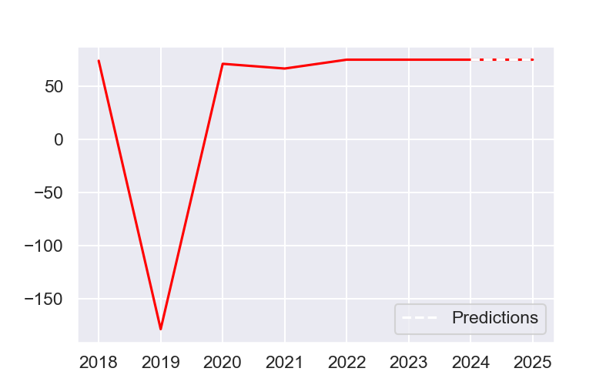
FCF margin

Slide 26
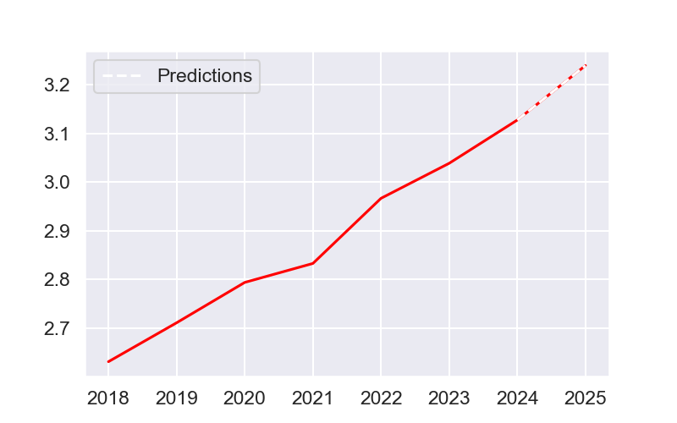
Dividend / Action

Slide 27
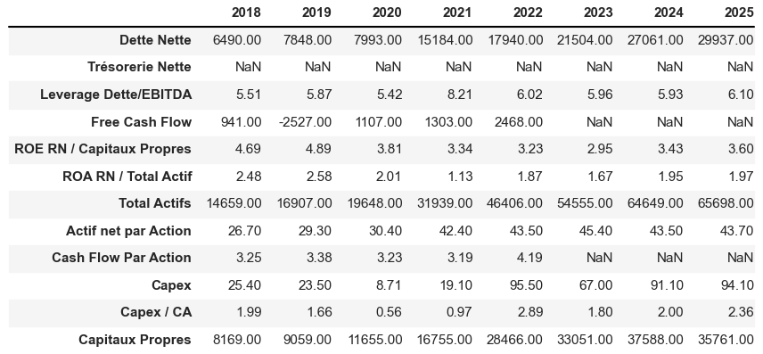
Array 3

Slide 28
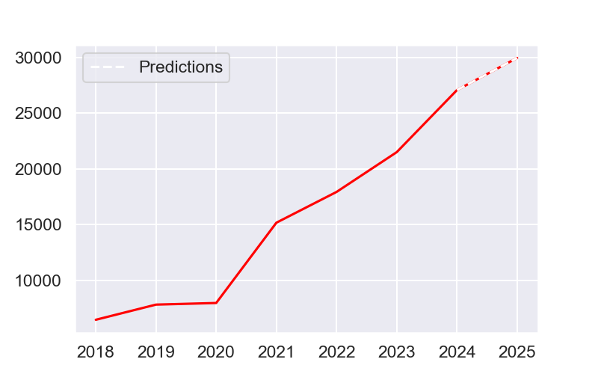
Net debt

Slide 29
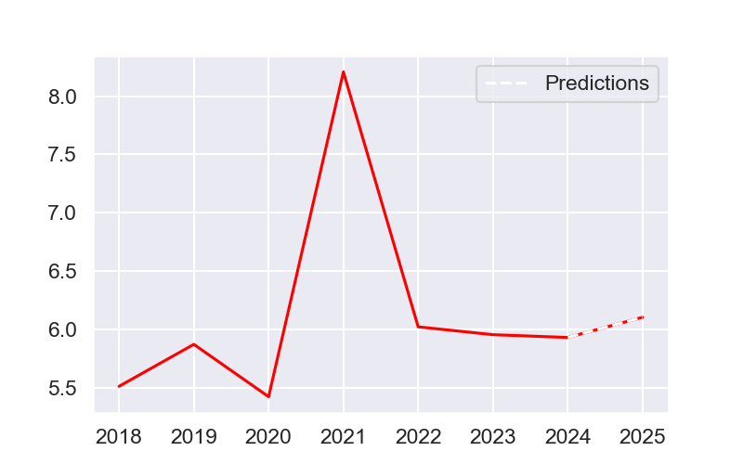
Debt/Ebitda Leverage

Slide 30
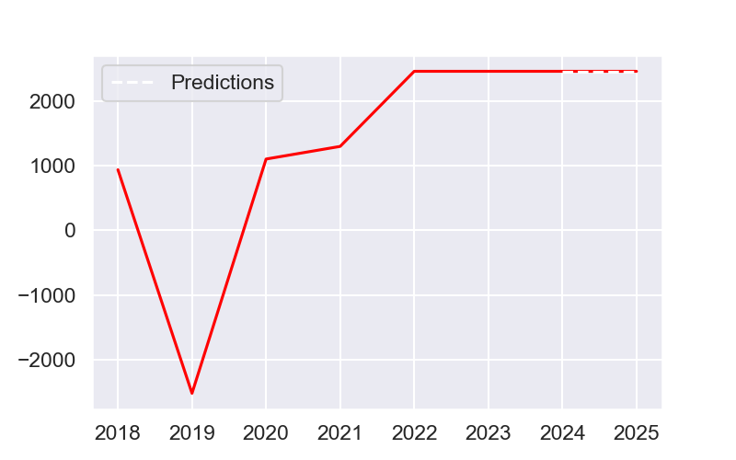
Free cash flow

Slide 31
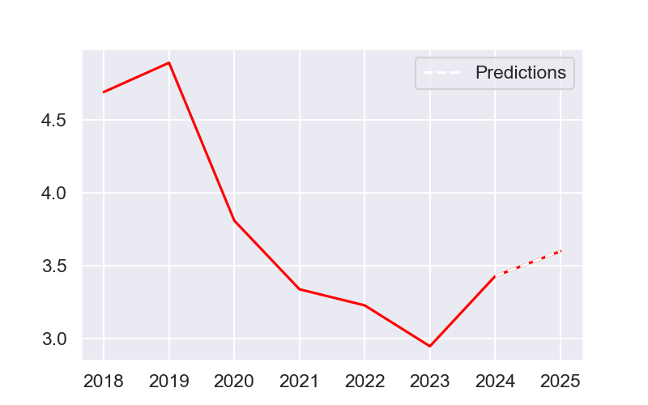
ROE RN / Equity

Slide 32
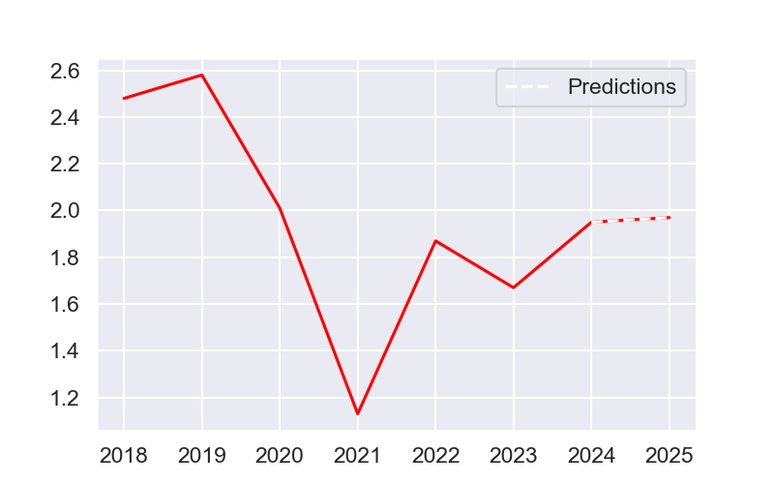
ROA RN / TOTAL Active

Slide 33
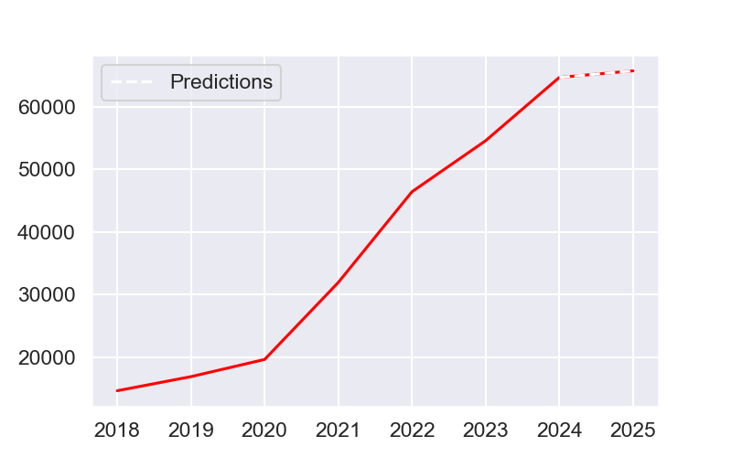
Total active

Slide 34
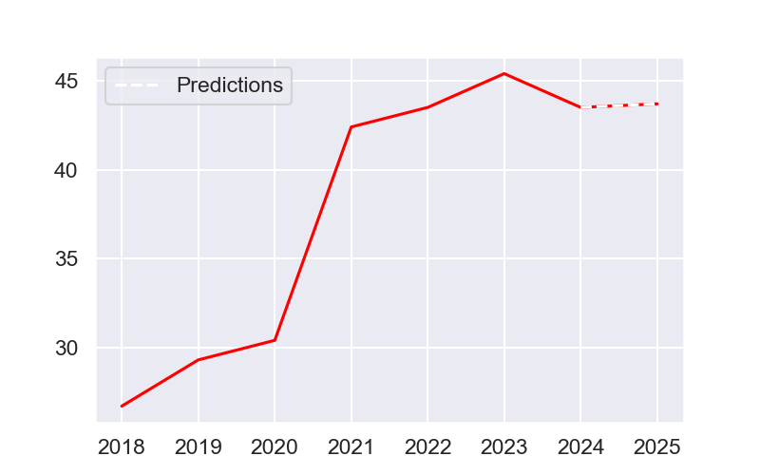
Net assets per share

Slide 35
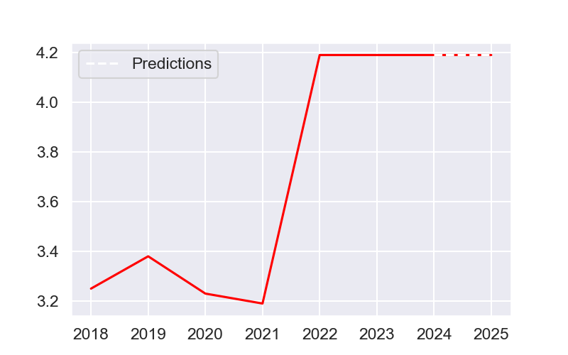
Cash flow by action

Slide 36
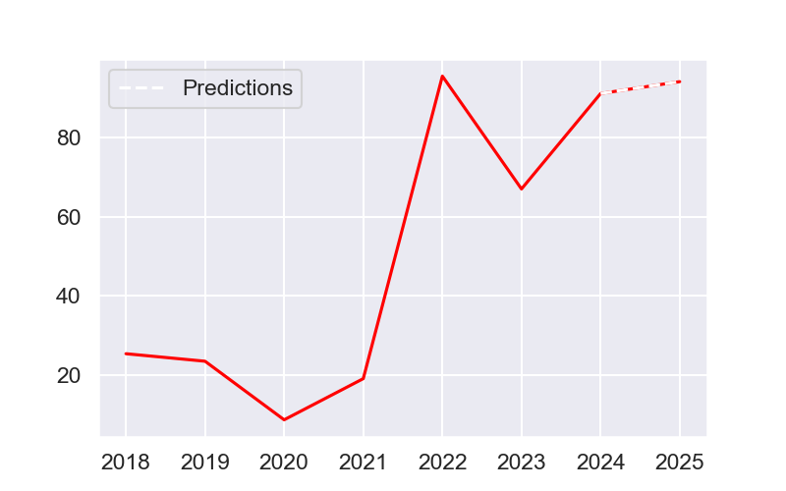
Capex

Slide 37
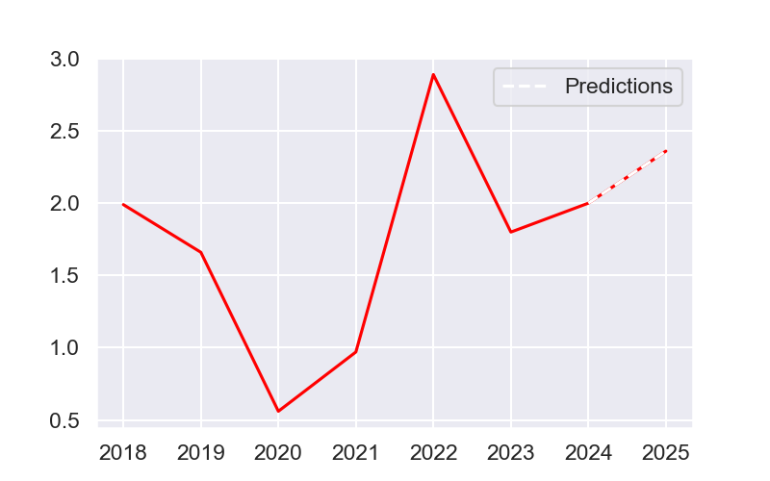
CAPEX / CA

Slide 38
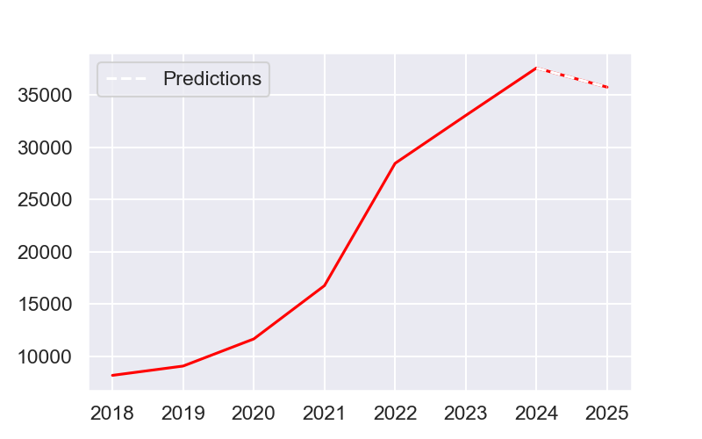
Equity

Slide 39
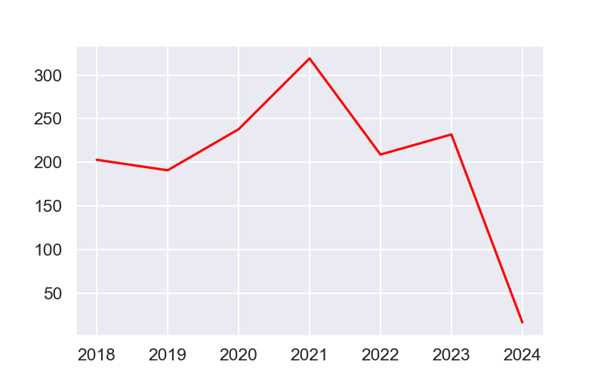
Pay out ratio

Slide 40
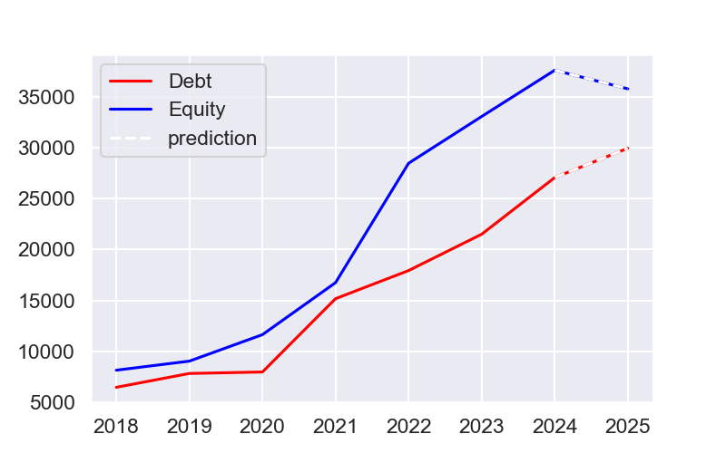
Equity versus debt

Slide 41
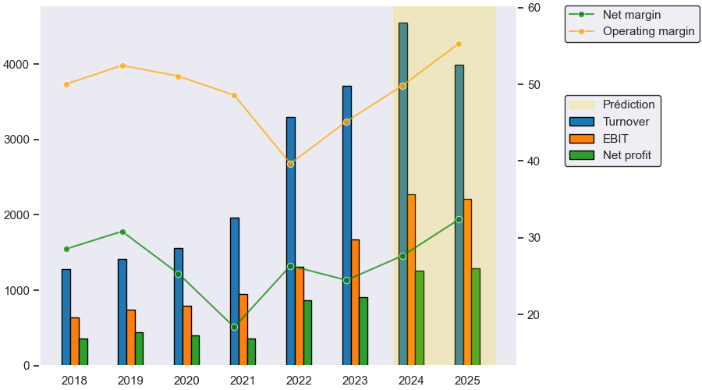
Evolution of the annual income statement

Slide 42
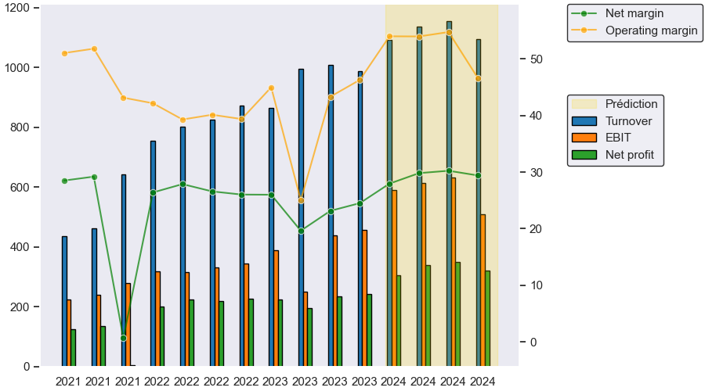
Evolution of the quarterly income statement

Slide 43
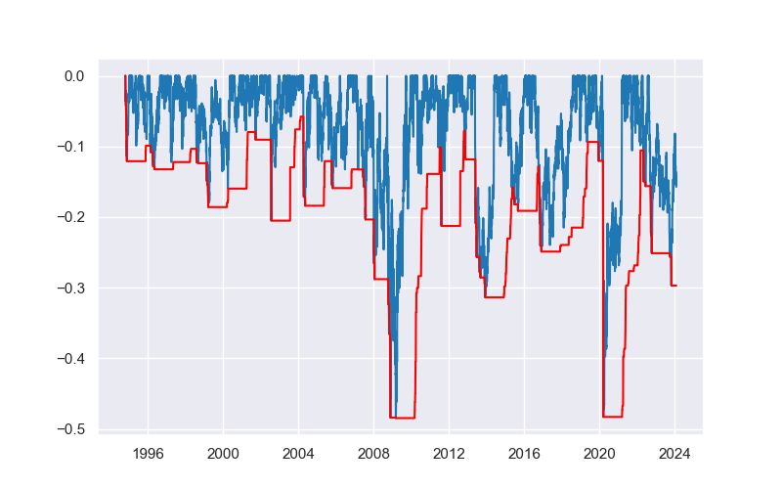
Maximum loss

Slide 44
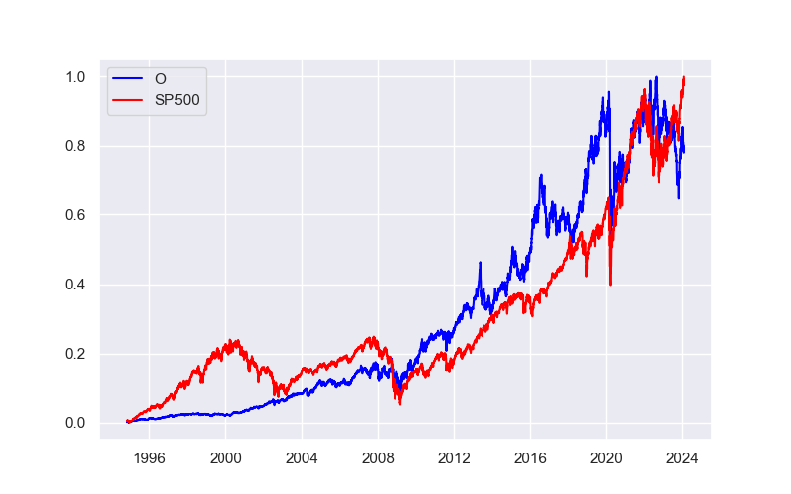
Normalized stocks price :O vs SP500

Slide 45
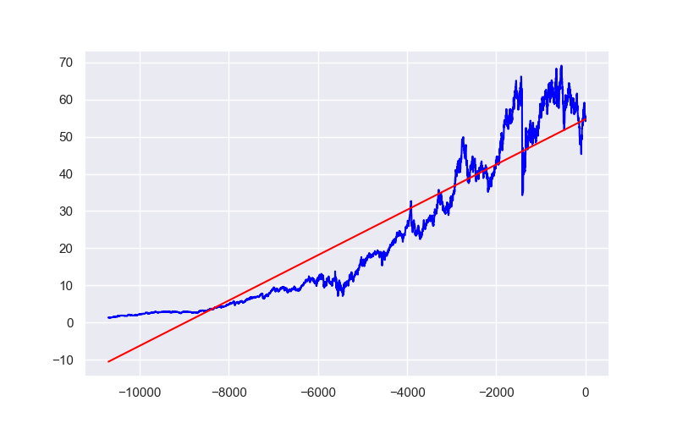
Linear regression

Slide 46
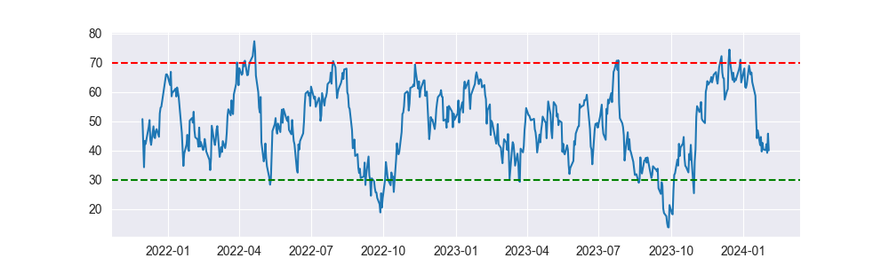
Relative Strength Index (RSI)

Slide 47
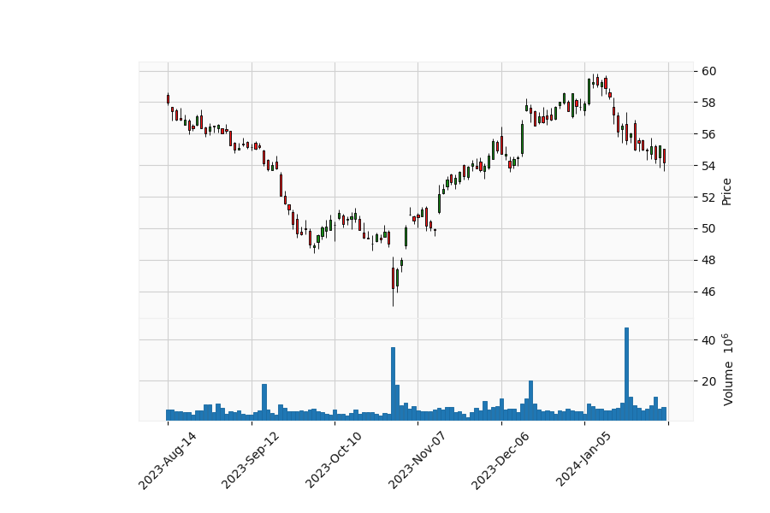
Last six months zoom

Slide 48
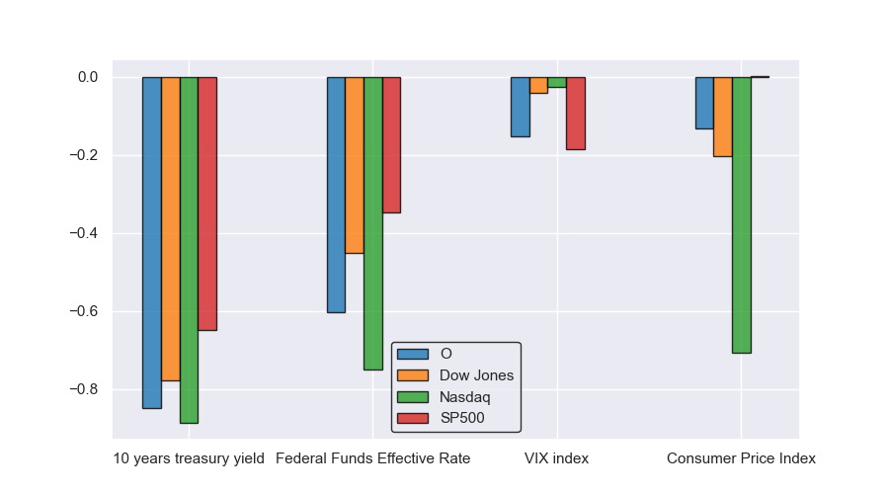
Correlations between various indexes and indicators

Slide 49
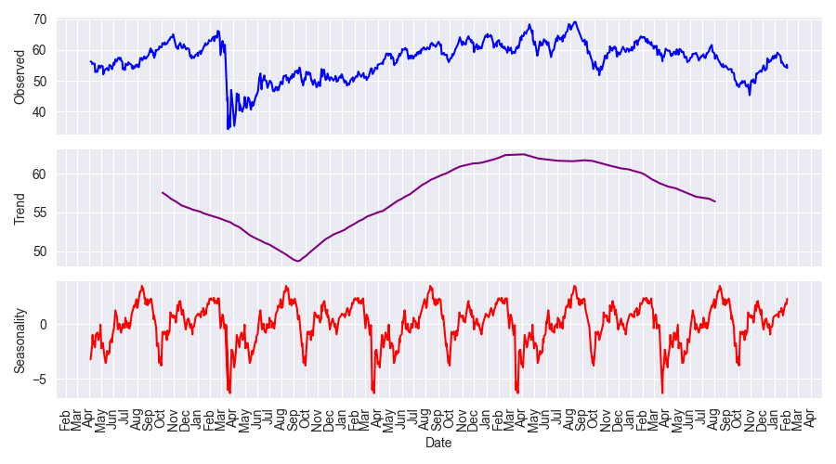
Breakdown of annual seasonality within the last years

Slide 50
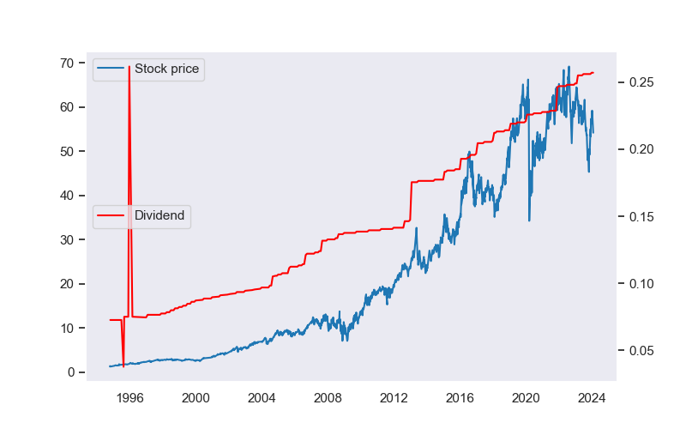
Price and dividends

Slide 51
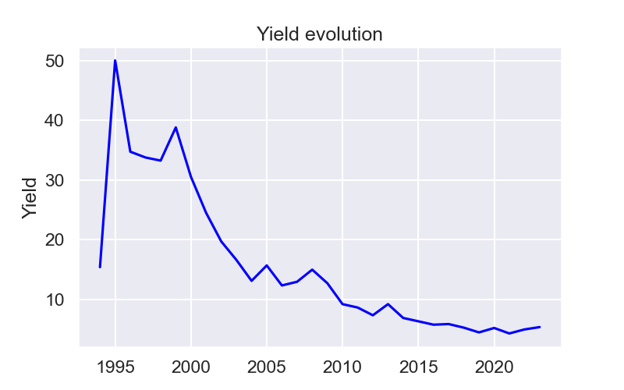
Dividend yield for O

Slide 52

Dividend yield for O 5 years

Slide 53

Dividend per year and per share

Slide 54

Dividend percentage changes statistics by year

Slide 55

Dividend percentage changes statistics by year (5 years)

Slide 56

Dividend scores overall

Slide 57

Dividend scores 5 years

Slide 58

Investor distribution

Slide 59

Market feeling analysis, based on news titles.

Slide 60
Numbers and interestings informations.
The increase in average price over 30 years is 13.28% and 1.88% over the last 5 years. The average standard deviation a year is 1.78 and 1.32 over the last 5 years. The Sharpe and Sortino ratios are respectively 0.4709 and 0.0479 and 0.0897 and 0.0202 over the last 5 years. The three main institutional investors are, in decreasing order of detention: -Avanguard Group Inc -BlackRock Inc. -State Street Corporation. Date of this report: 2024-02-04

