Slide 1
VF-CORPORATION-14798
V. F. Corporation specializes in the design, manufacture and marketing of clothing and accessories for men, women and children.The CA by family of products is distributed as follows:- clothes, shoes and relaxed and sport accessories (45%): Vans® brands, Supreme®, Kipling®, Napapijri®, Eastpak®, Jansport® and Eagle Creek®;-Clothes, shoes and outdoor equipment (44.7%): The North Face® brands, Timberland®, Smartwool®, Icebreaker® and Altra®;- Clothes and work shoes (10.2%): Dickies® andTimberland Pro®;- Others (0.1%). CA per source of income ventilates between product sales (99.4%) and royalties (0.6%). The geographic distribution of the CA is as follows: States-Unis (50.2%), Americas (5%), Europe (28.3%) and Asia-Pacific (16.5%). Number of employees: 35,000 people.Capitalization, business value, turnover, EBITDA, EBIT, EBT, net profit, debt and net cash, free cash flow, equity, total assets and CAPEX are in millions.

Slide 2
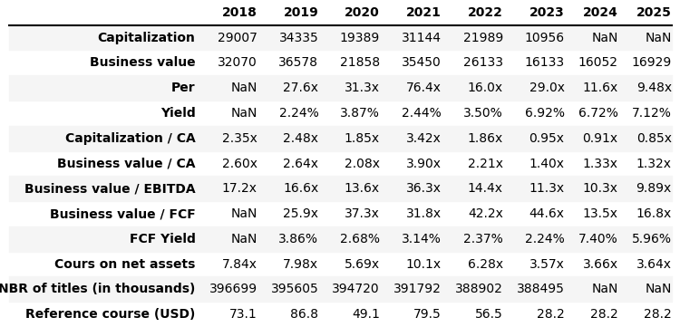
Array 1

Slide 3
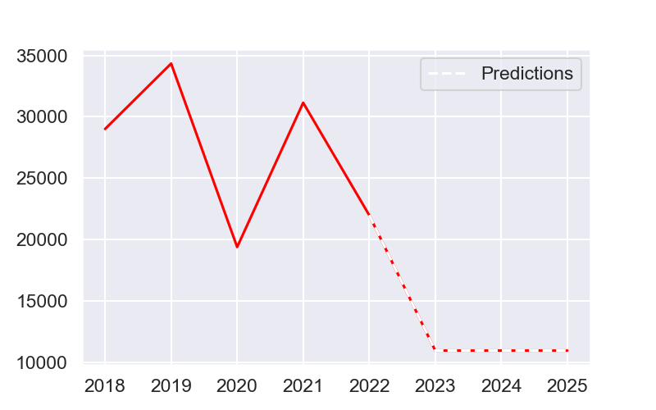
Capitalization

Slide 4
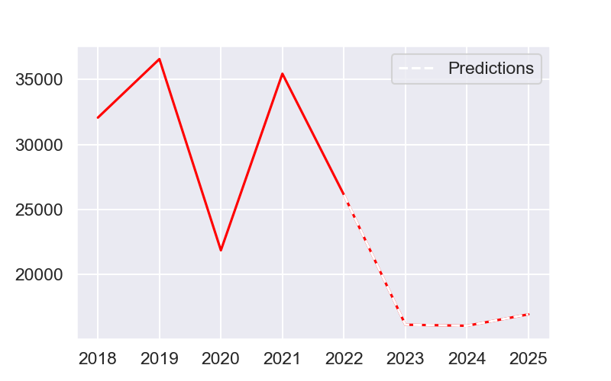
Business value

Slide 5
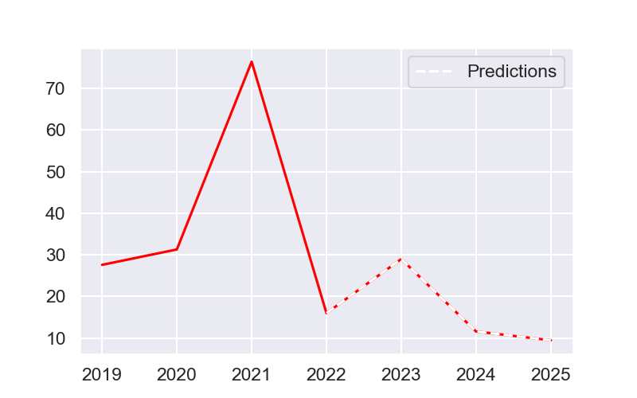
Per

Slide 6
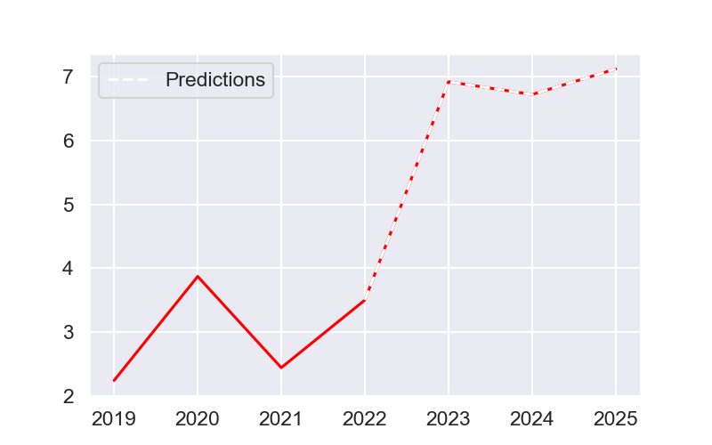
Yield

Slide 7
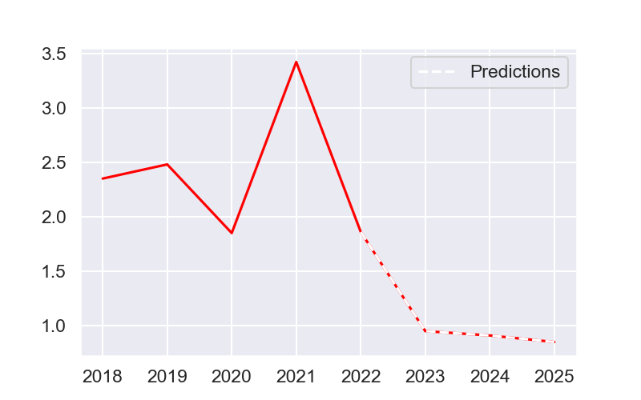
Capitalization / CA

Slide 8
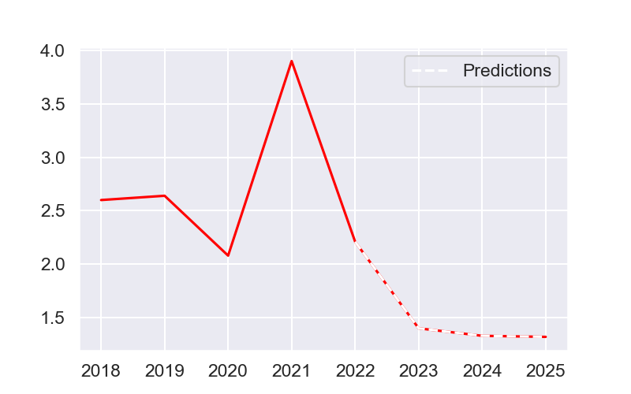
Business value / CA

Slide 9
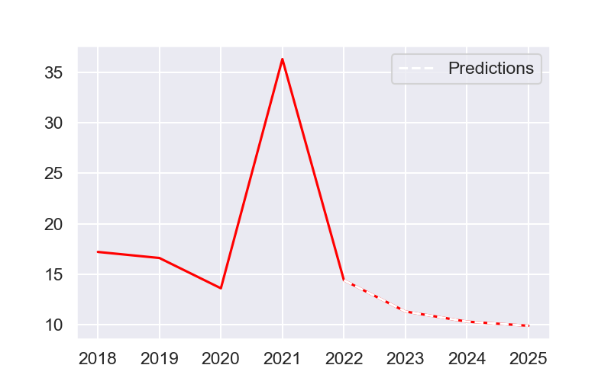
Business value / EBITDA

Slide 10
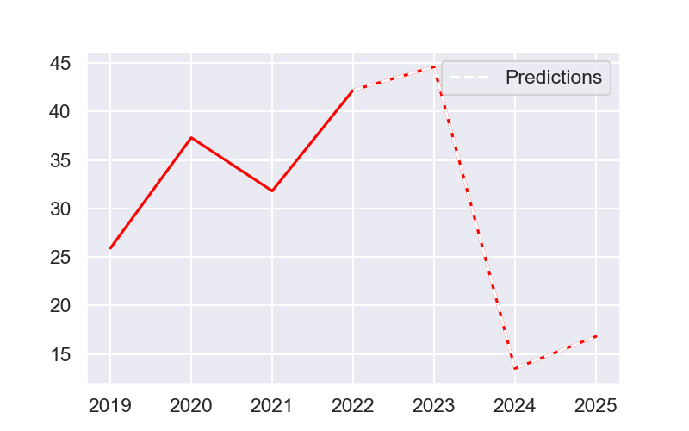
Business value / FCF

Slide 11
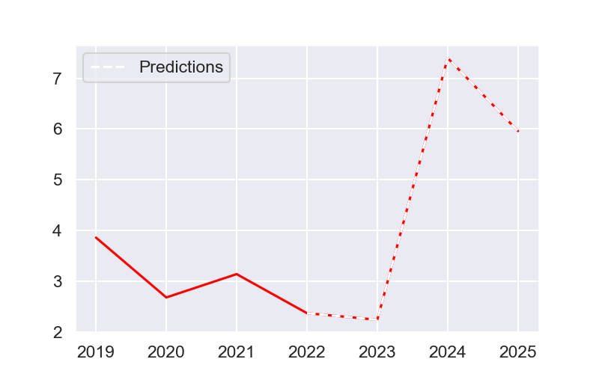
FCF Yield

Slide 12
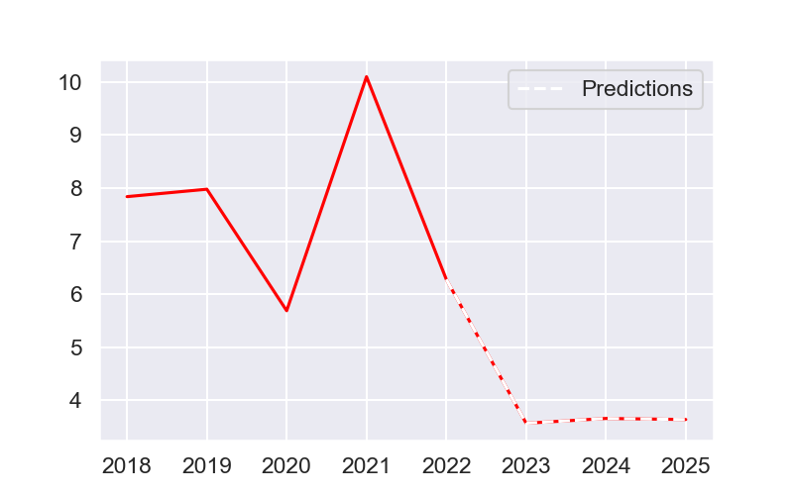
Cours on net assets

Slide 13
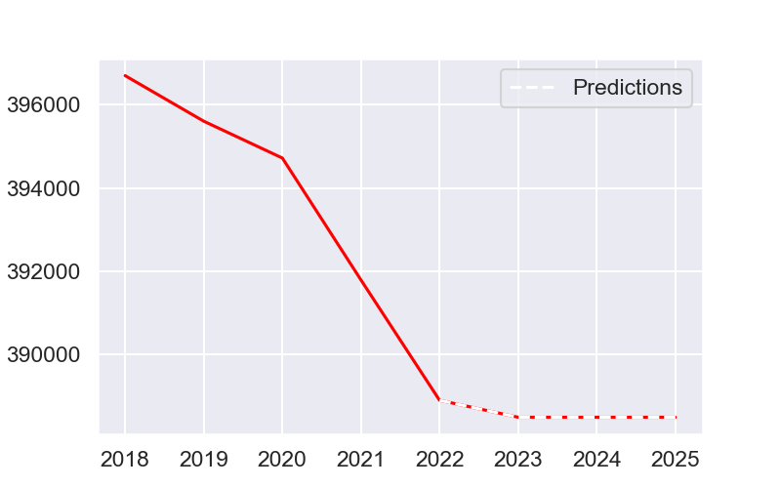
NBR of titles (in thousands)

Slide 14
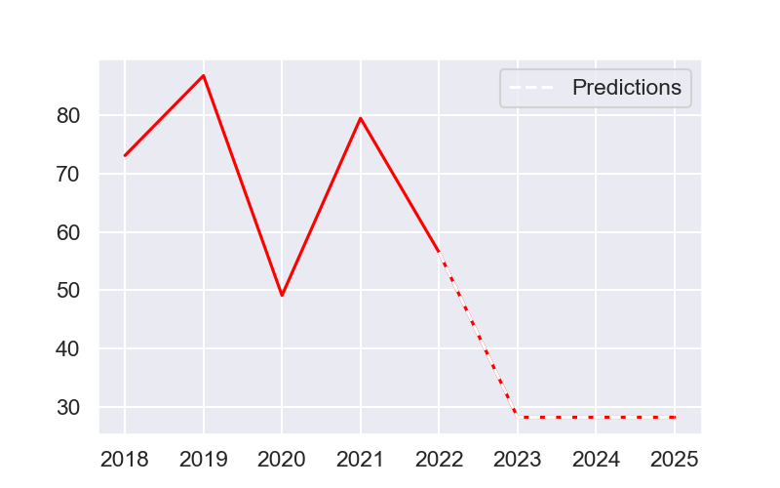
Reference course (USD)

Slide 15
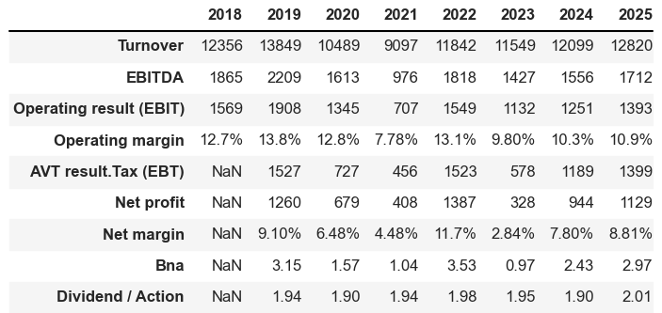
Array 2

Slide 16
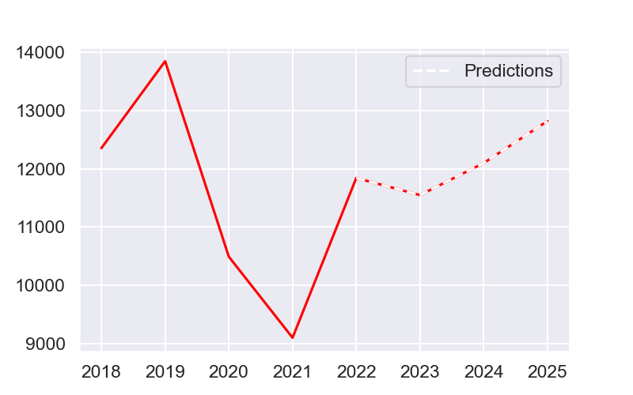
Turnover

Slide 17
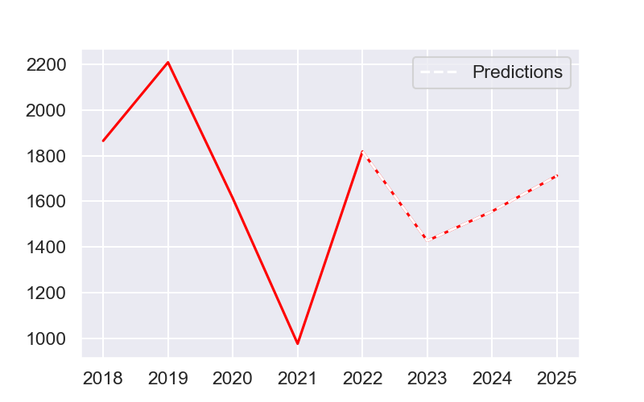
EBITDA

Slide 18

Operating result (EBIT)

Slide 19
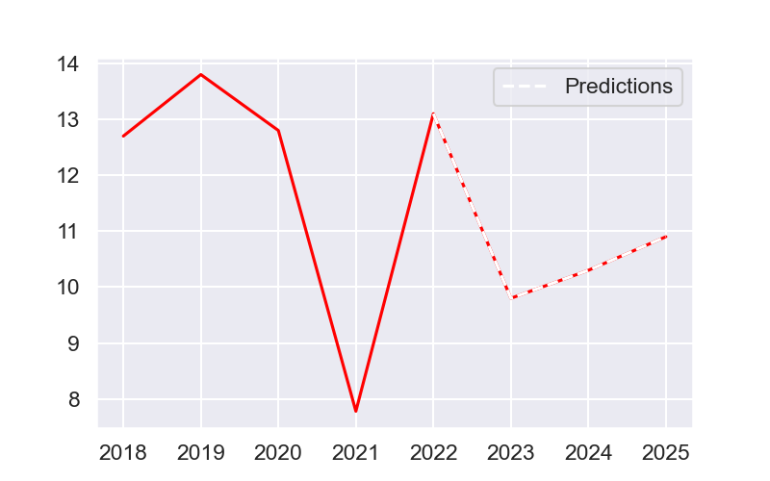
Operating margin

Slide 20
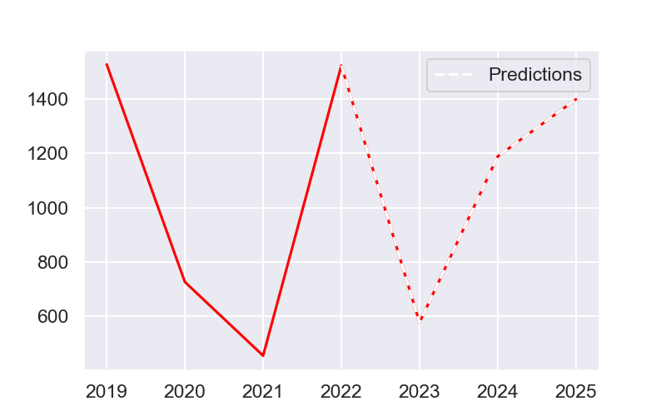
AVT result.Tax (EBT)

Slide 21
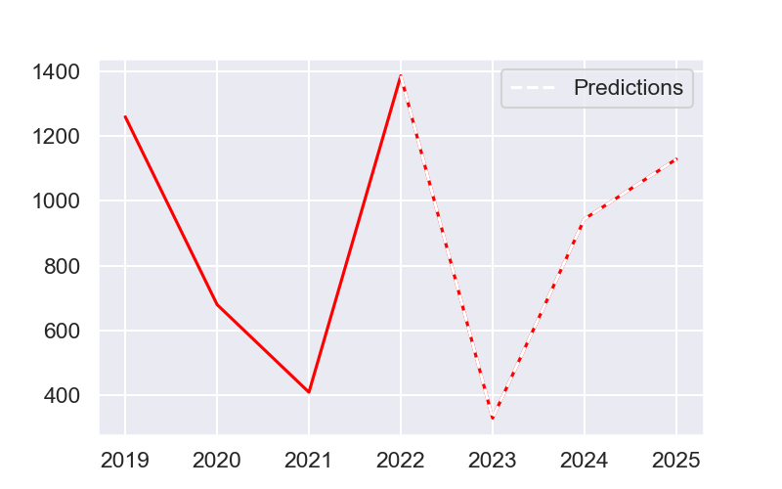
Net profit

Slide 22
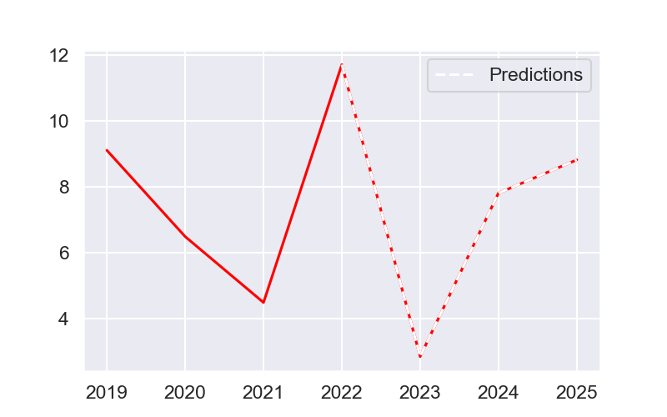
Net margin

Slide 23
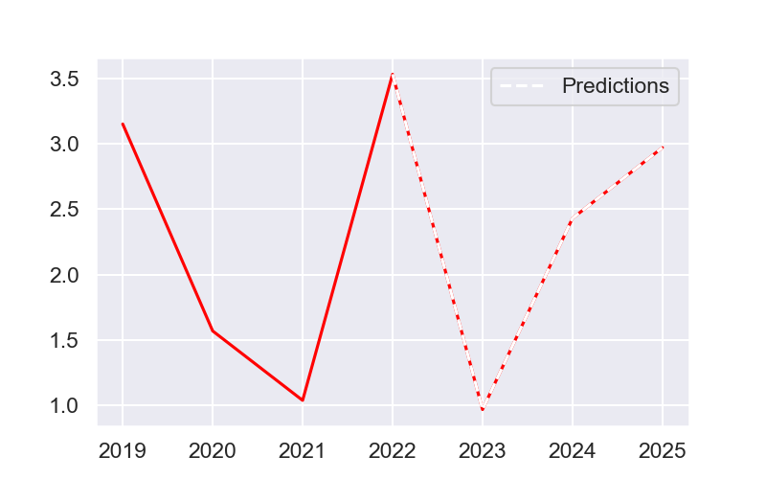
Bna

Slide 24
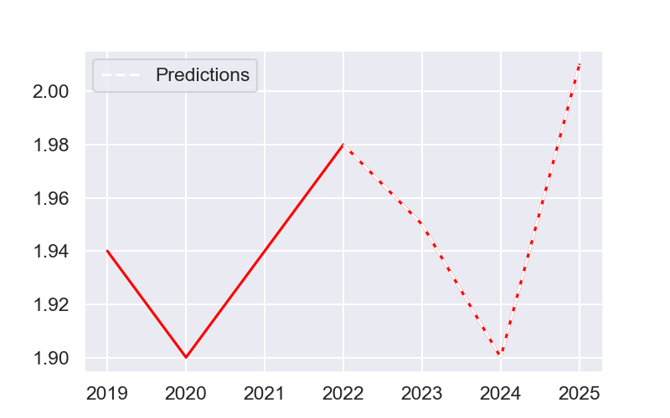
Dividend / Action

Slide 25
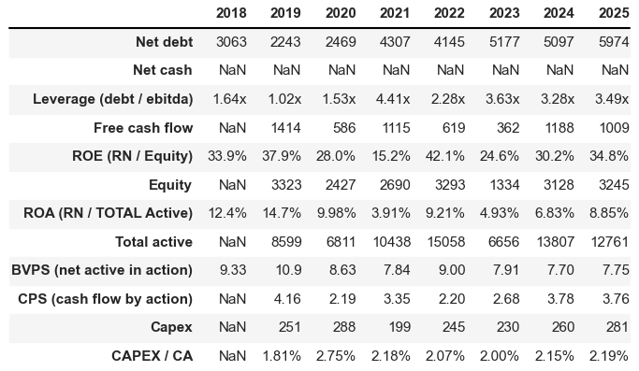
Array 3

Slide 26
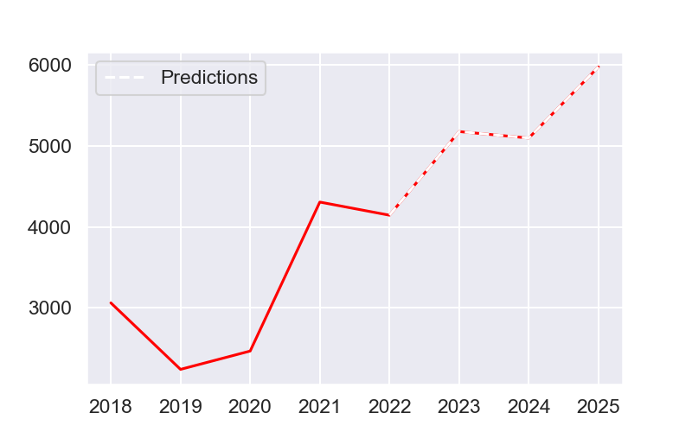
Net debt

Slide 27
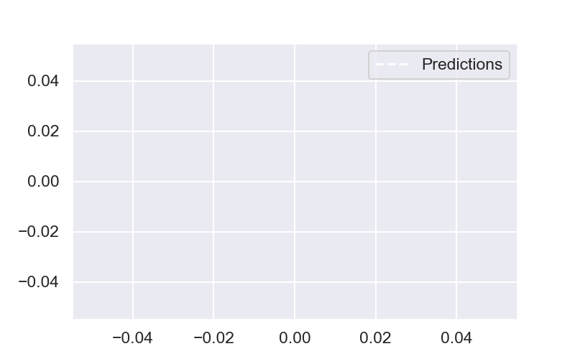
Net cash

Slide 28
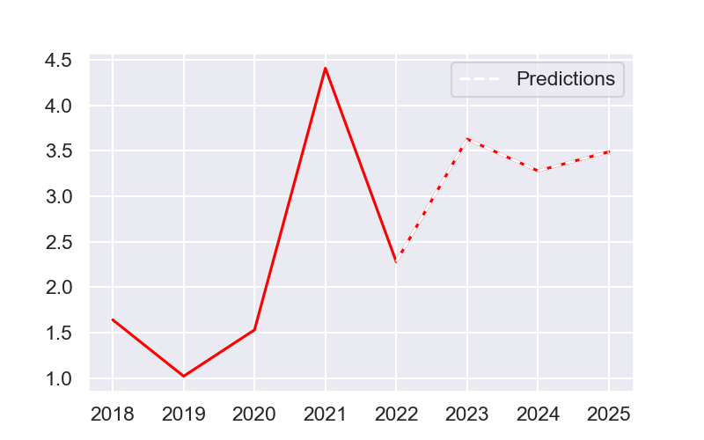
Leverage (debt / ebitda)

Slide 29
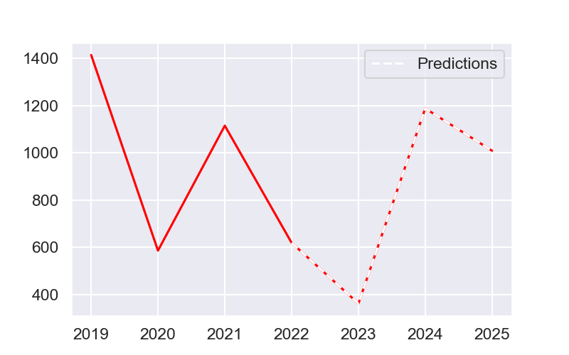
Free cash flow

Slide 30
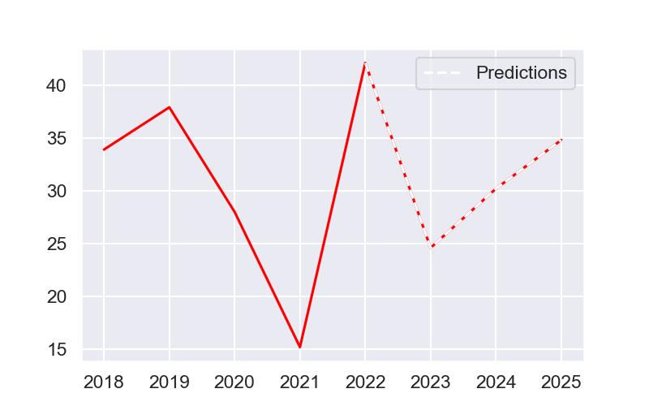
ROE (RN / Equity)

Slide 31
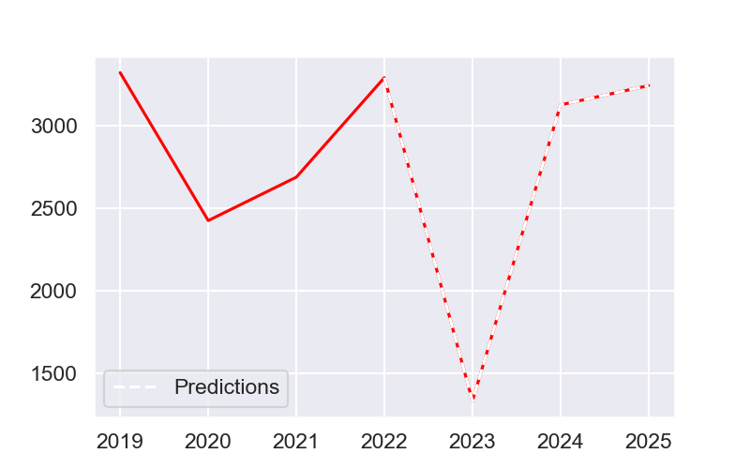
Equity

Slide 32
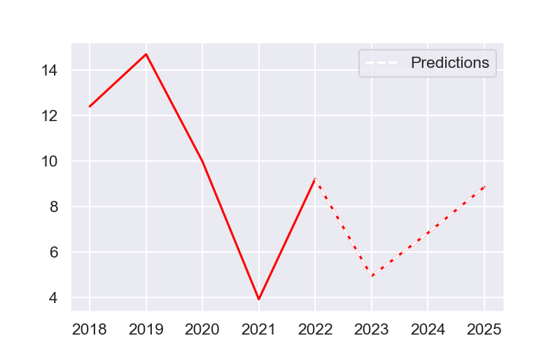
ROA (RN / TOTAL Active)

Slide 33
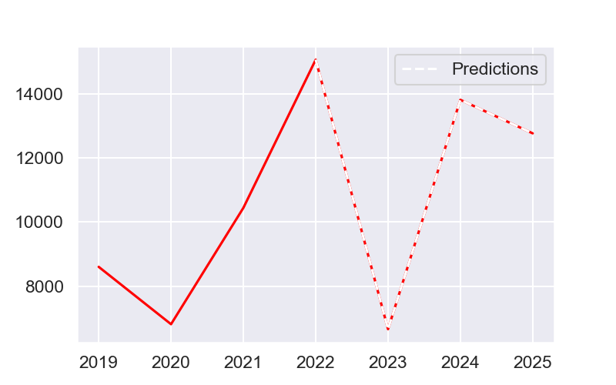
Total active

Slide 34
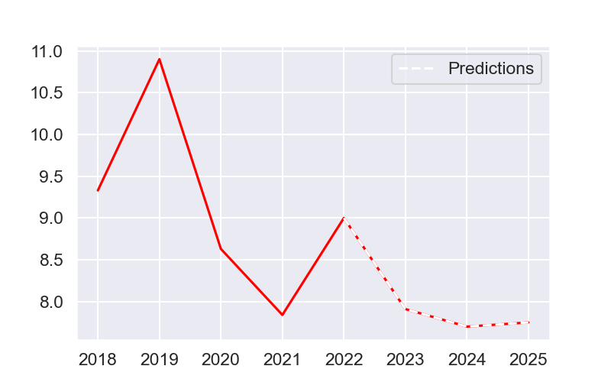
BVPS (net active in action)

Slide 35
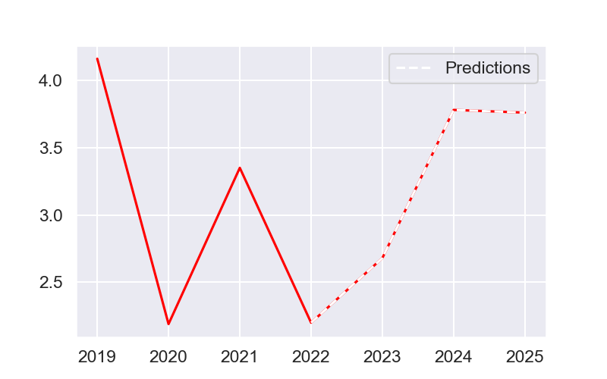
CPS (cash flow by action)

Slide 36
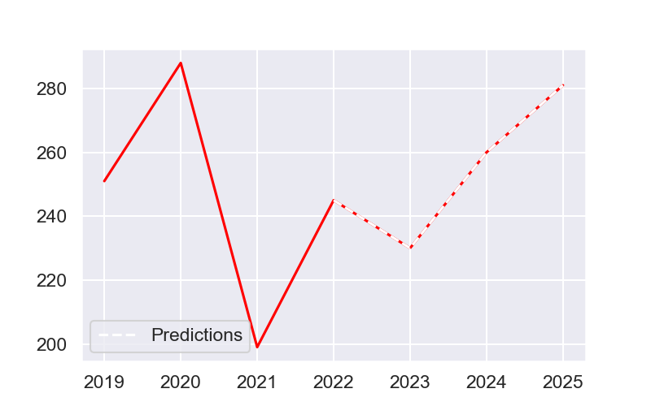
Capex

Slide 37
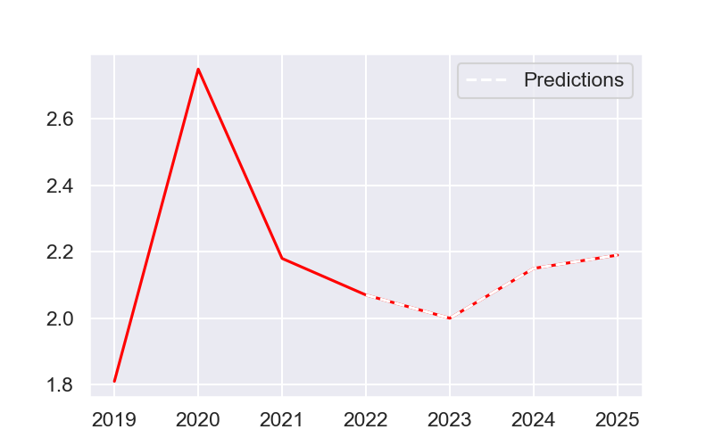
CAPEX / CA

Slide 38
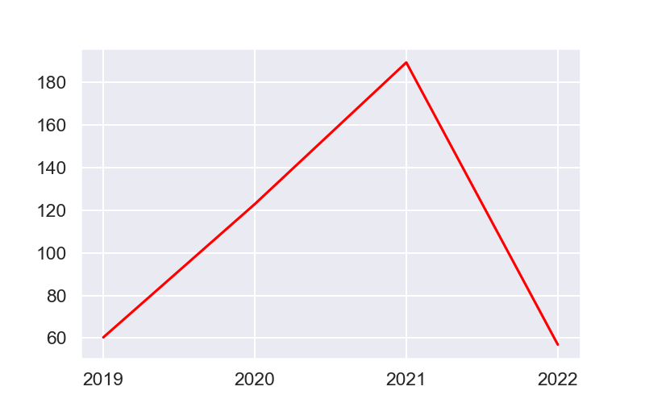
Pay out ratio

Slide 39
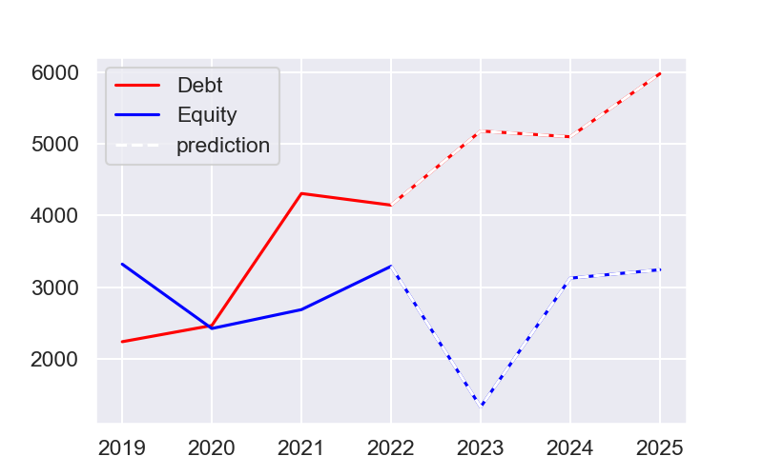
Equity versus debt

Slide 40
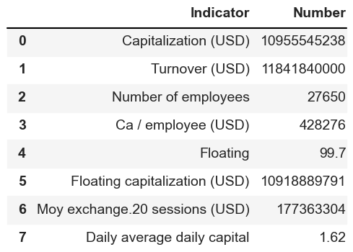
Key numbers

Slide 41
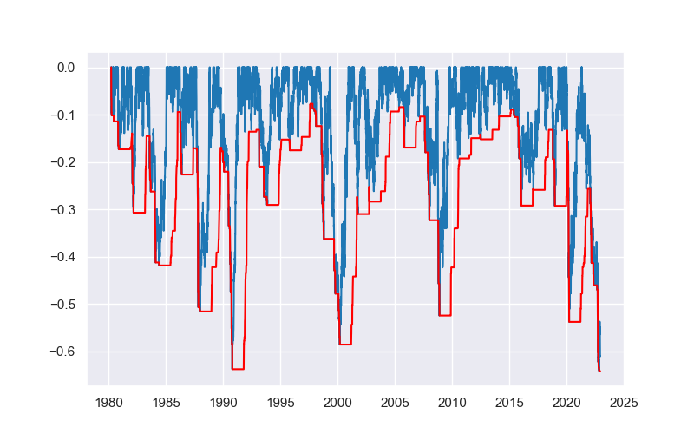
Maximum loss

Slide 42
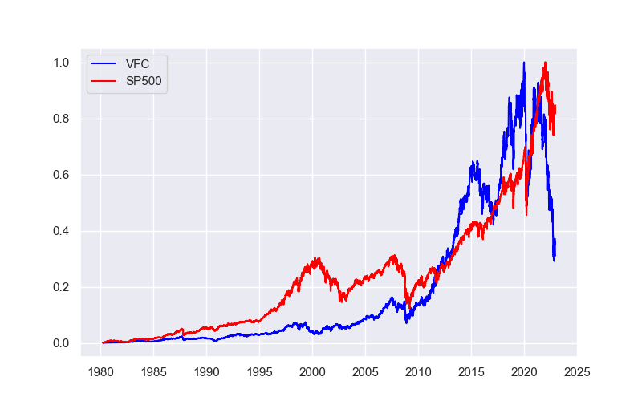
Normalized stocks price :VFC vs SP500

Slide 43
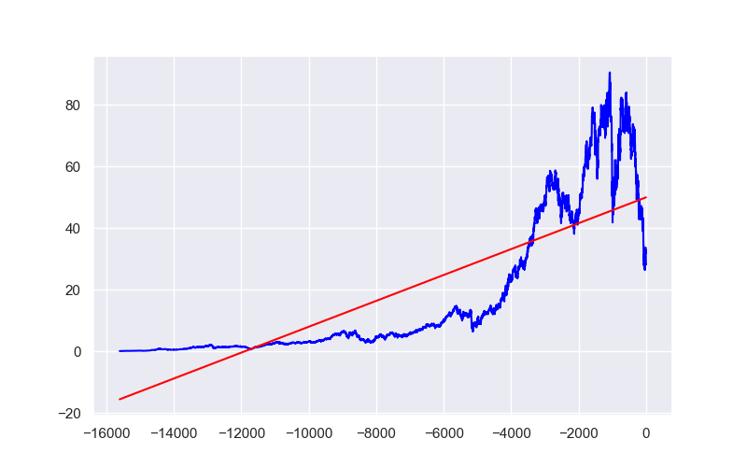
Linear regression

Slide 44
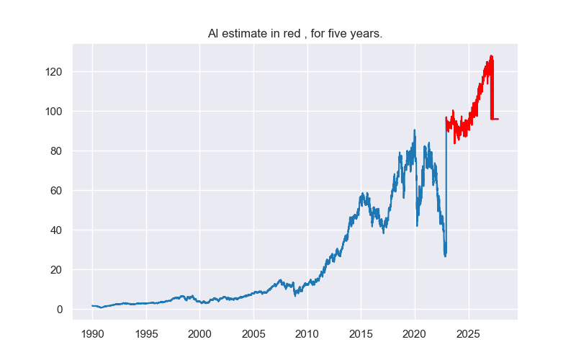
AI estimate

Slide 45
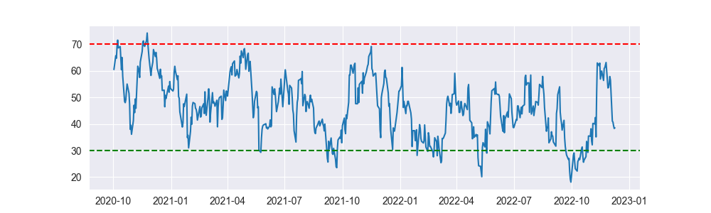
Relative Strength Index (RSI)

Slide 46
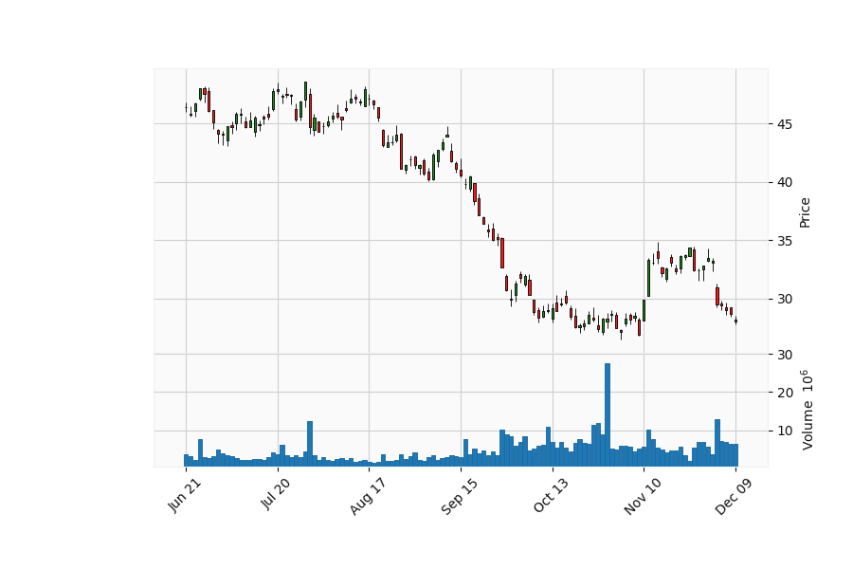
Last six months zoom

Slide 47
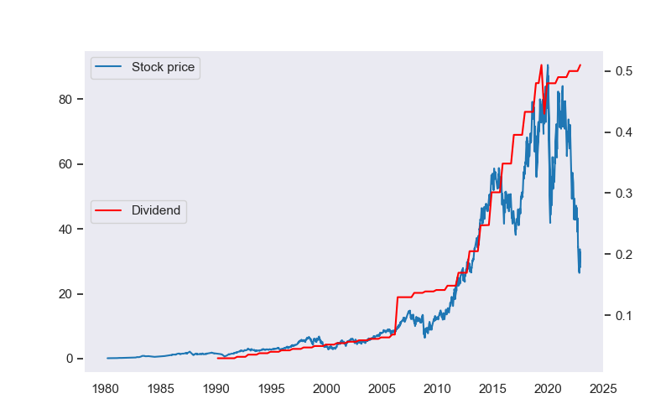
Price and dividends

Slide 48
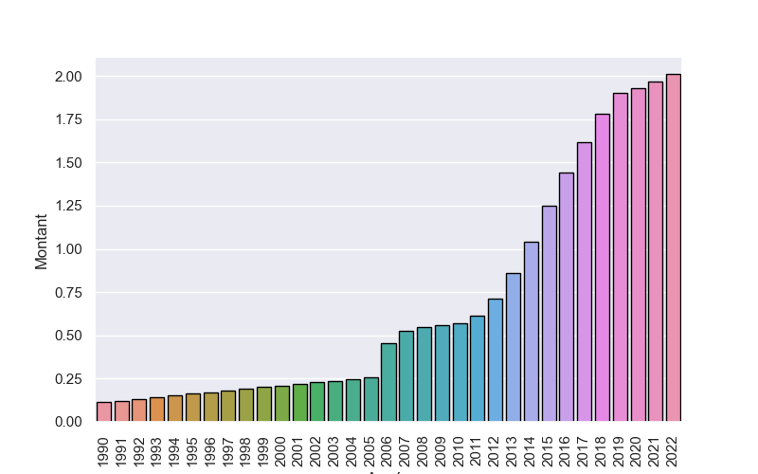
Dividend per year and per share

Slide 49
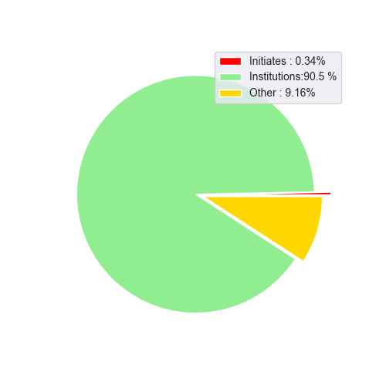
Investor distribution

Slide 50
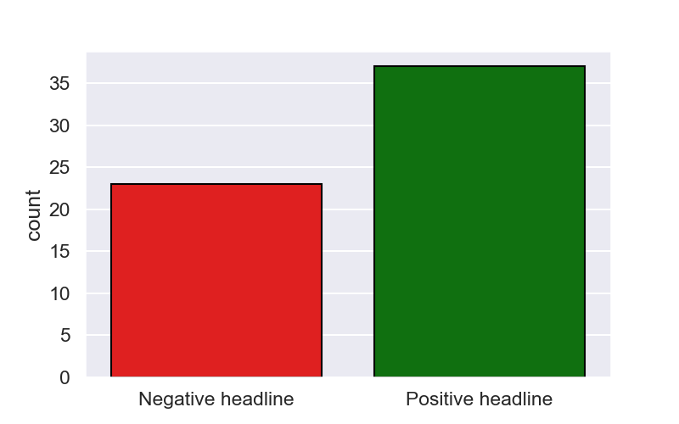
Market feeling analysis, based on news titles.

Slide 51
Numbers and interestings informations.
The annual return on investment over 42 years is 13.99% and -28.79% over the last 5 years. The standard deviation of gains and losses is 1.95 and 2.7 over the last 5 years. The Sharpe and Sortino ratios are respectively 0.4516 and 0.0493 and -0.6703 and -0395 over the last 5 years. The three main institutional investors are, in decreasing order of detention: PNC Financial Services Group, Inc. Vanguard Group, Inc. (The) International International Capital. Date of this report: 2022-12-10

