Slide 1
Projet 4 : OpenPLC – I2C

Slide 2
Programme
Problématique
Organisation
Résulta
Difficultés rencontrées
Conclusion

Slide 3

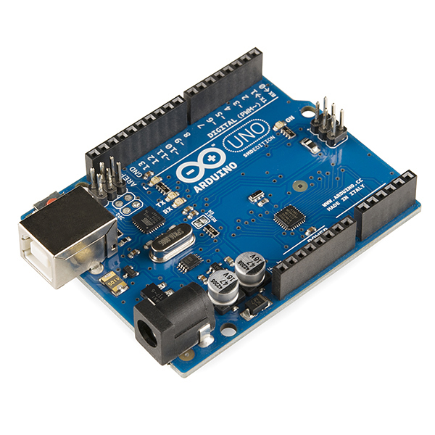
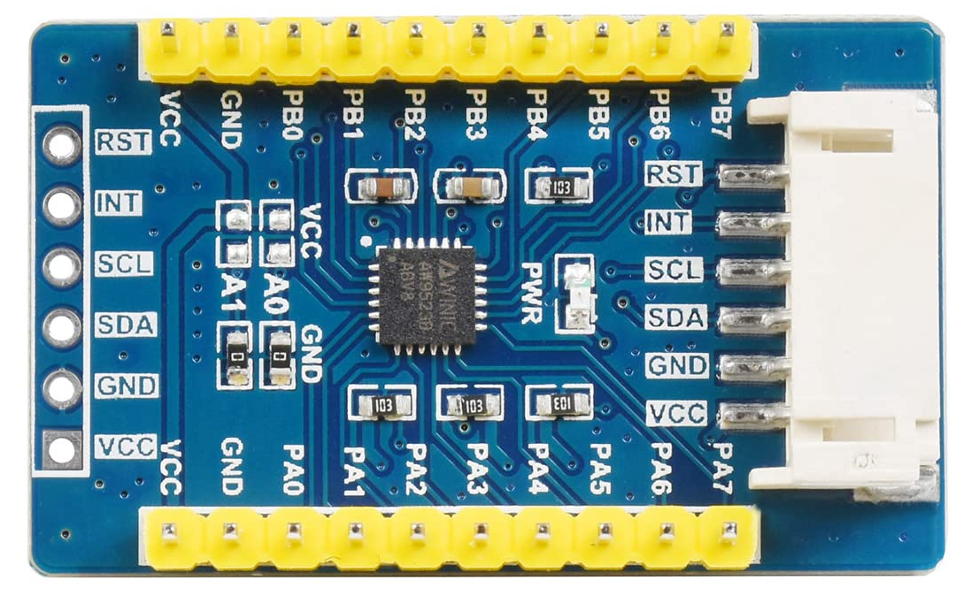
Problématique
OpenPLC
I²C
Arduino
GPIO

Slide 4



Organisation – Roadmap
Rapport de réunion
Roadmap

Slide 5

Organisation – Temps
Planning de travail
Temps de travaillé
Temps de prévu (ADE)
Balance :
Worklog

Slide 6
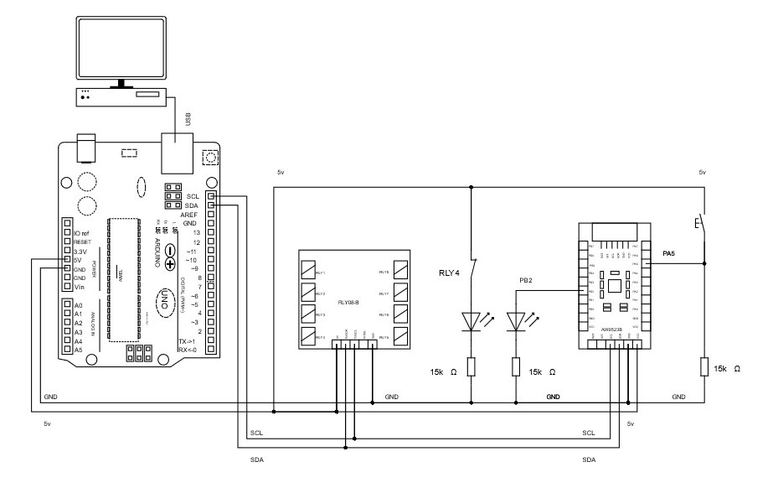
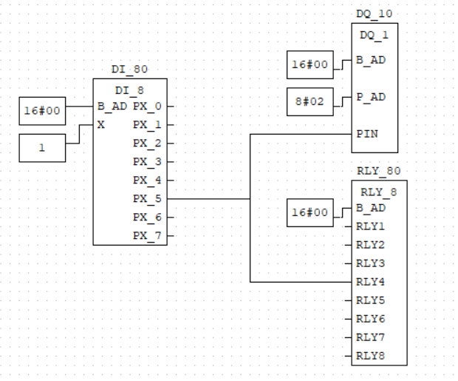
Résulta – Bloque
Circuit
Bloque OpenPLC

Slide 7



Résulta – Outil d’Importation
Librairie
Script Python
Configuration

Slide 8


Difficultés – Organisationnel
Objectif variable
Agile

Slide 9



Difficultés – Technique
Code erreur
Terminal

Slide 10


Difficultés – Technique
Syntaxe
Forum

Slide 11
Conclusion

Slide 12
Merci
Mathieu Giamberini

Slide 13
Crédit
Activity icons created by redempticon – Flaticon
Spreadsheet icons created by Hopstarter - Flaticon
Python icons created by Freepik - Flaticon
Zip file format icons created by NajmunNahar - Flaticon
Json icons created by LAB Design Studio - Flaticon
Methodology icons created by SBTS2018 - Flaticon
Adventurer icons created by max.icons - Flaticon
Pathway icons created by Freepik - Flaticon
Cyber security icons created by Vlad Szirka - Flaticon
Terminal icons created by Assetwave - Flaticon
Syntax icons created by Uniconlabs - Flaticon
Forum icons created by Smashicons - Flaticon
Copy link icons created by riajulislam - Flaticon

