Slide 1
Caspofungin

Slide 2
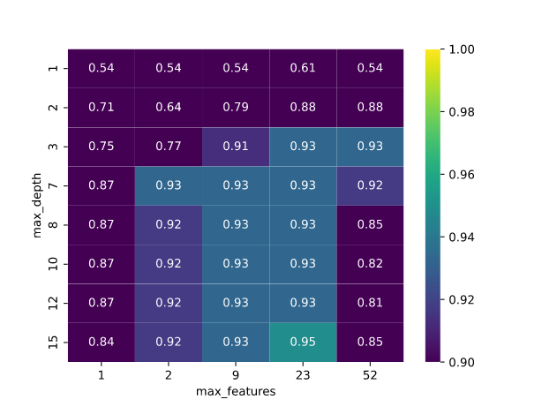
Log2(522) == 9
SQRT(522) == 23

Slide 3
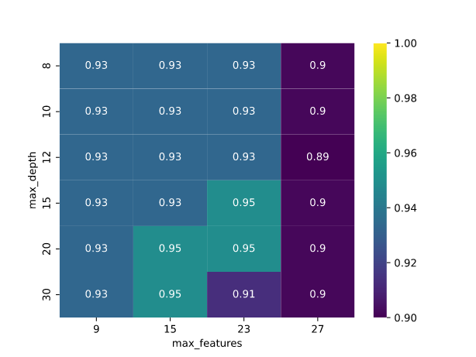

Slide 4
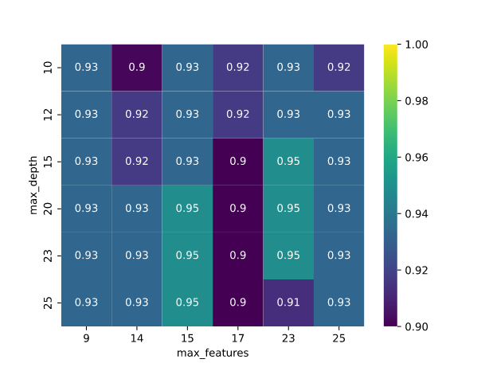

Slide 5
New gridsearch:
grid = {'n_estimators': [100],
'max_features': [9, 14, 15, 17, 23, 25],
'max_depth': [10,12,15,20,23,25],
'min_samples_split': [2],
'min_samples_leaf' : [1],
'random_state': [18]}

Slide 6
Best params caspofungin:
{'max_depth': 23, 'max_features': 9, 'min_samples_leaf': 1, 'min_samples_split': 2, 'n_estimators': 100, 'random_state': 18}

Slide 7
Train Balanced Acc : 0.9663919413919414
Test Balanced Acc : 0.9330357142857143

Slide 8
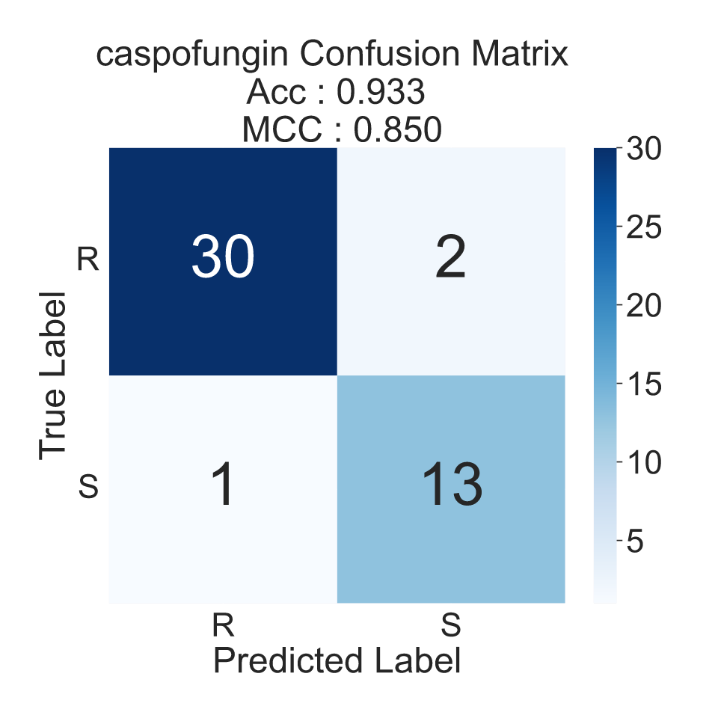

Slide 9
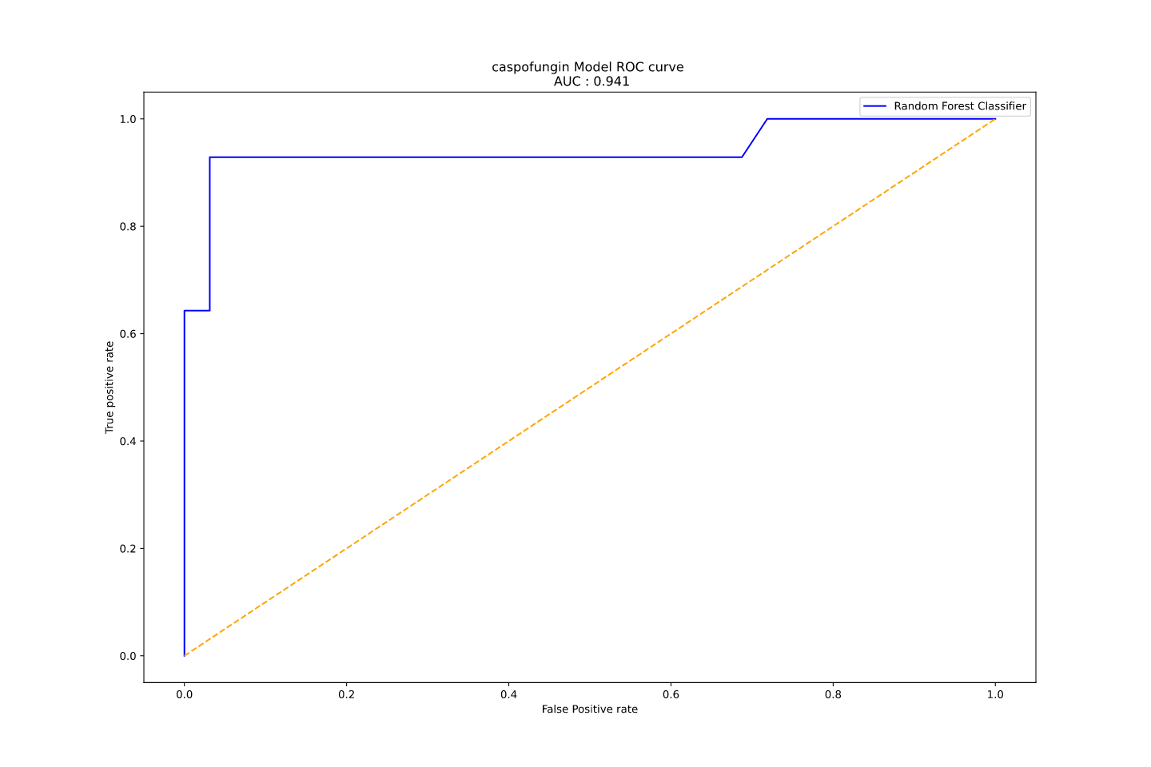

Slide 10
Anidulafungin

Slide 11
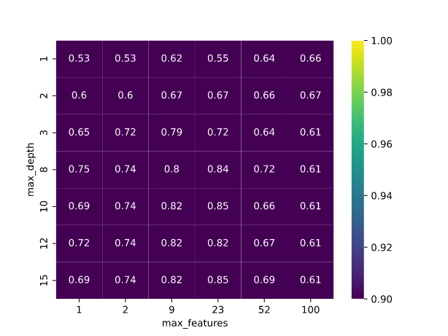

Slide 12
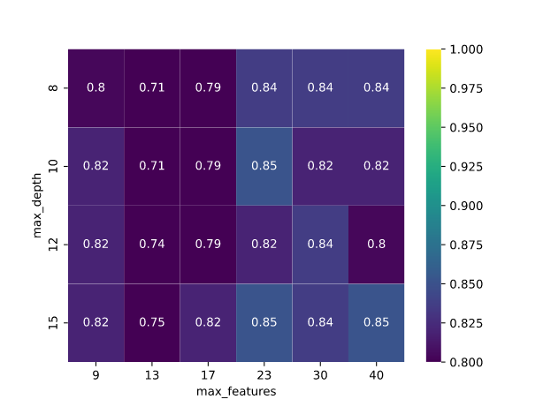

Slide 13
New gridsearch:
grid = {'n_estimators': [100],
'max_features': [9, 13, 17, 23, 30, 40],
'max_depth': [8, 10, 12, 15],
'min_samples_split': [2],
'min_samples_leaf' : [1],
'random_state': [18]}

Slide 14
Best params anidulafungin:
{'max_depth': 15, 'max_features': 9, 'min_samples_leaf': 1, 'min_samples_split': 2, 'n_estimators': 100, 'random_state': 18}

Slide 15
Train Balanced Acc : 0.965958605664488
Test Balanced Acc : 0.8193548387096774

Slide 16
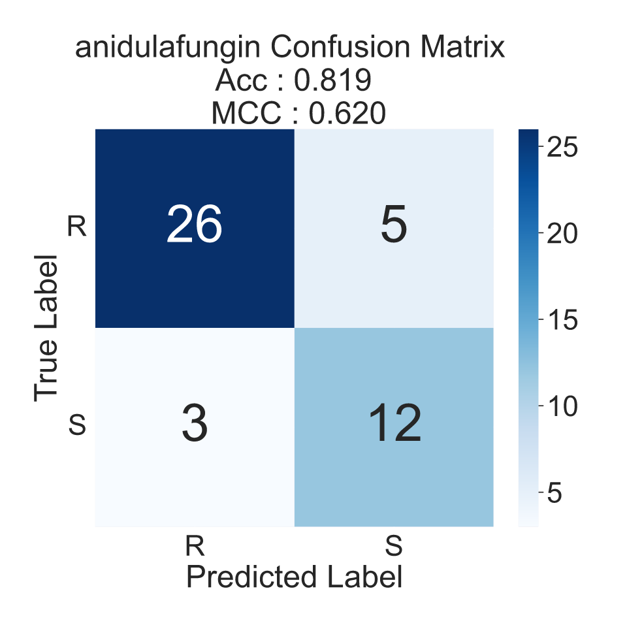

Slide 17
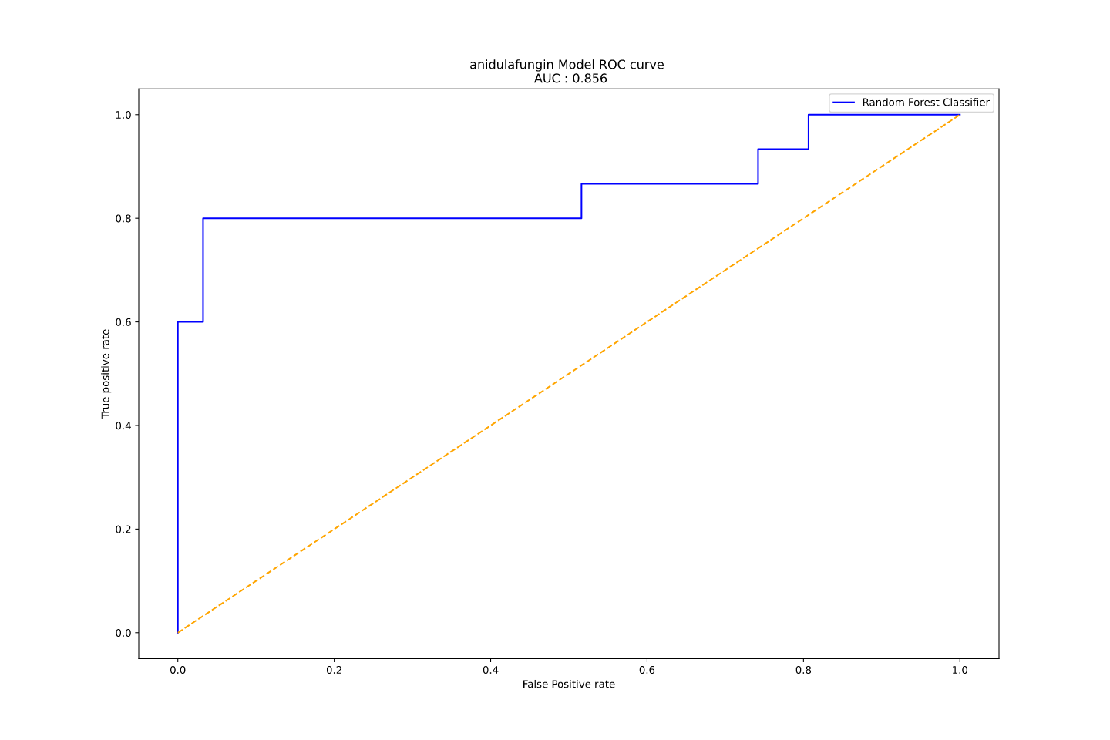

Slide 18
Micafungin

Slide 19
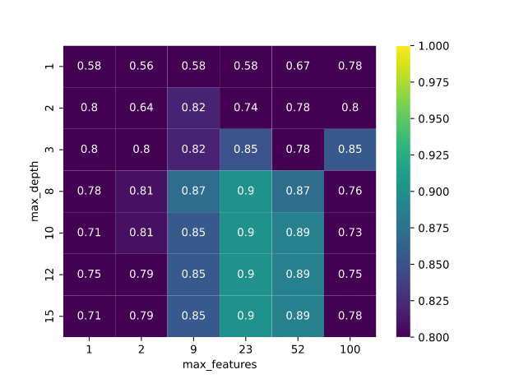

Slide 20
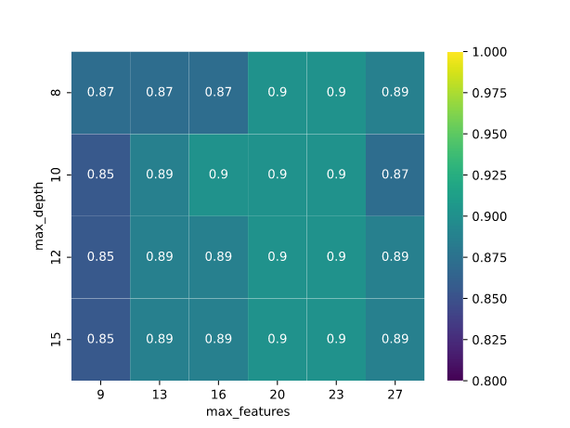

Slide 21
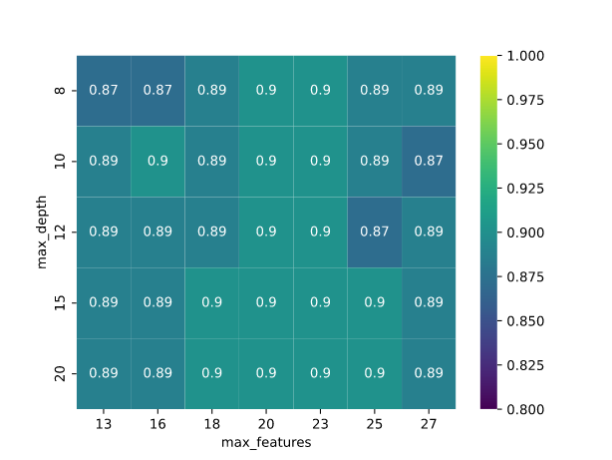

Slide 22
New gridsearch:
grid = {'n_estimators': [100],
'max_features': [19,20,21,23,25,27],
'max_depth': [12,13,14,15,16,17,20],
'min_samples_split': [2],
'min_samples_leaf' : [1],
'random_state': [18]}

Slide 23
Best params micafungin:
{'max_depth': 20, 'max_features': 27, 'min_samples_leaf': 1, 'min_samples_split': 2, 'n_estimators': 100, 'random_state': 18}

Slide 24
Train Balanced Acc : 0.9592925659472422
Test Balanced Acc : 0.8861607142857143

Slide 25
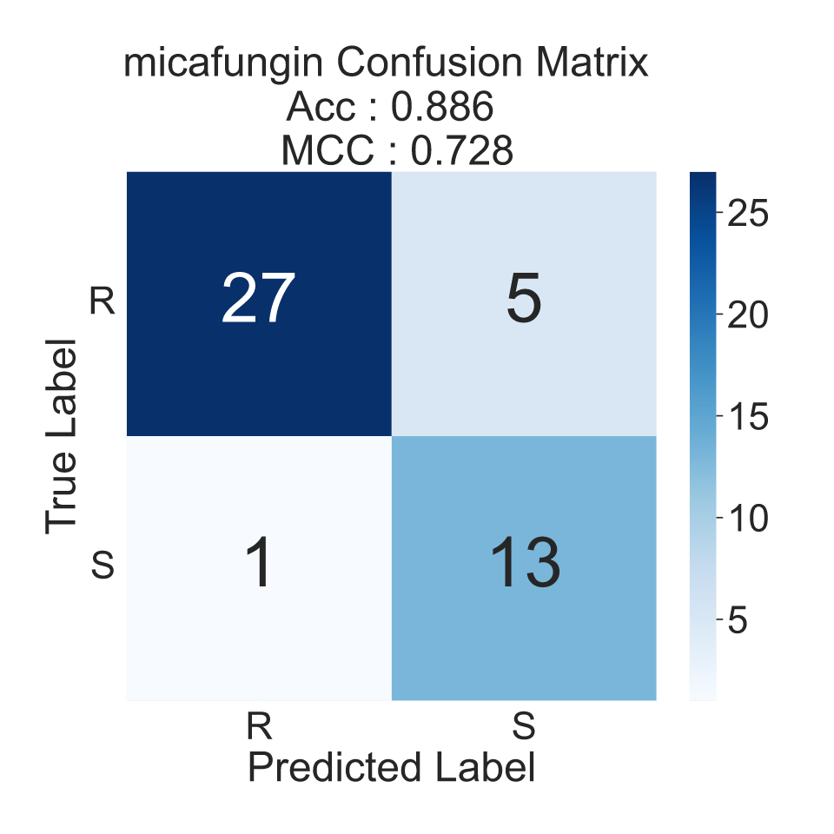

Slide 26
