Slide 1
Wahab Hamou-Lhadj Associate Professor Department of Electrical and Computer Engineering Concordia University abdelw@ece.concordia.ca
May 2, 2016

Slide 2
The Mission of the Software Behaviour Analysis Research Lab
To investigate techniques and tools to help software (and system) analysts understand and analyze the behaviour of complex software systems with the primary goal of enhancing maintenance, security, and addressing performance problems

Slide 3
Topics of interest
Tracing, logging, and runtime monitoring
Big data analytics of log and trace data
Log management and engineering
Cloud-based logging and tracing infrastructures
System diagnosis and observability
Dynamic analysis for program comprehension
Model-driven software tracing and debugging
Online system observation and surveillance
Software healing and adaptation
Visualization and classification of program behaviour

Slide 4







Current Projects
AHLS - Advanced Host-Level Surveillance
D2K - From Data 2 Knowledge for Better System Maintenance
OpenSim - An Open Architecture for Aircraft Simulation Integration and Monitoring Methods Using the HLA Standard
AVIO 508 - Diagnostics for Real Time Distributed Multi-core Architecture in Avionics

Slide 5
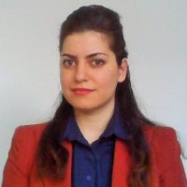

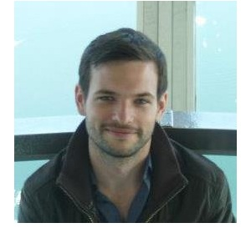
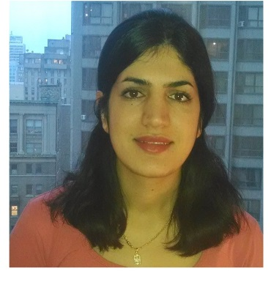

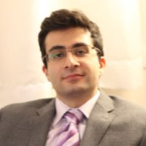
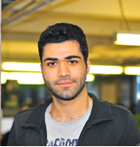
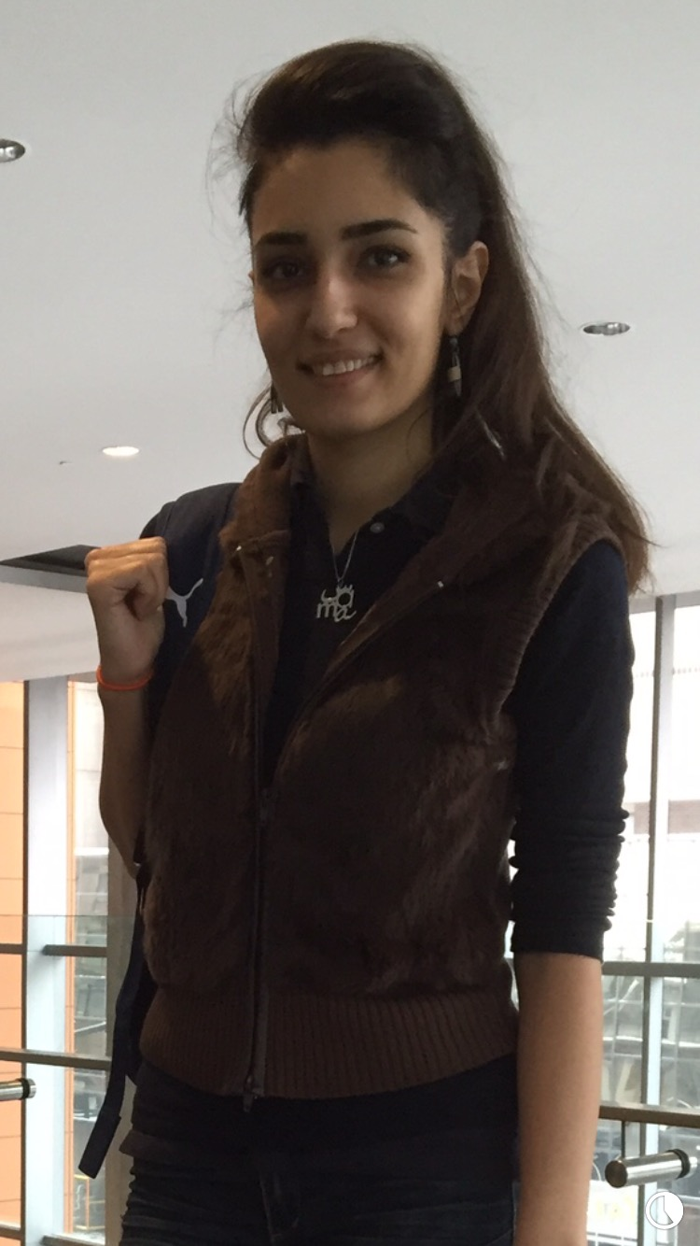

Neda Ebrahimi (PhD)
Korosh K. Sabor (PhD)
Mathieu Nayrolles (PhD)
Ava Khanmohammadi (PhD)
Md Islam Shariful (PhD)
Mohammad R. Rejali (PhD)
Amir Gahroosi (RA)
HQP
Sama Khosravifar (MSc.)
Abhishek Koyalkar (MEng.)

