Slide 1
Hyatt Hotel Analysis
IST 687 project
By Hannah, Leslie, Minyang, Palaniappan, Shaojie
Notes:
Hannah

Slide 2
Our Approach
Urban California business hotel
12 months
15,711,540 observations of 13 variables
All “N/A” data was omitted
Modeling techniques: probit modeling, linear modeling, and association rules to answer our business questions
SVM and Naive Bayes modeling were used to validate our results
The 13 variables :
Room Type
Room Type Description
Likelihood to Recommend
State
Type
Location
NPS Type
Guest room Satisfaction
Tranquility
Hotel Condition
Staff Cared Satisfaction
Customer Service Satisfaction
Internet Satisfaction
Check in Satisfaction
Notes:
Hannah

Slide 3
Business Questions
Which state in the country and area within a state and hotel type will provide the most useful information to improve NPS scores?
Which satisfaction metric including guest room satisfaction, tranquility satisfaction, hotel condition satisfaction, staff cared satisfaction, customer service satisfaction, internet satisfaction and check in satisfaction, is most important in predicting a promoter or detractor NPS type?
What room types should be increased or decreased to improve NPS?
Notes:
Hannah

Slide 4
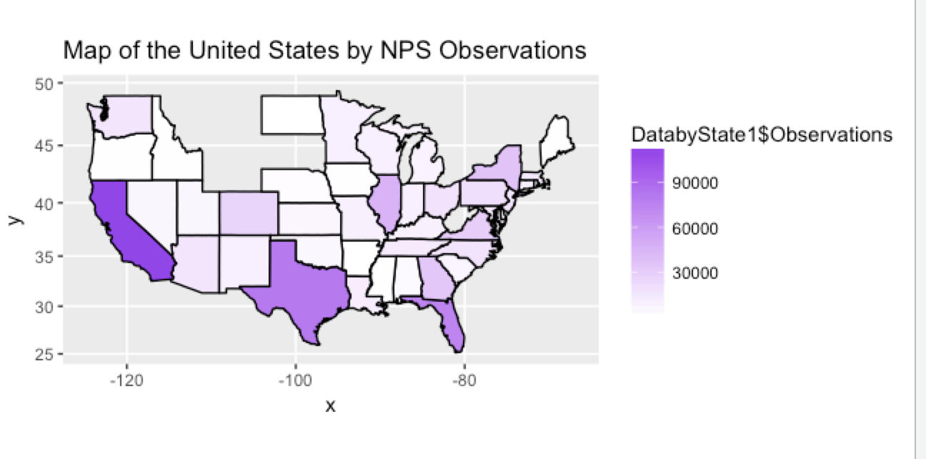
Understanding the Data- Why California?
Notes:
Palani

Slide 5
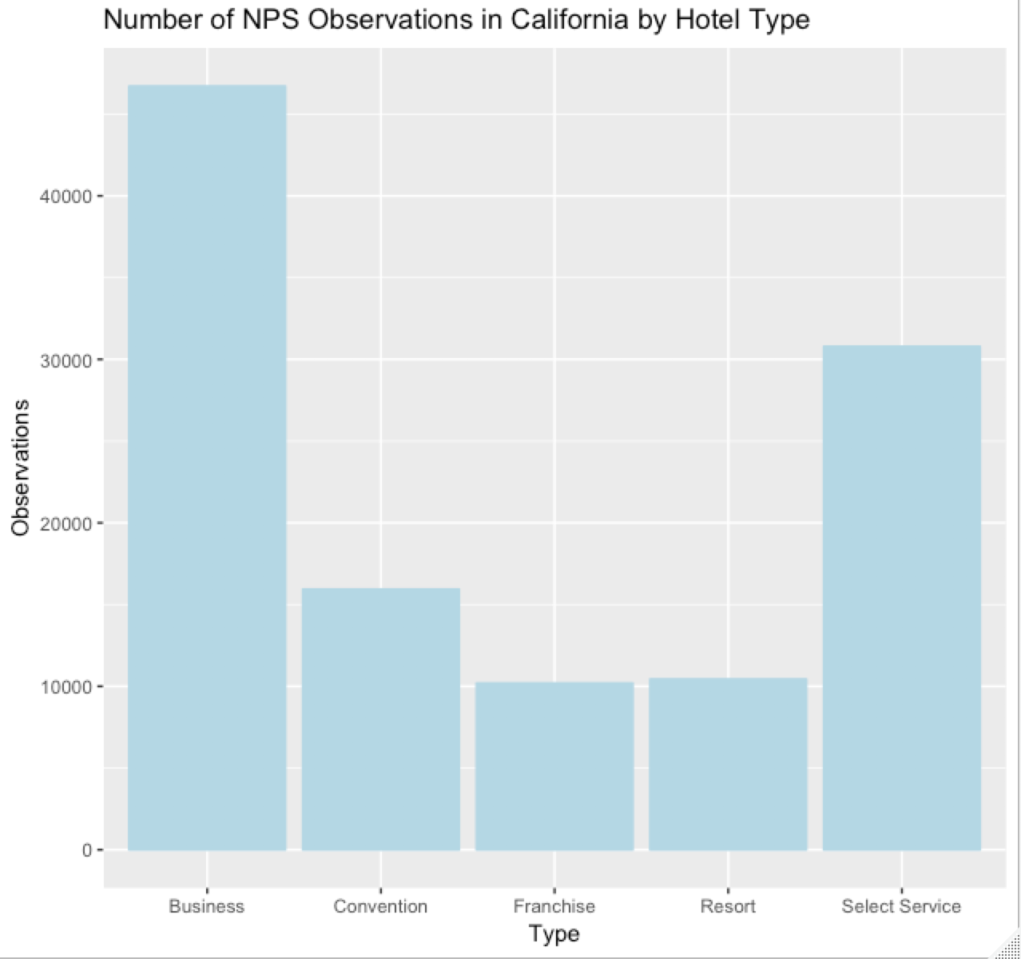
Understanding the Data- Why Business?
Notes:
Palani

Slide 6
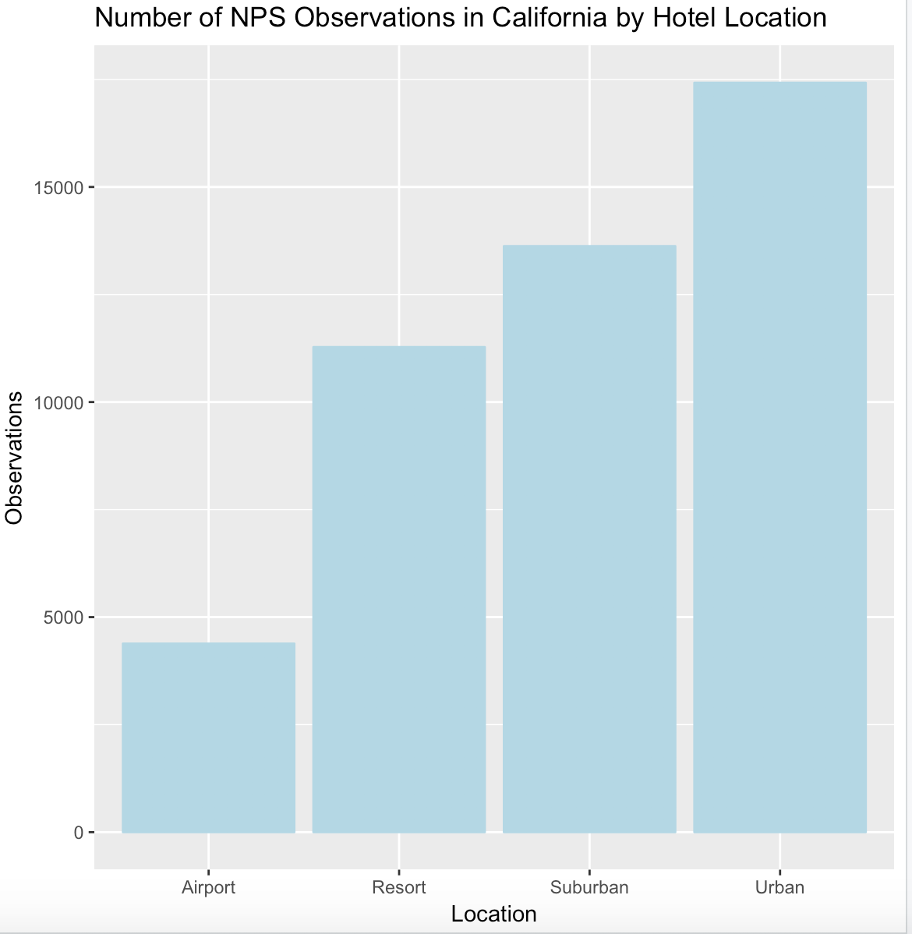
Understanding the Data- Why Urban?
Notes:
Palani

Slide 7
Modeling the Data- Probit Modeling
Hotel condition
Customer service quality
Guest room satisfaction
Internet satisfaction
Staff attitude
Tranquility
Check in process satisfaction
Different change in the possibility of having a promoter & detractor NPS type
Increase NPS score
Notes:
We used the profit model trying to find the relationship between the satisfaction metric and the possibility of having a promoter or detractor type of visit, to see whether a higher metric is associated with a higher chance of having a promoter. And then to see which specific aspect among these 7 satisfaction affects the most, so that hotels can focus on that specific aspect to increase the NPS.

Slide 8
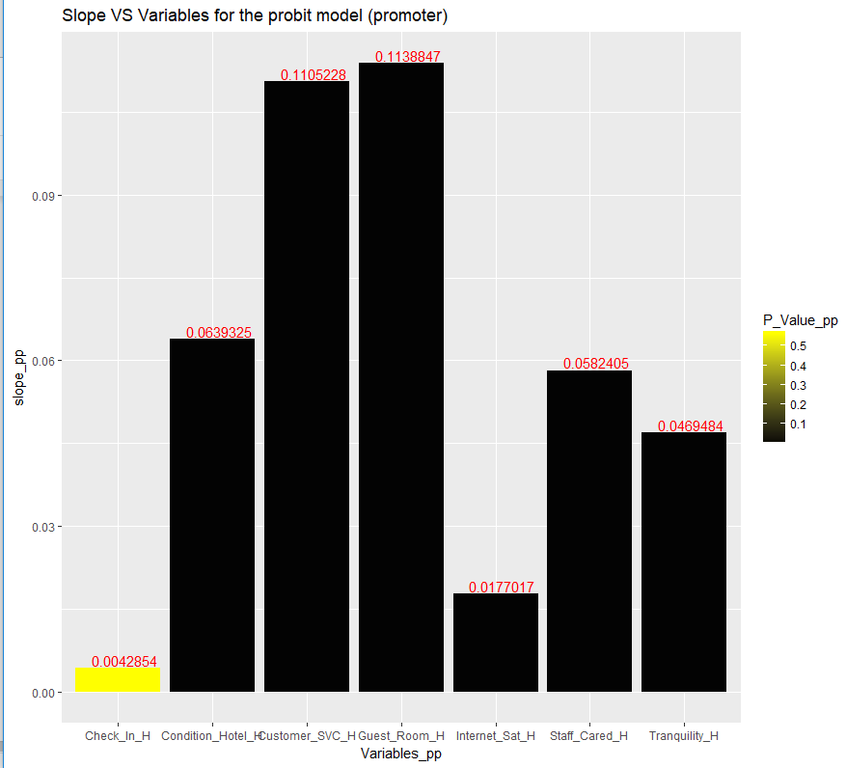
Modeling the Data- Probit Modeling
Positive influence:
Hotel condition
Customer service quality,
Guest room satisfaction
Internet satisfaction
Staff attitude
Tranquility
One point increase in guest room satisfaction metric will lead to 11.39% increase in the possibility of having a promoter type of guest.
Similarly, each increase in customer service satisfaction metric contributes 11.05% higher possibility of having a promoter type of guest.
Notes:
Looking at the two highest bars, we found that with

Slide 9
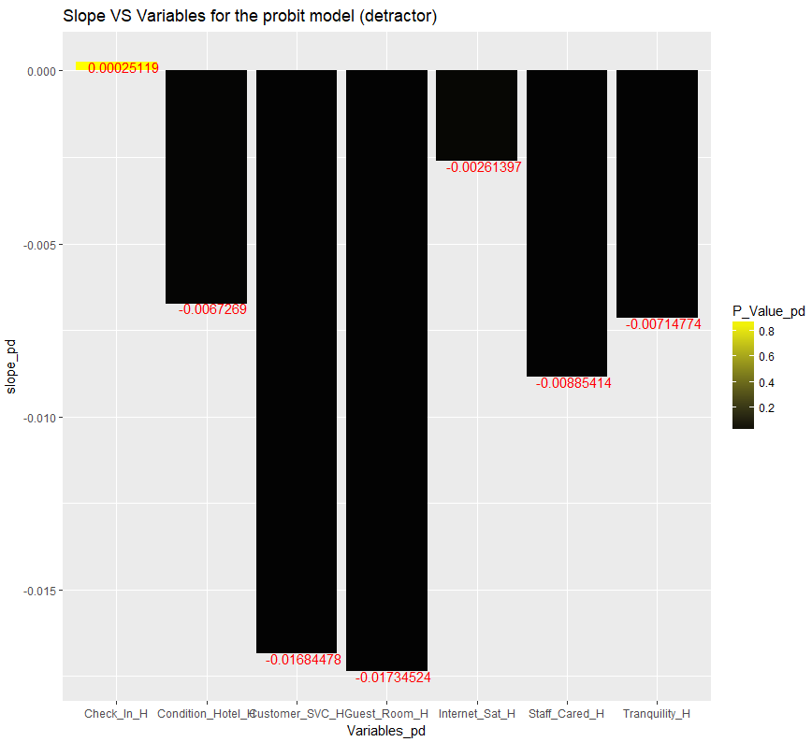
Modeling the Data- Probit Modeling
One point increase in guest room satisfaction metric will lead to 1.73% decrease in the possibility on having a detractor type of guest.
Increase in customer service satisfaction metric contributes 1.68% lower possibility of having a detractor type of guest.
Notes:
Looking at the detractor type side,

Slide 10
Modeling the Data- Linear Modeling
Hotel condition
Customer service quality
Guest room satisfaction
Internet satisfaction
Staff attitude
Tranquility
Check in process satisfaction
Different change in the likelihood to recommend
Increase NPS score
Notes:
In linear model, we tried to find the relationship between the satisfaction metric and the LTR, to see whether a higher metric is associated with a higher LTR. Also to see which specific satisfaction will increase the LTR the most.

Slide 11
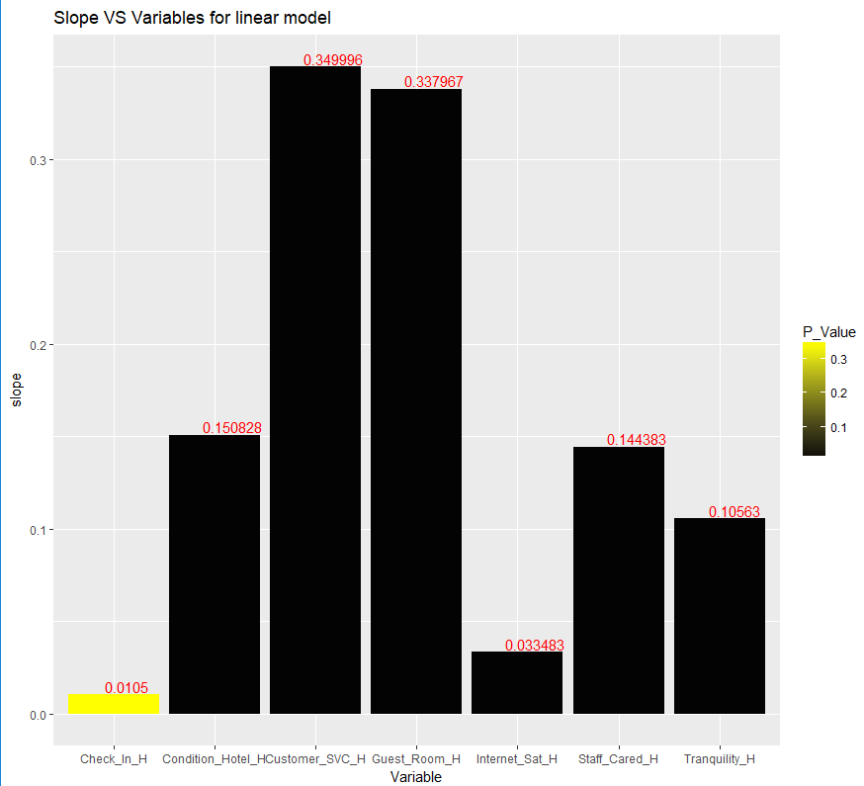
Modeling the Data- Linear Modeling
Customer service quality and guest room satisfaction are still the most important contributor to high LTR.
With one unit metric increase in customer service quality and guest room satisfaction, respectively the LTR will increase by 0.35 and 0.34.
Guest room satisfaction and customer service quality are the most important factors.
Notes:
We found that

Slide 12
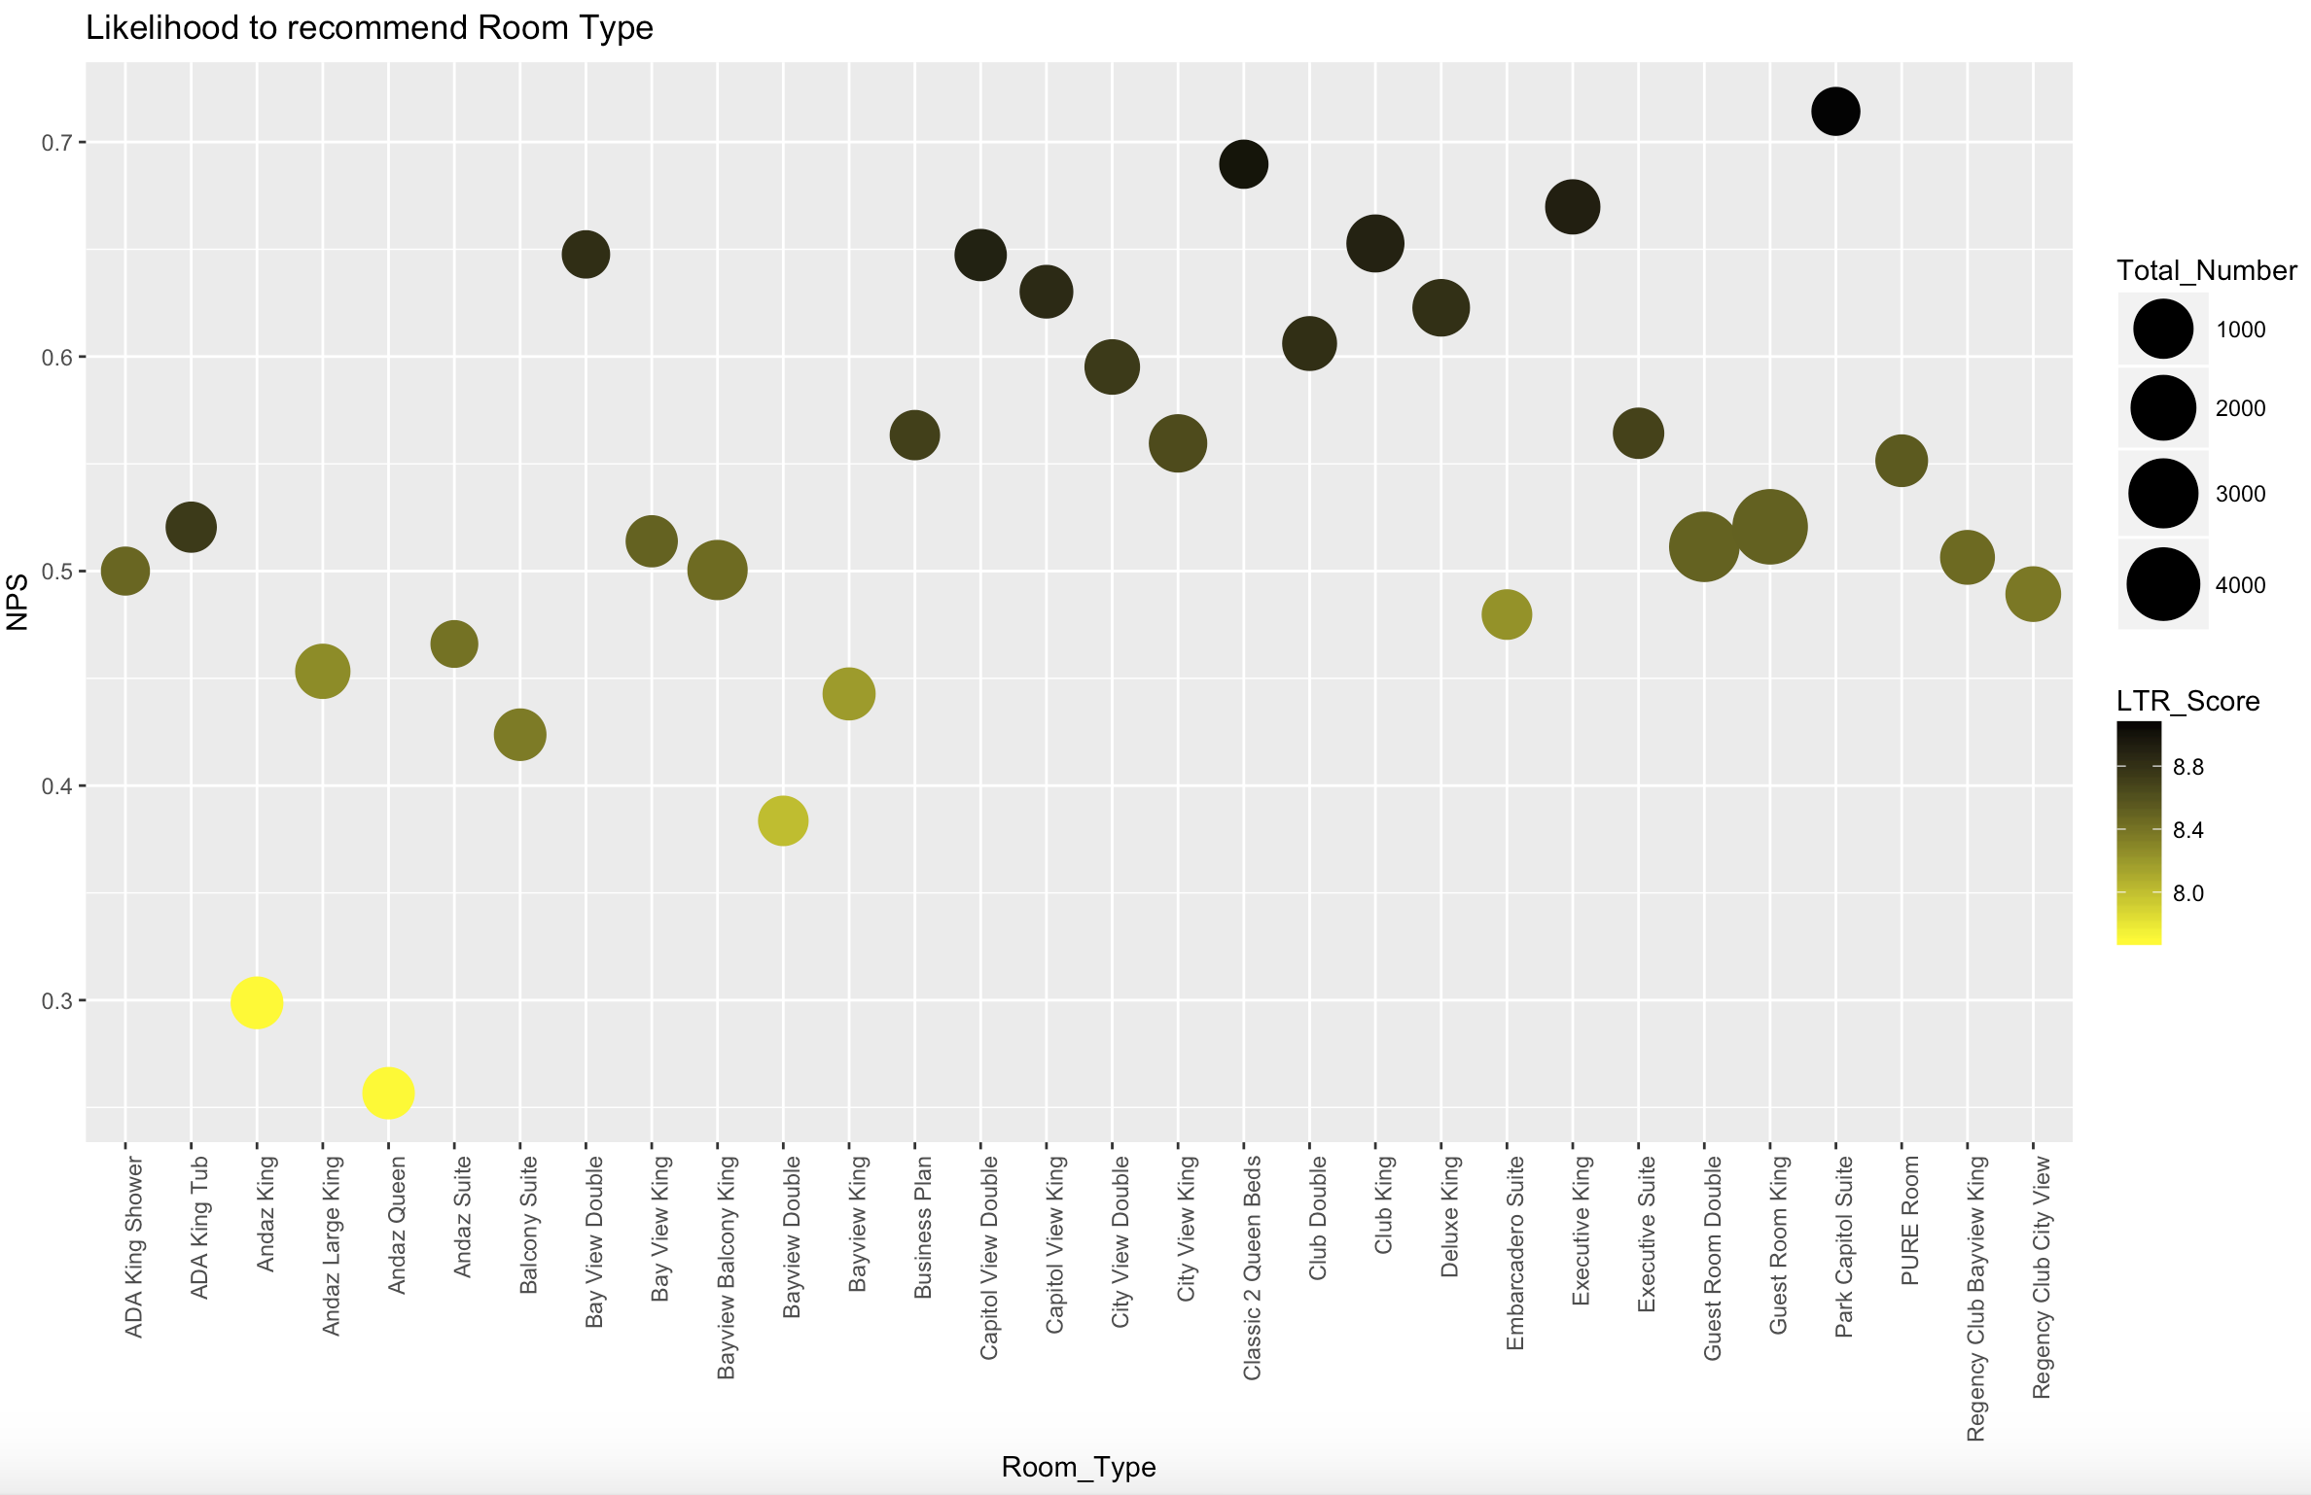
Understanding the Data- Room Type
Notes:
Hotels should focus more on improving room satisfaction and customer service. So then we moved to analyze which type of room has the highest NPS score and which has the lowest.In this graph, the y axis represents… the color represents... We can see that Classic 2 queen beds and Park Capitol Suite room have both the highest NPS score and LTR score, so hotels offering such two types of room should increase the number of those rooms. Andaz queen and Andaz king have the lowest NPS score and LTR score, thus Andaz brand hotels should either decrease the number of those rooms, or increase the room condition of these two types.

Slide 13
Modeling the Data- Association Rules
Hotel condition
Customer service quality
Guest room satisfaction
Internet satisfaction
Staff attitude
Tranquility
Check in process satisfaction
NPS type
Increase NPS score
Notes:
First we convert all the satisfaction metric into satisfaction level ,with 1 to 6 being low, 7 to 8 being medium, 9 to 10 being high. Then we tried to find the association between the satisfaction levels and the different NPS type. Eventually, we can increase the net promoter score by improving the most important factor.

Slide 14
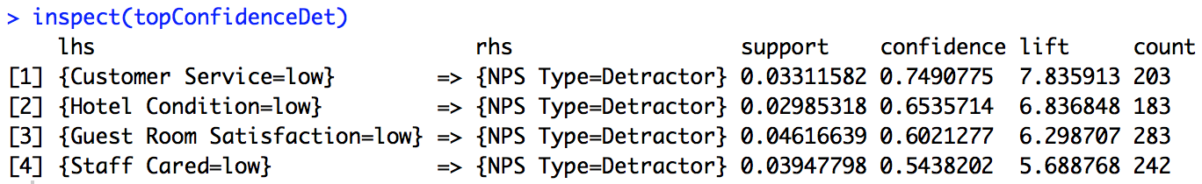
Modeling the Data- Association Rules
In 74.9% of cases when the customer service quality metric is low (1-6 points), there is detractor NPS type.
Notes:
For detractor, when customer service, hotel condition, and guest room satisfaction are low, the customer is more likely to be a detractor.
For instance, 74.9% of the customer who give a low score in customer satisfaction, are detractor.

Slide 15
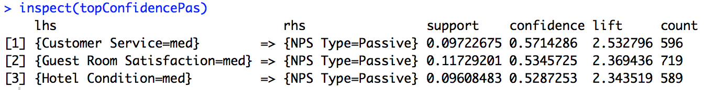
Modeling the Data- Association Rules
In 57.1% of cases when the customer service quality metric is medium (7-8 points), there is passive NPS type.
Notes:
for passive, when customer service, hotel condition, and guest room satisfaction are medium, the customer is more likely to be a passive.
57.1% of the customer who give a medium score in customer satisfaction, are passive.

Slide 16
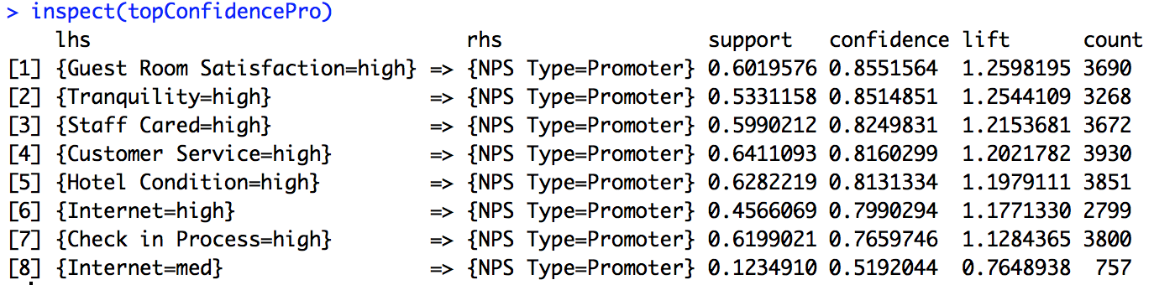
Modeling the Data- Association Rules
In 85.5% of cases when the guest room satisfaction metric is high (9-10 points), there is promoter NPS type.
Notes:
For promoter, we can also see that when tranquility, staff cared, customer service, hotel condition, and guest room satisfaction are high, more than 80% of the time, the customer is a promoter.

Slide 17
Modeling the Data- Association Rules
Notes:
Therefore, if we look at all three parts together, we can see that increasing customer service, hotel condition, and guest room satisfaction will pull the detractor to the passive and the passive to the promoter.

Slide 18
Validation
Probit and Linear Modeling gave similar results
Linear Modeling: Adjusted R squared= 0.6458; 64.58% of the variation in the model is attributed to the independent variables in the model
Probit Modeling : Pseudo R Squared= 0.68765; 68.77% of the variation in the model is attributed to the independent variables in the model
KSVM:
Reg:75%,
Arule:79.4%
Predicted NPS: 56.82%
Actual NPS: 53.93%
Naive Bayes:
Reg: 78.1%
Arule: 80%
Predicted NPS:61.65%
Actual NPS: 53.93%
Notes:
Validation: For our linear model, 66 percent of the data can be explained by our model.
For the Probit model,69 percent of the data is explained by the model.
We also use two model to predict the NPS type by using the most important factor we got from the regression model, and the factors we got from the Arule model.
Using the 2 factor we got from the regression model to predict NPS type, we got 75% of them correct in KSVM, and 78.1% correct when using naive bayes.
When using the 3 factors we got from the arule model to predict NPS type, we got 79.4% of them correct in KSVM, and 80% correct while using Naive Bayes.
We also predict the NPS using all 3 factors, in the KSVM the error is 5.4%, and in naive bayes the error is 14.31%

Slide 19
Actionable Insights/Recommendations
Hyatt should focus more on guest room satisfaction, customer service quality and hotel condition in order to increase NPS score
Increasing the number of Park Capitol Suite, Classic 2 Queen Beds room
Decreasing Andaz Queen and Andaz King room, and improve the condition of these two room type
Investing in better or more frequent staff customer service training and upgrade expectations of hotel cleanliness and train staff on new policies
Updating furniture, technology and facilities to ensure hotel is in its best condition
Notes:
This policy change would help move detractors to the passive level and passive to the promoter level which would improve overall NPS scores

Slide 20
Thank you !
Questions?

