Slide 1
Course Information Sharing Platform
Minyang Wang

Slide 2
The goals:
What data to collect
Student
SUID
Name
Year of attendance
Semester of attendance
Professor
Name
Tittle
Department
Email address
Course
Basic information:
course number
section number
academic year, semester
location
Enrollment information
Teaching information

Slide 3
The goals:
Who can input the data
Student
Professor
Administrator
Who can query the data
Student
Professor

Slide 4
The goals:
Major questions:
For student usage
What specific courses are selected by students from a particular program in their particular academic year (the first year or the second year of the program) and particular semester (the first or the second semester of this academic year)? What are the most popular courses?
Given a particular course taught by a specific professor, what’s the average final grade of the students who have taken this specific course before? And what’s the average course evaluation score of this course?
For professor usage
How many courses does a professor teach in a given academic year and semester?
For a professor, who are the students that have taken his class? Which program are they from and what’s the distribution of programs?
How much the students like a professor’s class? Within the past few semesters, do student like more his class or less?

Slide 5
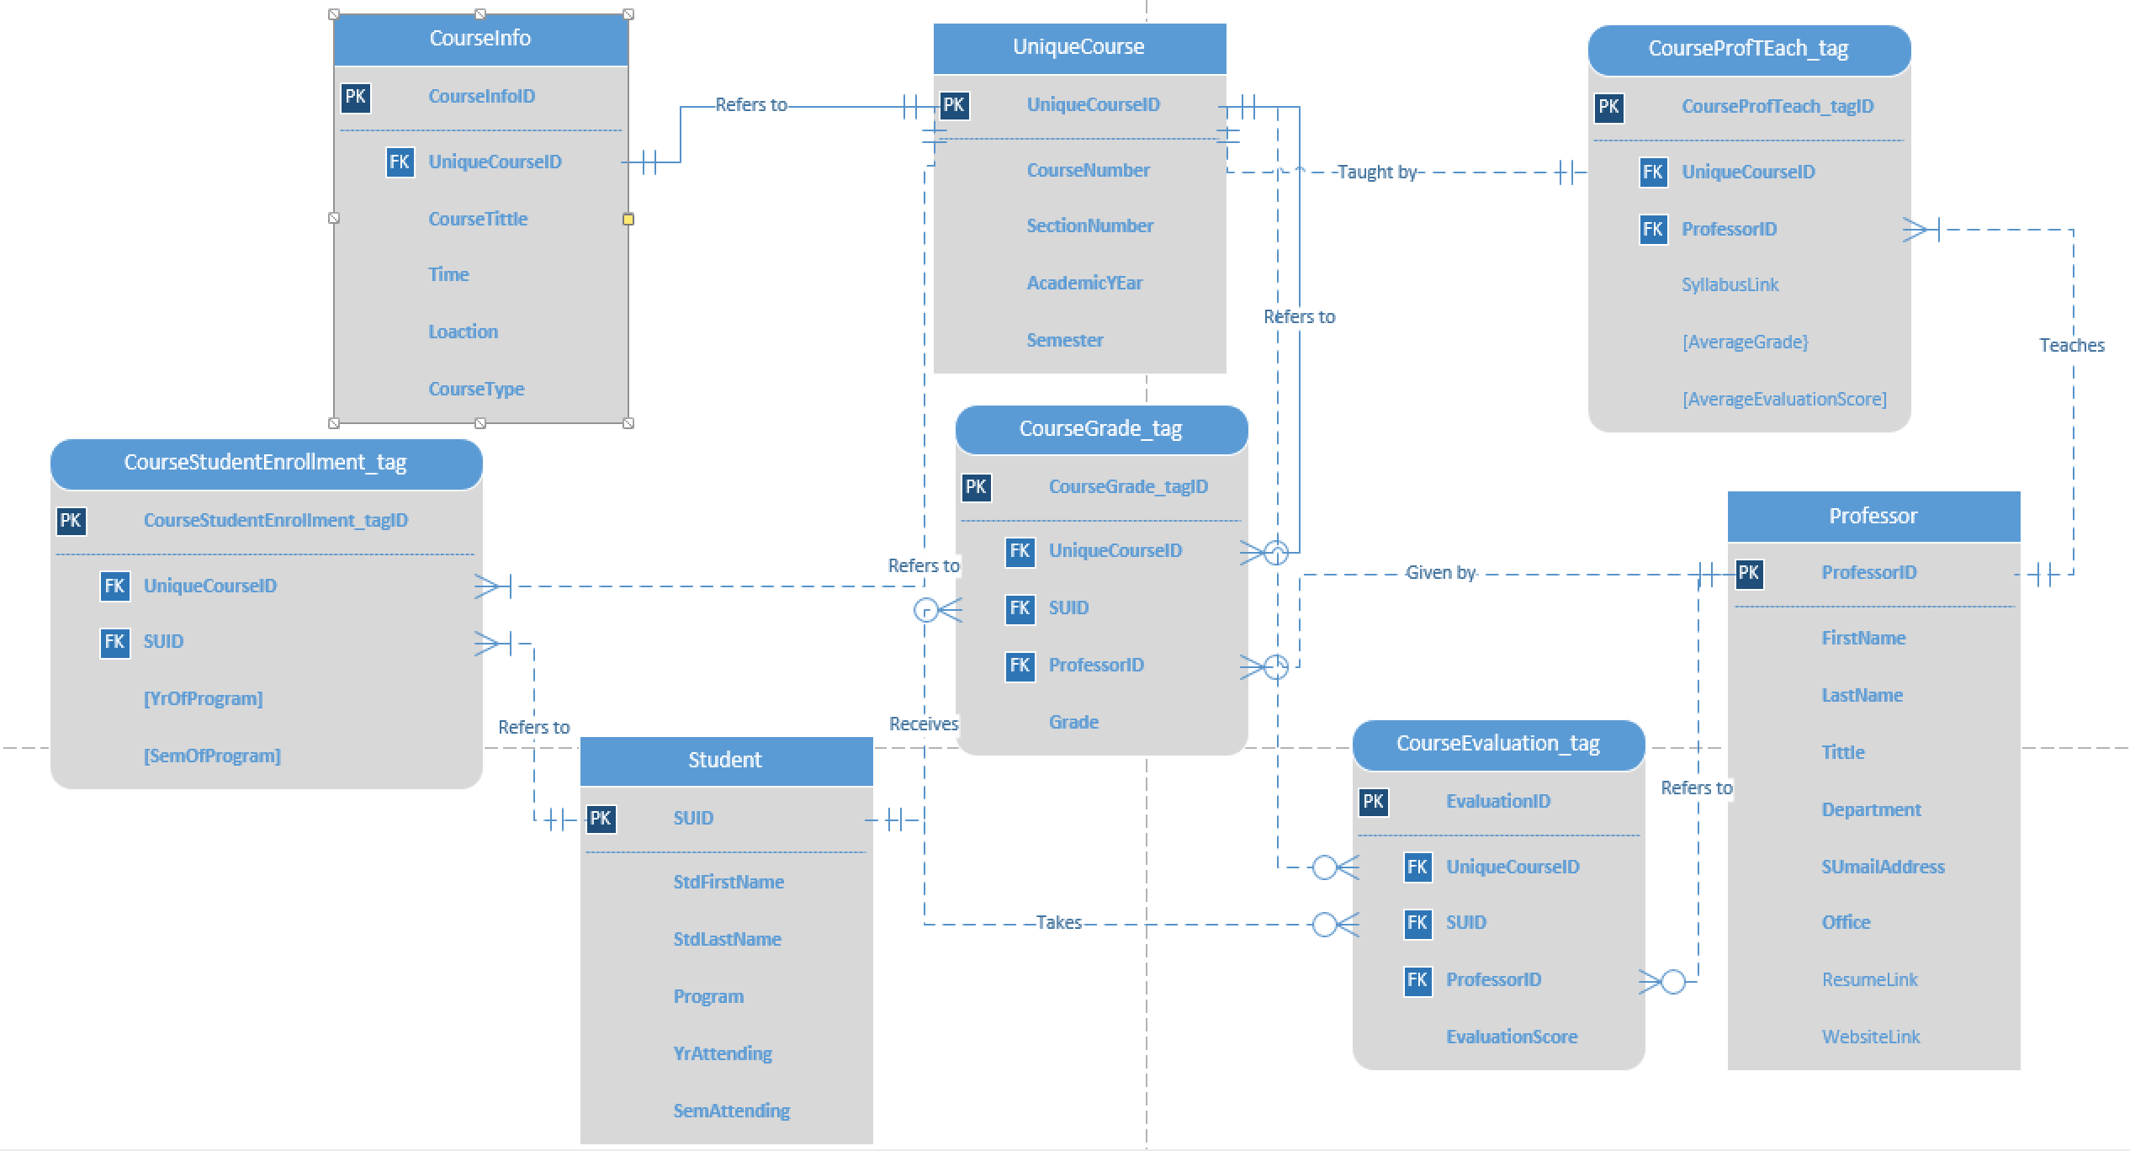
ER Diagram - Visio

Slide 6
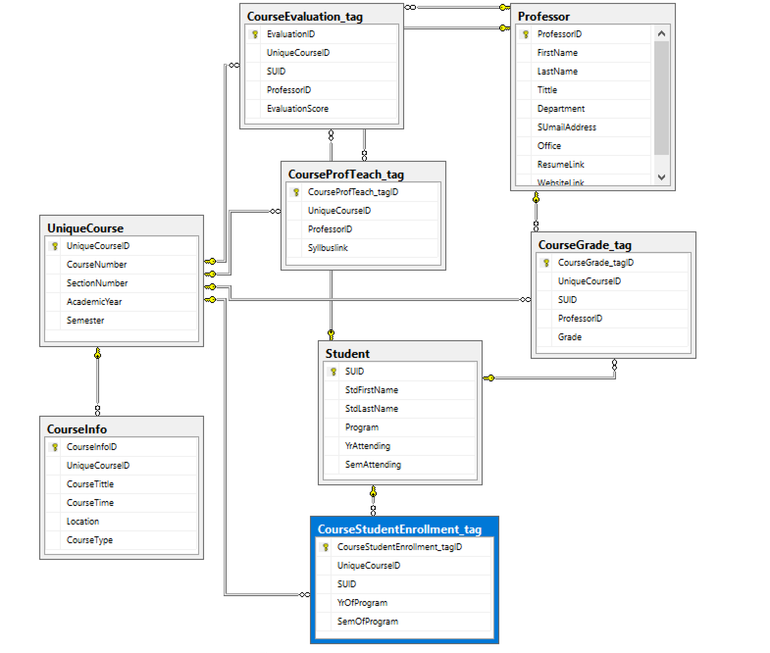
ER Diagram - SQL

Slide 7
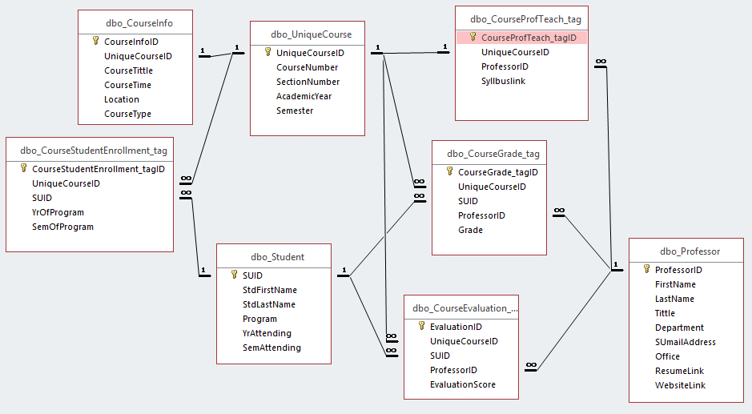
ER Diagram - Access

Slide 8
Forms
Total number of tables: 8
Total number of forms: 10
Number of forms that created so far: 9
User login form (N) (user logs in to the system)
Student_form (Y) (allows you to add and view student records)
Professor_form (Y) (allows you to add and view professor records)
Unique_course_form (Y) (allows you to add and view unique course records)
Course_information_form (Y) (allows you to add and view course information)
Course_enrollment_form (Y) (allows you to add and view course enrollment records)
Course_teaching_form (Y) (allows you to add and view course teaching records)
Course_grade_form (Y) (allows you to add and view course grade records)
Course_evaluation_form (Y) (allows you to add and view course evaluation scores)
Course_enrollment_check_form(Y) (allows you to check the class enrollment information of different program)

Slide 9

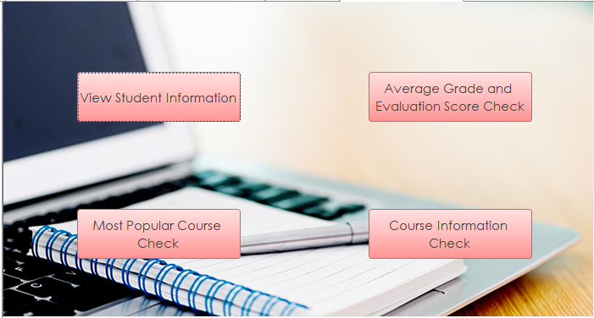

Slide 10
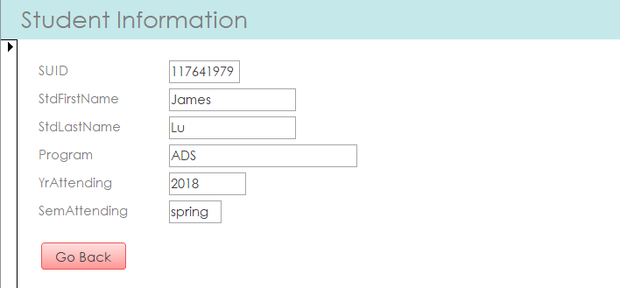

Slide 11
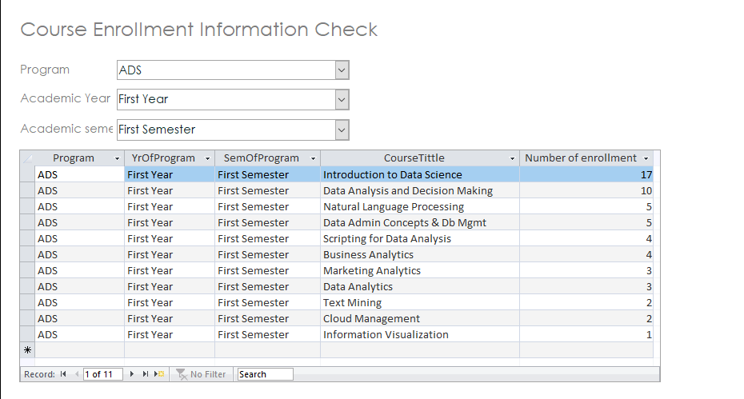

Slide 12
Queries
What are the most popular courses for a given program? (Y)
What is the average final score and average evaluation score of a course taught by a particular professor? (Y)
How many courses does a professor teach in a given academic year and semester? (Y)
For a professor, who are the students that have taken his class? Which program are they from and what’s the distribution of programs? (Y)
How much the students like a professor’s class? Within the past few semesters, do student like more his class or less? (N)

Slide 13
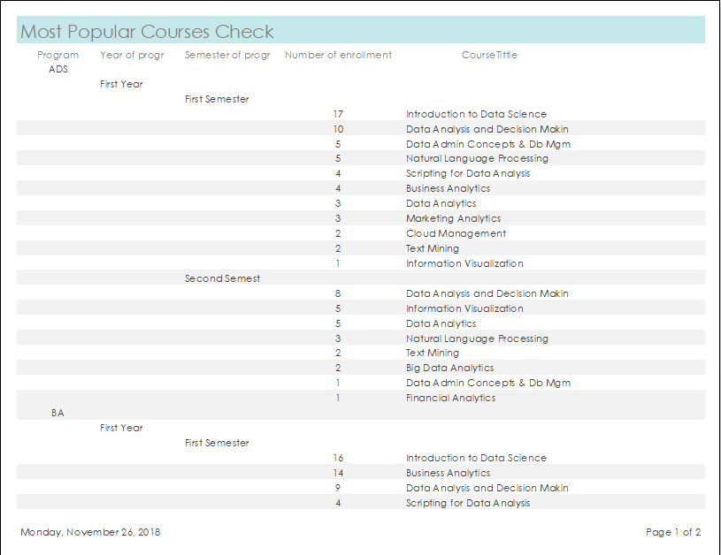
What are the most popular courses for a given program?

Slide 14
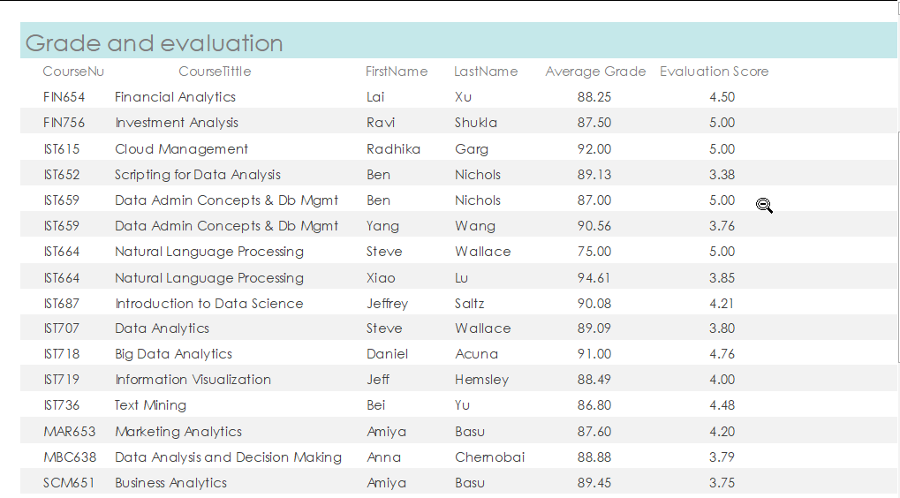
What is the average final score and average evaluation score of a course taught by a particular professor?

Slide 15
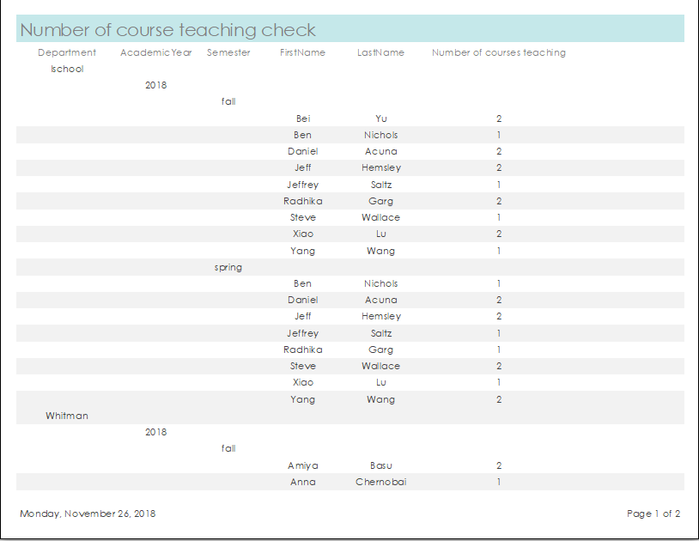
How many courses does a professor teach in a given academic year and semester?

Slide 16
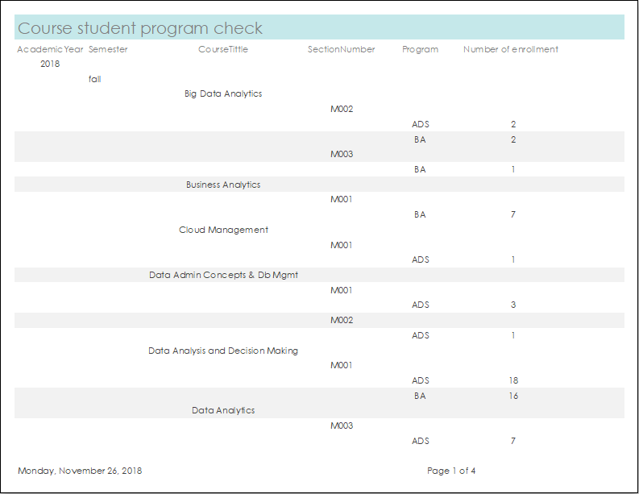
For a professor, who are the students that have taken his class? Which program are they from and what’s the distribution of programs?

Slide 17
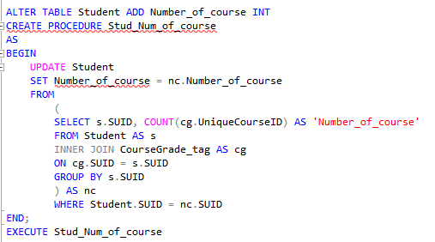
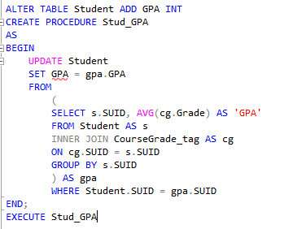
Procedures
These procedures calculate the total number of courses that a student has taken, and his GPA during his entire program.

Slide 18
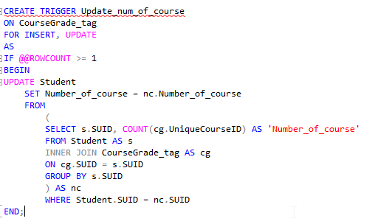
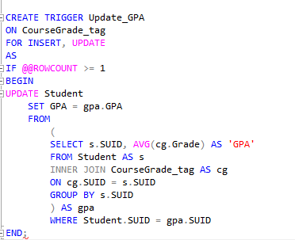
Triggers
These triggers update the total number of courses that a student has taken, and his GPA during his entire program when new grade records are inputted into this database.

Slide 19
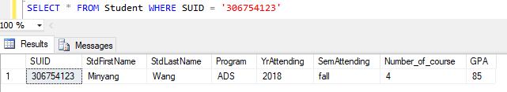
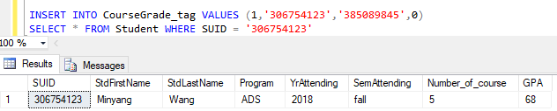
Before the insertion
After the insertion

