Slide 1
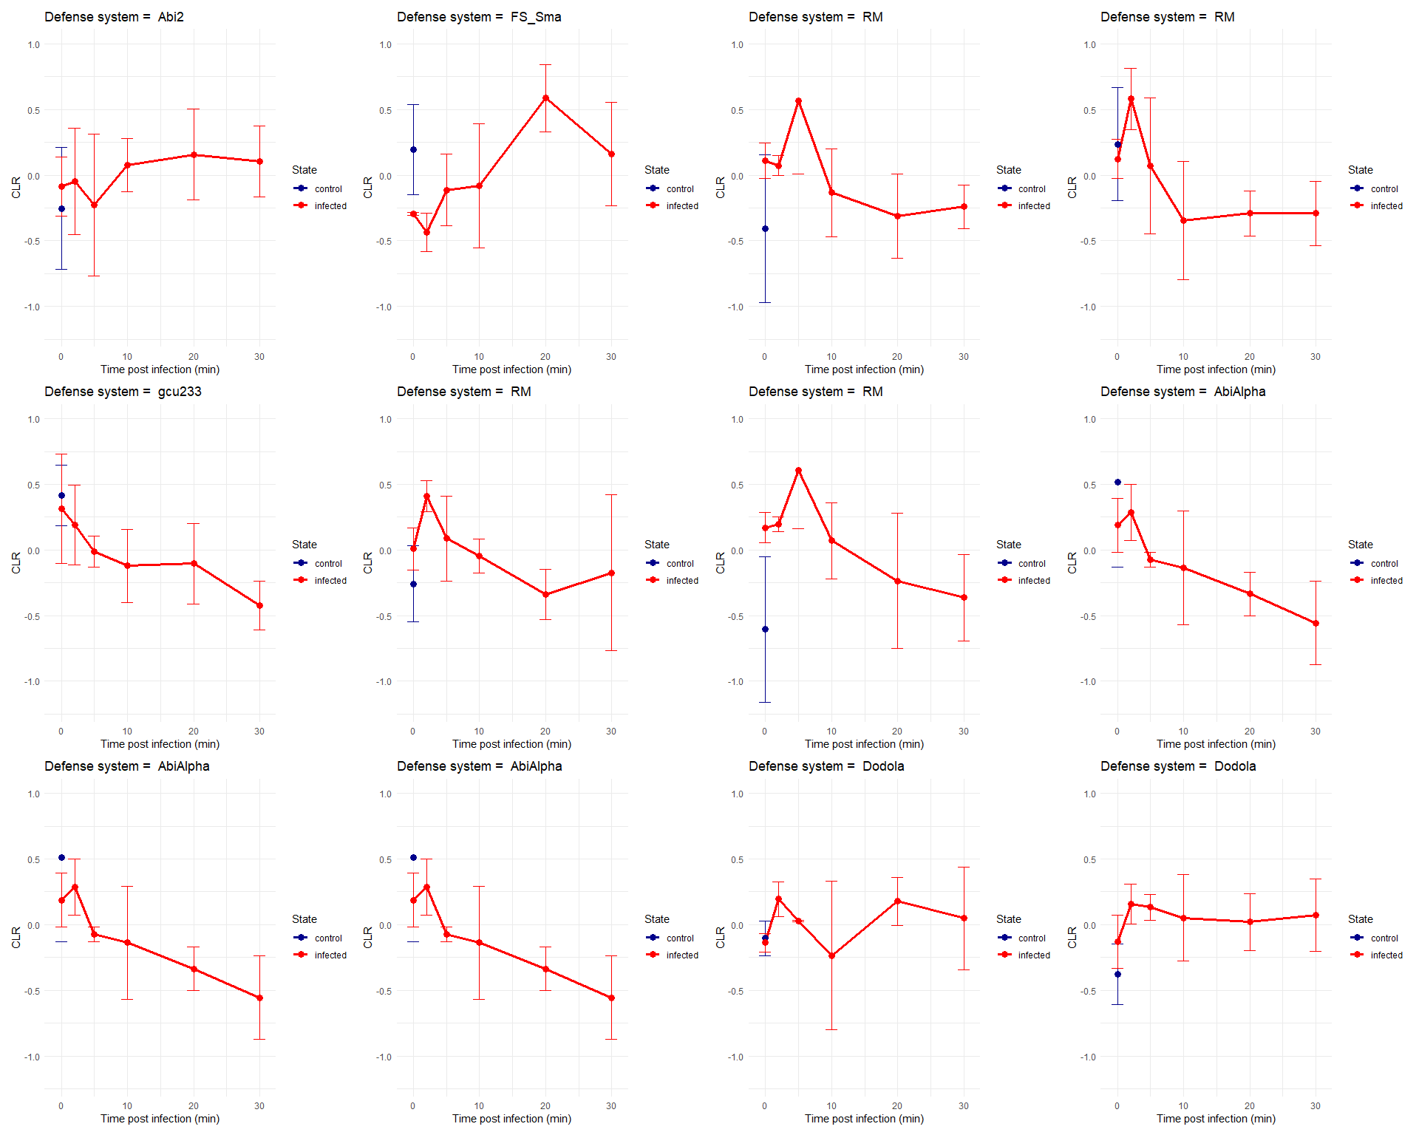
Staphylococcus aureus Newman VS Staphylococcus phage K
Phage cycle = minimum 30min
PRJNA787900

Slide 2
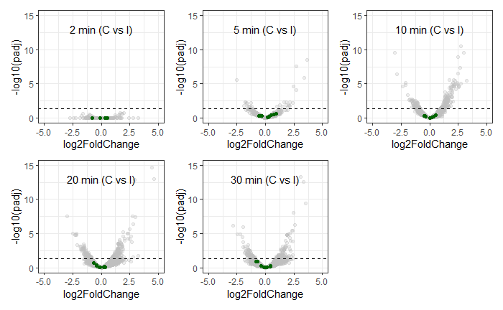
Staphylococcus aureus Newman VS Staphylococcus phage K
PRJNA787900

Slide 3
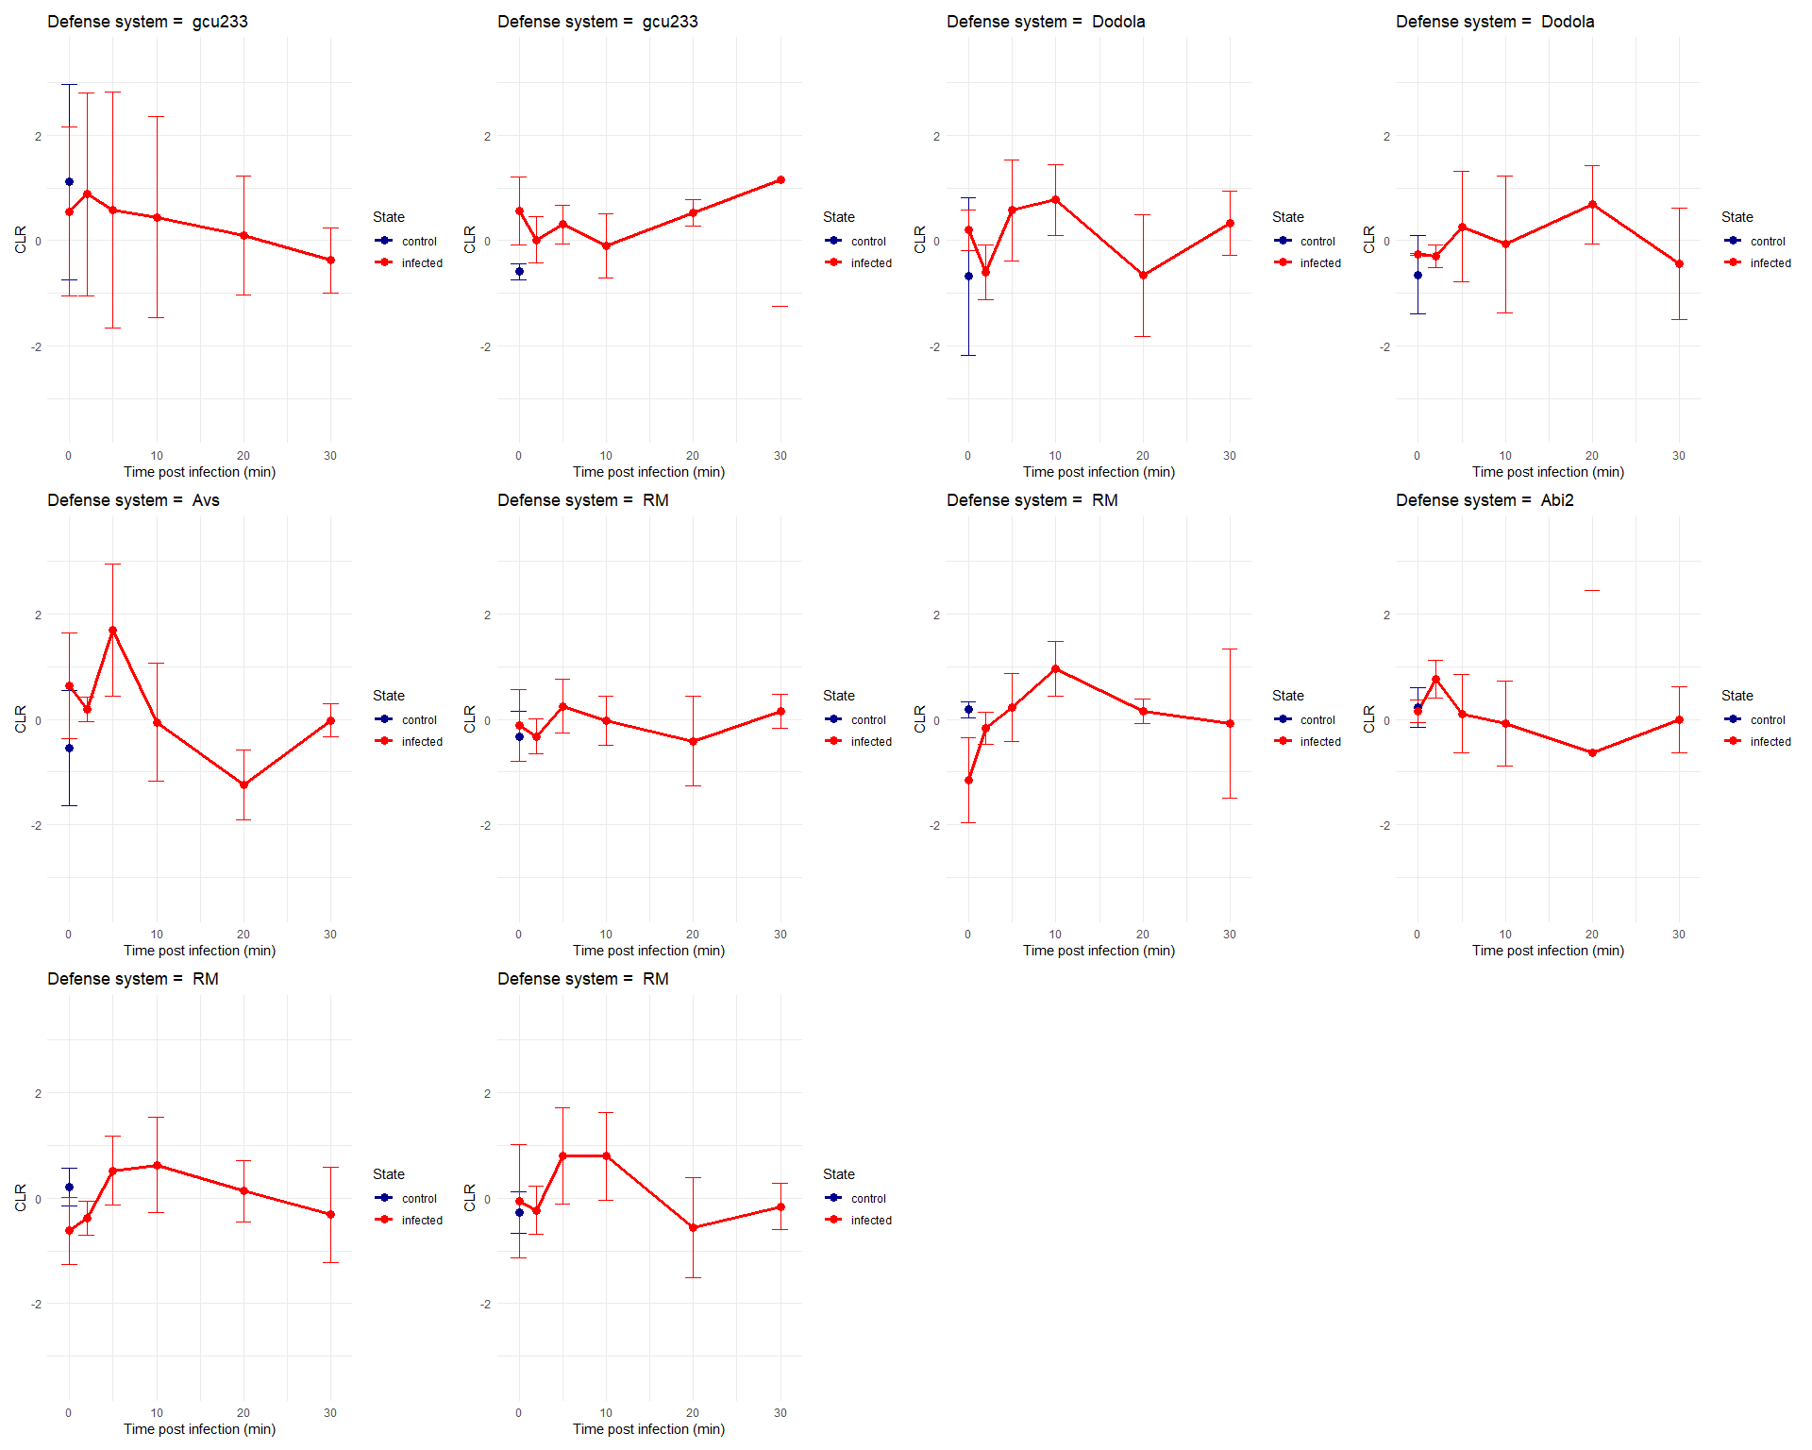
Staphylococcus aureus SH1000 VS Staphylococcus phage K
Phage cycle = minimum 30min
PRJNA787900

Slide 4
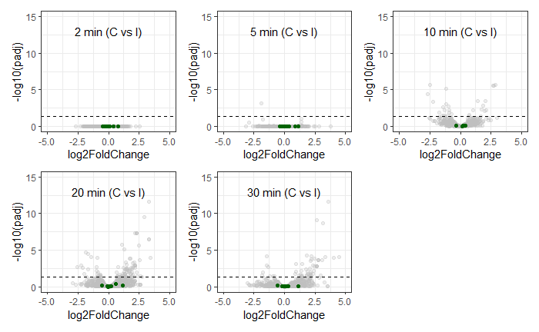
Staphylococcus aureus Newman VS Staphylococcus phage K
PRJNA787900

Slide 5
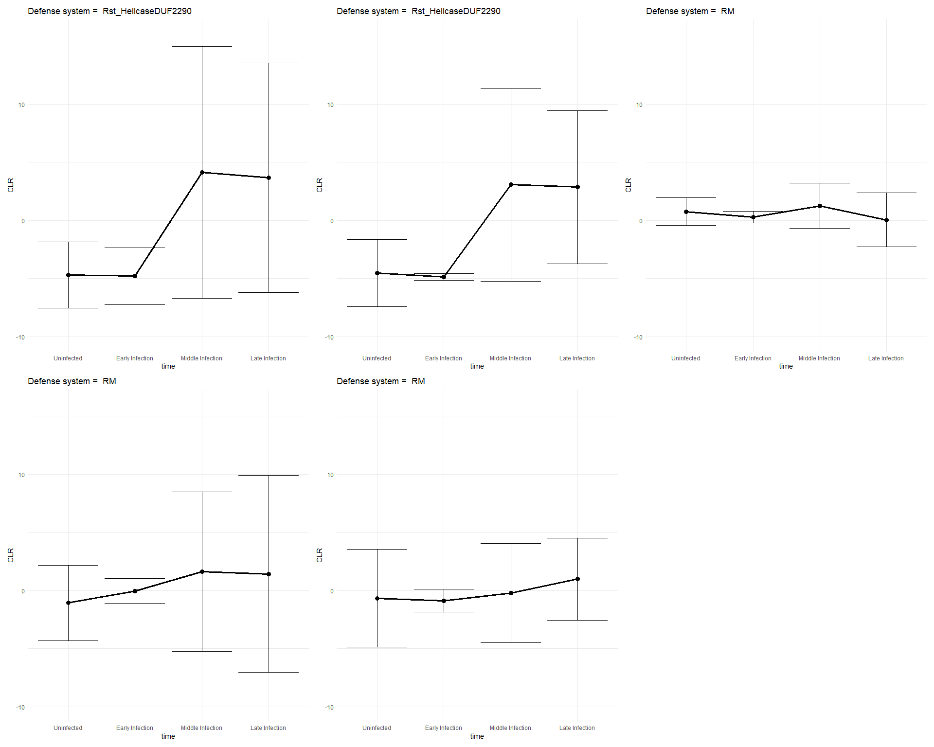
Pseudomonas aeruginosa VS Pseudomonas phage phiKZ
Phage cycle = minimum 40min
PRJNA252740

Slide 6
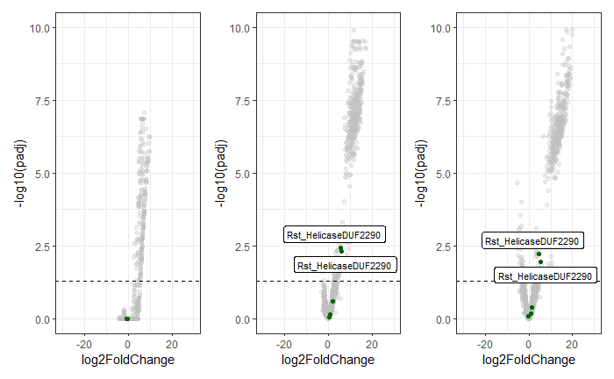
Pseudomonas aeruginosa VS Pseudomonas phage phiKZ
PRJNA252740

Slide 7
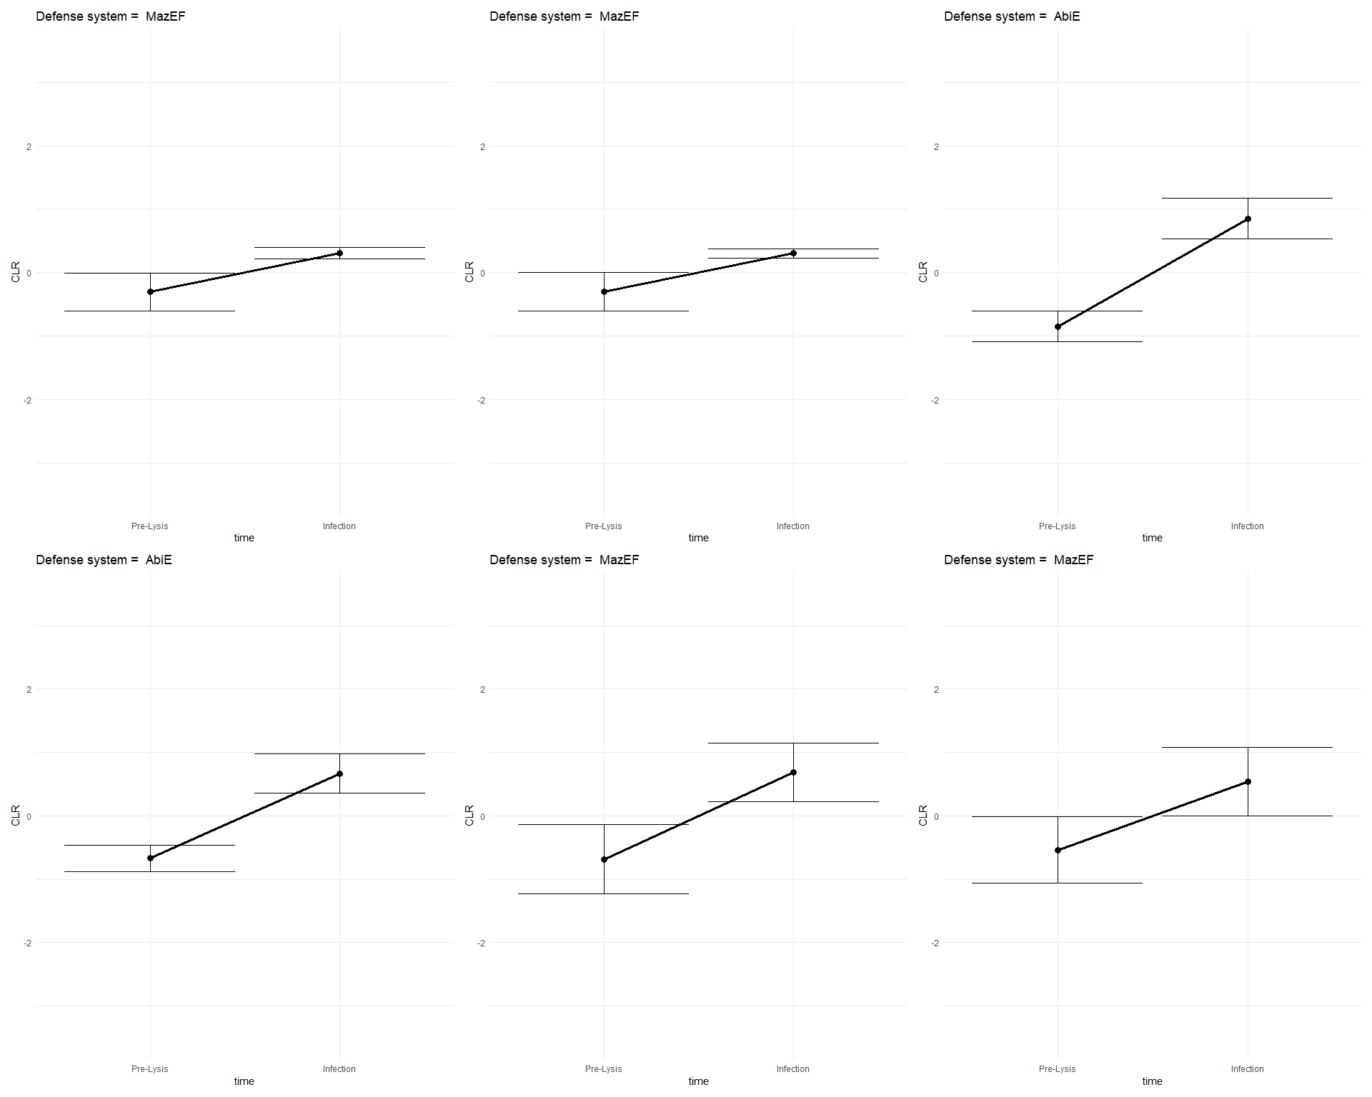
Escherichia coli C strain VS Enterobacteria phage phiX174
PRJNA687267

Slide 8
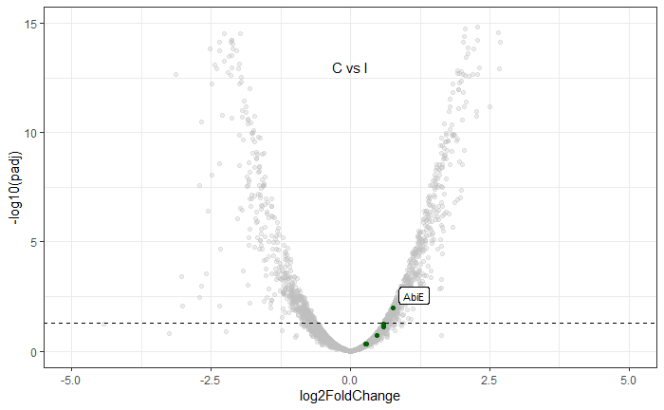
Escherichia coli C strain VS Enterobacteria phage phiX174
PRJNA687267

Slide 9
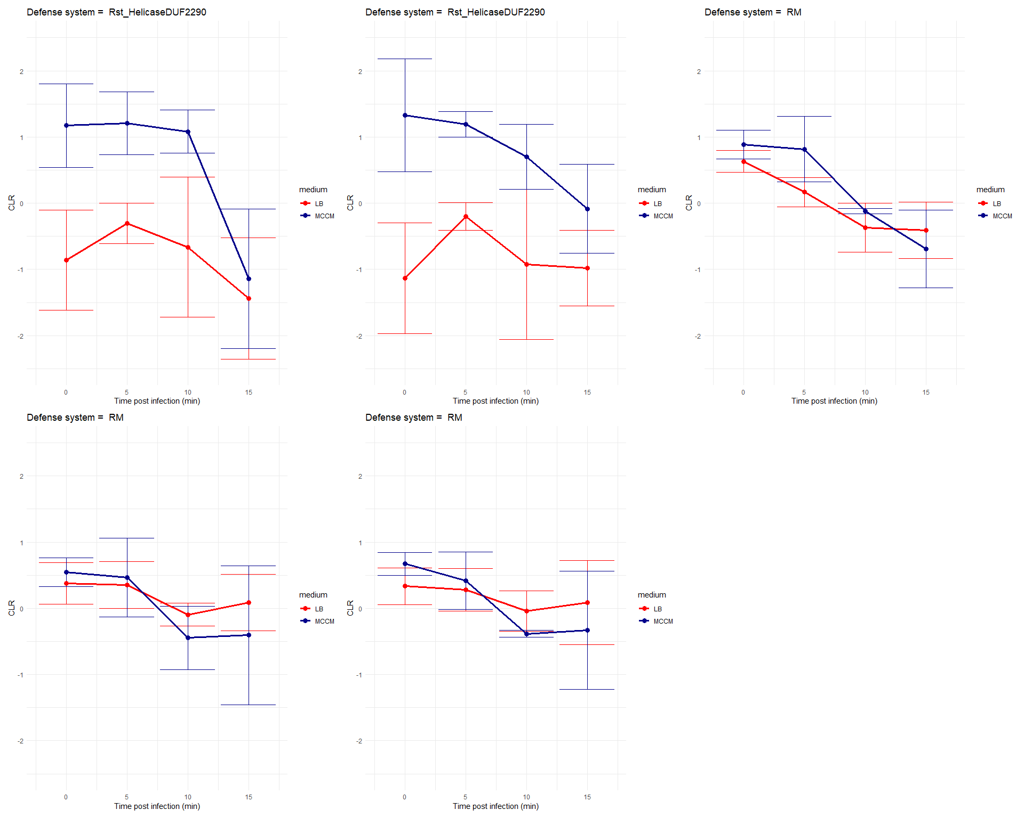
Pseudomonas aeruginosa VS Pseudomonas phage LUZ19
Phage cycle = minimum 25min
PRJNA681237

Slide 10
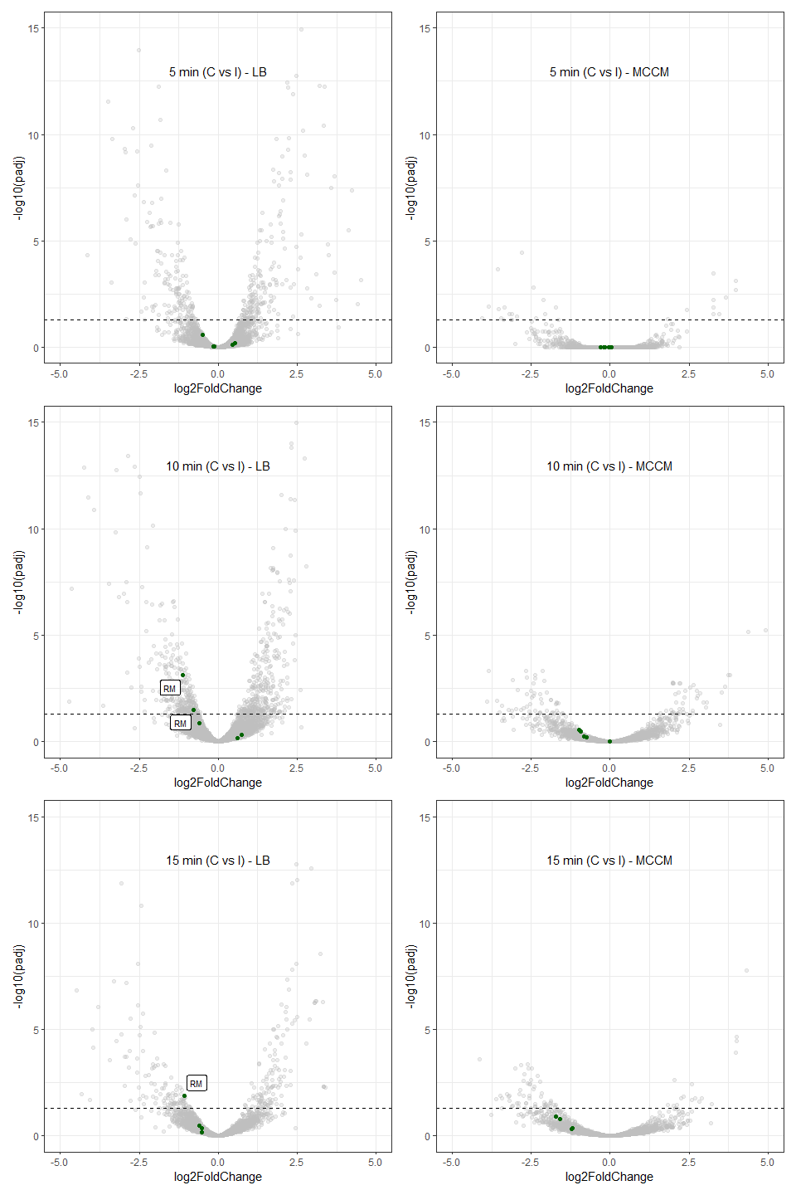
Pseudomonas aeruginosa VS Pseudomonas phage LUZ19
PRJNA681237

Slide 11
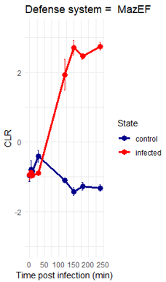
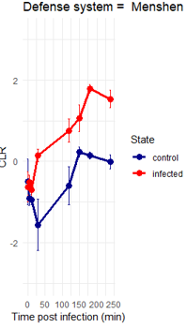
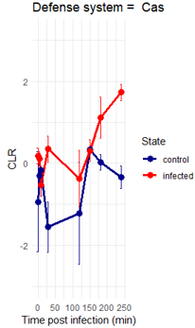
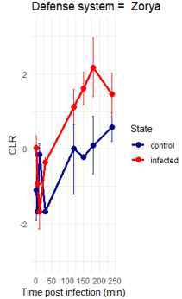
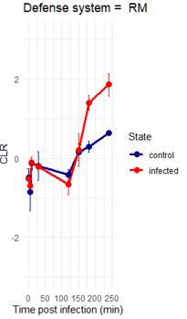
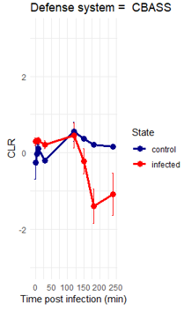
Fusobacterium nucleatum VS Fusobacterium phage JD-Fnp4
Phage cycle = minimum 150-240min
PRJNA1025116

Slide 12
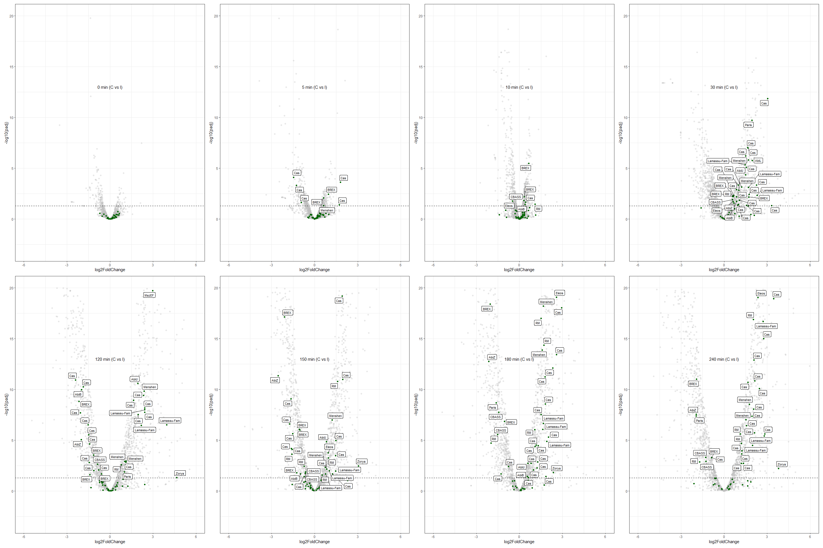
Fusobacterium nucleatum VS Fusobacterium phage JD-Fnp4
PRJNA1025116

Slide 13
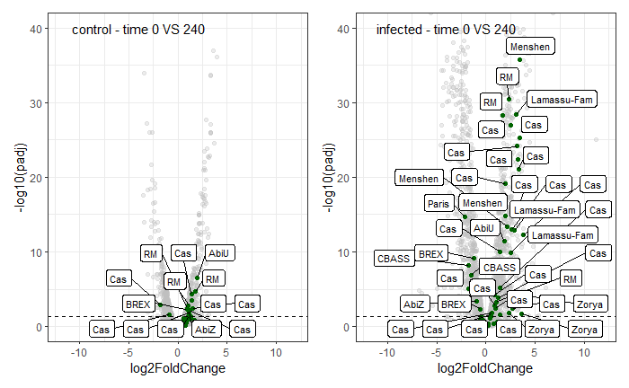
Fusobacterium nucleatum VS Fusobacterium phage JD-Fnp4
PRJNA1025116

Slide 14
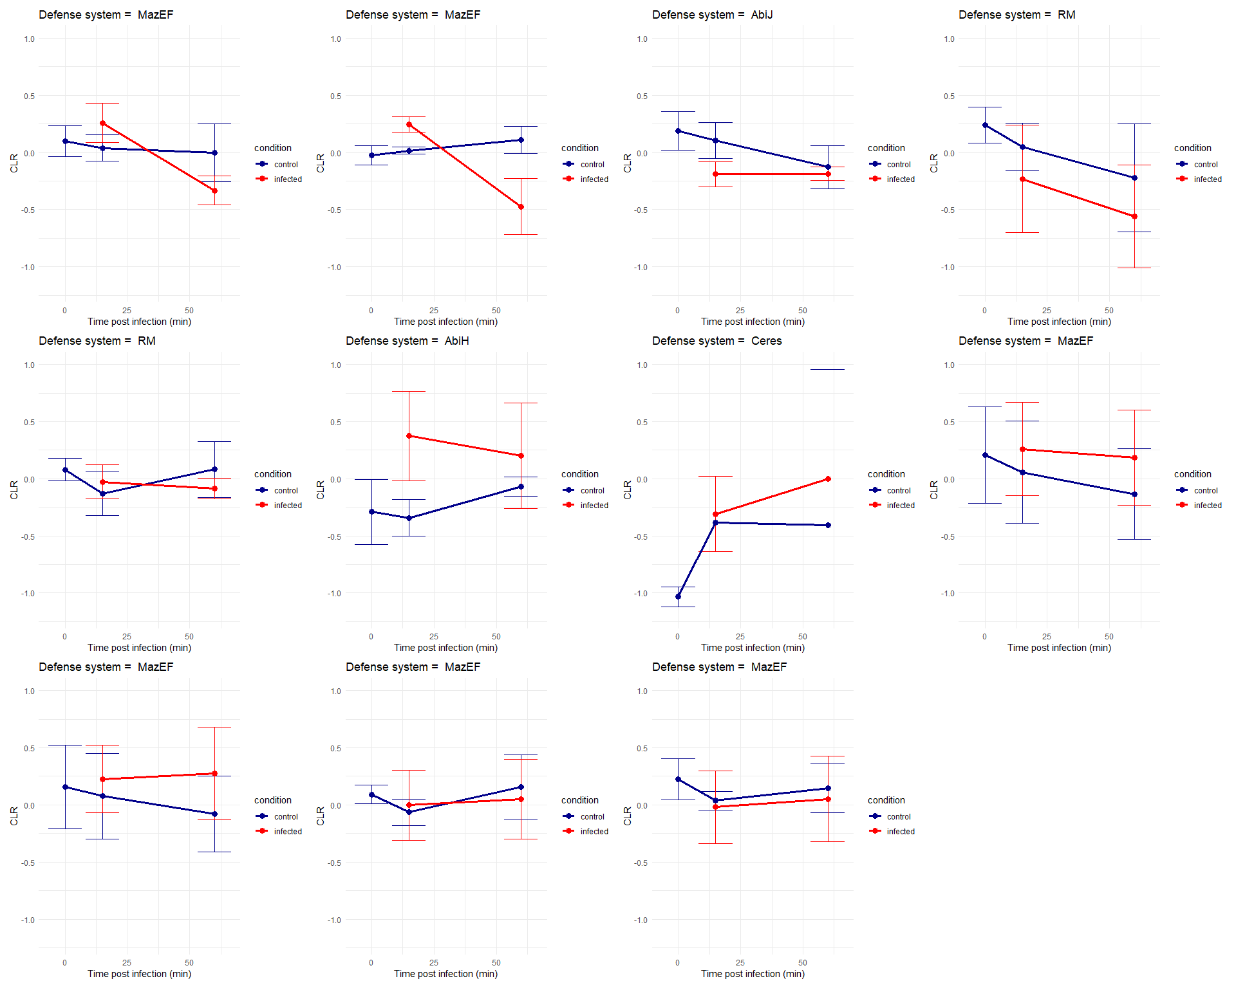
Liquorilactobacillus mali VS UCMA21115
Phage cycle = minimum 2.5-4h
PRJNA804221

Slide 15
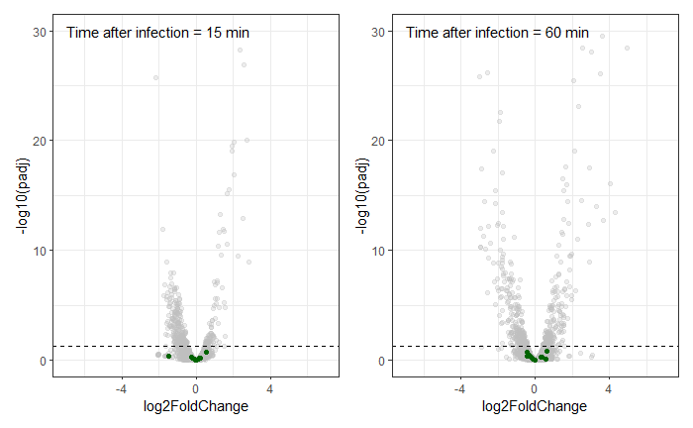
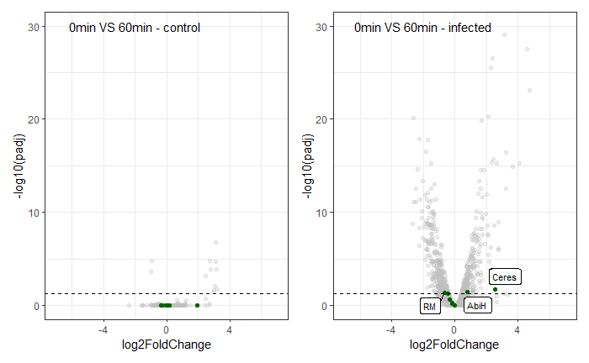
Liquorilactobacillus mali VS UCMA21115
PRJNA804221

