Slide 1
Defense systems expression VS bacterial/phage growth
My interpretation
Slope ds_vs_ribosome
Positive | Defense increases with cellular activity → active defense when the bacterium is healthy
~0 | Defense independent of physiological state
Negative | Trade-off: when the bacterium invests in defense, it slows down its growth.
Slope ds_vs_phage
Positive | Defense activated in response to infection
~0 | Weak interaction / other strategy for defense
Negative | When the phage is expressed, defense is inhibited → effective phage / suppression of defenses

Slide 2
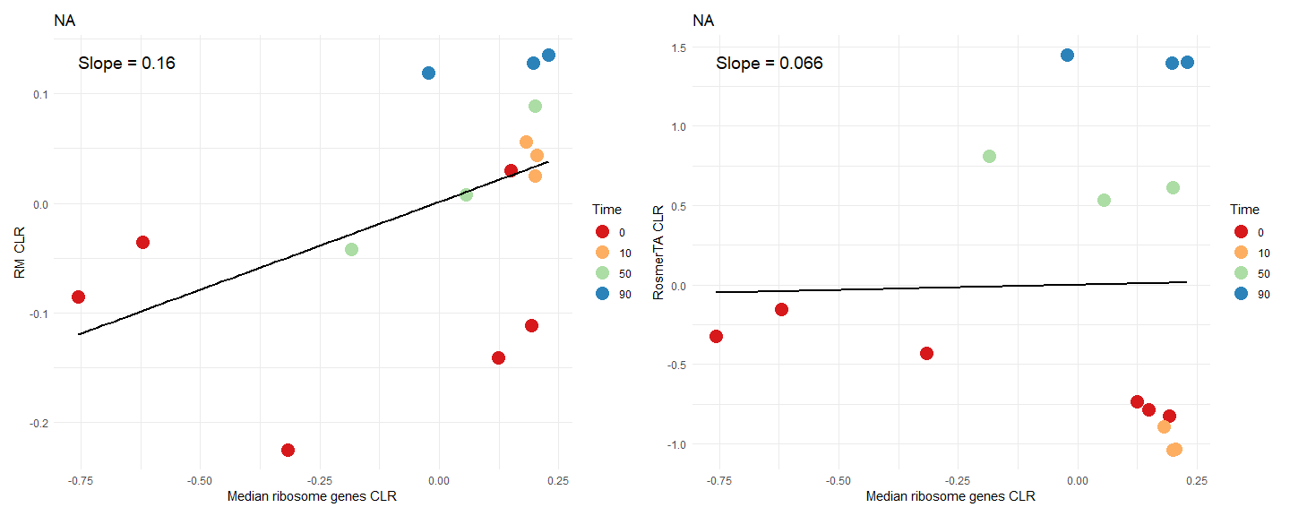
Streptococcus pneumoniae D39 VS Streptococcus phage SpSL1
PRJNA548534

Slide 3
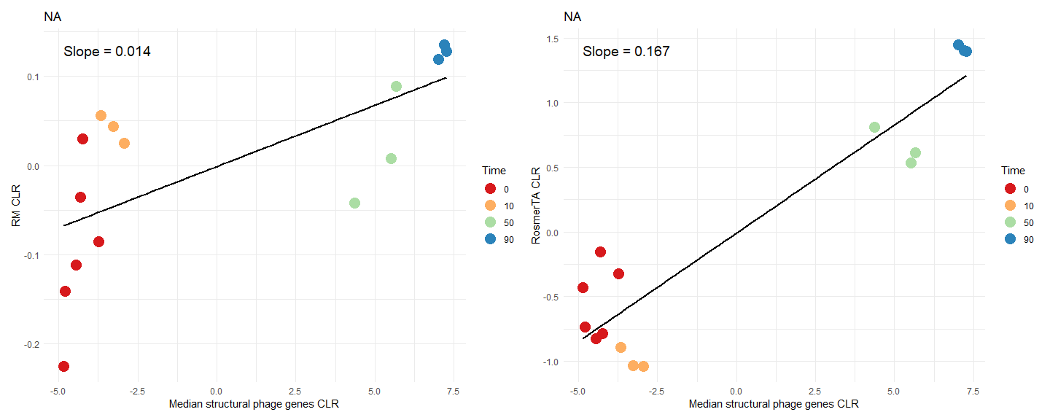
Streptococcus pneumoniae D39 VS Streptococcus phage SpSL1
PRJNA548534

Slide 4
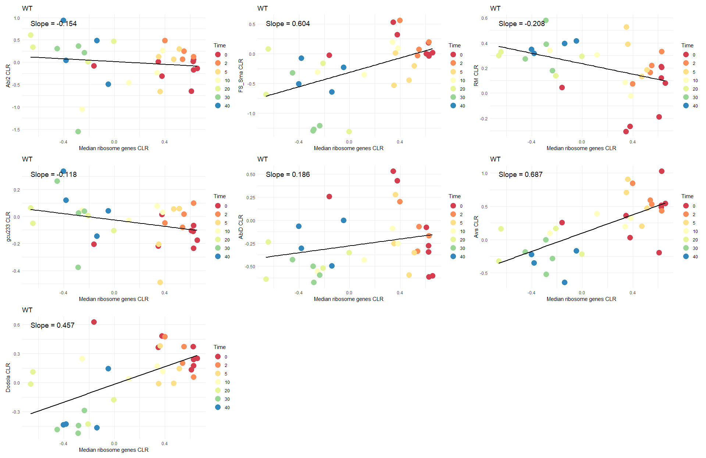
Staphylococcus aureus subsp. aureus USA300 VS Staphylococcus phage K
PRJNA1065939

Slide 5
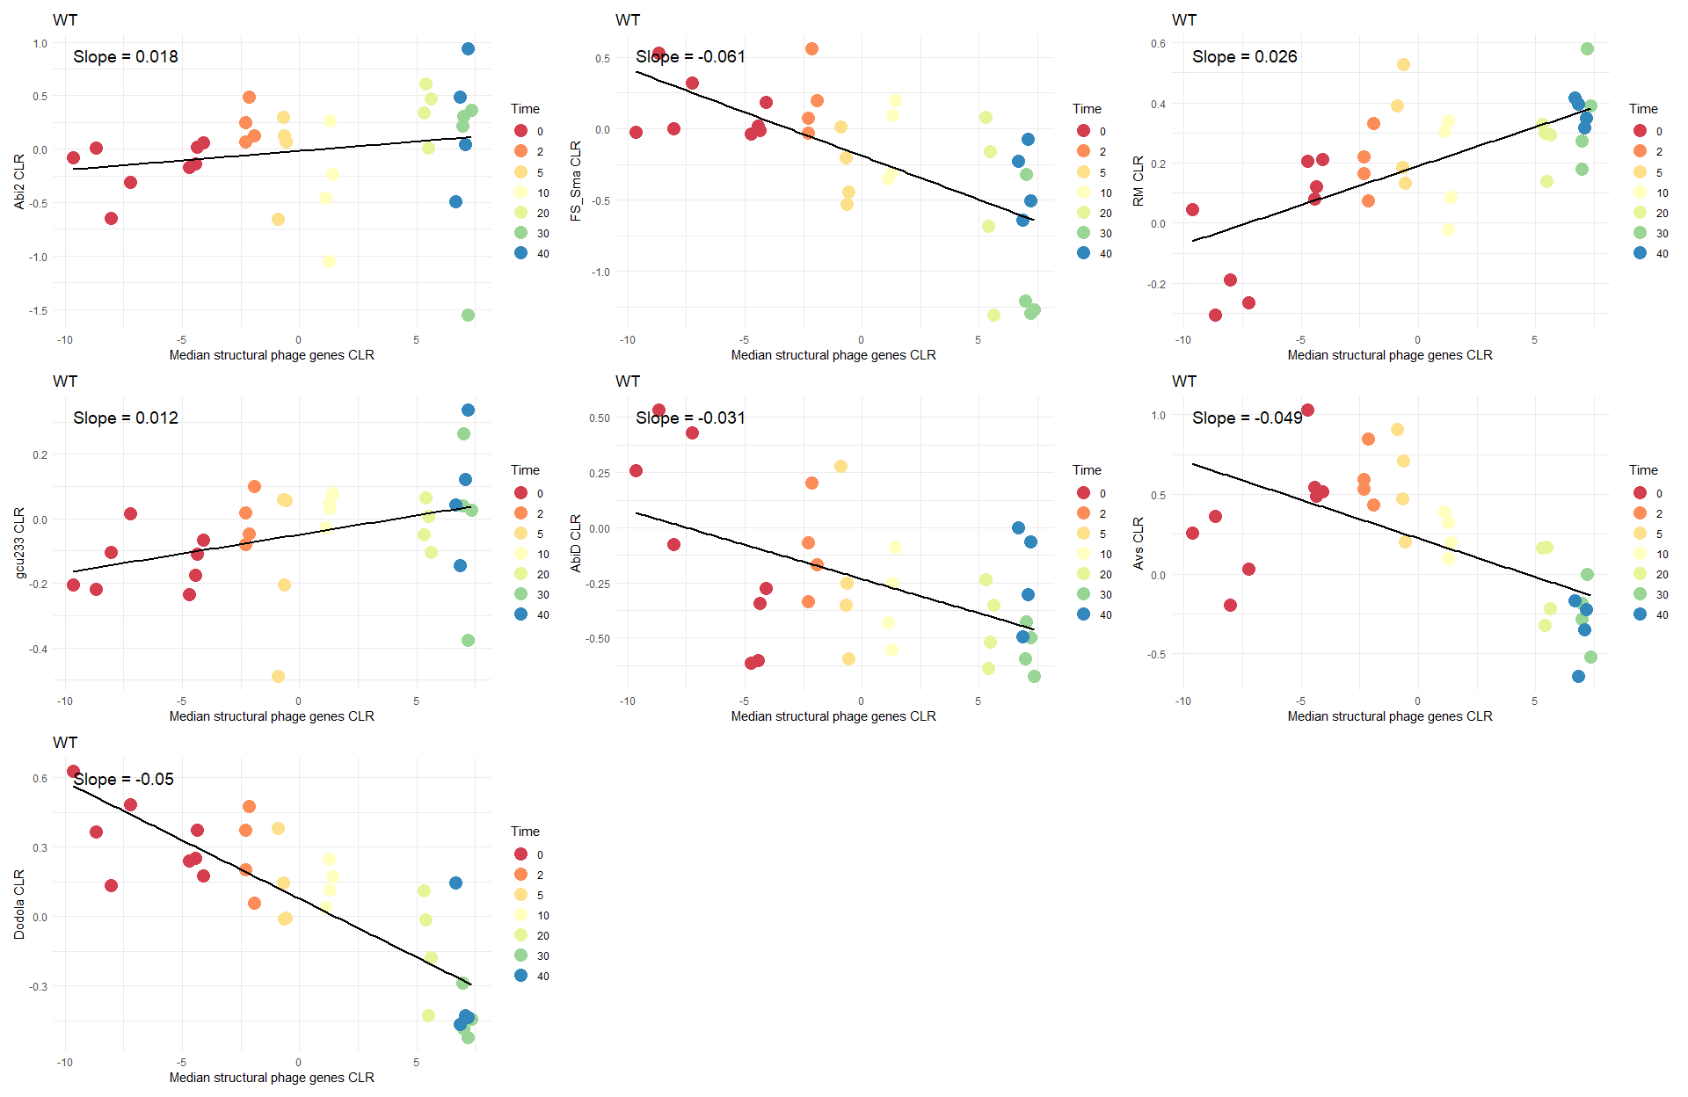
Staphylococcus aureus subsp. aureus USA300 VS Staphylococcus phage K
PRJNA1065939

Slide 6
Defense systems expression VS bacterial/phage growth
My questions | Some phage slopes are not equal to 0 in the control: PRJNA307603 pseudocount of 0.05 was too small to compute the CLR so had to set it at 0.6 PRJEB12430 almost all phage genes detected in the control PRJNA315575 and PRJNA340008 even though very few struct phage genes expressed in control, gives
How to interprete these results ? | Plot slope ribosome vs slope phage (how to handle conditions?) – color defense-systems and then bacteria
 | Heatmap defense-systems vs strain_condition with color gradient for the slope value
 | Slopes distribution to have a global idea
 | PCoA highlighing defense systems
 | PCoA highlighing bacteria

Slide 7
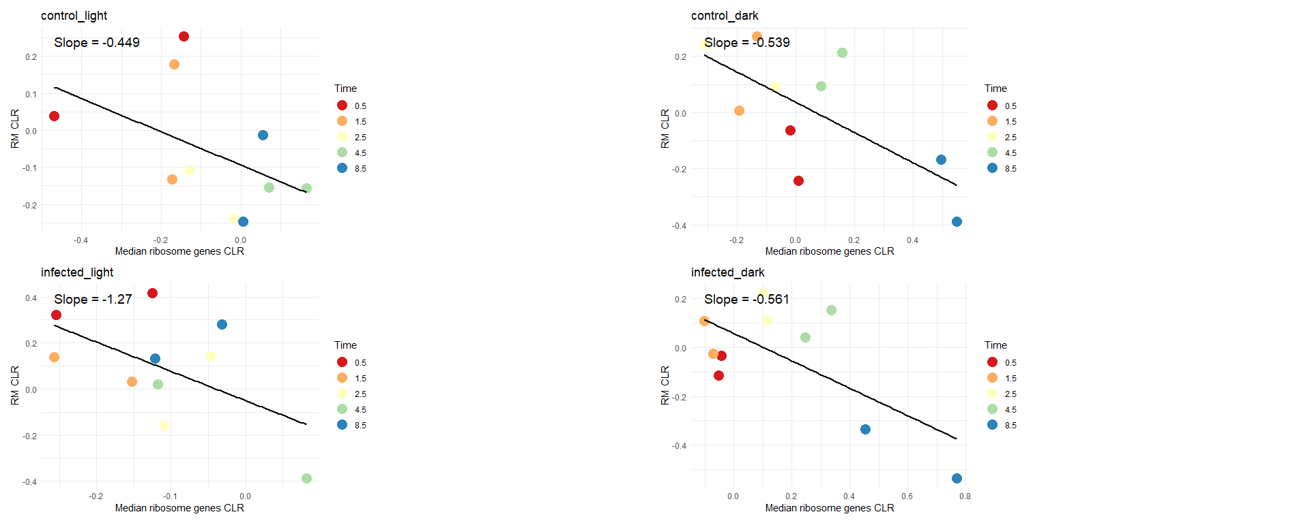
Prochlorococcus marinus subsp. Pastoris VS Prochlorococcus phage P-HM2
PRJNA315575

Slide 8
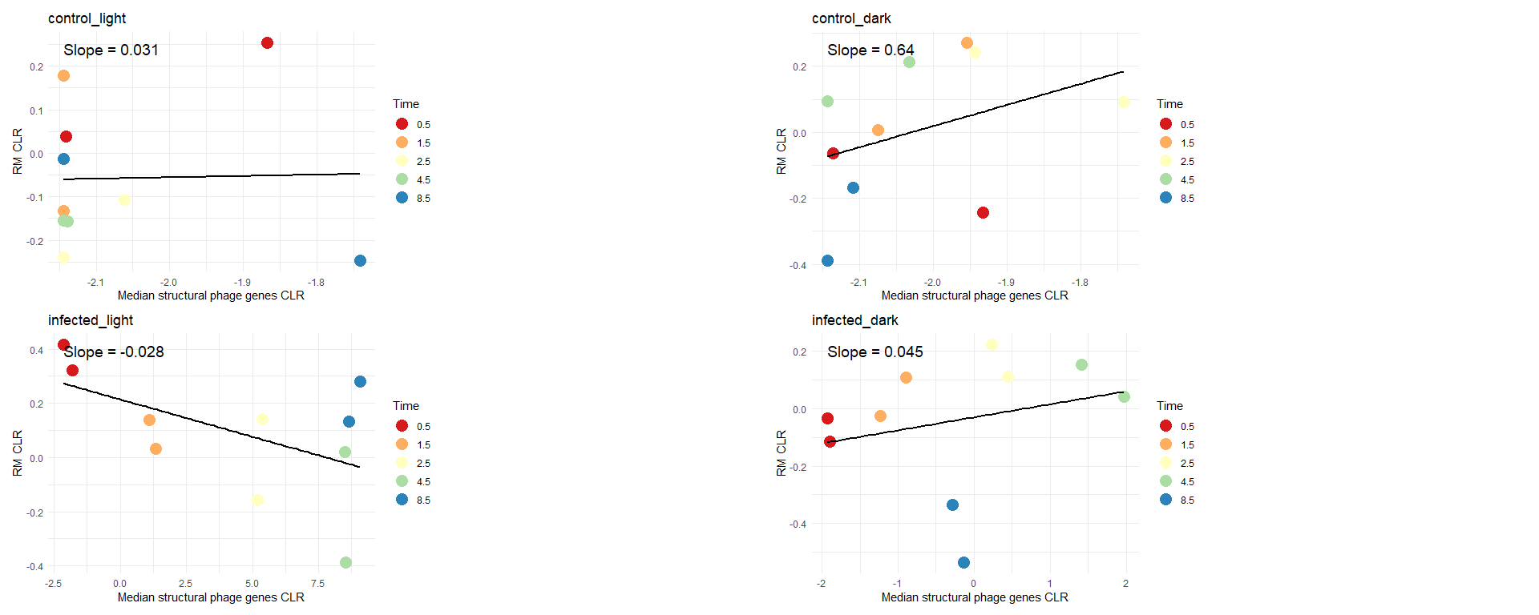
Prochlorococcus marinus subsp. Pastoris VS Prochlorococcus phage P-HM2
PRJNA315575

