Slide 1

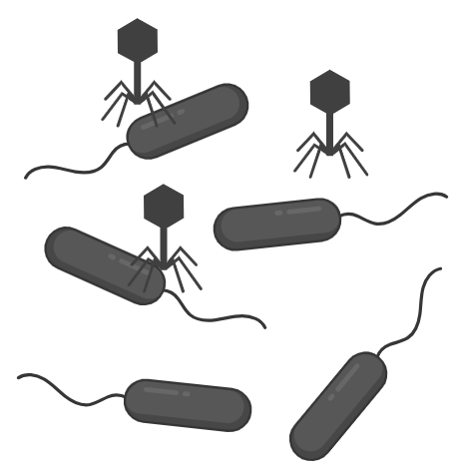
Project defense regulation
09/2025-02/2026
Mathilde Roulleau
Teacher – Lucas Paoli
Assistant – Agathe Bredel
How are bacterial defense systems expressed relative to bacterial growth and phage infection?

Slide 2
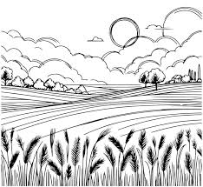
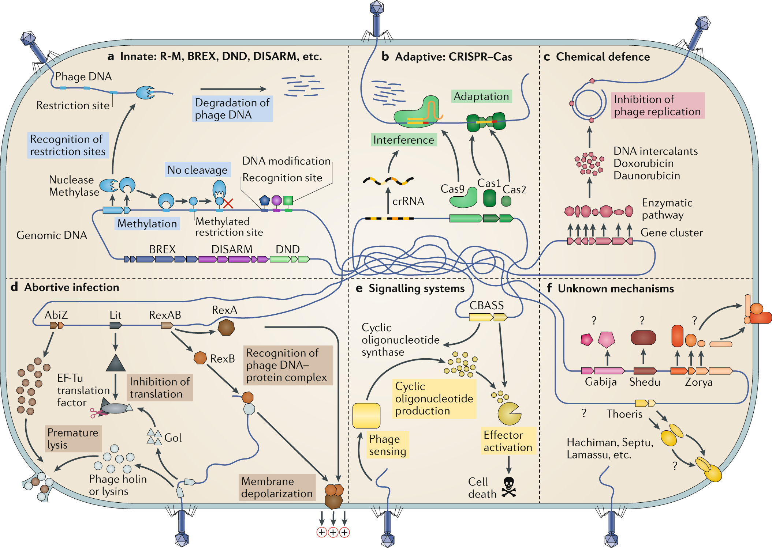
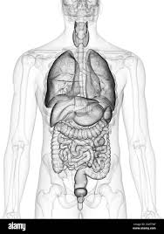
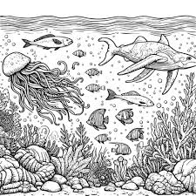














Bacterial defense systems
Bernheim, A., Sorek, R. The pan-immune system of bacteria: antiviral defence as a community resource. Nat Rev Microbiol 18, 113–119 (2020).
Notes:
Bacteria constantly exposed to phage (most abundant biological entities on Earth), exerts strong selective pressure driving the evolution of a remarkable diversity of defense systems. These include innate mechanisms such as restriction–modification systems, adaptive immunity mediated by CRISPR–Cas systems, and a wide range of recently discovered antiviral systems such as chemical defense, abortive infection modules and signalling systems. Over the past years, more than 200 antiphage defense systems were discovered, prokaryotic genomes are now thought to encode an average of at least ten such defenses. In eukaryotes, the immune response is largely driven by transcriptomic upregulation of immune genes following pathogen detection. By contrast, the extent, drivers, and nature of transcriptional regulation in prokaryotic immunity remains largely unexplored. We currently don’t know how defense system transcription levels vary across physiological and environmental gradients, as well as across strains or species.

Slide 3
Why studying bacterial defense systems
Phage therapy, resistance, microbiota
Regulation of microbial cycles and biodiversity
Biocontrol and ground microbiome
Notes:
Studying phage resistance is important both ecologically and practically. Phages control bacterial populations, drive nutrient cycling, and shape biodiversity—from oceans to soils—affecting microbial community stability and soil health. Understanding how bacteria resist phages is also key for applications like phage therapy, agricultural biocontrol, and maintaining healthy microbiomes, since resistance influences treatment success and ecosystem balance.

Slide 4
In nature VS in vitro
Controlled conditions
Unique bacterial strain and phage
Notes:
But studying these interactions in nature is challenging due to complexity and variability. In this project, we focus on in vitro studies under controlled conditions, using a single bacterial strain and phage, to better understand how defense systems are regulated relative to growth and infection.

Slide 5
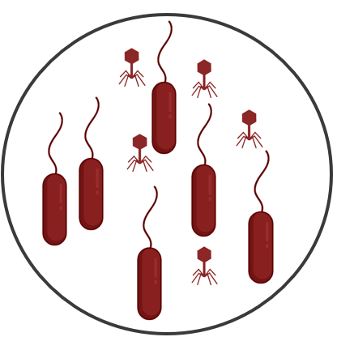
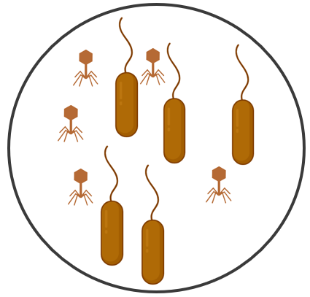
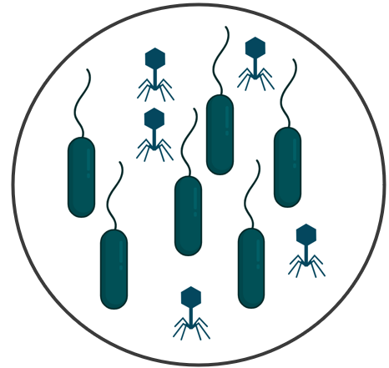
How are bacterial defense systems expressed relative to bacterial growth and phage infection?
29 projects
20 strains
24 phages
59 defense systems
…
Project 1
Project 2
Project 3
Condition:
infected / uninfected,
time after infection,
medium composition,
growth stage,
light,
temperature
…
…
…
…
Condition 1
Condition 2
Condition 3
Condition 1
Condition 2
Condition 3
Condition 1
Condition 2
Condition 3
RNA
RNA
RNA
Illumina sequencing

Slide 6
The data
Illumina RNAseq
Quality control
Alignment, counting, annotation
 | Sample 1 Condition1 rep 1 | Sample 2 Condition1 rep 2 | Sample 3 Condition2 rep 1 | Sample 4 Condition2 rep2 | …
Gene 1
Gene 2
Gene 3
Gene 4
…

Slide 7
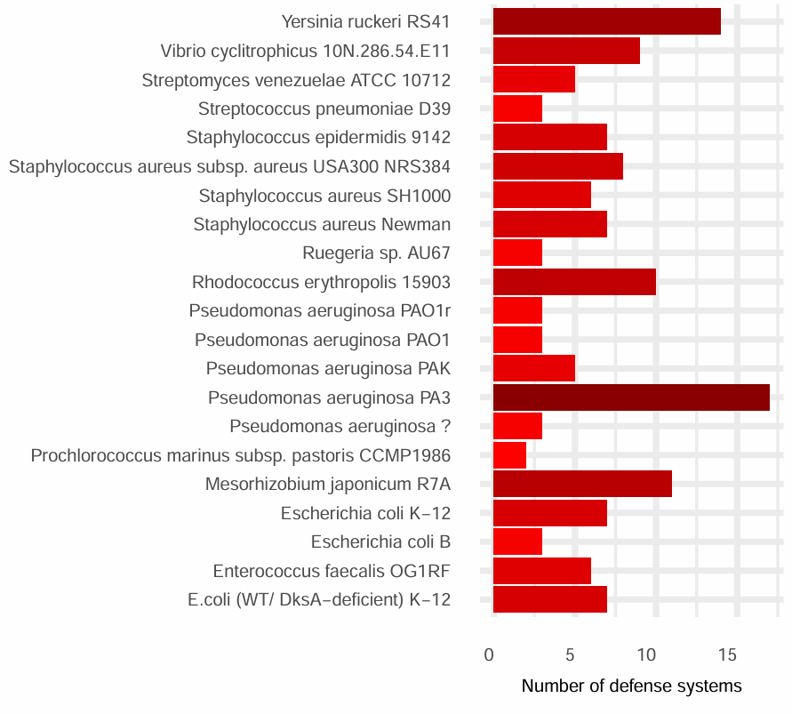
The data
Identification of defense system genes using Defense Finder

Slide 8
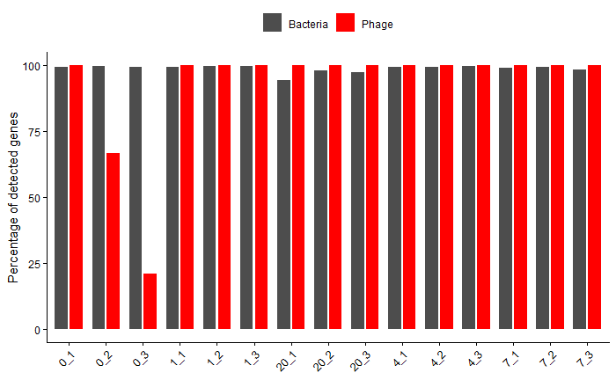
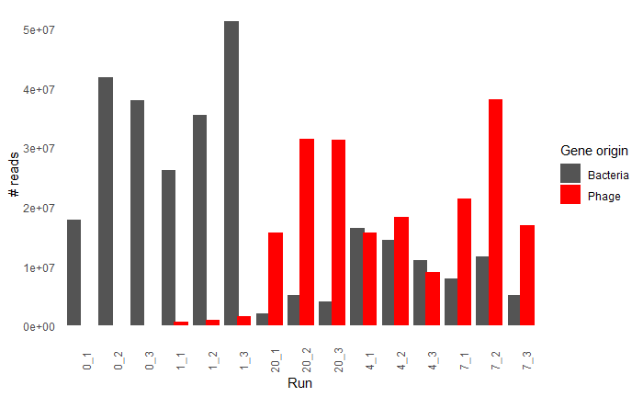
Quality control
Percentage of detected bacterial and phage genes
Number of reads per run
1 project
1 project
1 sample =
1 condition
1 sample =
1 condition

Slide 9
The data
 | Sample 1 Condition1 rep 1 | Sample 2 Condition1 rep 2 | Sample 3 Condition2 rep 1 | Sample 4 Condition2 rep2 | …
Gene 1
Gene 2
Gene 3
Gene 4
Variance Stabilizing Transformation (VST) - each gene has roughly constant variance across samples
2^(VST) – because VST function apply a log2
Normalization by gene length
Centered Log2 Ratio (CLR) - ‘Centres’ the distribution of values around 0, comparing each gene to the overall mean of the sample transcriptome

Slide 10
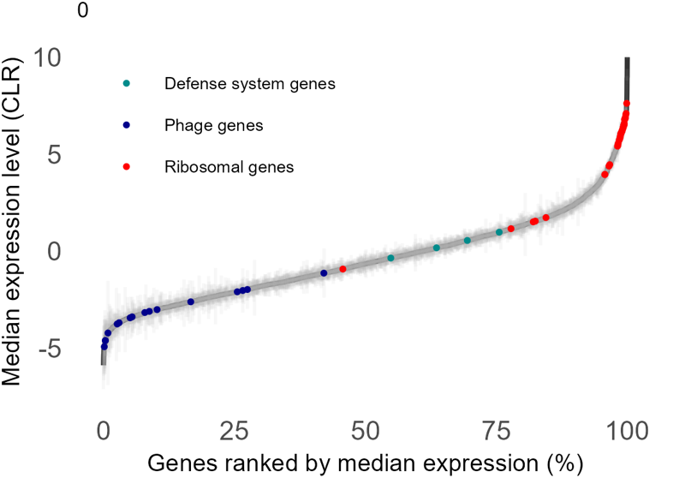
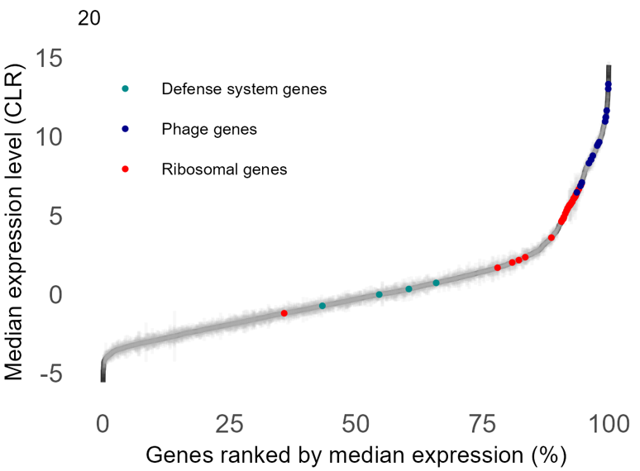
Quality control
Time 0 after infection
Time 20 after infection
CLR ranked
Ribosomal genes
Phage genes

Slide 11
How are bacterial defense systems expressed relative to bacterial growth and phage infection?

Slide 12
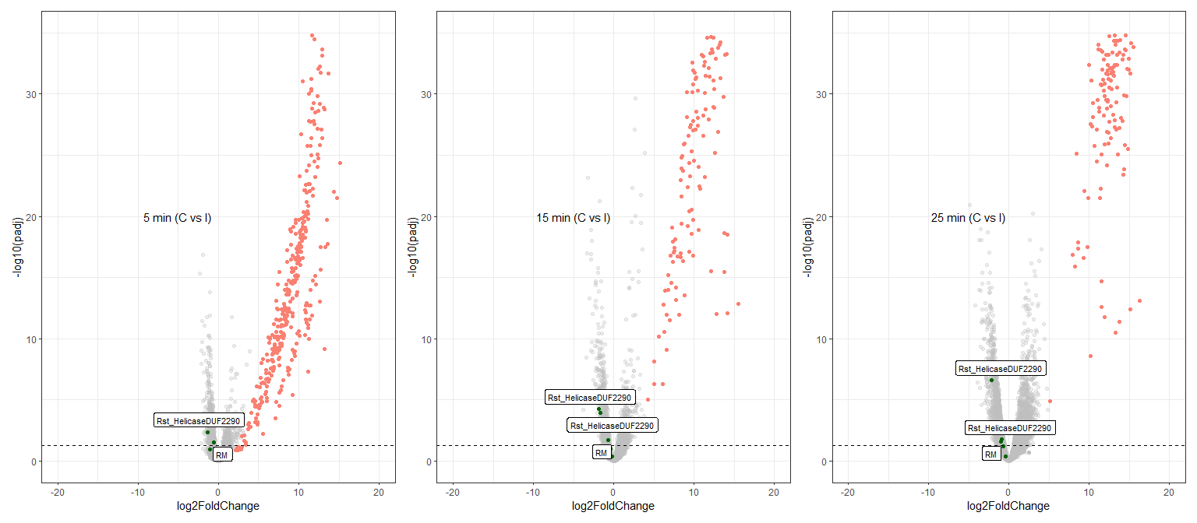
How are the defense system genes more expressed in infected strains compared to control strains ?
- control
+ infected
p_{adj} = significance
Defense system genes
Of genes counts

Slide 13
How are the defense system genes more expressed in infected strains compared to control strains ?
- control
+ infected
Problem – This requires:
Clear metadata
Time points
Replicates
Control at time 0
Control uninfected
No sequencing issues
Only 1 project satisfies all
p_{adj} = significance
Defense system genes
Of genes counts

Slide 14
What markers to use instead of time?
Bacterial growth markers - Ribosomal genes
Infection markers – Structural phage genes
How are bacterial defense systems expressed relative to host growth and phage production?

Slide 15
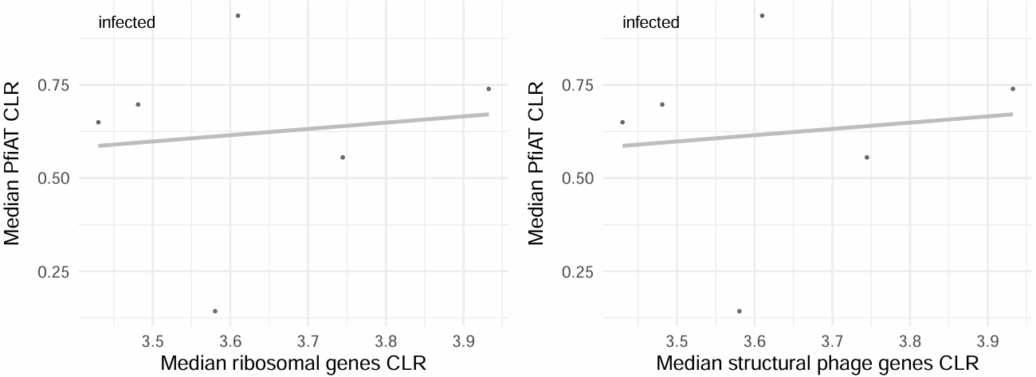
How are bacterial defense systems expressed relative to host growth and phage production?
1 sample =
1 condition
Identification of structural phage genes with Genomad

Slide 16
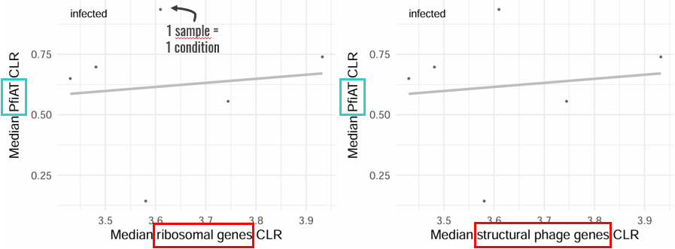
How are bacterial defense systems expressed relative to host growth and phage production?
Correlation ρ to bacterial growth
Correlation ρ to phage growth
 | Defense system | Condition | ρ_{(bacterial growth)} | ρ_{(phage growth)} | _{Padj (phage growth)} | _{Padj (phage growth)}
Project 1 | SpbK | infected
Project 1 | RM | infected
Project 1 | Gao_Tmn | control
Project 2 | Cas | stationnary
Project 2 | Cas | exponential
…
Notes:
Explain positive and negative correlation with biology

Slide 17
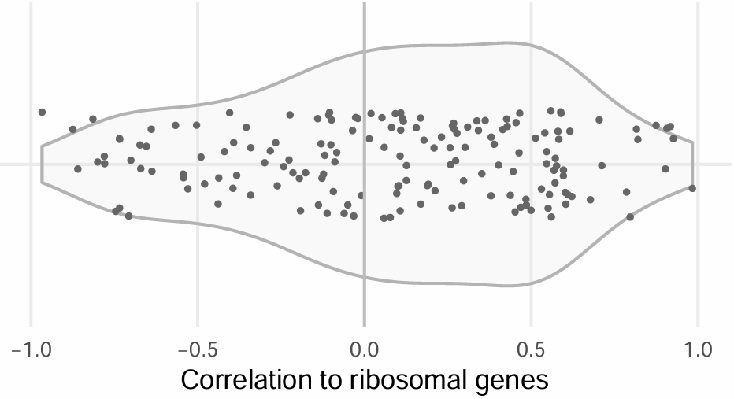
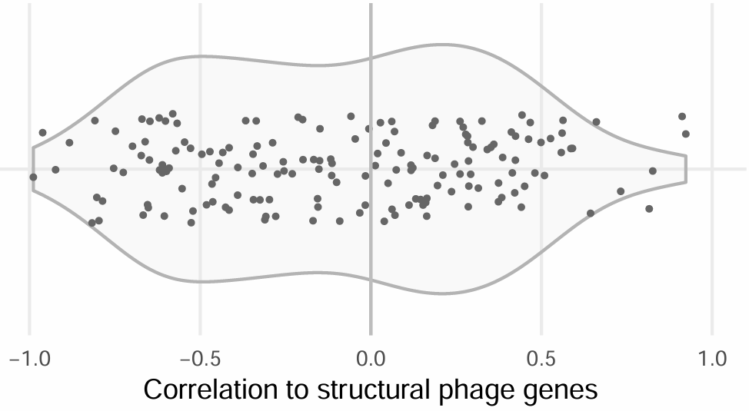
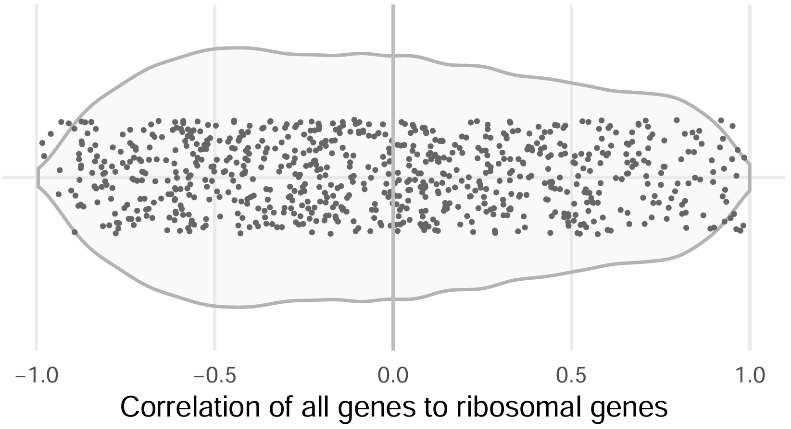
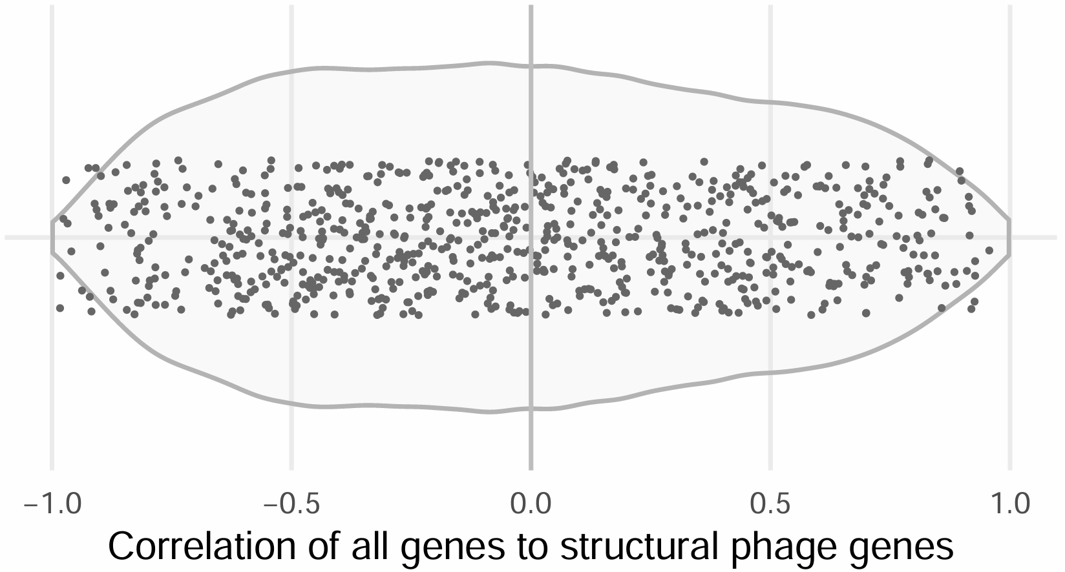
Correlation density
1 defense system in 1 project
Defense systems
All genes
Number of samples per project > 5
No sequencing issues
No control samples
Notes:
Selection of projects
Each dot (upper plots) correspond to 1 defense system in 1 project or (lower plots) to 1 gene in 1 project
The correlations of all genes with growth and infection is centered around 0 as expected
For the DS genes, slight + correlation with growth and no defined pattern for correlation with infection. Overall very heterogenous among DS, strains and conditions.

Slide 18
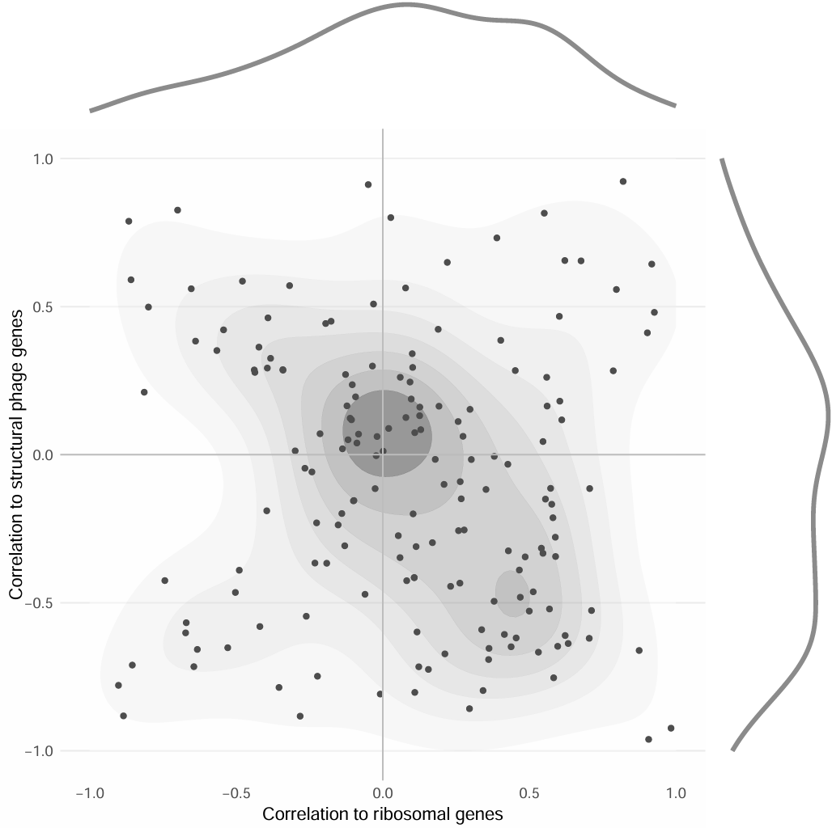
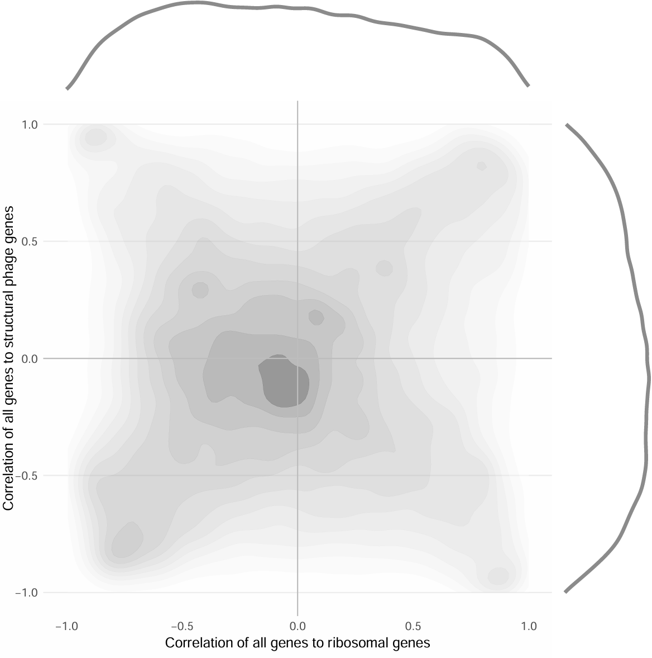
Correlation to infection VS correlation to growth
Defense systems
All genes
1 defense system in 1 project
Notes:
distinguish:
Genes driven mainly by growth → Strong growth correlation, weak infection correlation
Genes specifically responding to infection → Strong infection correlation, weak growth correlation
Genes responding to both → Strong in both directions
Unrelated genes → Near zero in both
Very heterogenous with a highest concentration near zero so no correlation. Slight tendancy towards positive correlation to growth and negative correlation to phage but not that relevant. All genes as comparison. Centered around 0 and spread all around.
Limitation -> some bacteria have more ds than other + if different conditions for one bacteria of a project represented twice on the graph

Slide 19
We currently have:
DS expression ↔ ribosomal genes (growth proxy)
DS expression ↔ phage structural genes (infection proxy)
But:
Phage replication impacts growth
Growth impacts transcription globally
Is DS expression associated with phage replication independent of growth effects?
Is DS expression associated with growth independent of infection level?

Slide 20
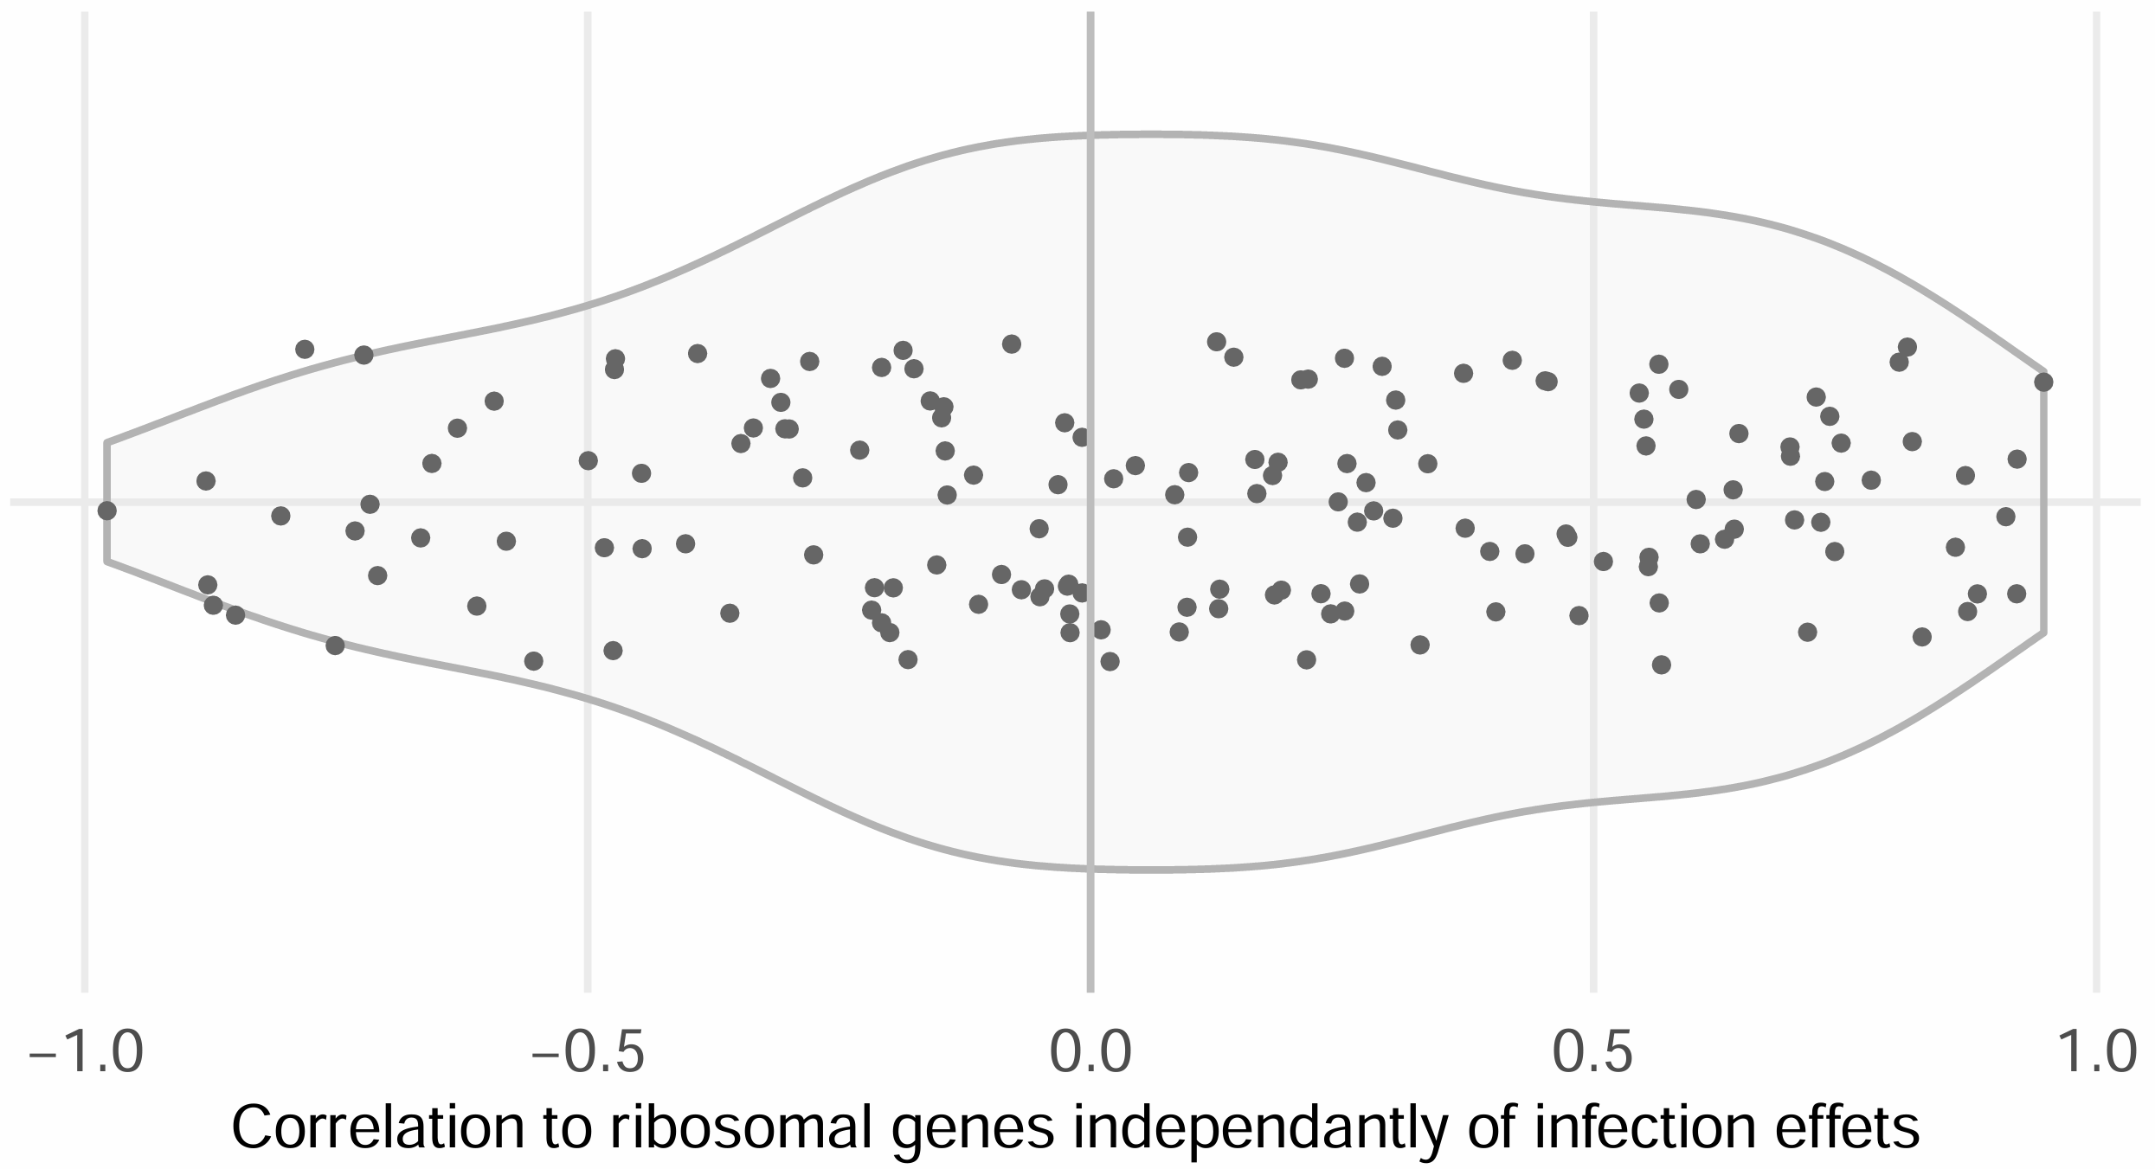
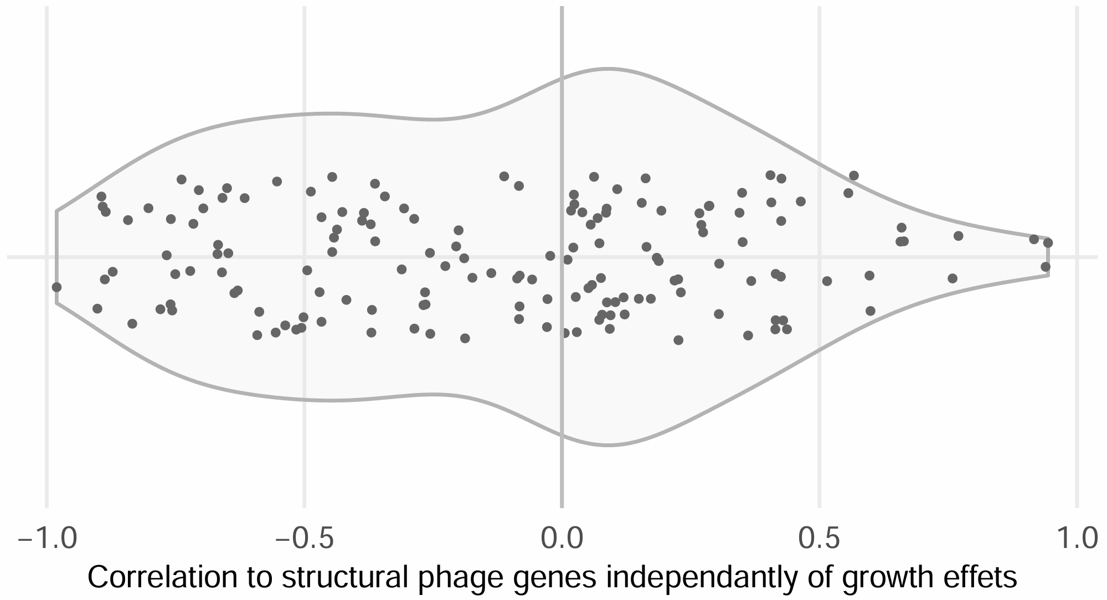
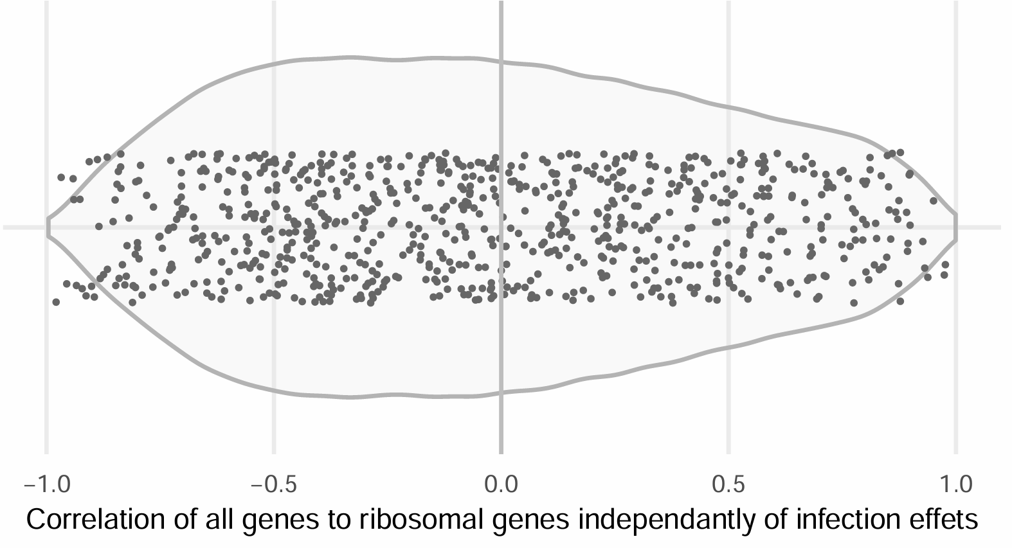
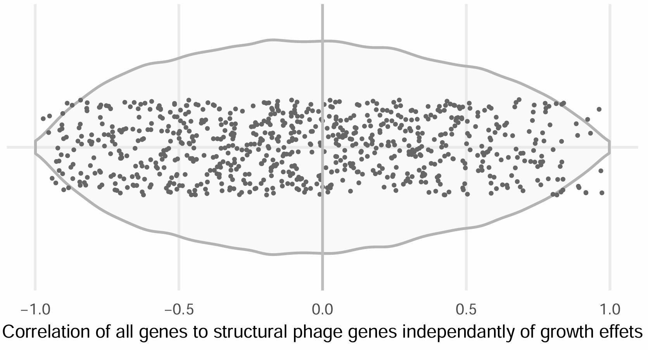
Partial correlation density
1 defense system in 1 project
Defense systems
All genes

Slide 21
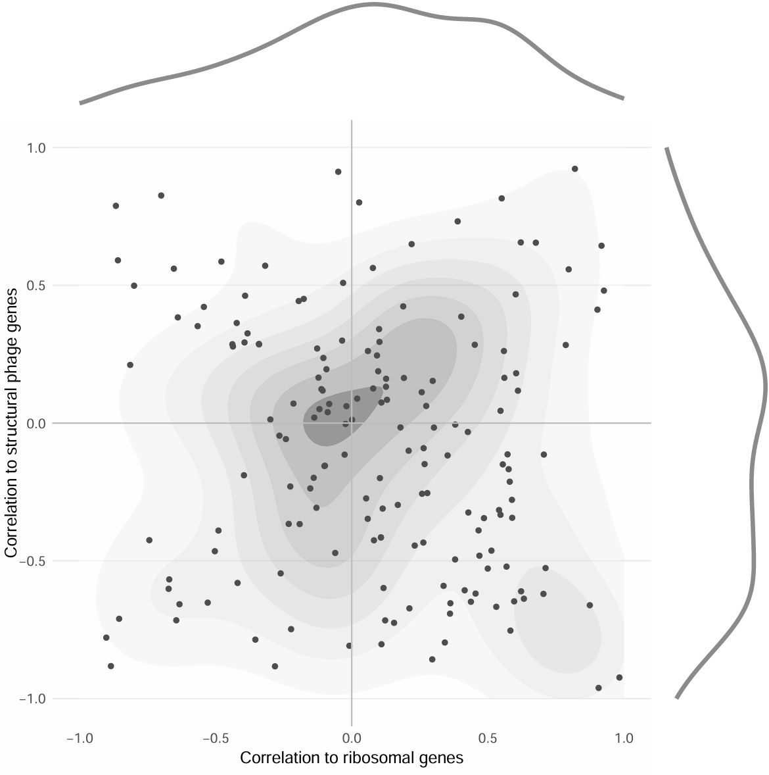
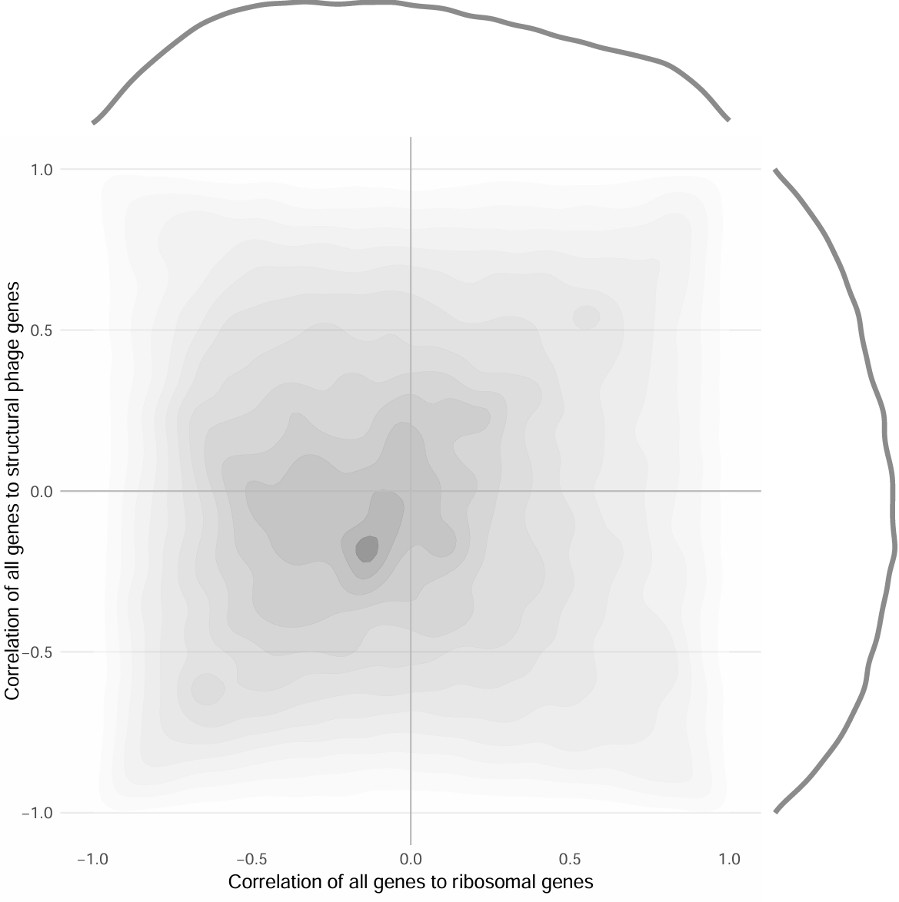
Partial correlation to infection VS partial correlation to growth
Defense systems
All genes
1 defense system in 1 project
Notes:
Still spread so still very heterogenous transcriptional regulations
Very smooth distribution of all the genes centered around 0

Slide 22
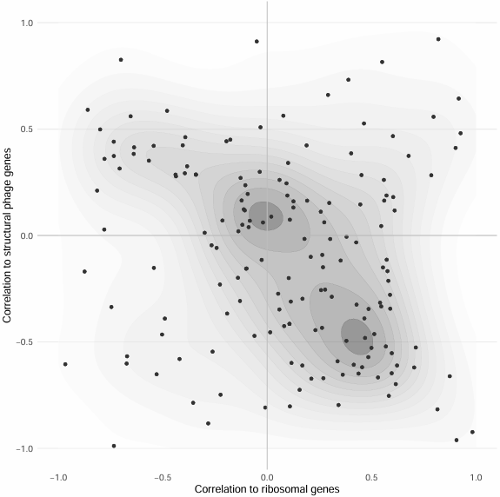
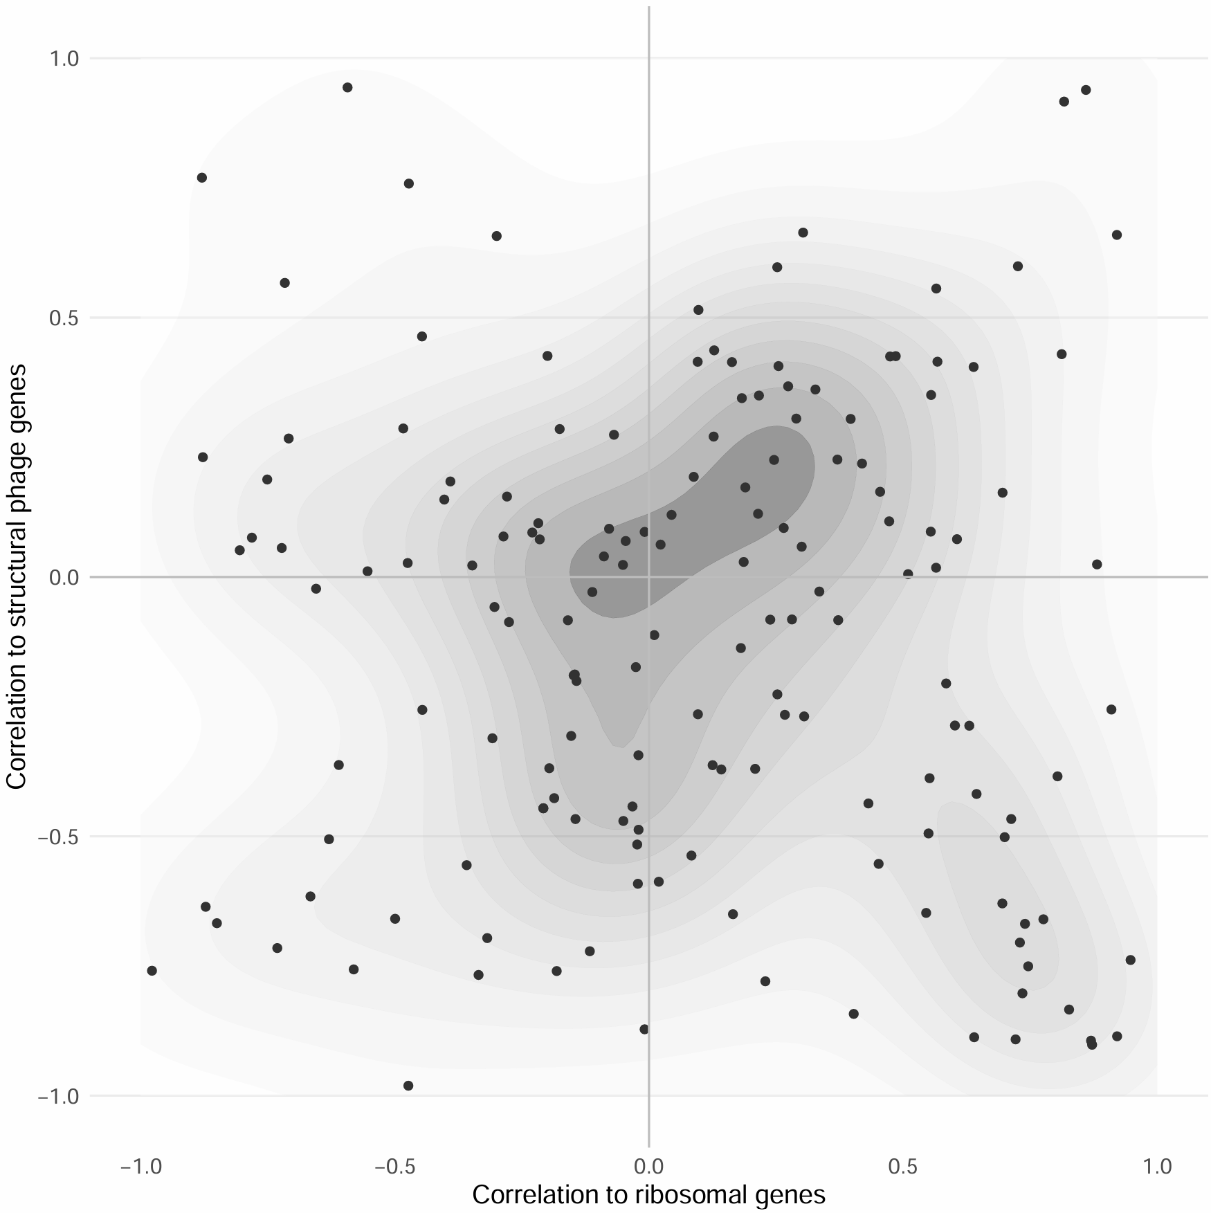
Correlation to infection VS correlation to growth
Simple correlations
Partial correlations
RM in 18≠ strains
Notes:
We talked about general transcription but what about individual DS and individual strains. I highlihted some DS that have both strong correlations and same behaviour among all projects and strains and same for the strains.

Slide 23
Correlation to infection VS correlation to growth
Simple correlations
Partial correlations
SEFIR in Staphylococcus epidermidis

Slide 24
Correlation to infection VS correlation to growth
Simple correlations
Stk2 in Staphylococcus epidermidis
Partial correlations

Slide 25
Correlation to infection VS correlation to growth
Simple correlations
Partial correlations
Avs in Staphylococcus aureus

Slide 26
Correlation to infection VS correlation to growth
Simple correlations
Partial correlations
Dodola in Staphylococcus aureus

Slide 27
Correlation to infection VS correlation to growth
Simple correlations
Partial correlations
AbiAlpha in Staphylococcus aureus Newman and Rhodococcus erythropolis 15903

Slide 28
Correlation to infection VS correlation to growth
Simple correlations
Partial correlations
Gabija in 6≠ strains

Slide 29
Correlation to infection VS correlation to growth
dGTPase in Vibrio cyclitrophicus
Simple correlations
Partial correlations

Slide 30
Correlation to infection VS correlation to growth
Staphylococcus epidermidis 9142 for 5≠ ds
Simple correlations
Partial correlations

Slide 31
Future perspectives
If possible, more data because huge variability between the projects
Gene clustering
Identify clusters enriched for infection correlation
Identify clusters enriched in known defense genes
Look for unknown genes in infection-specific clusters and check if they are genomically linked to defense islands
Check if some defense systems are co-activated or mutually exclusive

Slide 32
Thank you everyone !!!!

Slide 33
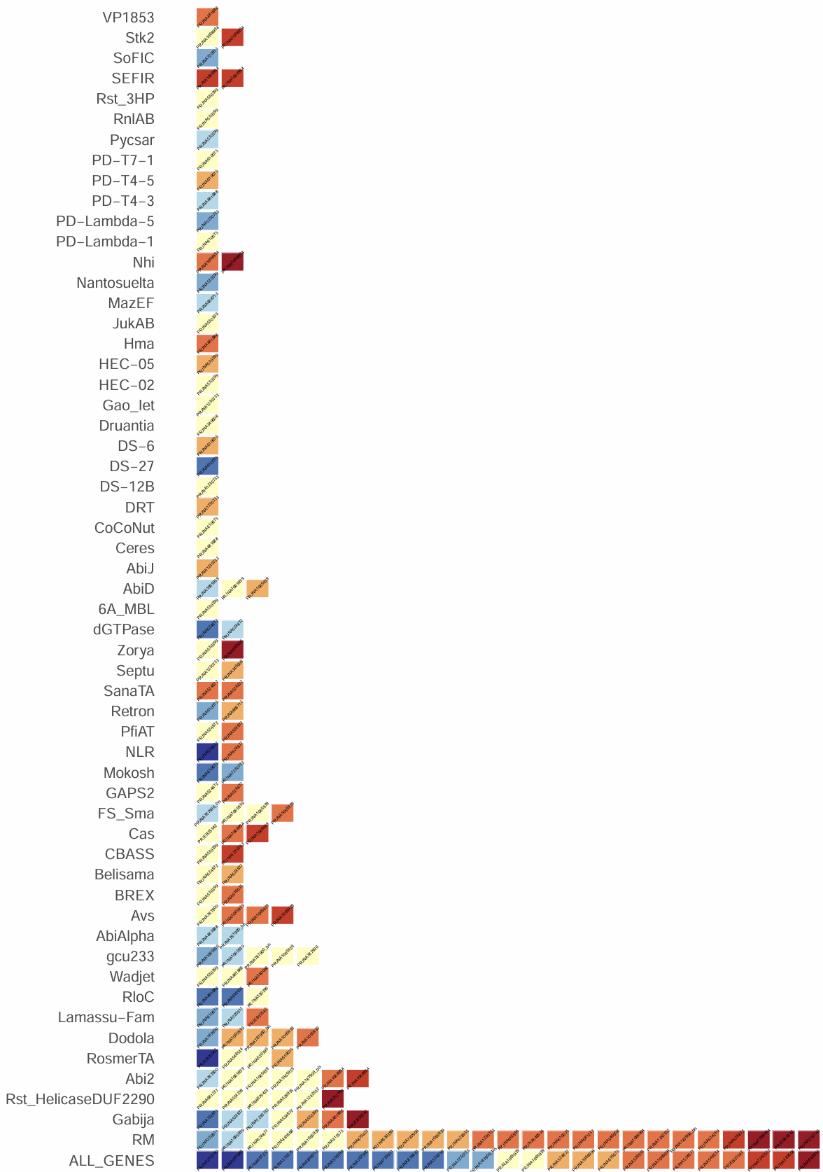
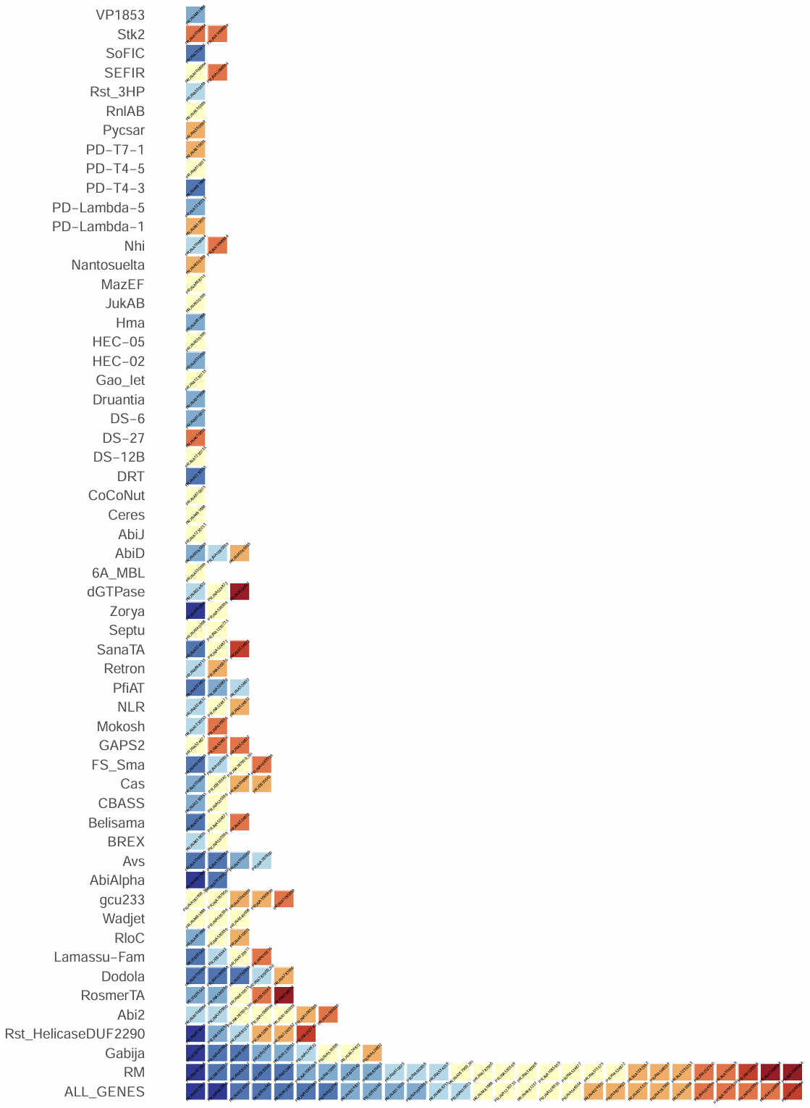
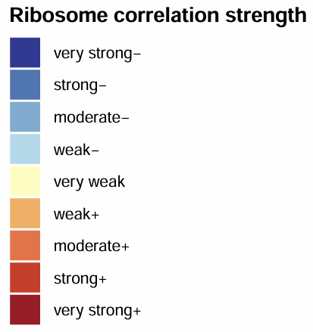
Correlation to ribosomal genes
Correlation to structural phage genes
Correlation strength

Slide 34
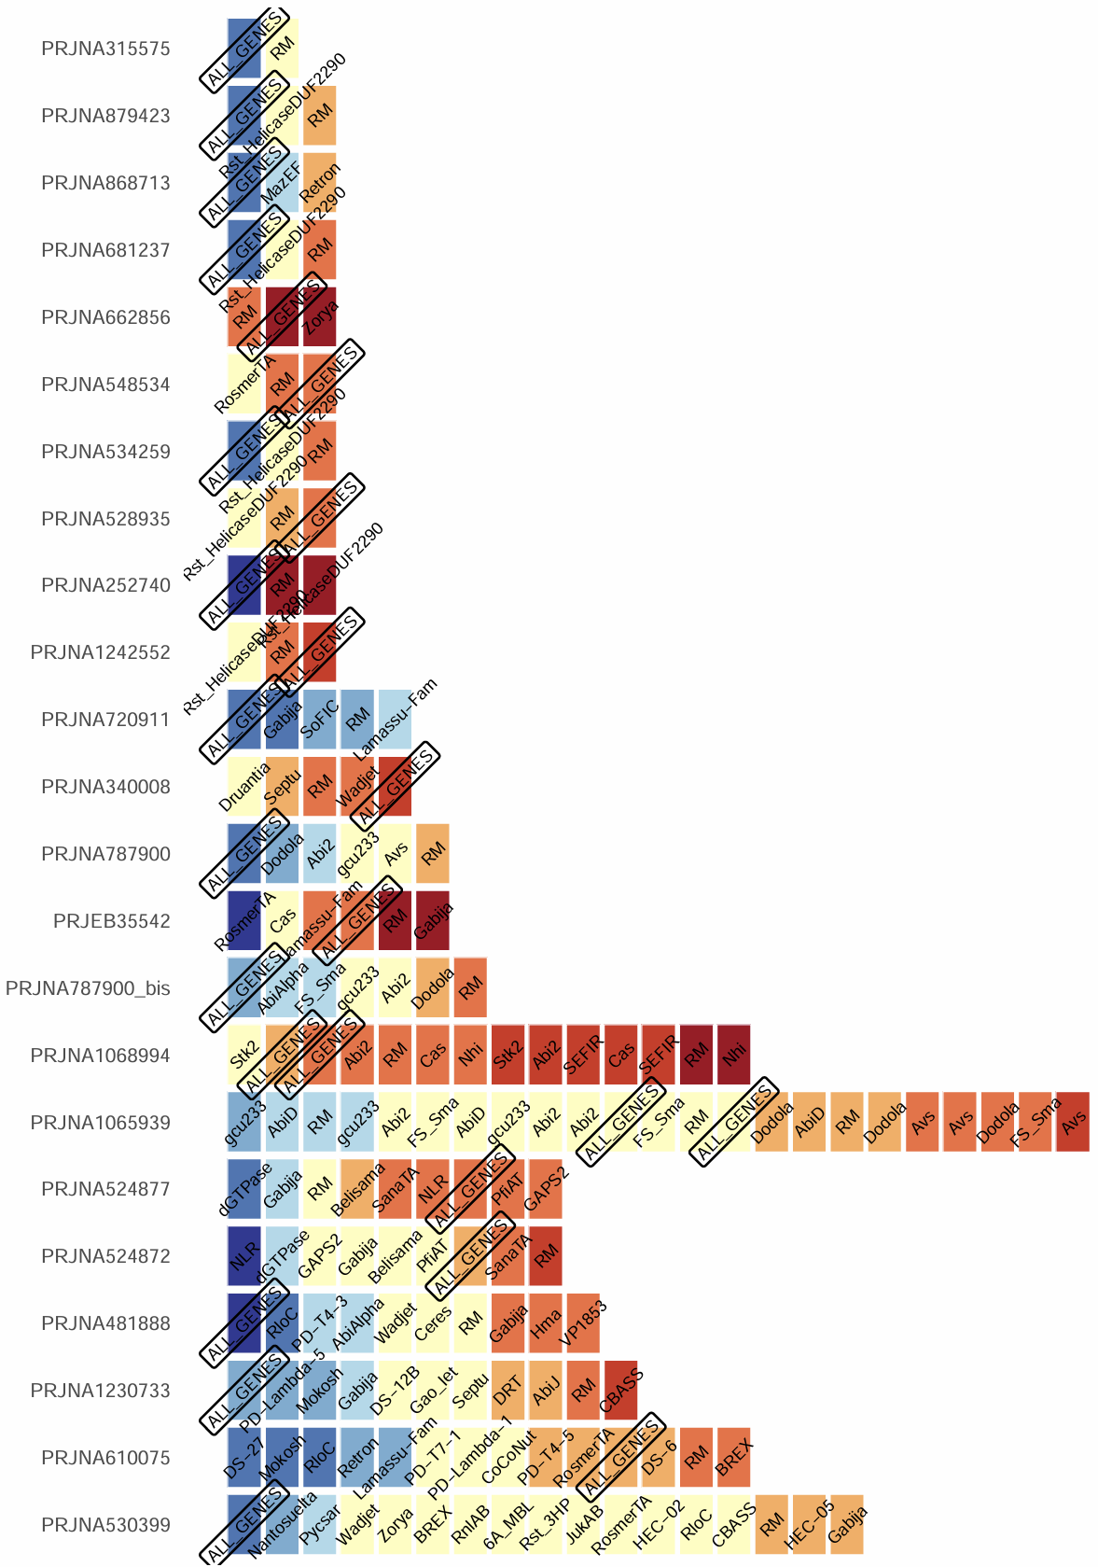
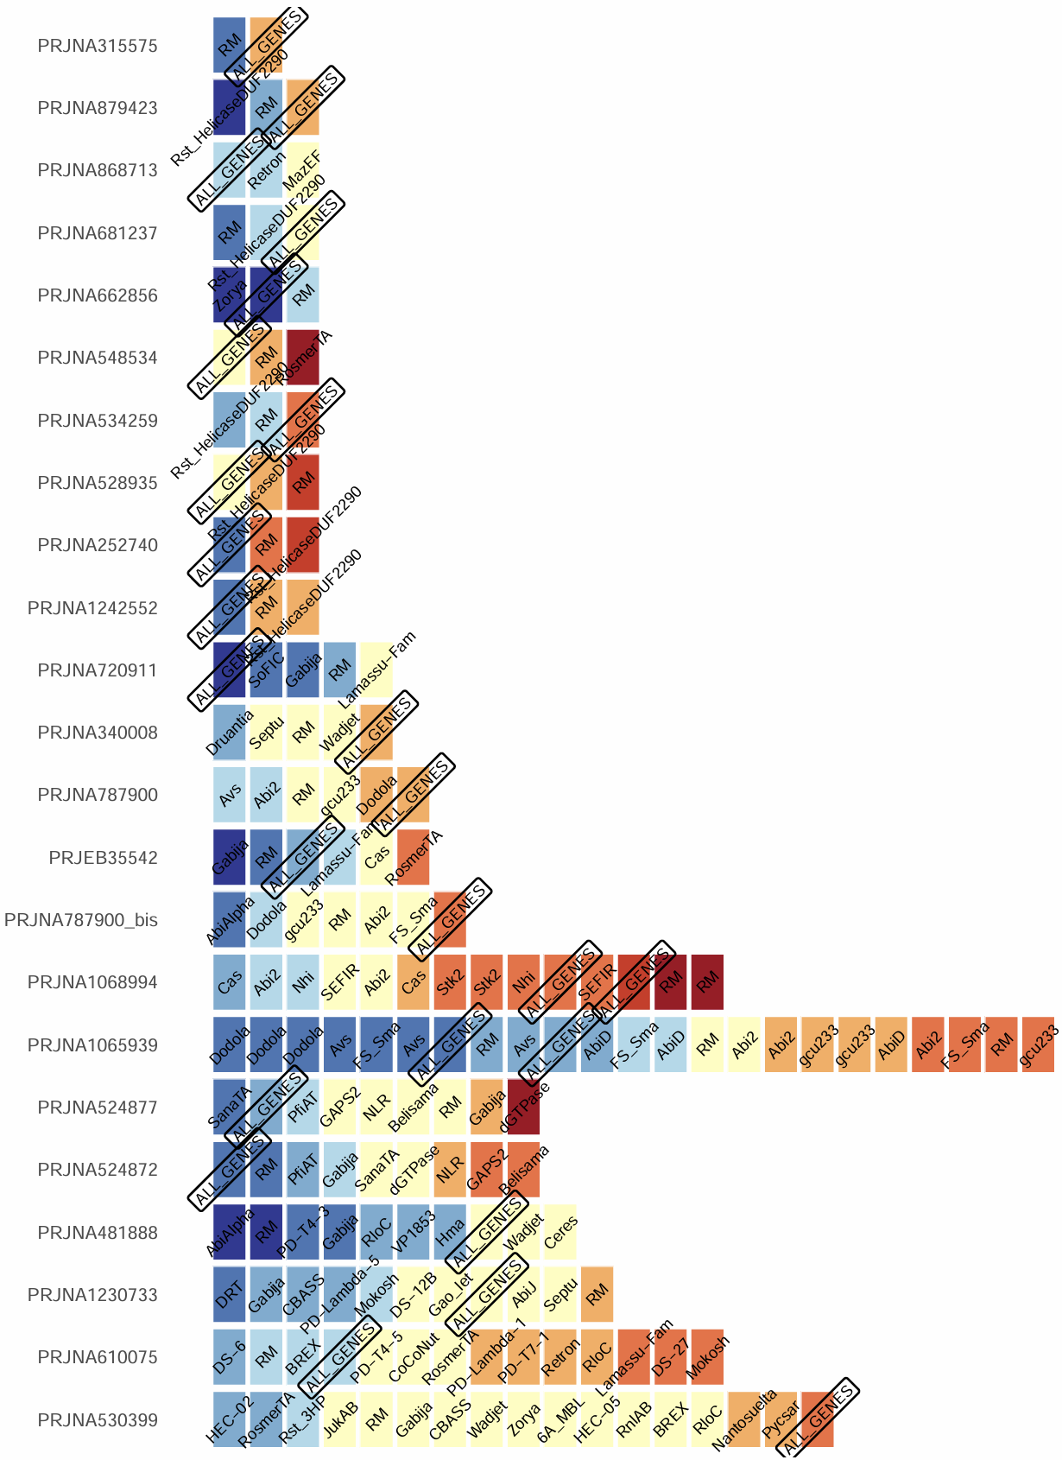
Correlation to ribosomal genes
Correlation to structural phage genes
Correlation strength

Slide 35
Is DS expression associated with phage replication beyond growth effects?
ppcor::pcor.test(
x = clr_defense_system,
y = clr_structural_phage_genes,
z = clr_ribosomal_genes,
method = "spearman"
)
Is DS expression coupled to growth independent of infection level?
ppcor::pcor.test(
x = clr_defense_system,
y = clr_ribosomal_genes ,
z = clr_structural_phage_genes,
method = "spearman"
)
Notes:
If some defense systems remain positively associated with phage gene expression even after controlling for host growth, it suggests infection-specific activation rather than indirect effects of growth inhibition

