Slide 1
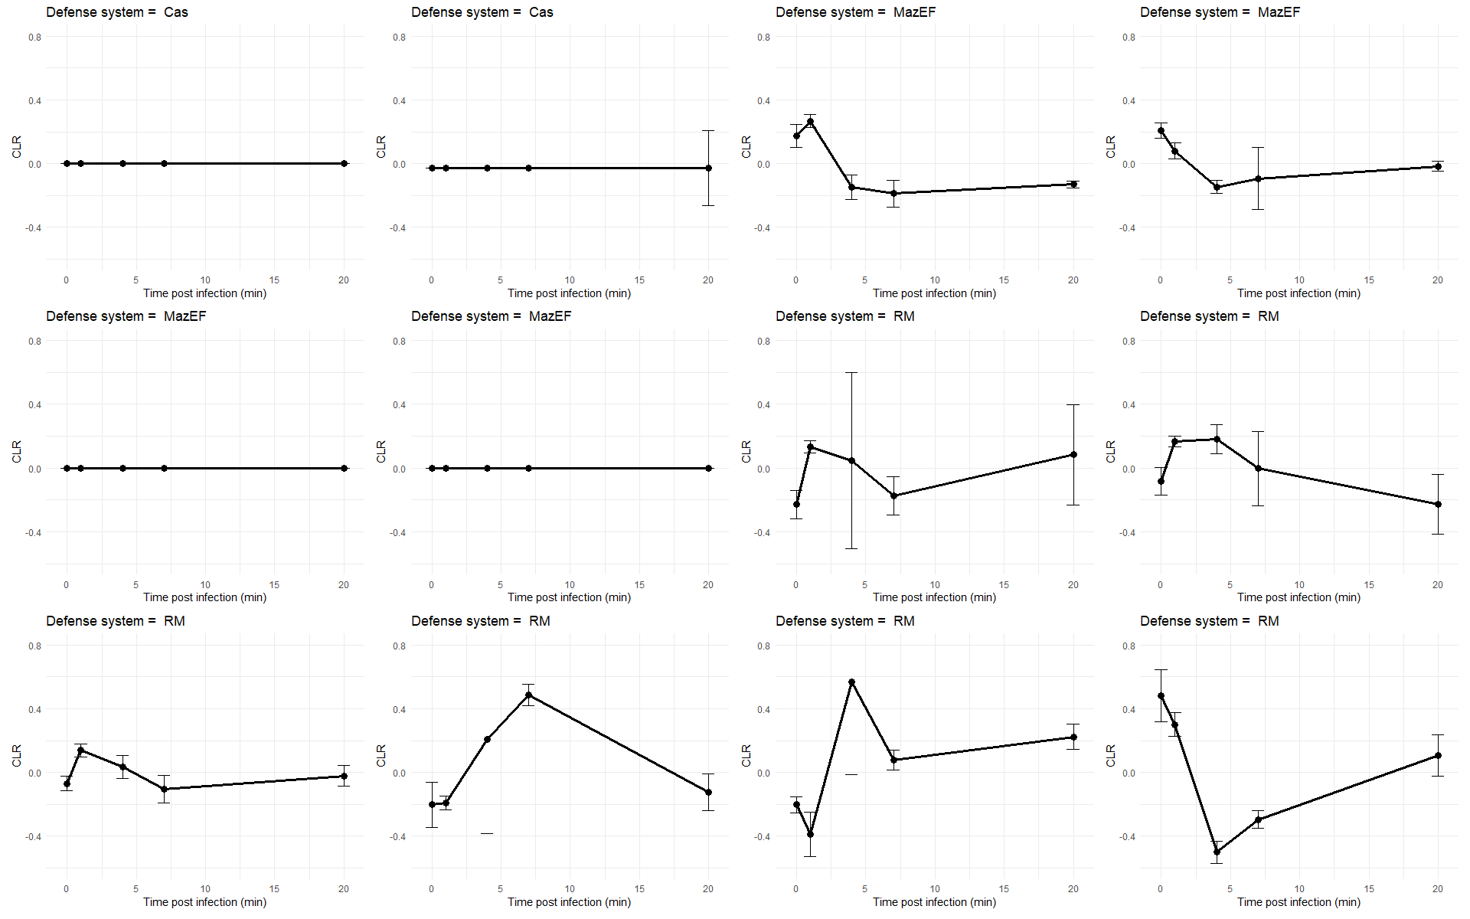
Escherichia coli VS Escherichia phage T4
PRJNA868713

Slide 2
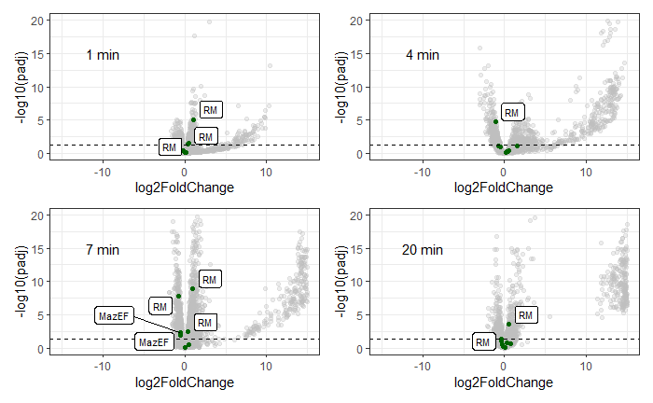
Escherichia coli VS Escherichia phage T4
PRJNA868713

Slide 3
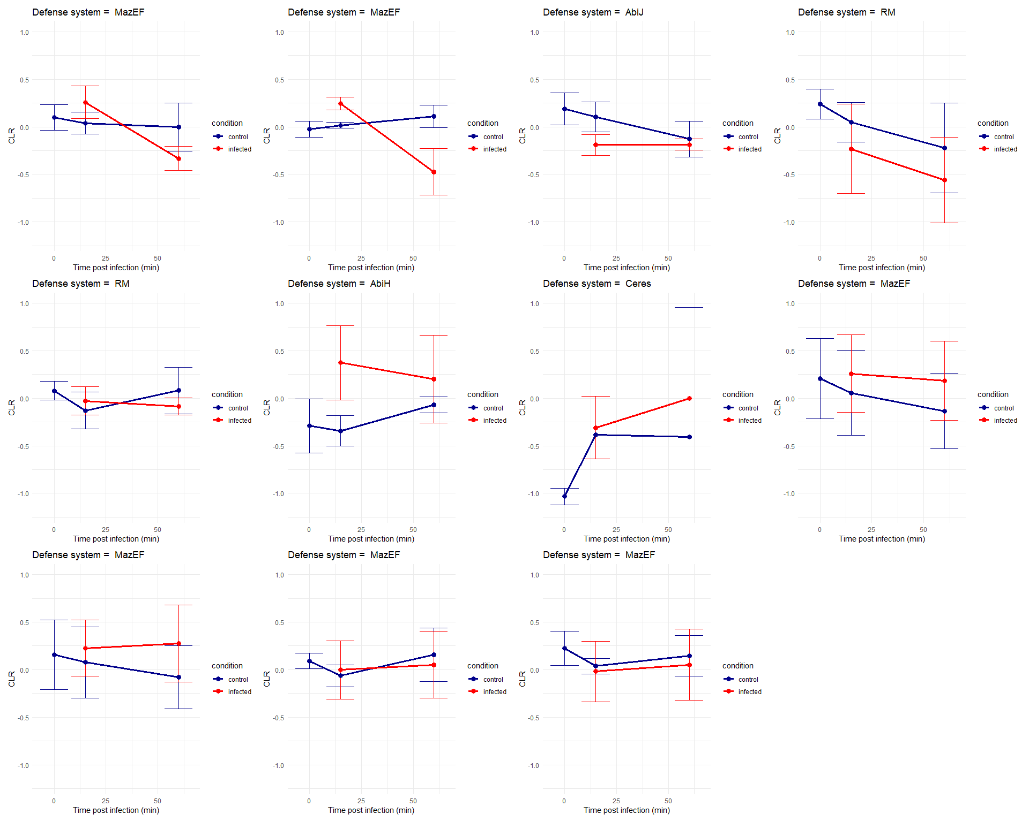
Liquorilactobacillus mali VS UCMA21115
PRJNA804221

Slide 4
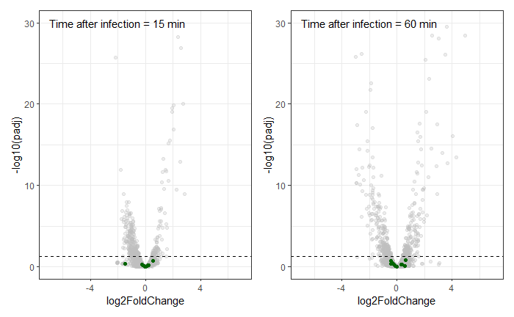
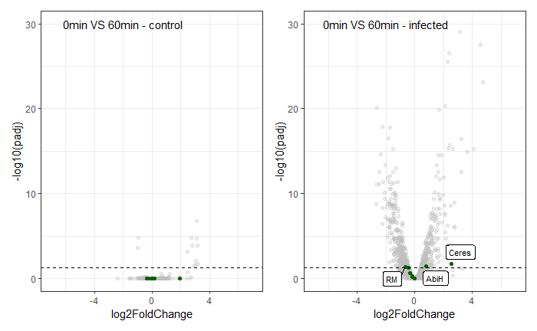
Liquorilactobacillus mali VS UCMA21115
PRJNA804221

Slide 5
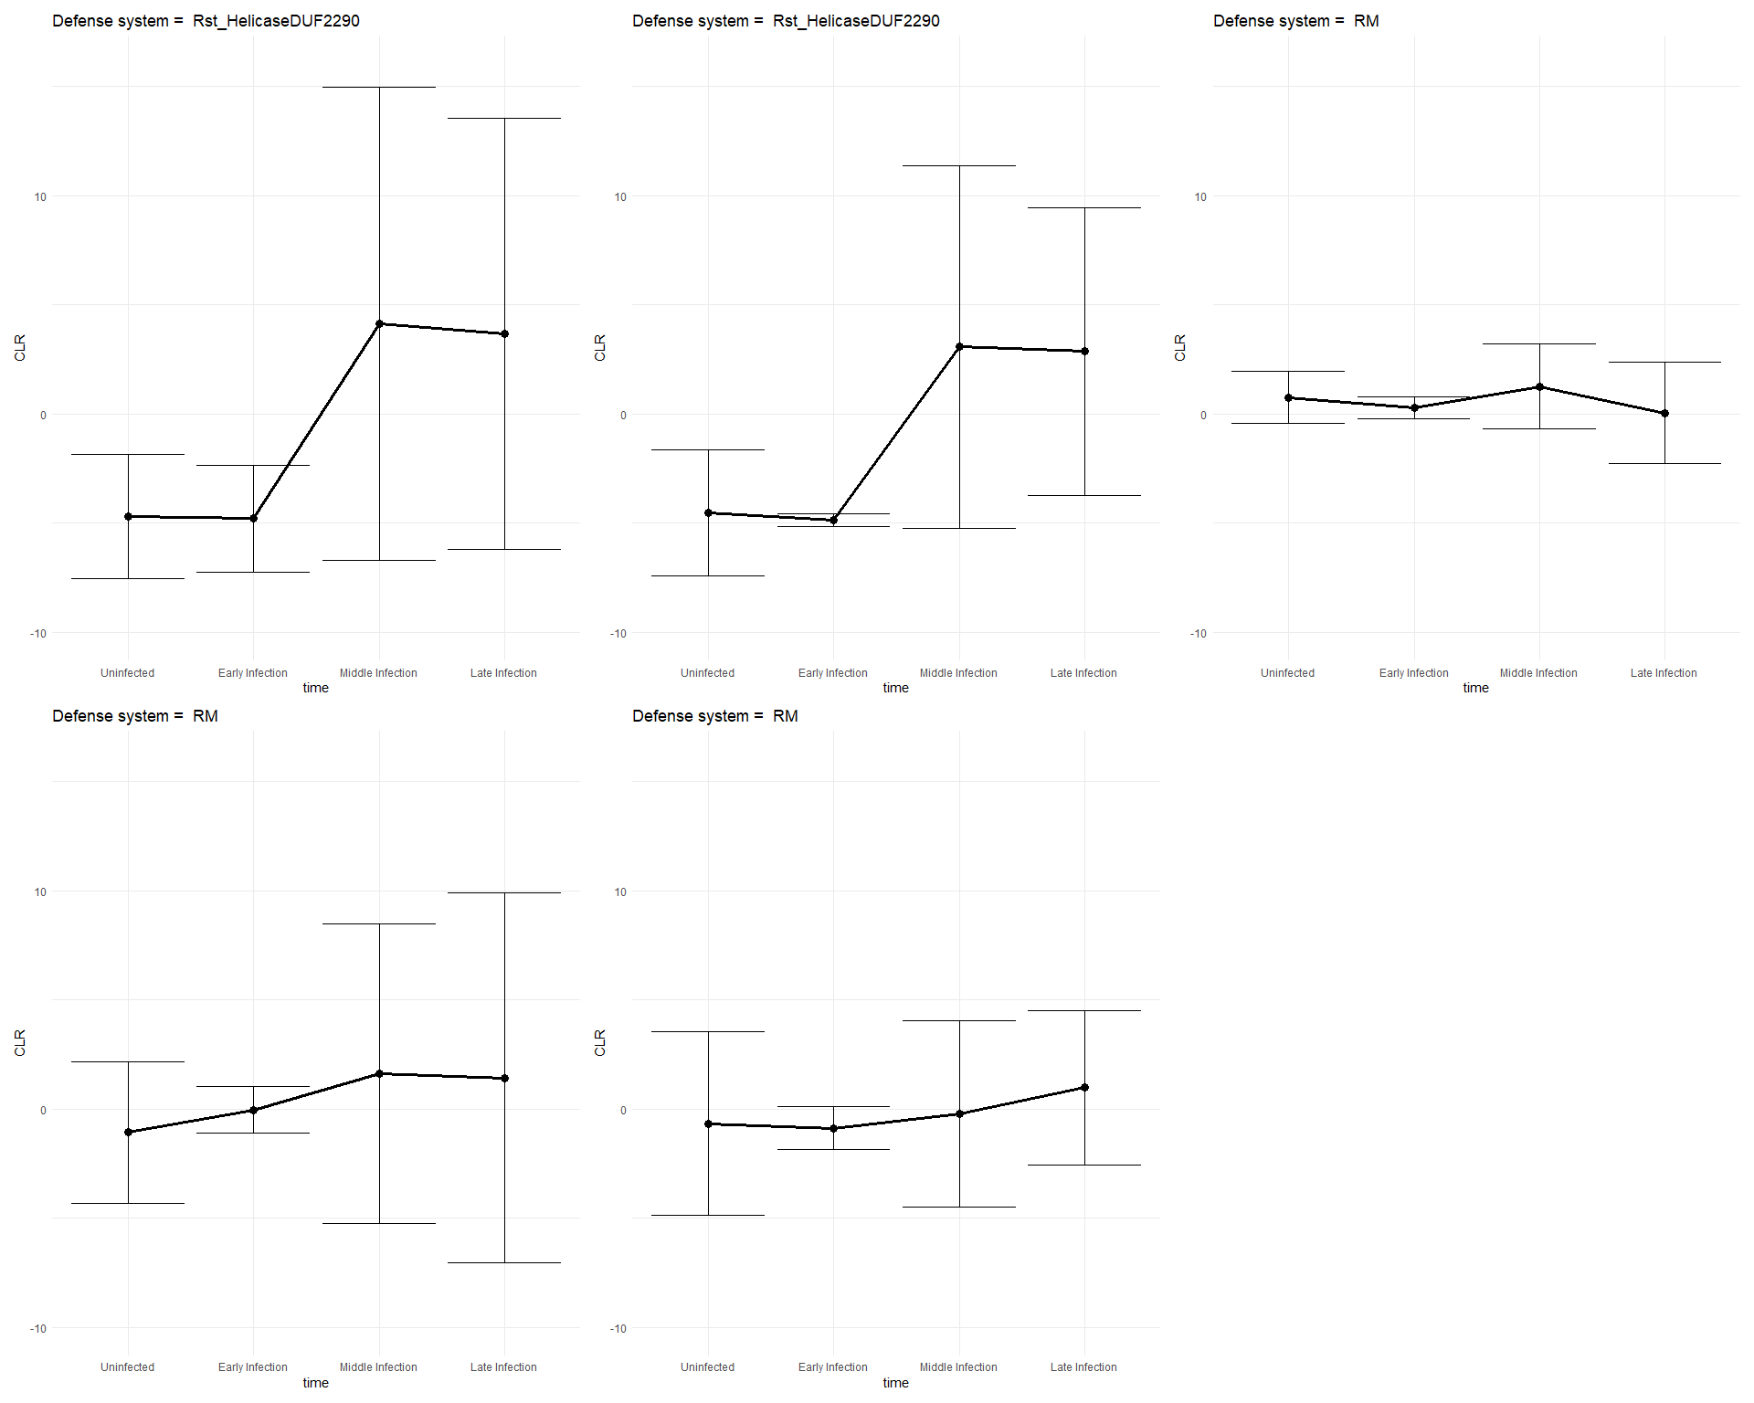
Pseudomonas aeruginosa VS Pseudomonas phage phiKZ
PRJNA252740

Slide 6
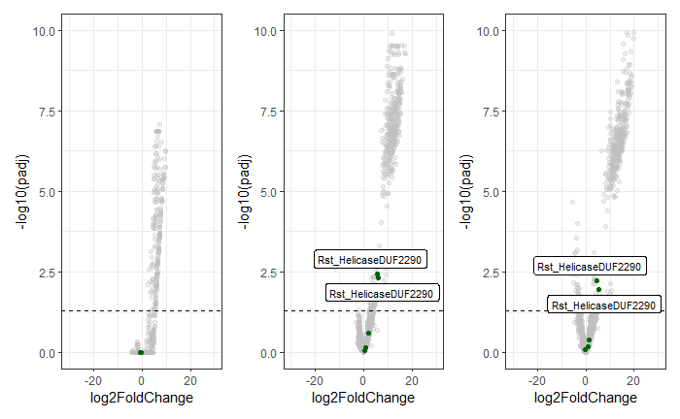
Pseudomonas aeruginosa VS Pseudomonas phage phiKZ
PRJNA252740

Slide 7
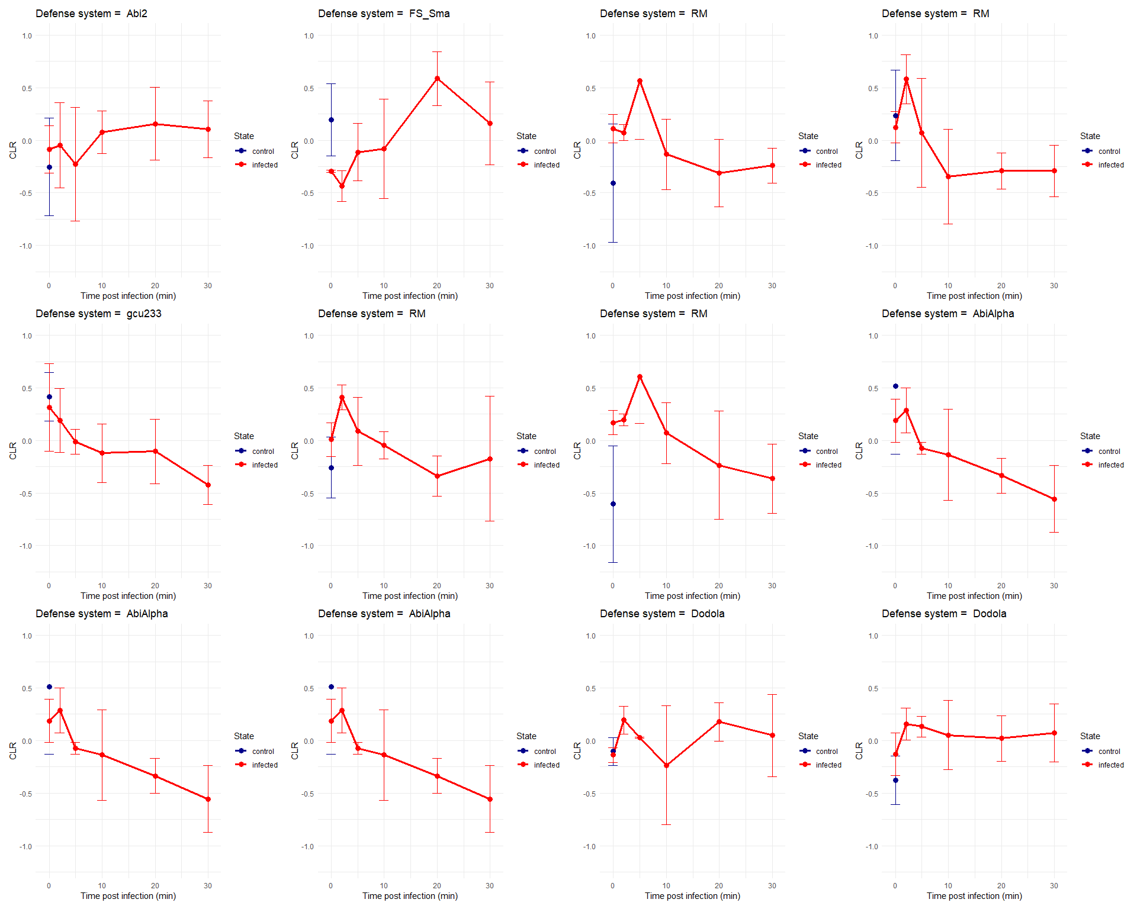
Staphylococcus aureus Newman VS Staphylococcus phage K
PRJNA787900

Slide 8
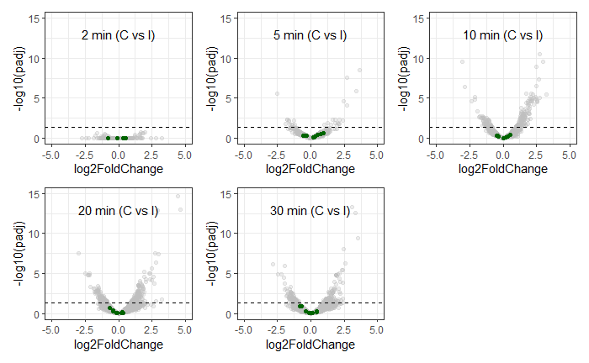
Staphylococcus aureus Newman VS Staphylococcus phage K
PRJNA787900

Slide 9
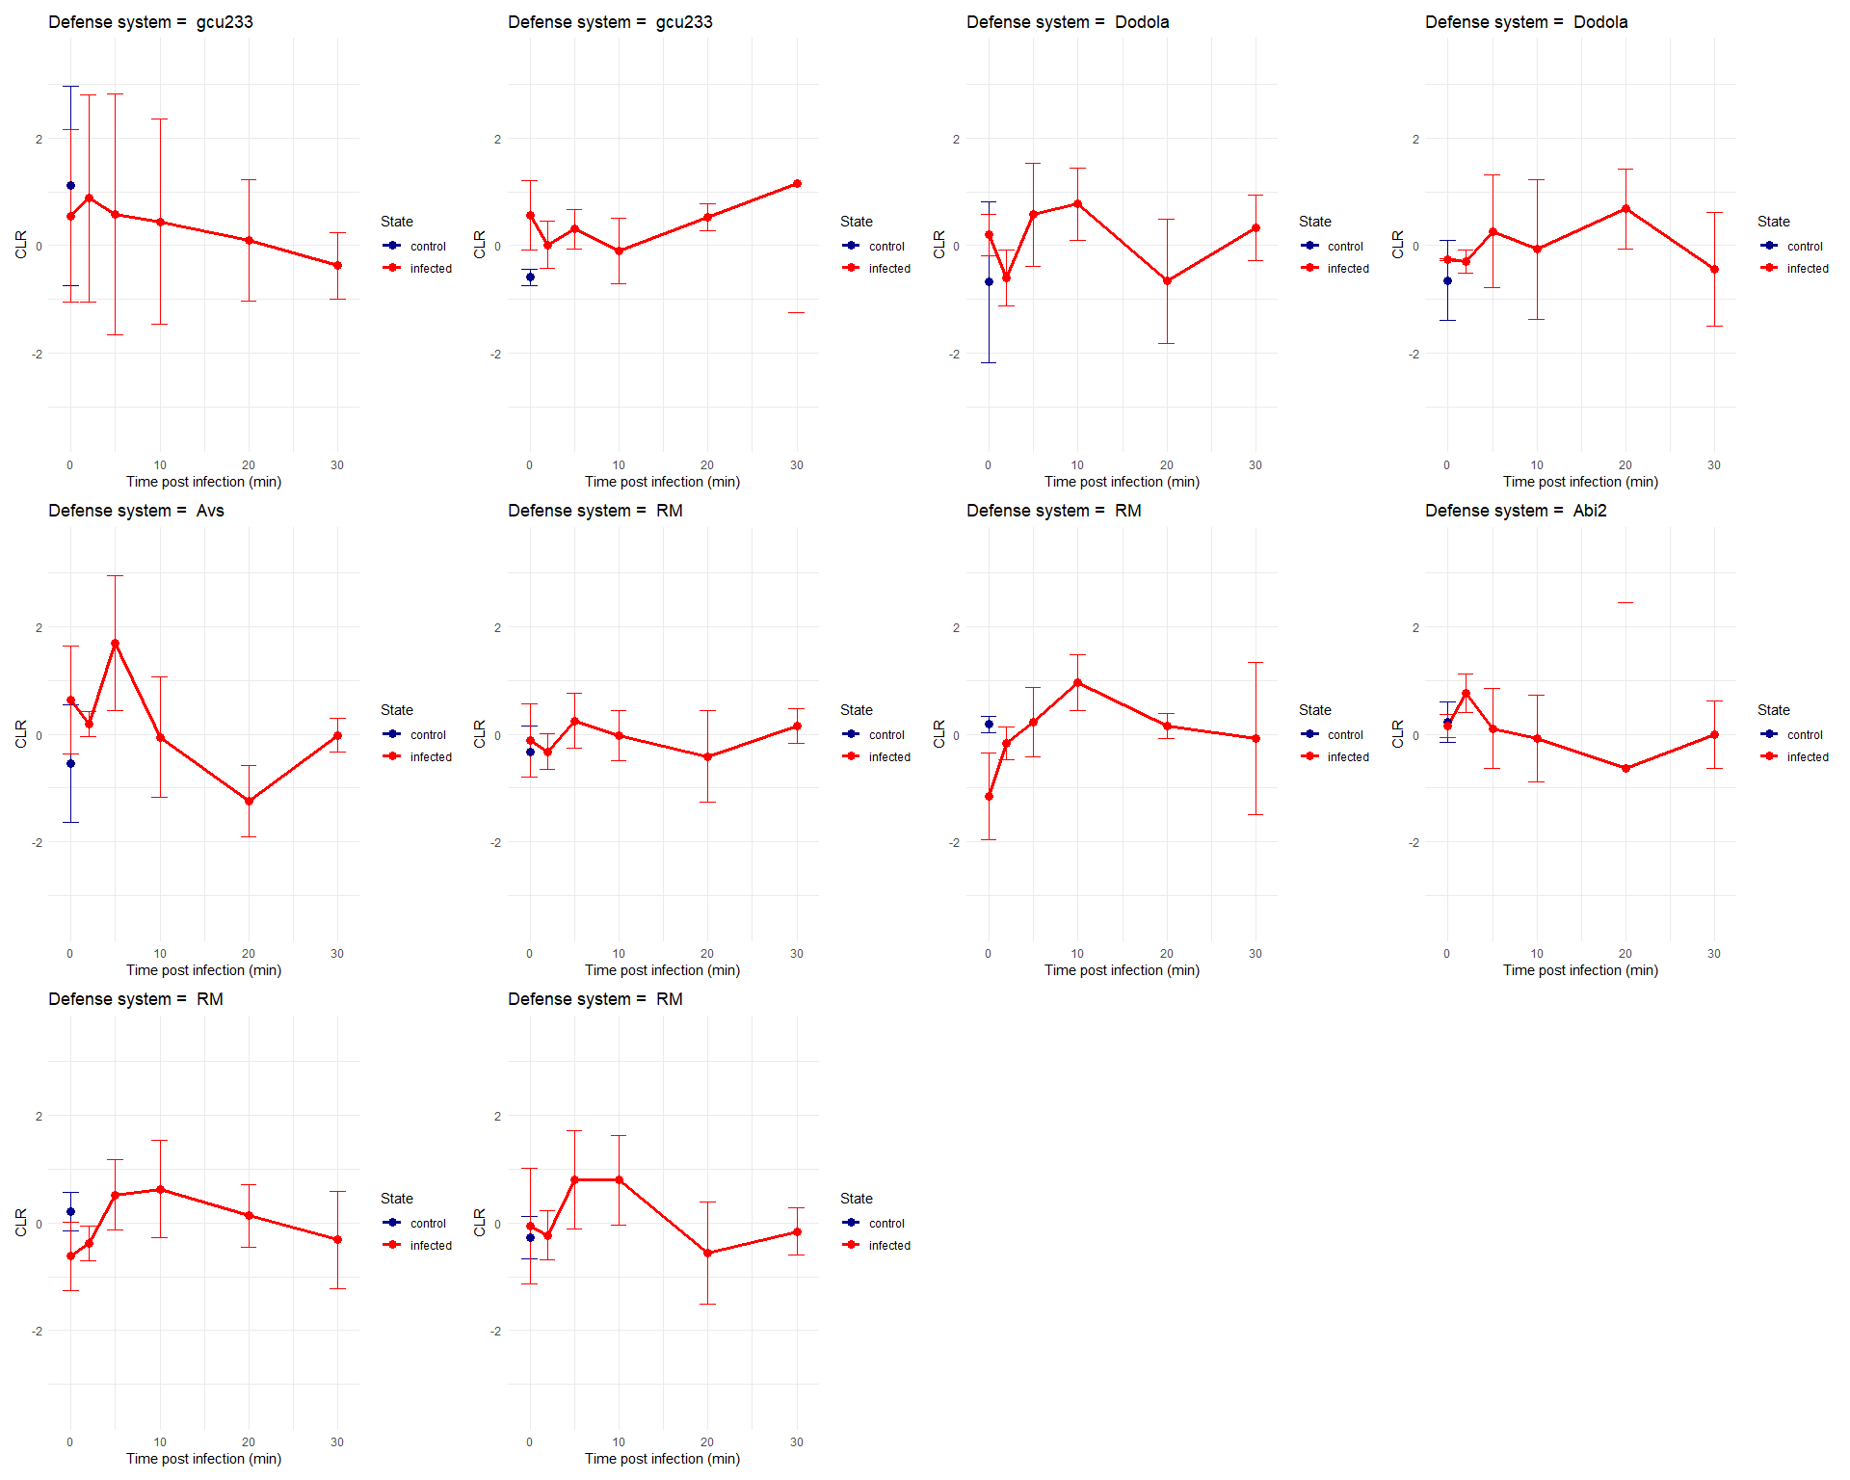
Staphylococcus aureus SH1000 VS Staphylococcus phage K
PRJNA787900

Slide 10
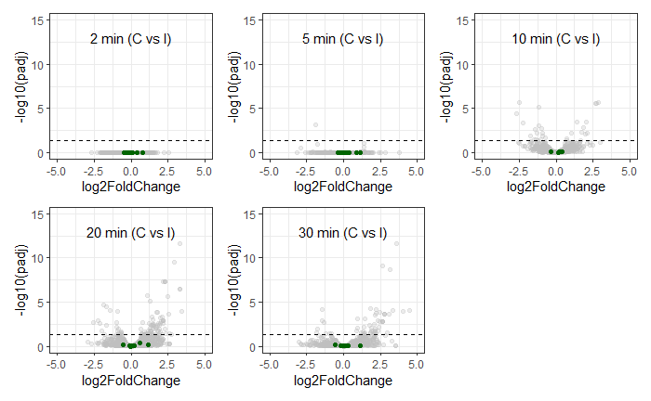
Staphylococcus aureus Newman VS Staphylococcus phage K
PRJNA787900

Slide 11
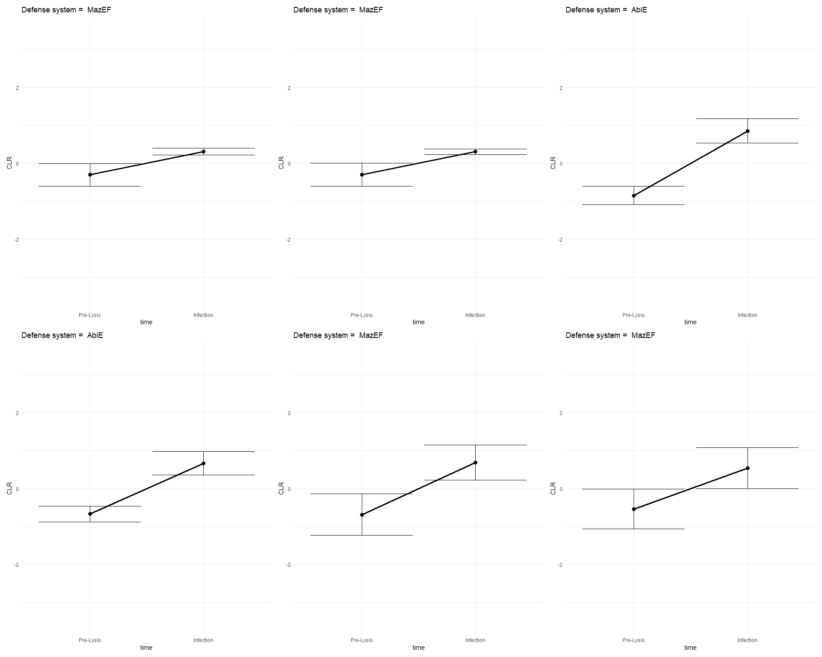
Escherichia coli C strain VS Enterobacteria phage phiX174
PRJNA687267

Slide 12
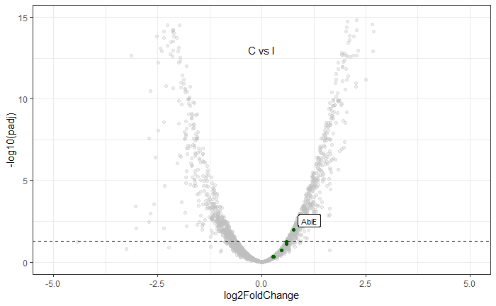
Escherichia coli C strain VS Enterobacteria phage phiX174
PRJNA687267

Slide 13
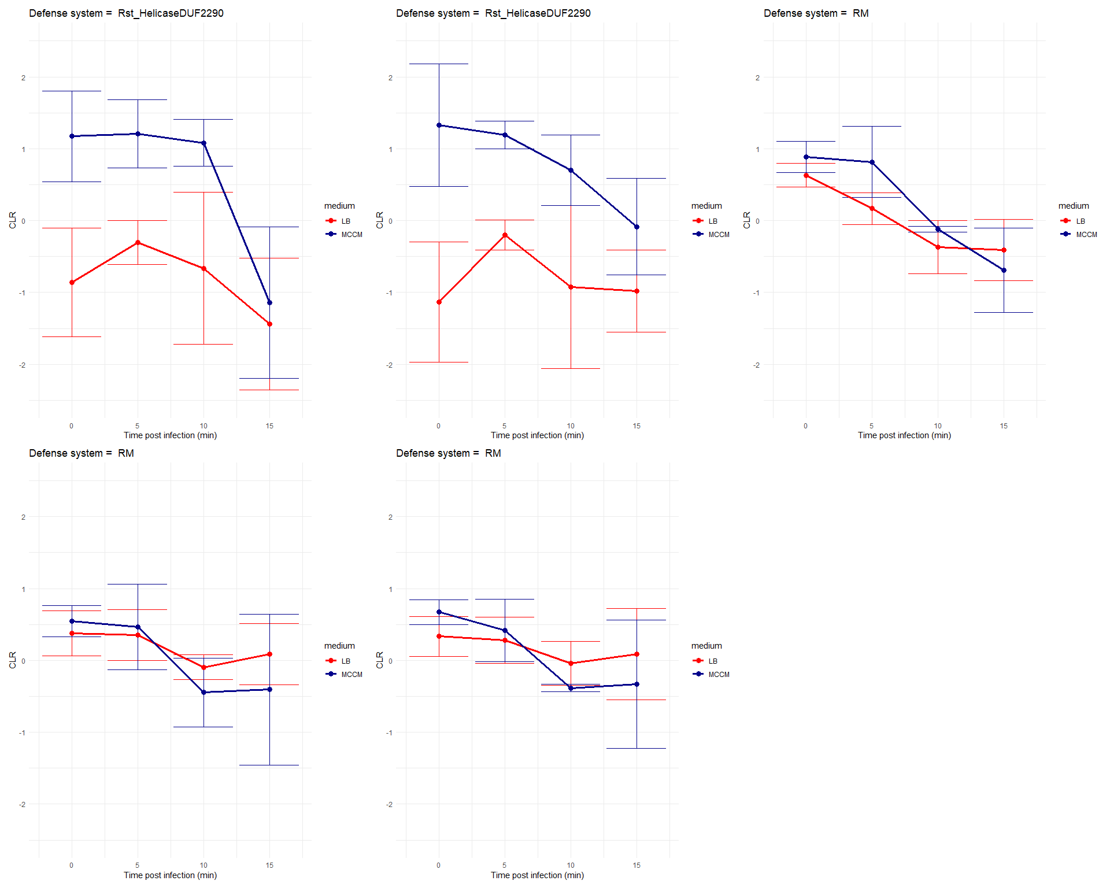
Pseudomonas aeruginosa VS Pseudomonas phage LUZ19
PRJNA681237

Slide 14
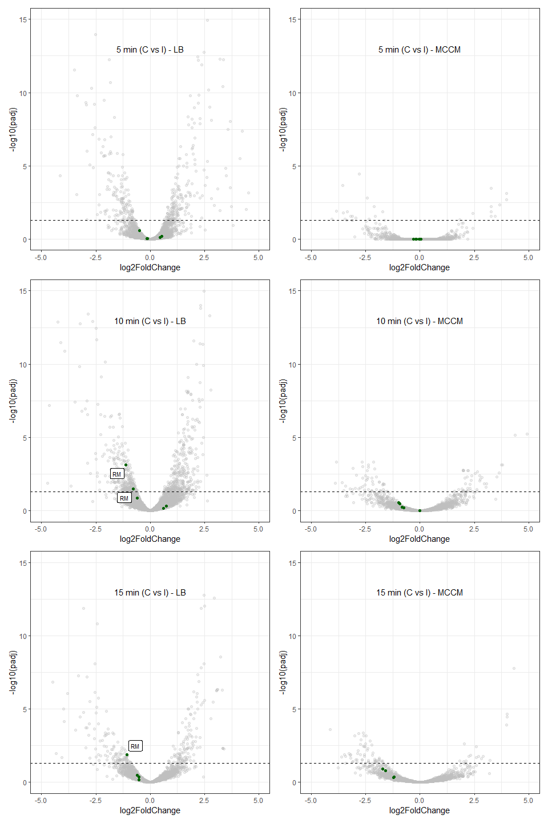
Pseudomonas aeruginosa VS Pseudomonas phage LUZ19
PRJNA681237

Slide 15
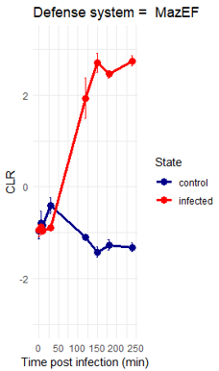
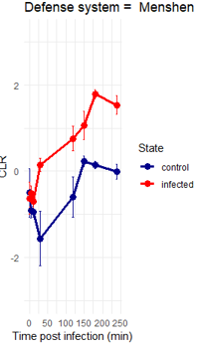
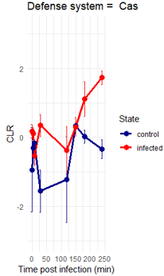
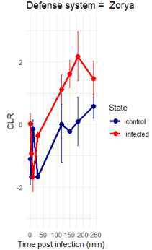
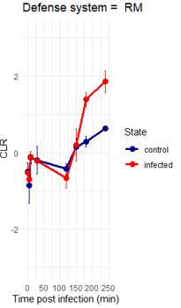
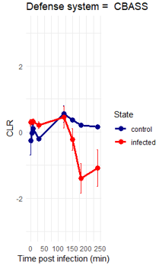
Fusobacterium nucleatum VS Fusobacterium phage JD-Fnp4
PRJNA1025116

Slide 16
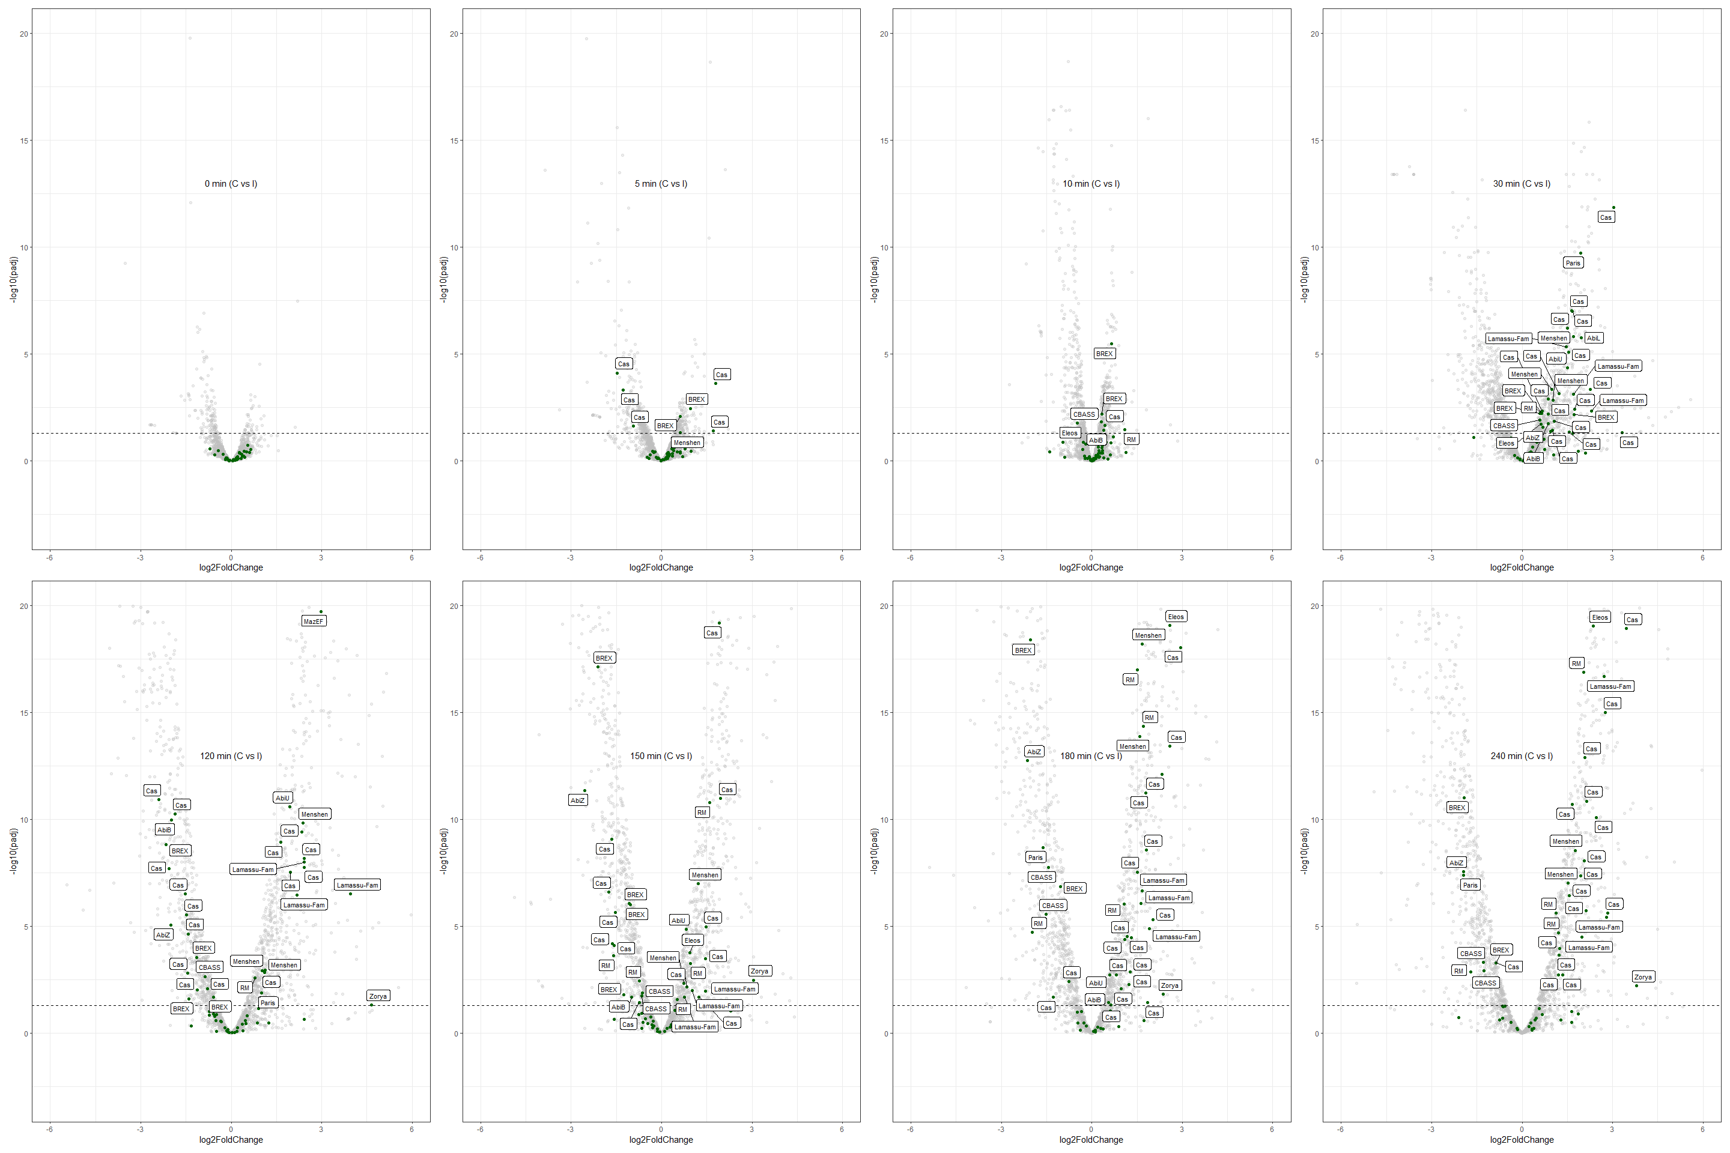
Fusobacterium nucleatum VS Fusobacterium phage JD-Fnp4
PRJNA1025116

Slide 17
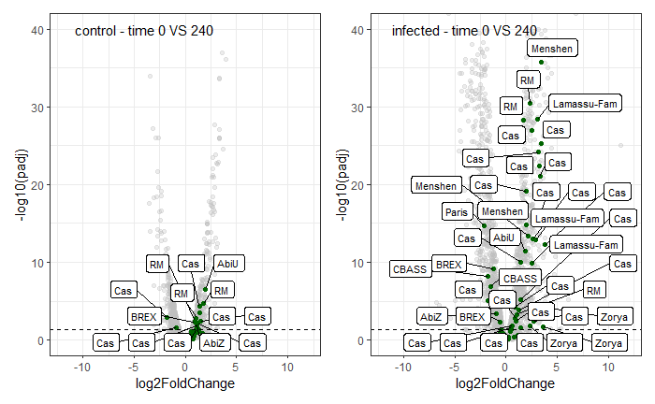
Fusobacterium nucleatum VS Fusobacterium phage JD-Fnp4
PRJNA1025116

