Slide 1

Lab 3
Ivana Calderon
Mathilde Krafft

Slide 2
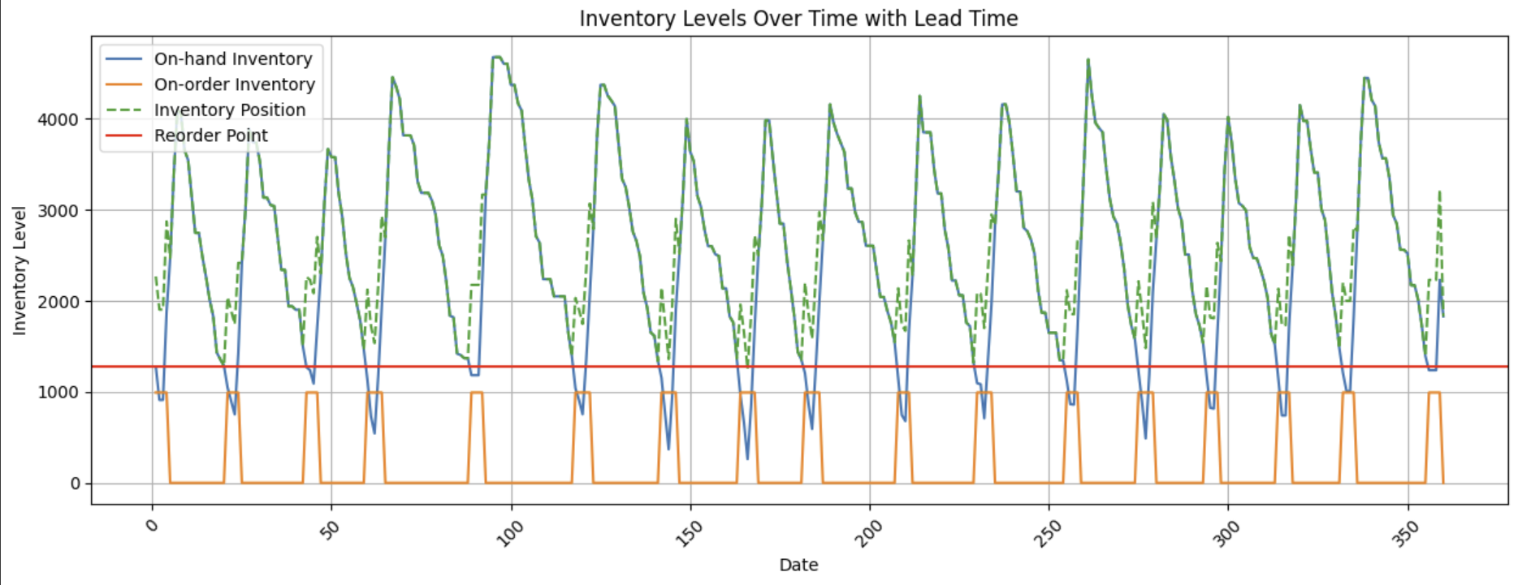
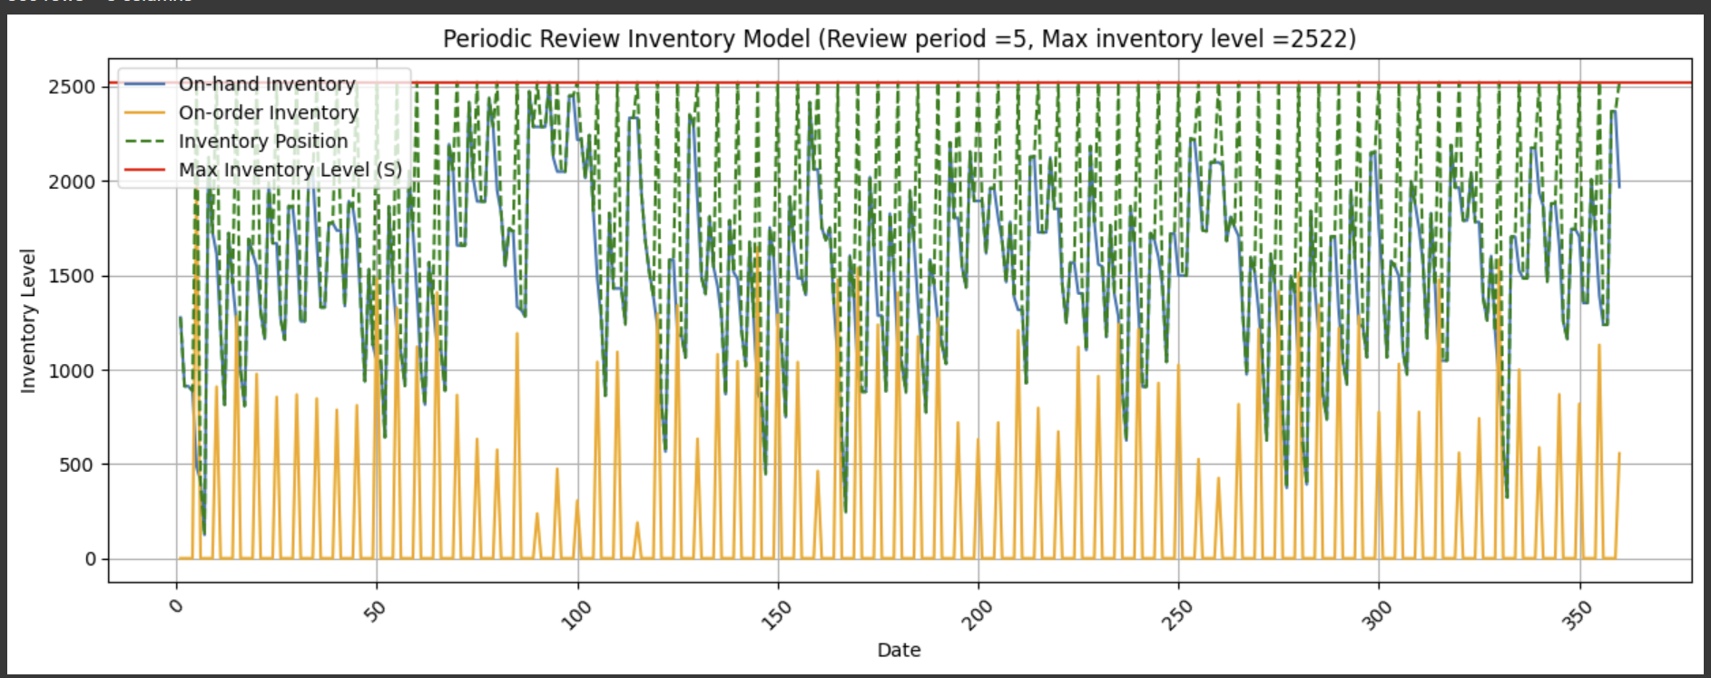
Continuous Review
Continuous Review (Q, R)
Reorder Point: 1281 notebooks.
Order Quantity: 992 notebooks.
Lead Time: 4 days.
On-hand inventory: Varies dynamically based on demand fluctuations.
On-order inventory: Orders are placed when inventory falls below the reorder point, ensuring availability.
Inventory Position: More stable due to frequent monitoring.
Periodic Review
Periodic Review (P, T)
Review Period: Every 5 days.
Max Inventory Level (S): 2522 notebooks.
Lead Time: 4 days.
On-hand inventory: Lower at times due to review gaps.
On-order inventory: Orders are placed at fixed intervals, meaning inventory levels fluctuate more.
Inventory Position: Peaks at replenishment but may drop between reviews.

Slide 3
Which Policy is Better for EcoPrint?
Continuous Review (Q, R) is better if:
EcoPrint wants to minimize stockouts and provide a high service level.
The company prefers lower safety stock, reducing holding costs.
Frequent monitoring and automated tracking are feasible.
Periodic Review (P, T) is better if:
EcoPrint prefers simpler inventory management with fewer monitoring requirements.
The company is okay with holding more inventory to compensate for review gaps.
Less frequent ordering is preferred to streamline operations.
Conclusion
Since EcoPrint prioritizes service level and customer satisfaction, the Continuous Review (Q, R) system is the better choice. It ensures:
✔ More responsive replenishment ✔ Lower risk of stockouts ✔ Lower safety stock levels, reducing holding costs

