Slide 1

Lab 4
Ivana Calderon
Mathilde Krafft

Slide 2
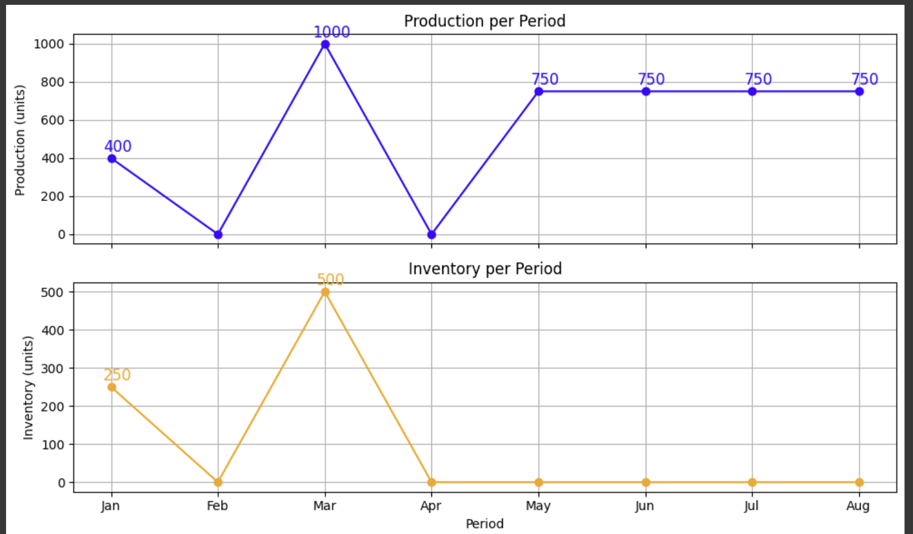
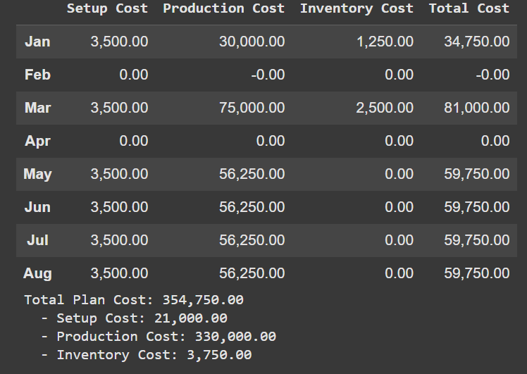
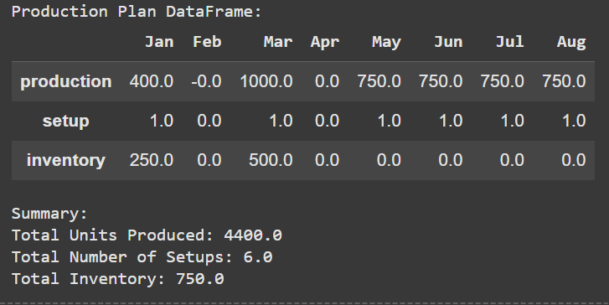
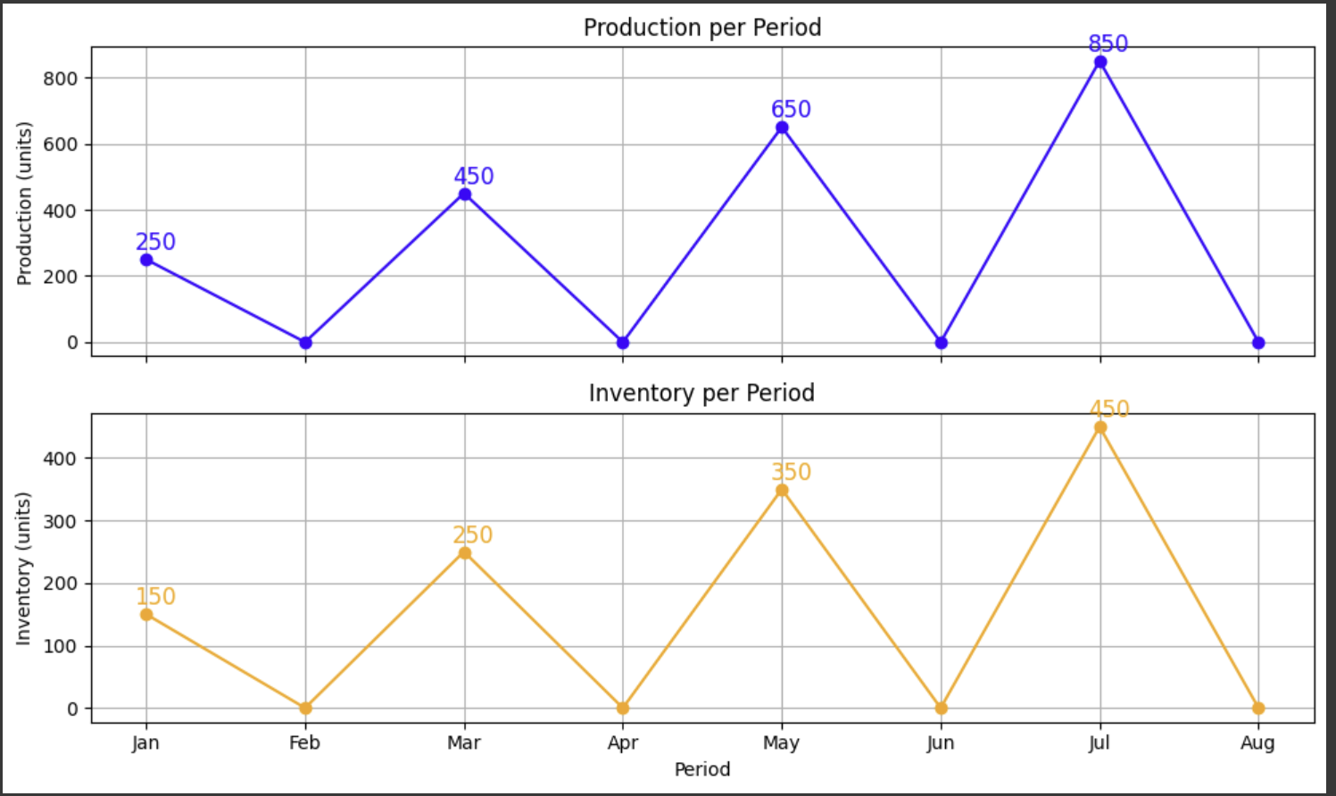
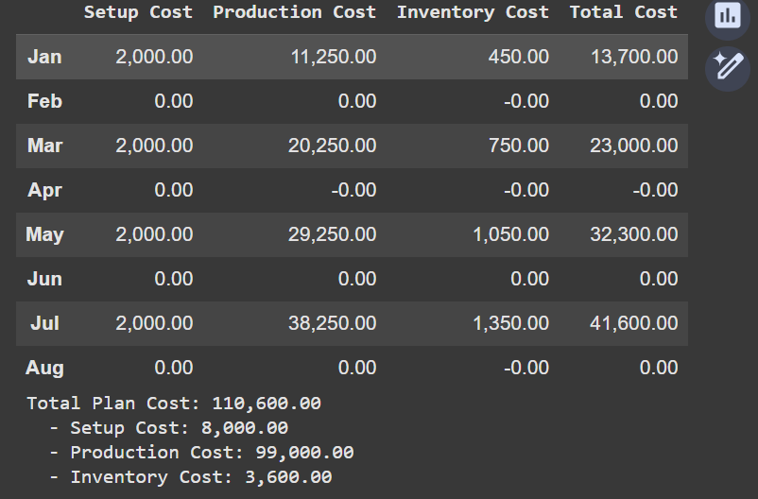
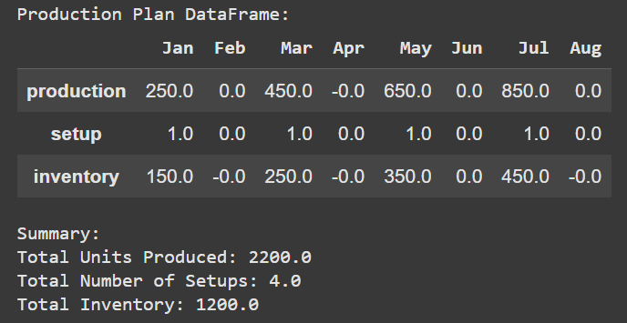
Independent Production Plans
Artisan Cookies
Specialty Brownies

Slide 3
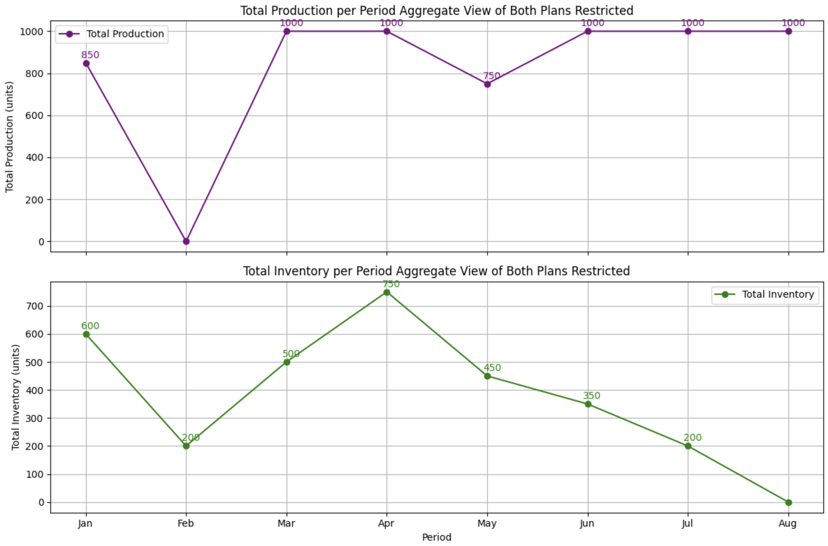
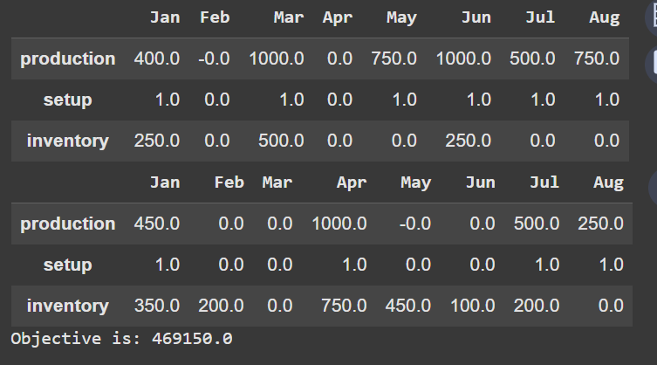
Joint Production Planning with capacity constraint
Artisan Cookies and Specialty Brownies
Total Cost Summary for the Entire Plant:
Total Setup Cost: 29000.0
Total Production Cost: 429000.0
Total Inventory Cost: 11150.0
Total Cost: 469150.0

Slide 4
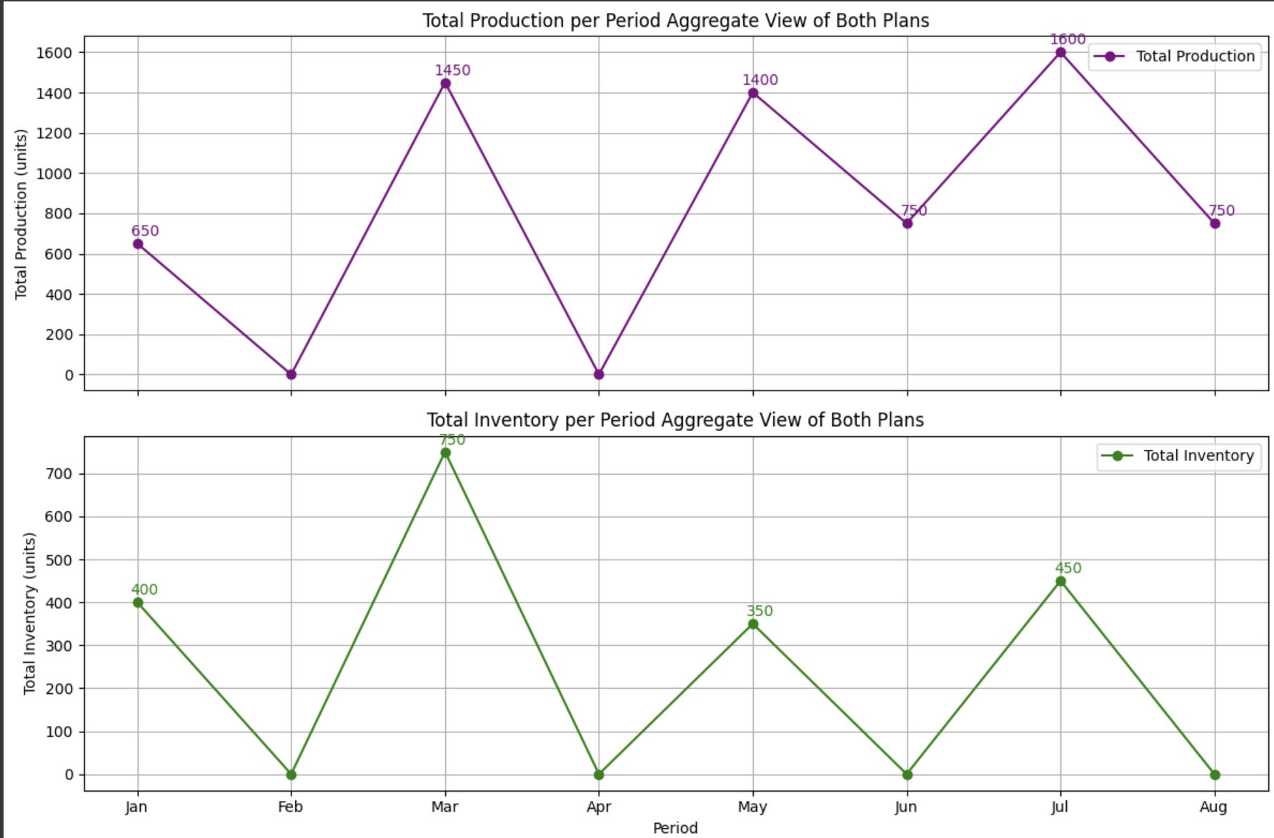
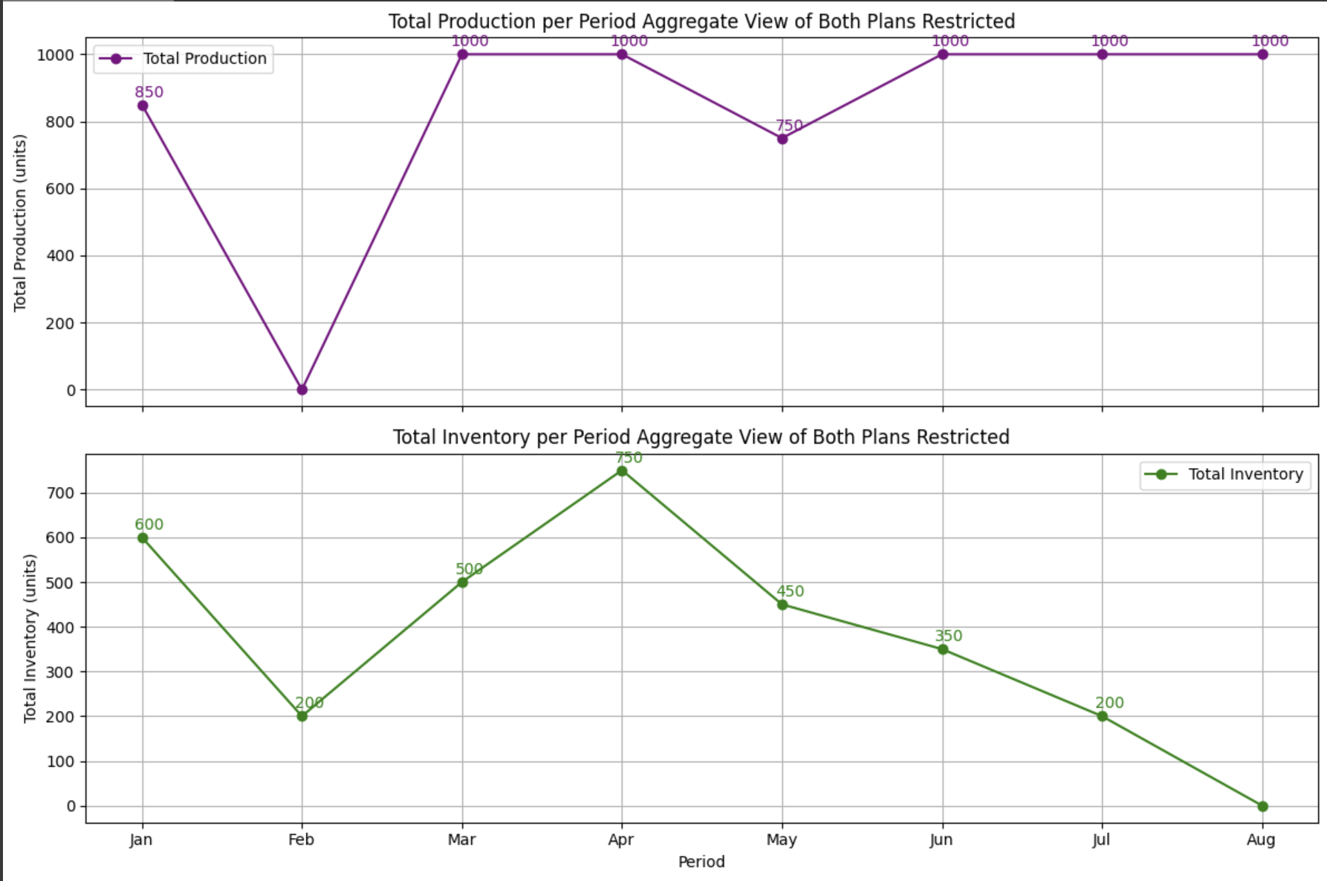
Capacity Restriction Impact
Artisan Cookies and Specialty Brownies
without Restriction
Artisan Cookies and Specialty Brownies
with Restriction
Total Cost Summary for the Entire Plant:
Total Setup Cost: 29000.0
Total Production Cost: 429000.0
Total Inventory Cost: 7350.0
Total Cost: 465350.0
Total Cost Summary for the Entire Plant:
Total Setup Cost: 29000.0
Total Production Cost: 429000.0
Total Inventory Cost: 11150.0
Total Cost: 469150.0
VS
Key Observations on Capacity Restriction Impact (Max Capacity: 1000 Units)
Costs
Total costs are slightly higher under restrictions due to increased inventory holding costs ($11,150 vs. $7,350).
Setup and production costs remain the same, meaning restrictions mainly impact inventory storage.

Slide 5
Capacity Restriction Impact
Artisan Cookies
with Restriction
Artisan Cookies
without Restriction
VS
Specialty Brownies
without Restriction
Specialty Brownies
with Restriction
VS
Key Observations on Capacity Restriction Impact (Max Capacity: 1000 Units)
Production and Inventory levels
Without restrictions, production varies significantly, peaking at 1450 units in March, 1400 in May, and 1600 in July.
With the 1000-unit cap, production is more evenly spread, staying at 1000 units for multiple months.
Inventory levels are higher with restrictions, indicating higher stockpiling risks.
The 1000-unit limit creates a smoother production schedule but raises inventory buildup risks.

