Slide 1

Lab 5
Ivana Calderon

Slide 2
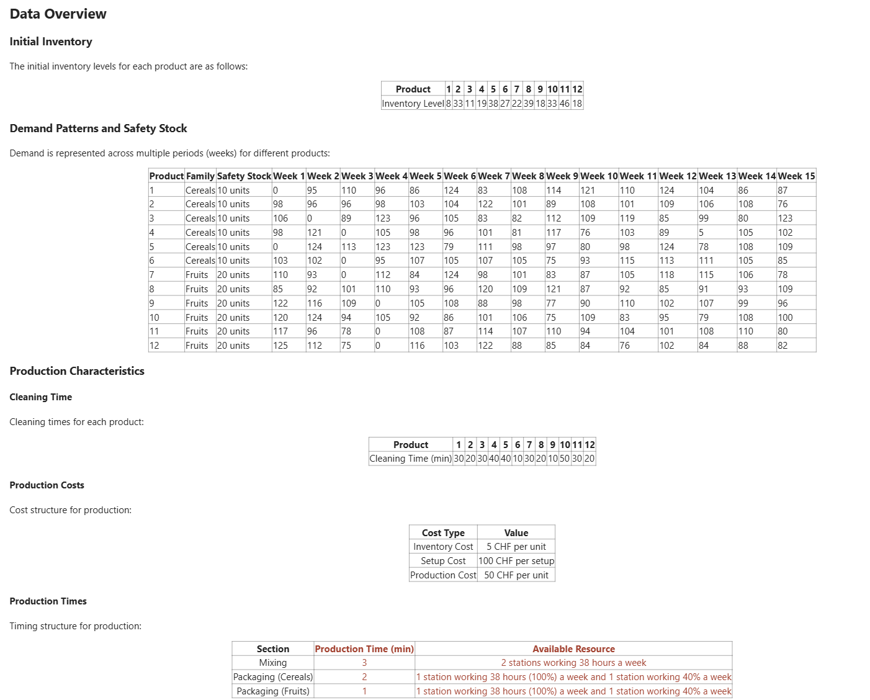
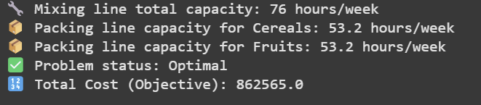
Independent Production Plans
Problem to Solve
Results
Optimal Solution Achieved
The model successfully found an optimal production plan with a total cost of CHF 862,565, fully satisfying demand, safety stock, and capacity constraints across the 15-week planning horizon.

Slide 3
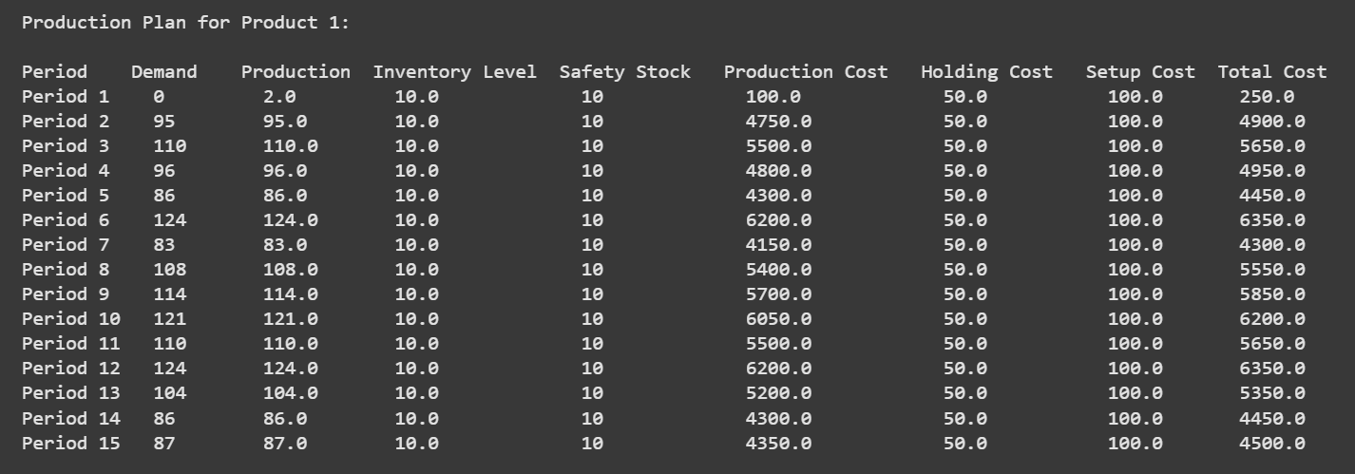
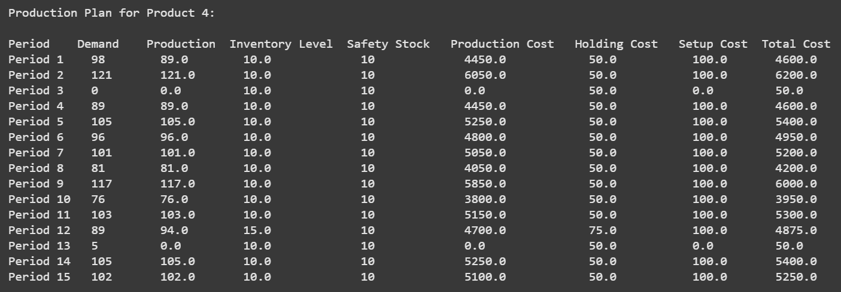
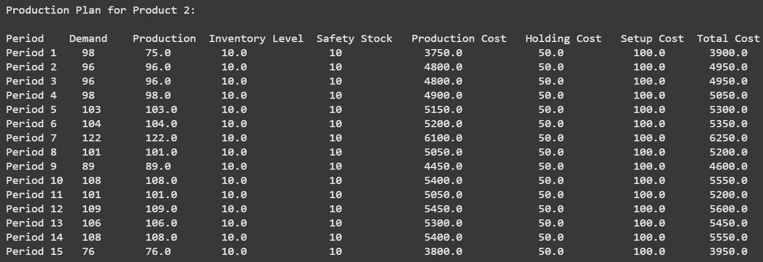
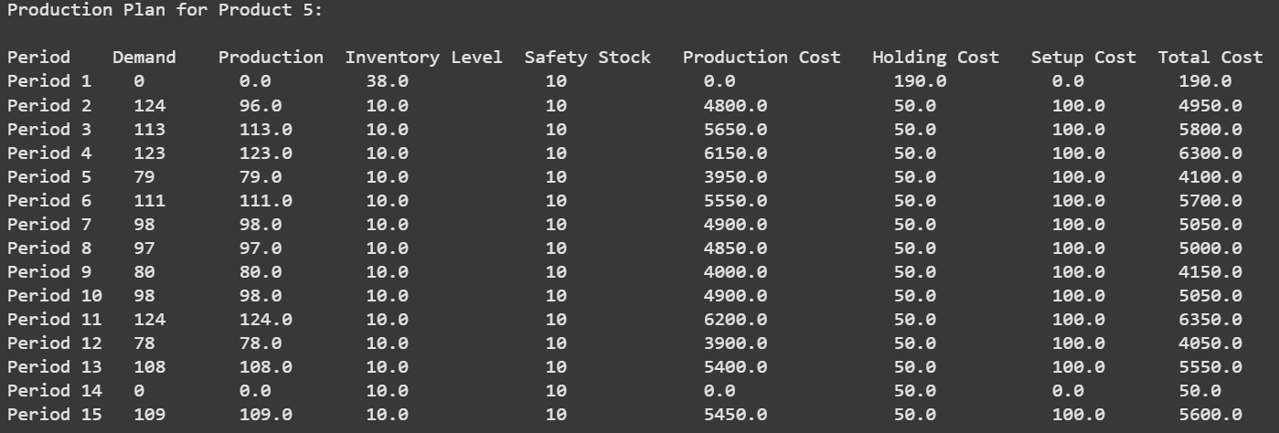
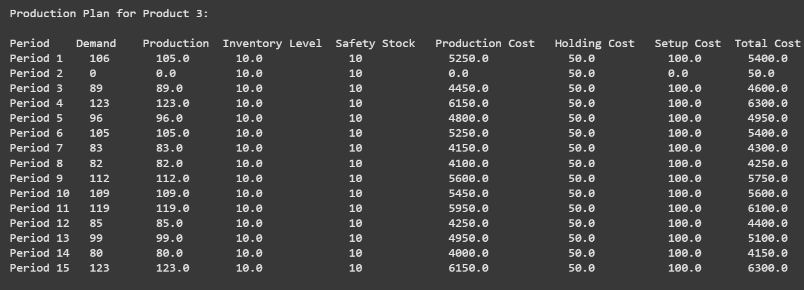
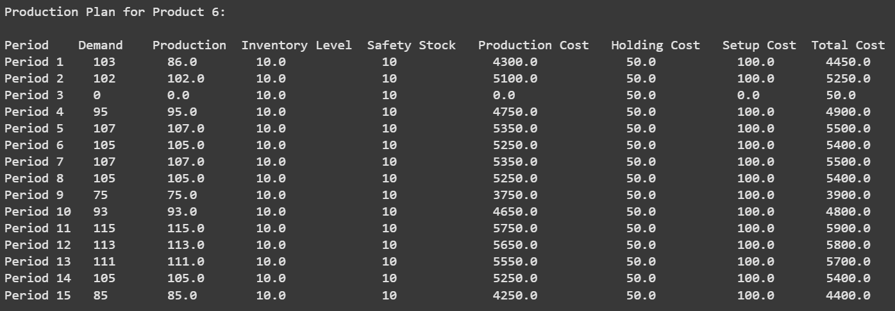
📦 Production - Cereals

Slide 4
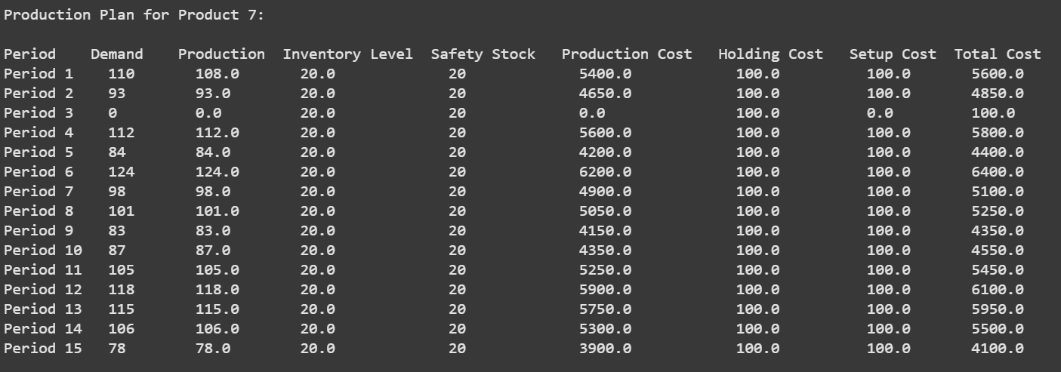
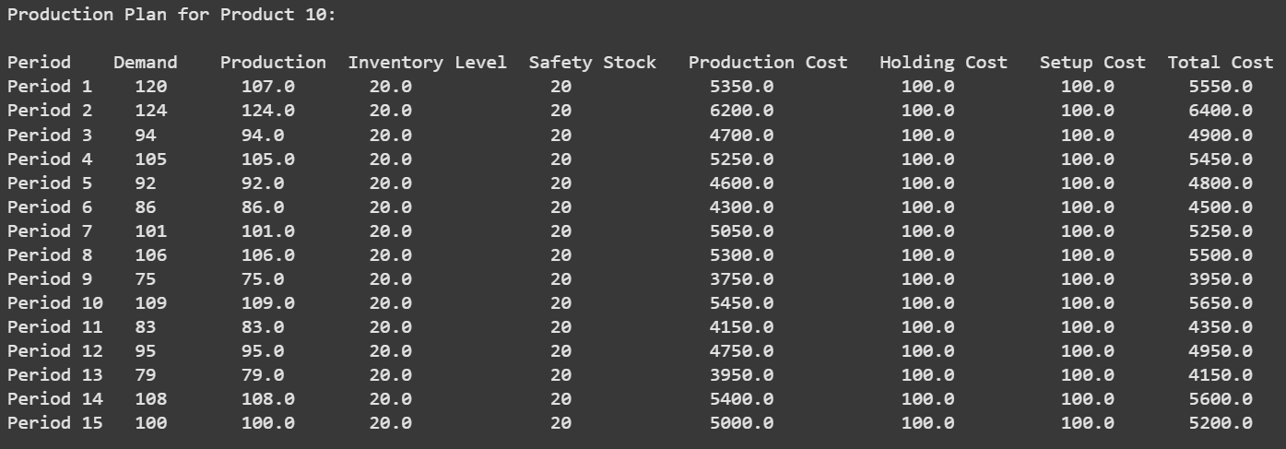
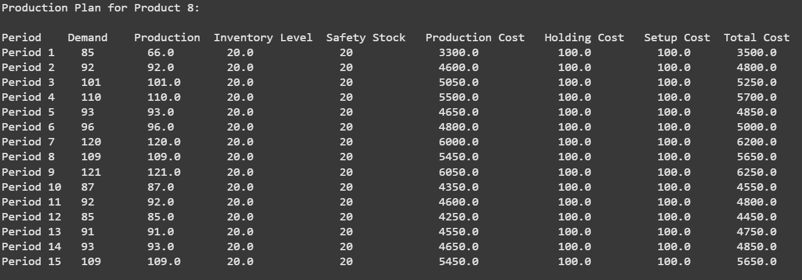
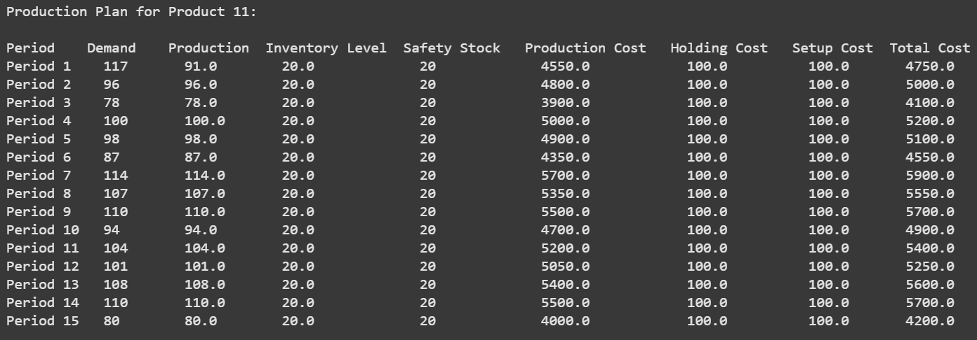
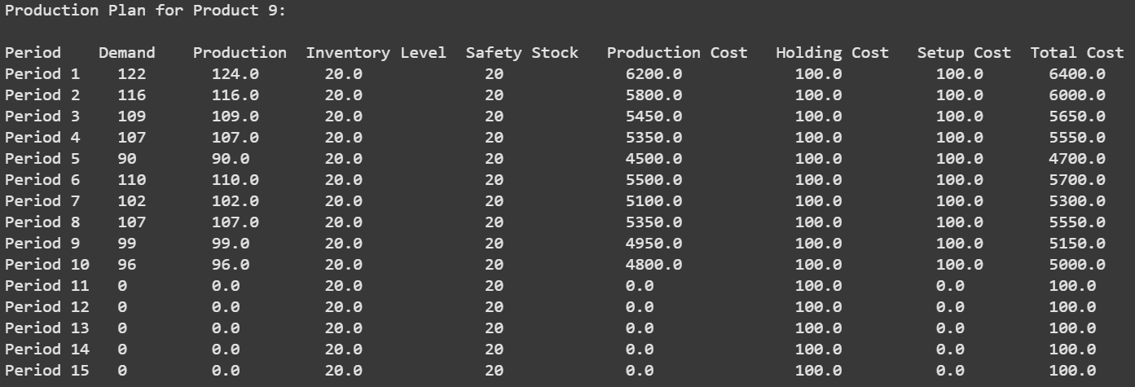
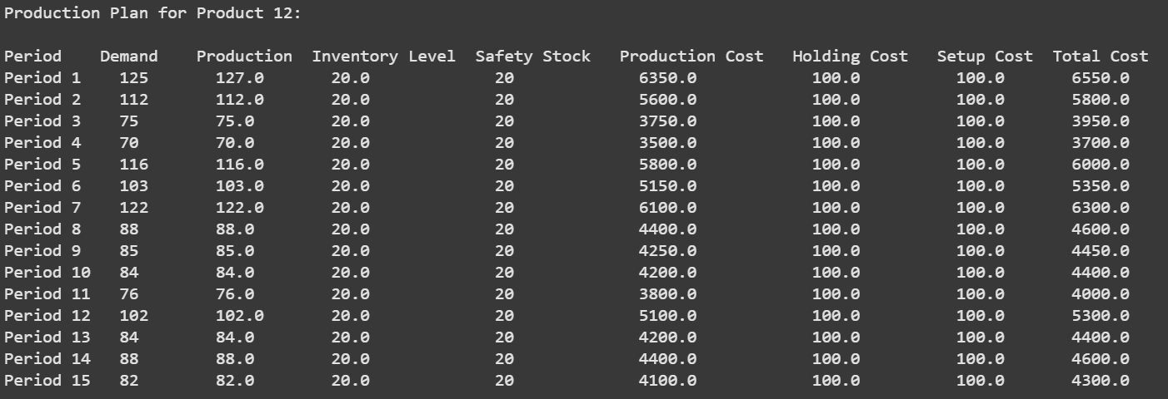
🍓 Production - Fruits

Slide 5
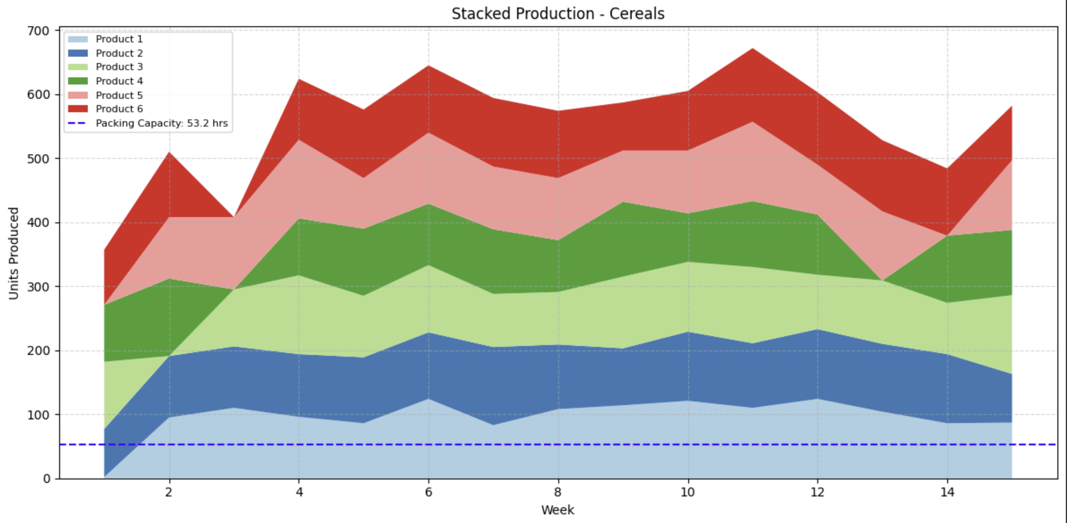
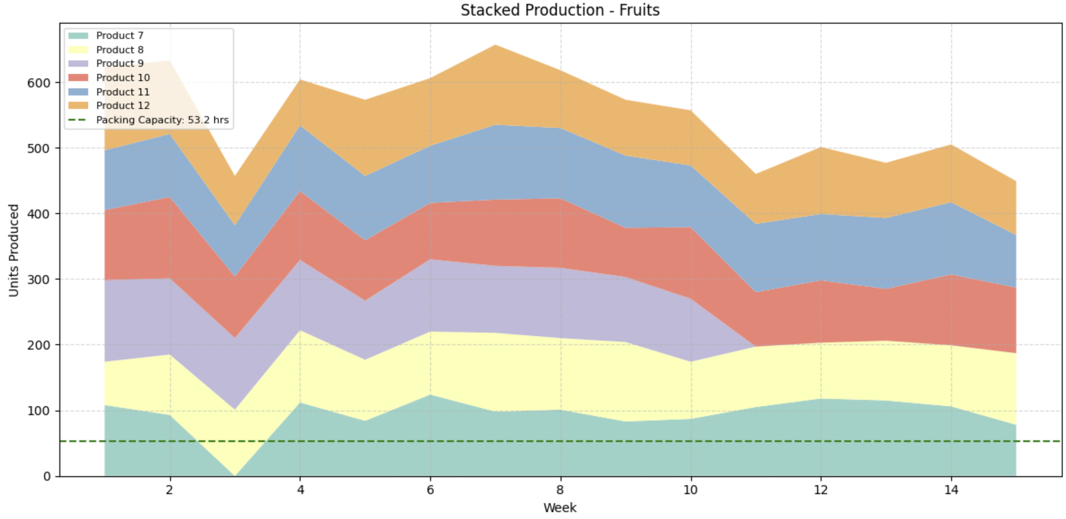
The stacked production graphs show how some products (e.g., Product 3, Product 7) are produced in advance to smoothen the load and reduce future setup requirements. This proactive planning avoids production spikes and stabilizes inventory

Slide 6
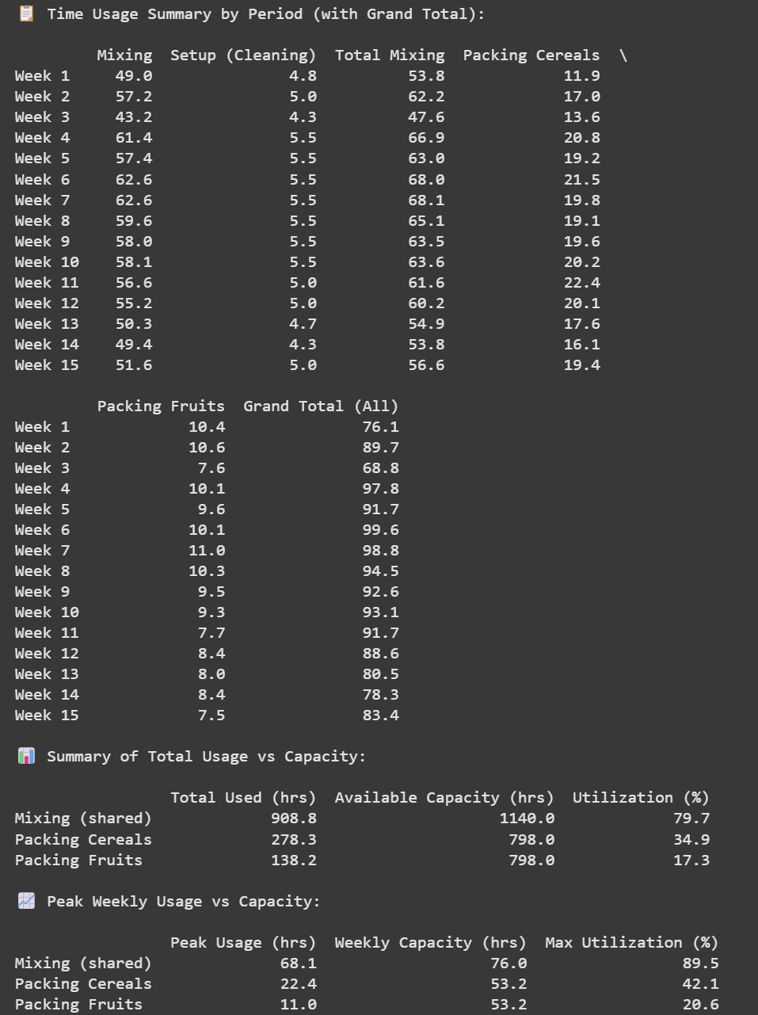
RESULTS
Resource Utilization: Efficient but Not Overloaded
Mixing Line (Shared): Averaged 79.7% utilization with a peak of 89.5%, indicating efficient usage without exceeding capacity limits.
Packing Line – Cereals: Low usage, averaging 34.9% with a peak of 42.1%, meaning there is significant spare capacity.
Packing Line – Fruits: Very underutilized, with only 17.3% average utilization and 20.6% peak. This resource is far from being a bottleneck.

Slide 7
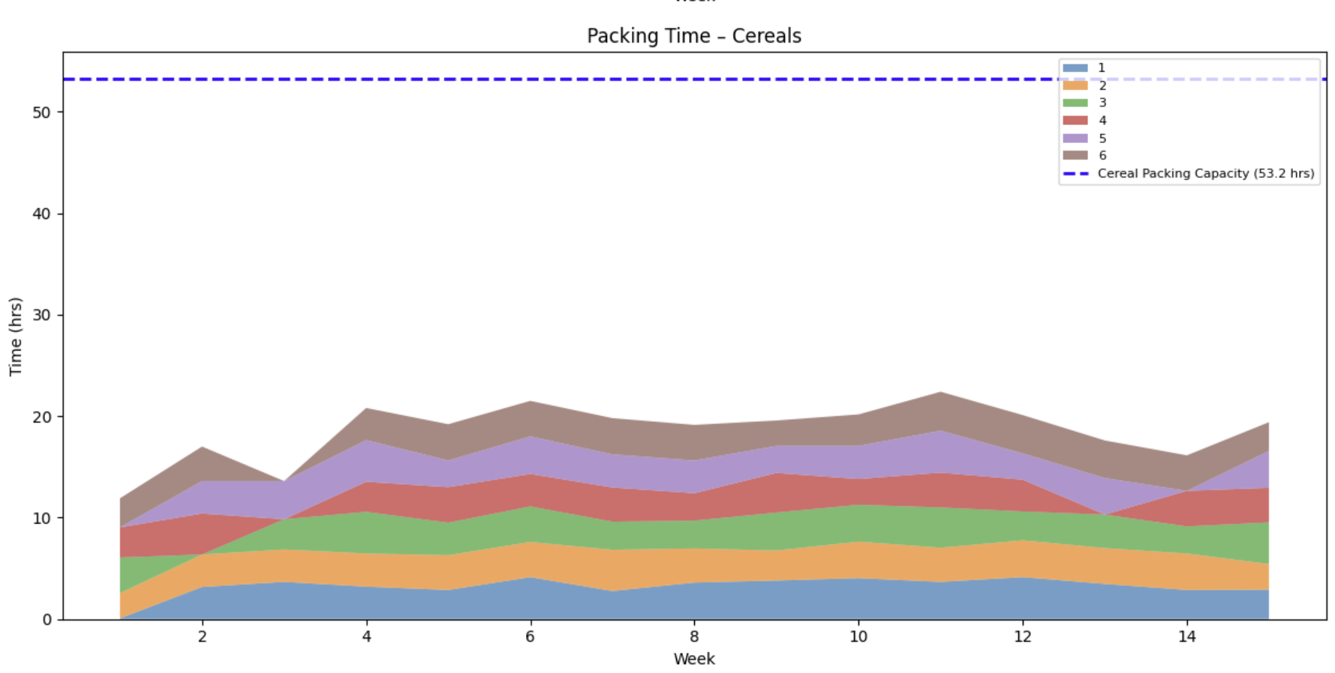
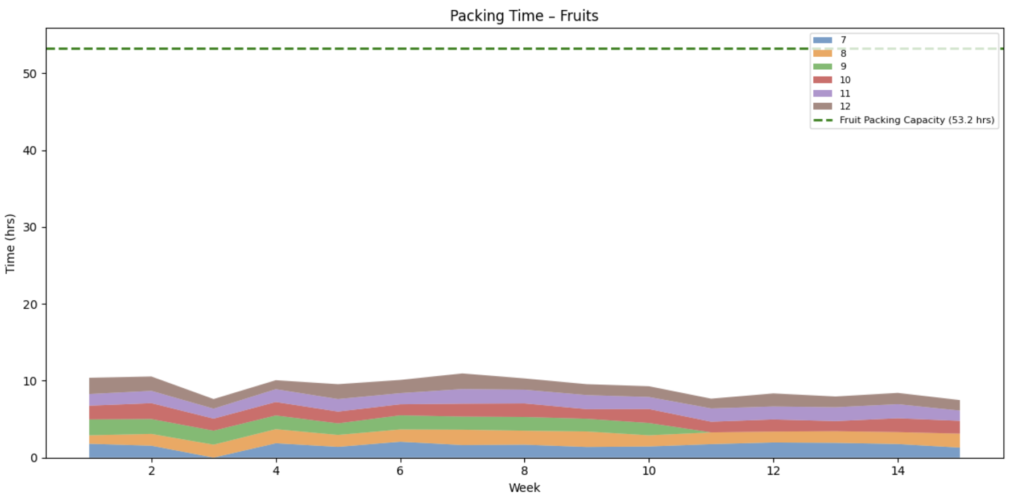
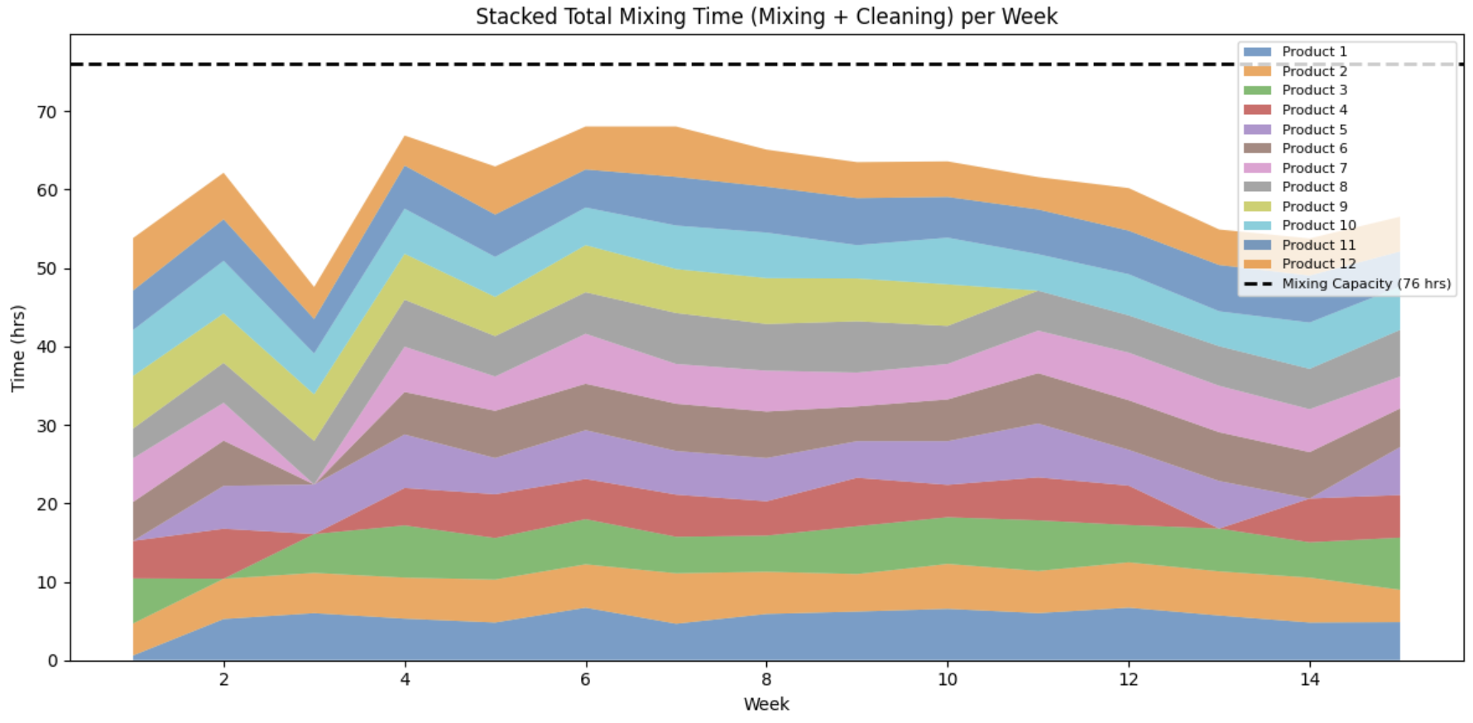
RESULTS
Key Insights
Mixing line is the most constrained: Utilization peaks at nearly 90%, and weekly loads remain consistently high. This confirms it's the critical resource.
Setup planning is efficient: The spread of cleaning times suggests thoughtful sequencing to reduce idle time and cleaning overlap.
Packing lines are underutilized:
Cereals reach only ~42% peak utilization.
Fruits are significantly underloaded, with usage hovering below 21%.
The packing lines offer significant slack, particularly fruits. In contrast, the mixing line is clearly the critical resource and has been carefully optimized through effective setup planning and workload leveling. Moving forward, the focus should be on exploring capacity rebalancing, leaner packing operations, or even introducing setup cost differentiation to reflect operational effort

Slide 8
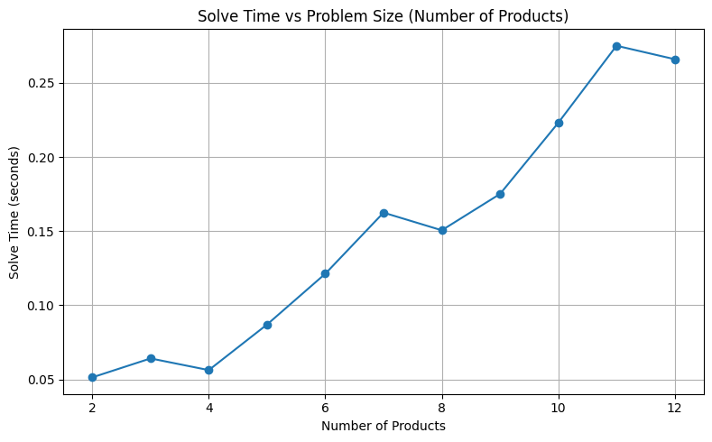
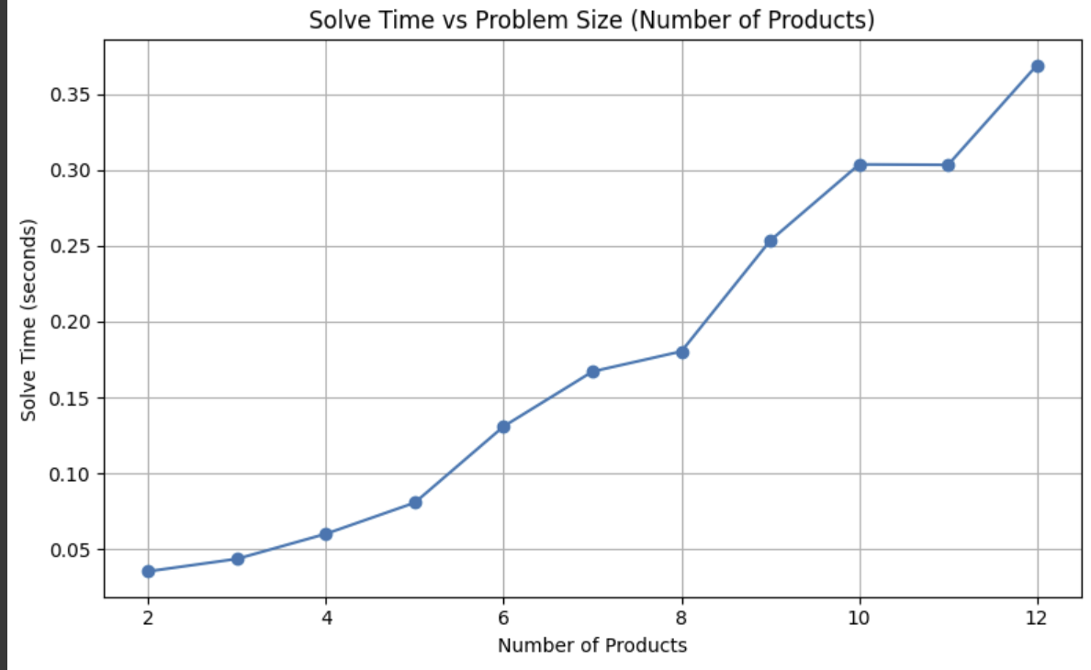
How the solving time increases as the dimension (number of variables and constraints) of the problem increases. Do you know why?
📊 Solving Time vs Problem Size: Key Insights
To explore scalability, we ran two simulations varying the number of products (2–12). The results highlight:
Increase in solve time as the number of products grows, a classic pattern in mixed-integer programming (MIP).
The right-hand plot shows a steeper curve, suggesting that added constraints (e.g., tighter capacity bounds or setup logic) significantly increase solver effort.
Around 10–12 products, the model likely hits a computational threshold, where binary decisions and constraint interactions drive up complexity.
🧠 Why Does Solve Time Rise?
While the number of variables and constraints increases linearly, the combinatorial space (due to binaries) grows exponentially.
Capacity, setup, and time-linked constraints create a highly coupled solution space, requiring deeper branch-and-bound exploration.

