Slide 1

Lab 2
Ivana Calderon
Mathilde Krafft

Slide 2
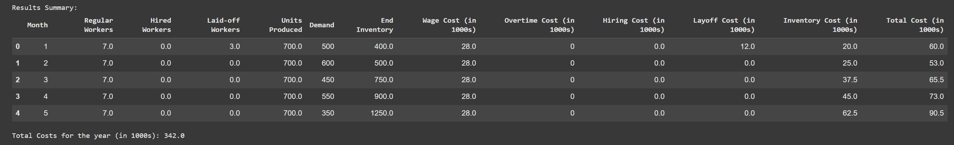
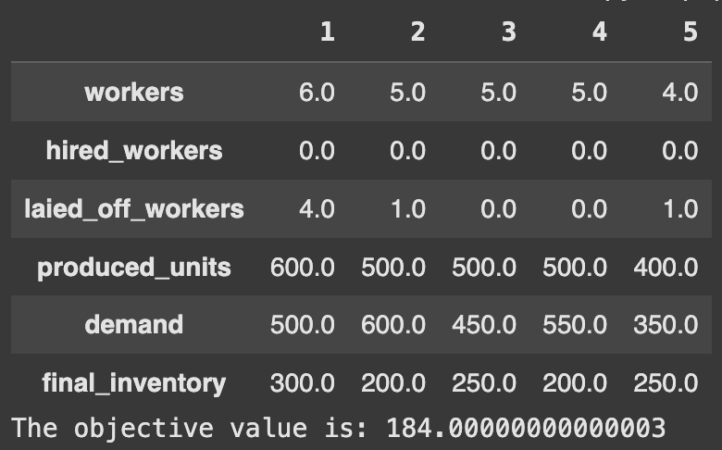
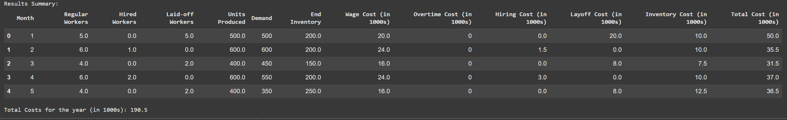
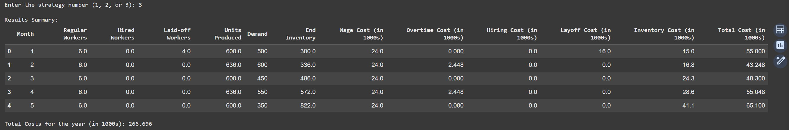
Optimal Production Plan
Level Strategy
Chase Strategy
VS
The Optimal Production Plan proves to be more cost-effective than both the Level Strategy and the Chase Strategy.
Even when incorporating overtime in July and September—assuming it is the best way to utilize %overtime—the total costs still exceed those of the Optimal Production Plan.
Overtime: Mixed Strategy

