Slide 1

Lab 5
Ivana Calderon

Slide 2
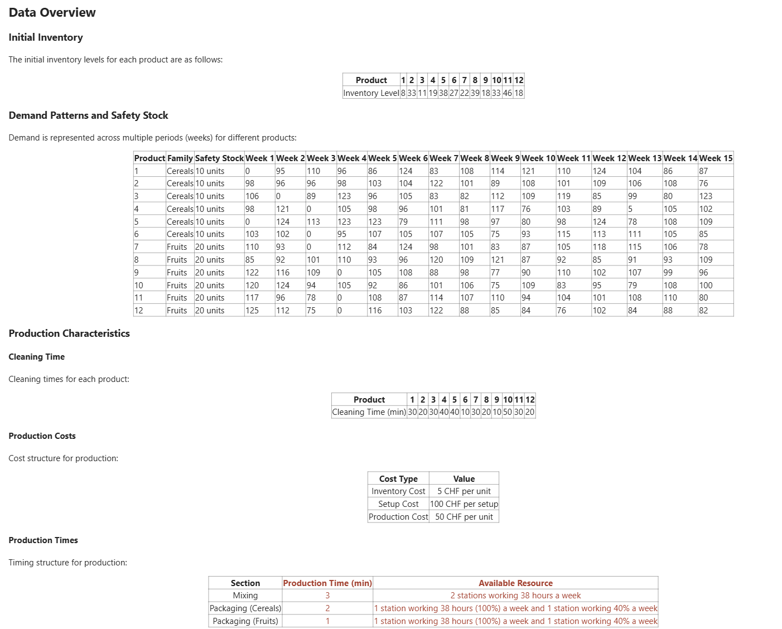
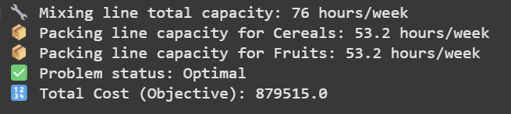
Independent Production Plans
Problem to Solve
Results
Optimal Solution Achieved
The model successfully found an optimal production plan with a total cost of CHF 879515, fully satisfying demand, safety stock, and capacity constraints across the 15-week planning horizon.

Slide 3
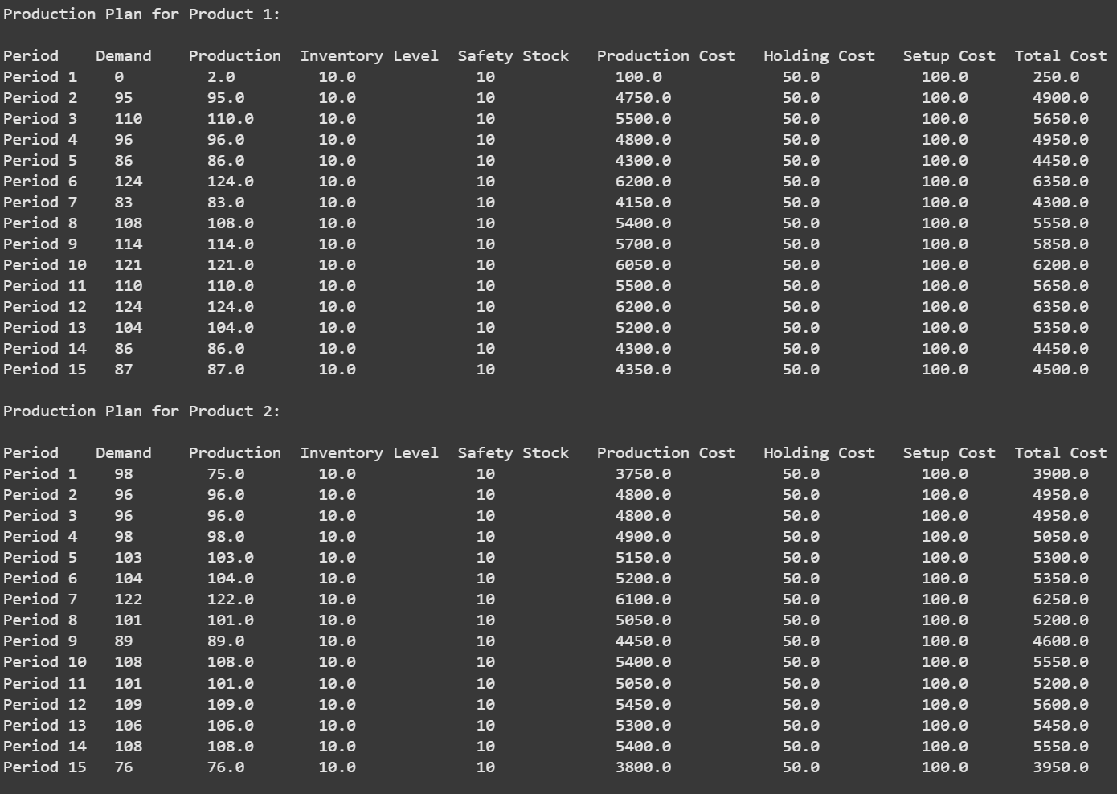
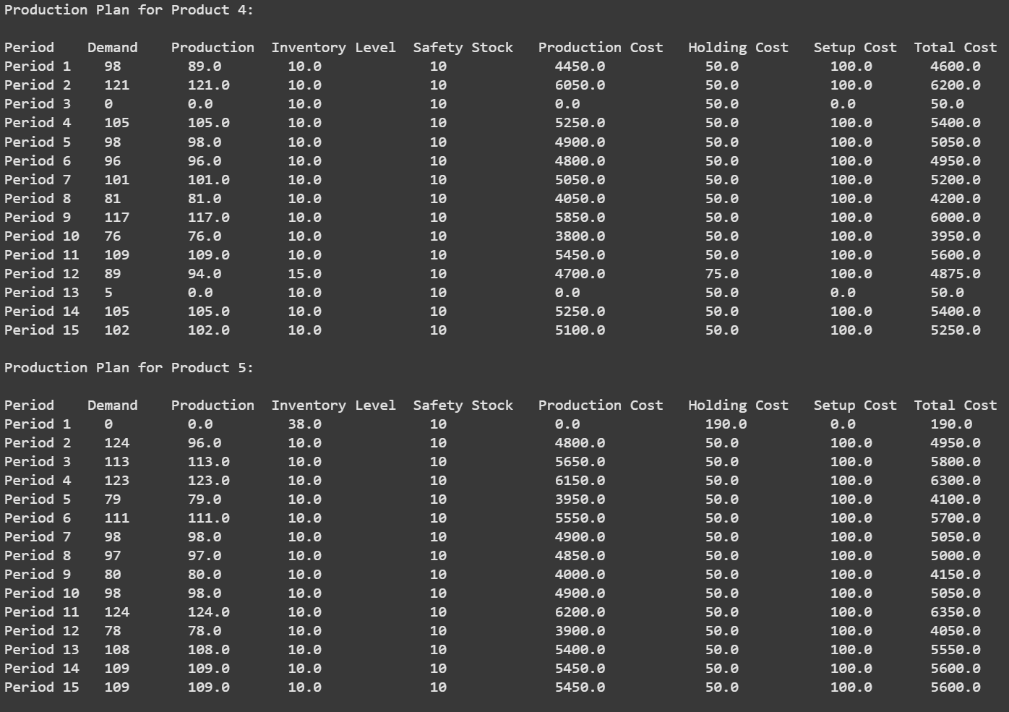
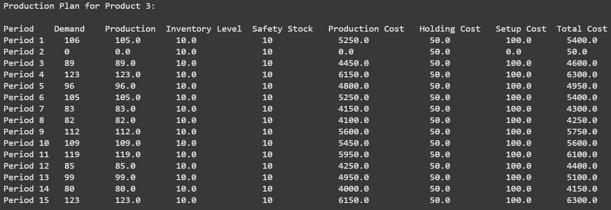
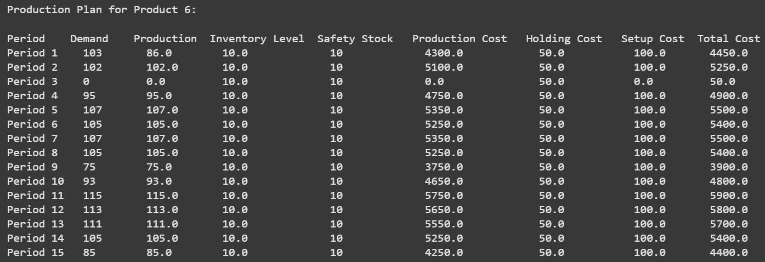
📦 Production - Cereals

Slide 4
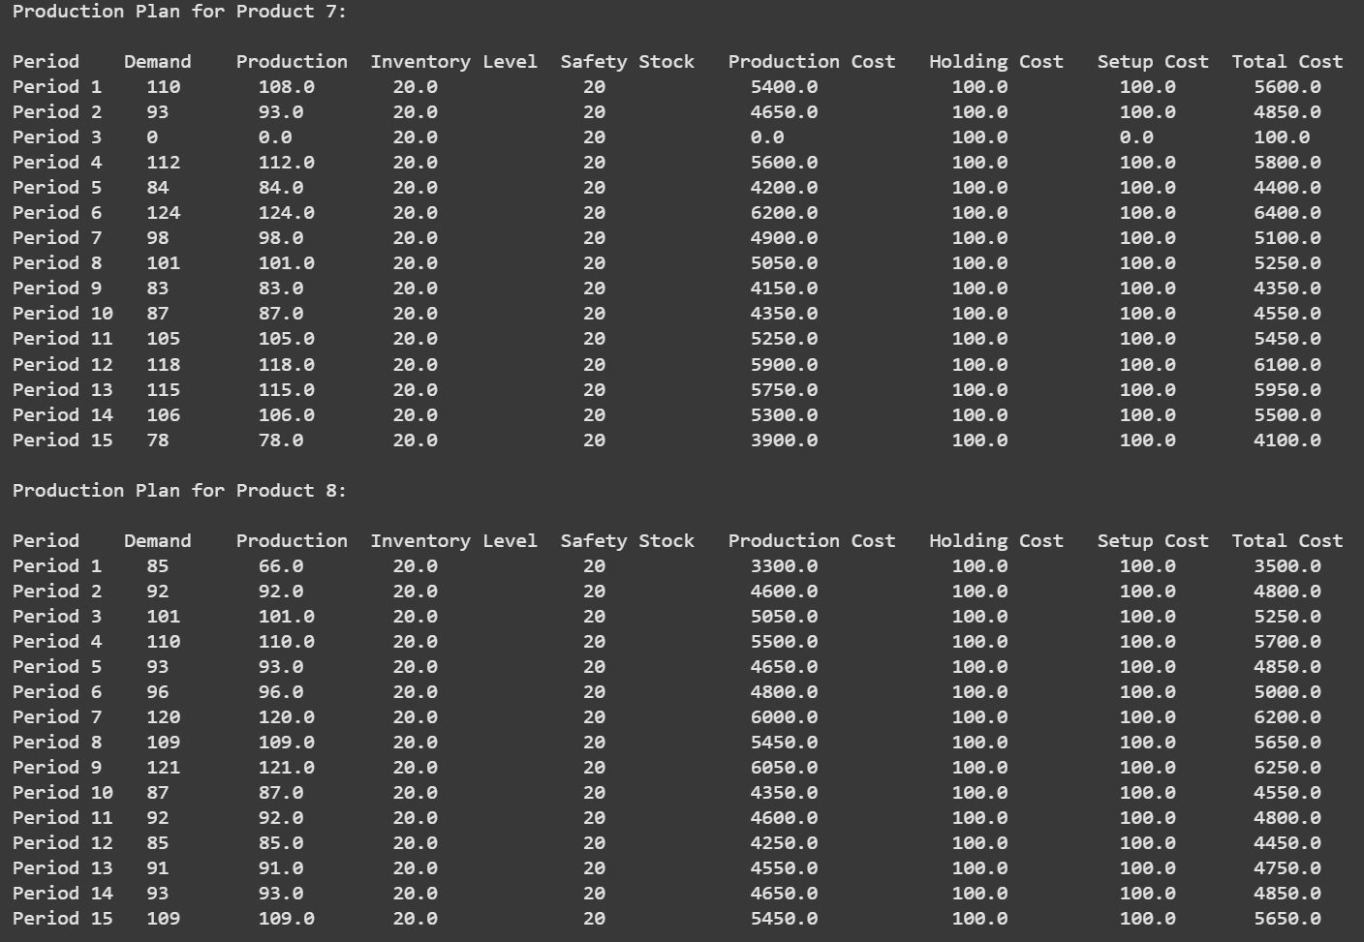
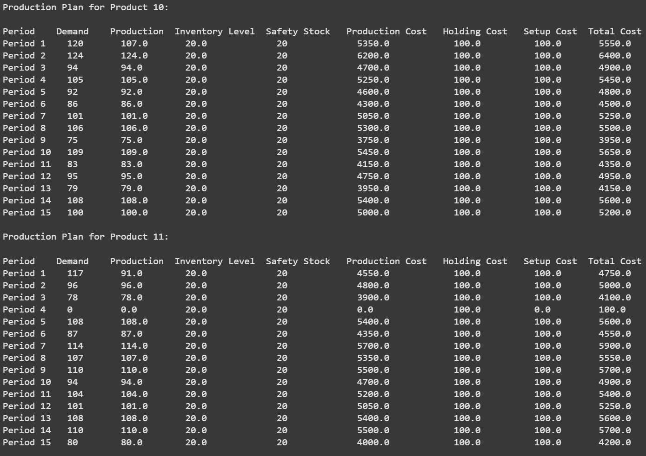
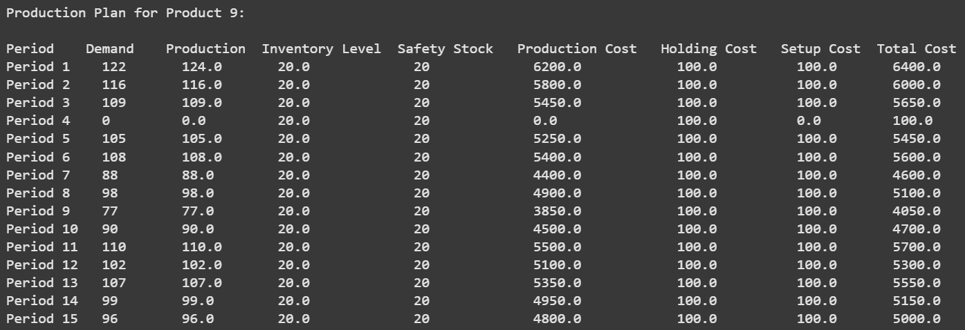
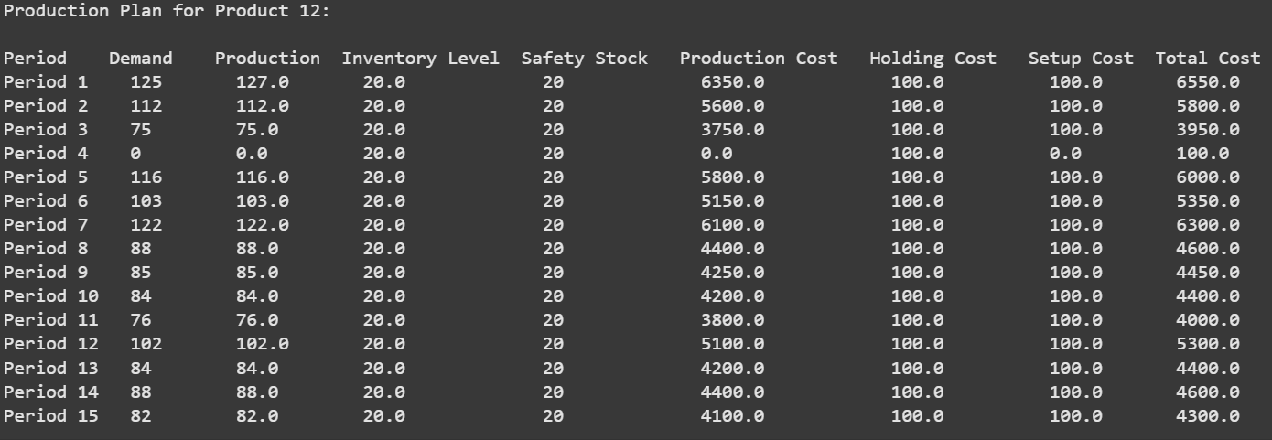
🍓 Production - Fruits

Slide 5
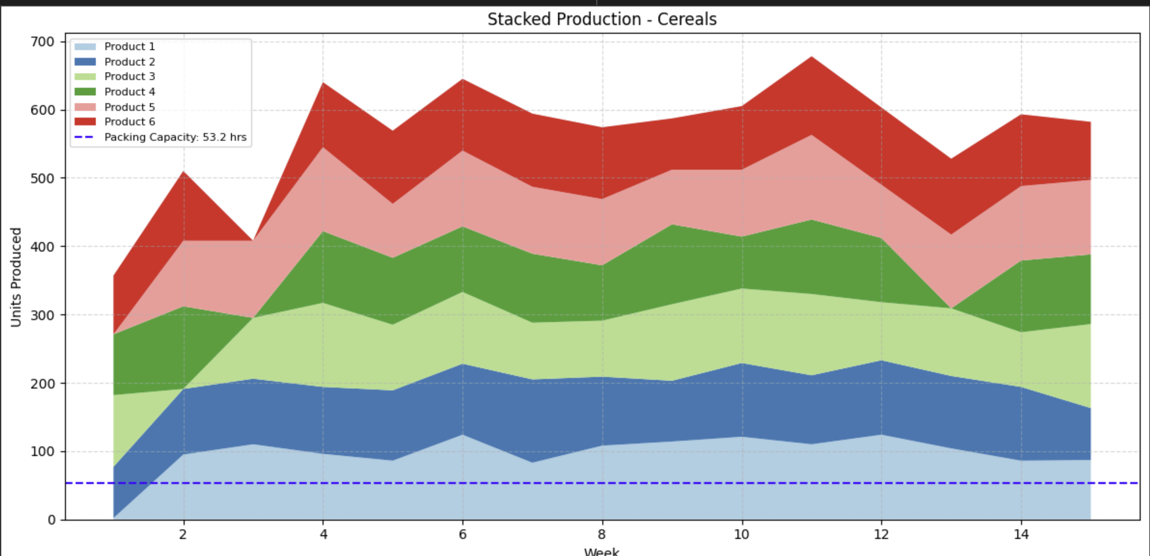
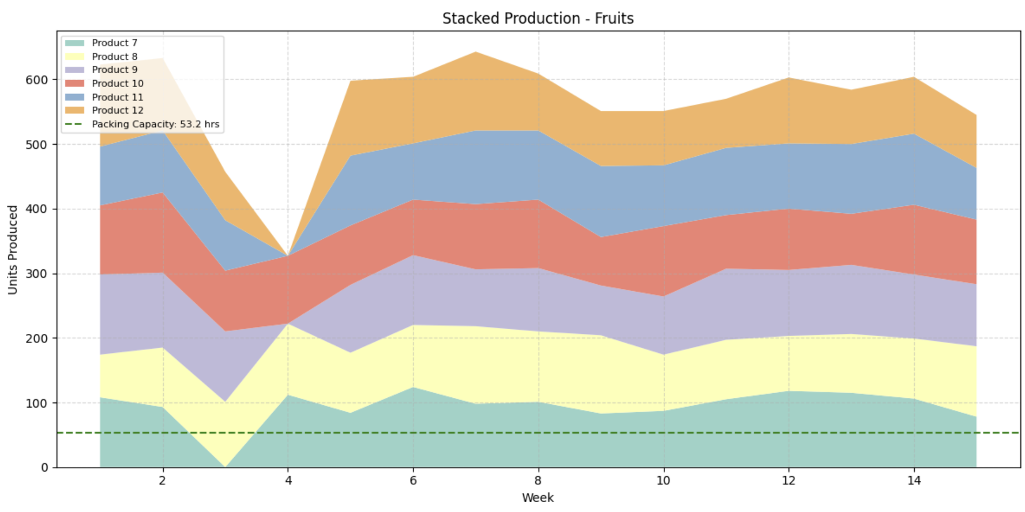
The stacked production graphs show how some products (e.g., Product 3, Product 7) are produced in advance to smoothen the load and reduce future setup requirements. This proactive planning avoids production spikes and stabilizes inventory

Slide 6
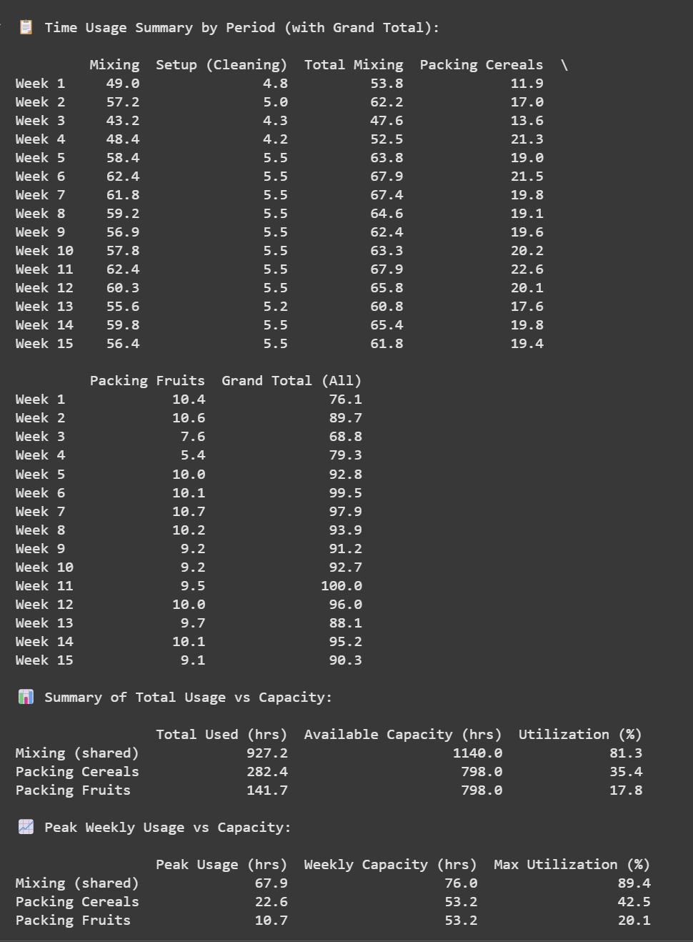
RESULTS
Resource Utilization: Well-Balanced, Not Constrained
Mixing Line (Shared): Operating at an average of 81.3% with a peak of 89.4%. This confirms the line is the critical resource but is well-managed fully leveraged without overload.
Packing Line – Cereals: Utilized at just 35.4% on average, with a peak of 42.5%. There's considerable spare capacity, suggesting room for reallocation or consolidation.
Packing Line – Fruits: Severely underused, averaging 17.8% with a peak of 20.1%. This is a non-critical resource and a strong candidate for optimization or reduction.
.

Slide 7
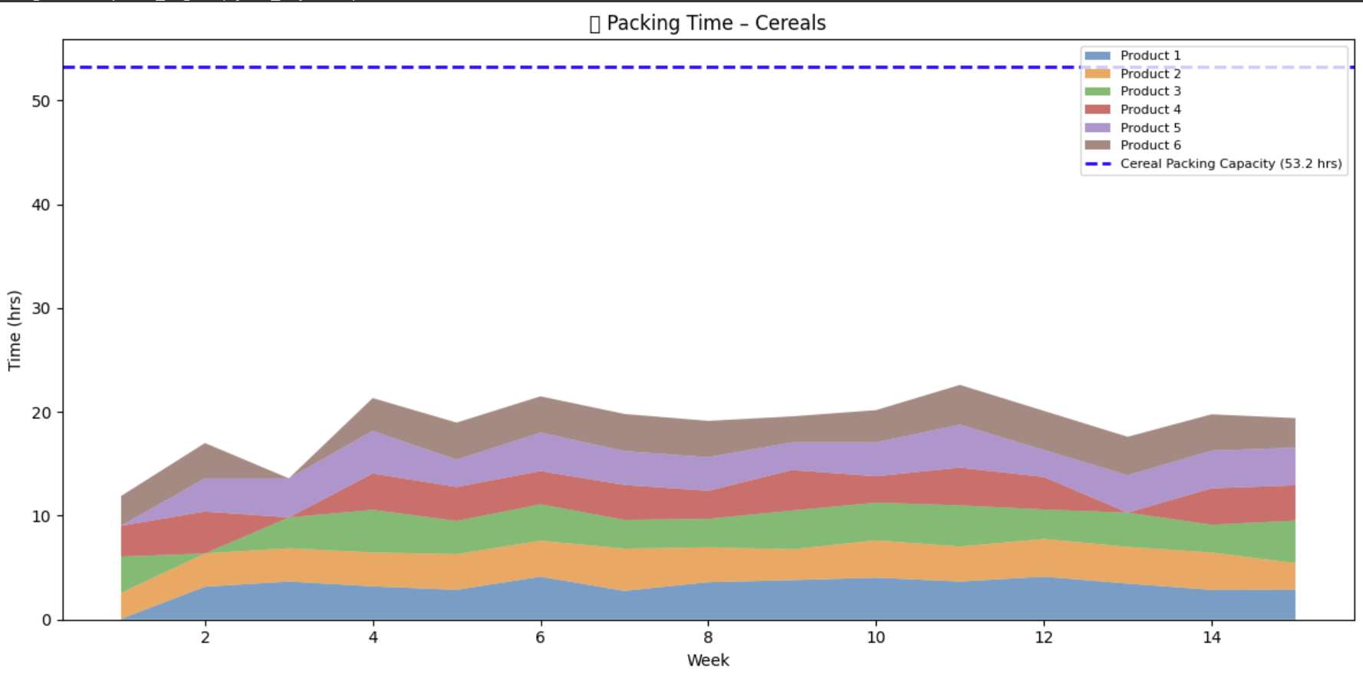
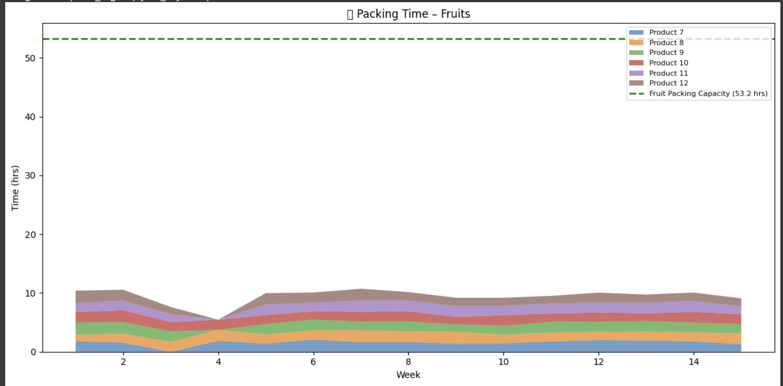
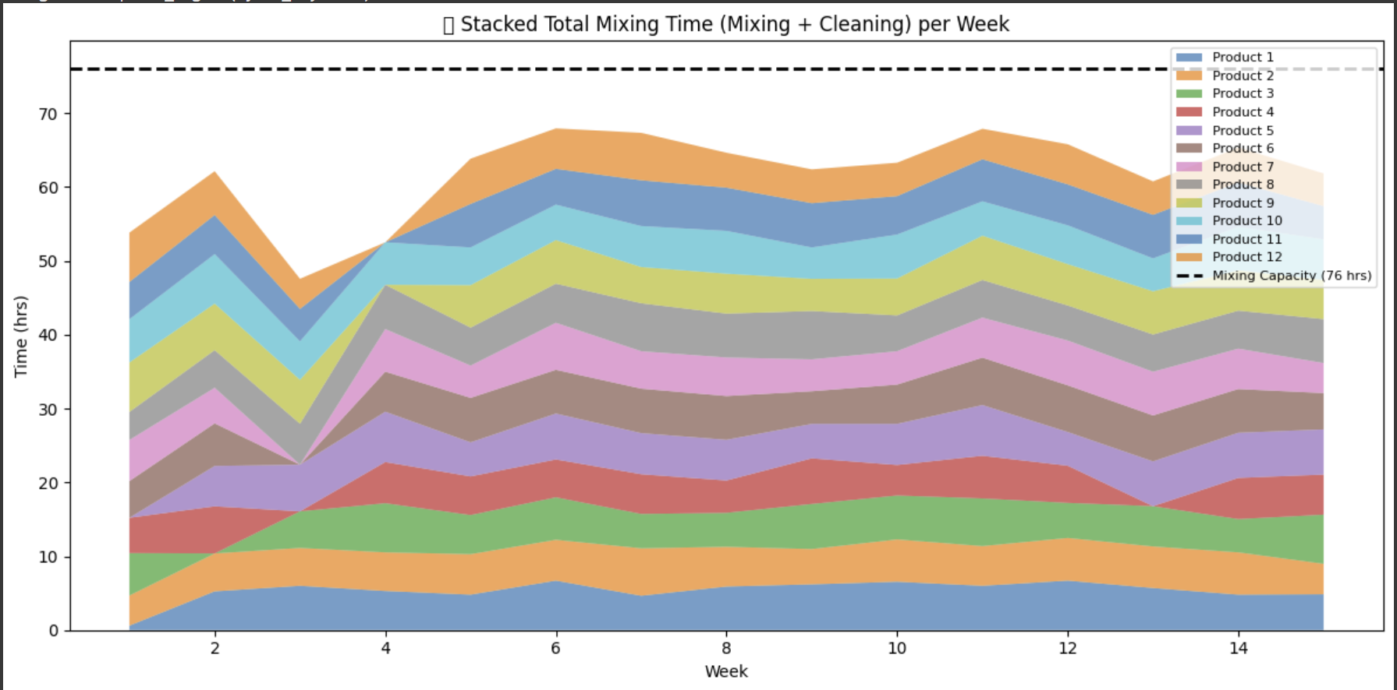
RESULTS
Key Insights
Mixing Line is the Bottleneck: Utilization peaks at nearly 90%, with consistently high weekly usage. This confirms it's the critical constraint in the system.
Cleaning (Setup) is Well-Leveled: The consistent layering of setup times across weeks shows strategic sequencing, helping avoid costly spikes and smoothing total workload.
Packing Lines are Oversized:
Cereals: Usage never exceeds 43% of capacity.
Fruits: Underused, peaking at just 20.6%, indicating major overcapacity.
The packing lines offer significant slack, particularly fruits. In contrast, the mixing line is clearly the critical resource and has been carefully optimized through effective setup planning and workload leveling. Moving forward, the focus should be on exploring capacity rebalancing, leaner packing operations, or even introducing setup cost differentiation to reflect operational effort

Slide 8
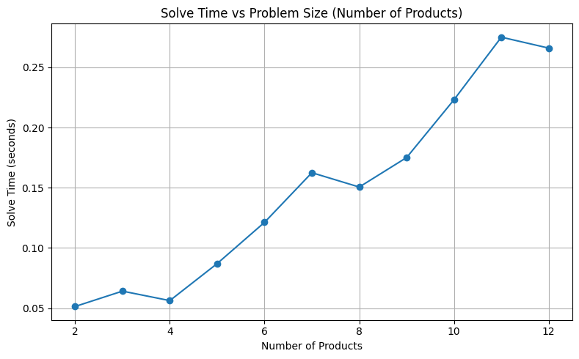
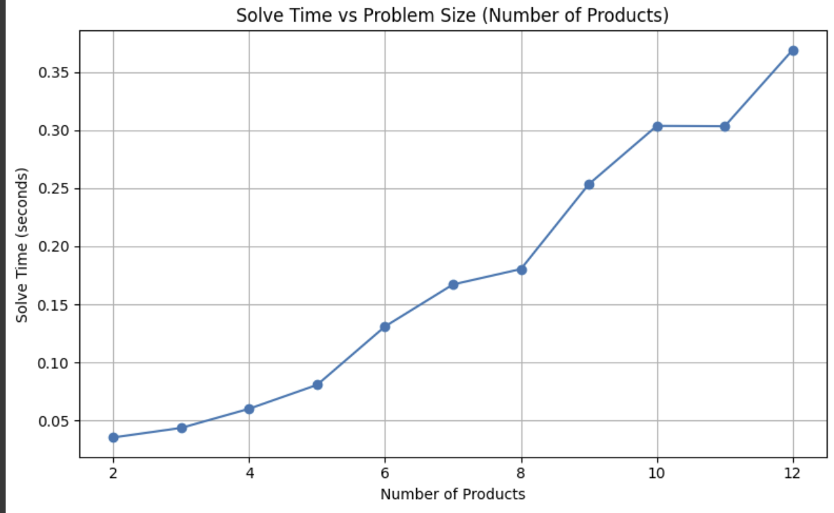
How the solving time increases as the dimension (number of variables and constraints) of the problem increases. Do you know why?
📊 Solving Time vs Problem Size: Key Insights
To explore scalability, we ran two simulations varying the number of products (2–12). The results highlight:
Increase in solve time as the number of products grows, a classic pattern in mixed-integer programming (MIP).
The right-hand plot shows a steeper curve, suggesting that added constraints (e.g., tighter capacity bounds or setup logic) significantly increase solver effort.
Around 10–12 products, the model likely hits a computational threshold, where binary decisions and constraint interactions drive up complexity.
🧠 Why Does Solve Time Rise?
While the number of variables and constraints increases linearly, the combinatorial space (due to binaries) grows exponentially.
Capacity, setup, and time-linked constraints create a highly coupled solution space, requiring deeper branch-and-bound exploration.

Slide 9
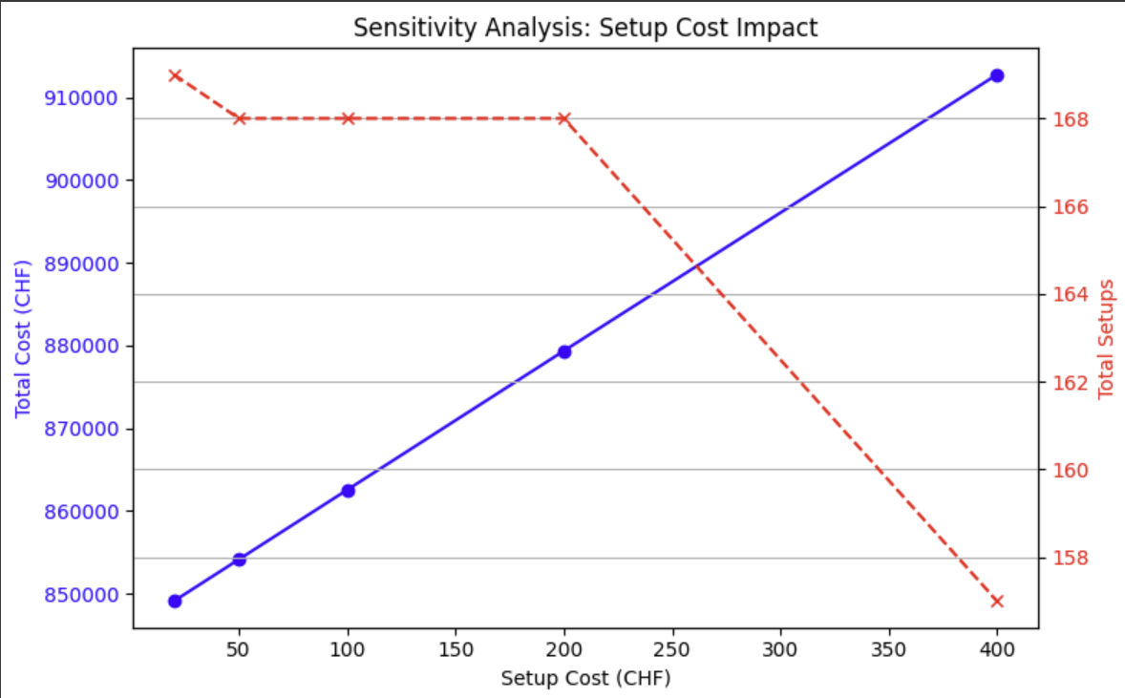
Sensitivity analysis Setup cost
Key Takeaways from Sensitivity Analysis:
🔵 Setup cost strongly impacts total cost – as setup cost increases, total cost rises significantly.
🔴 Setup frequency is only slightly reduced – the model avoids some setups as they get more expensive, but the effect is limited.
📉 Setup decisions are demand-driven – high demand variability and safety stock needs force setups, regardless of cost.
⚠️ Conclusion: The model is not highly sensitive to setup cost in terms of operational behavior. Most setups are structurally necessary.

