Slide 1


Comprehensive Analysis of IPL DATA
(2008 – 2025)
Name : Mathi Priyan A M M
College : Thiagarajar College of Engineering

Slide 2


Introduction
The Indian Premier League (IPL) is a globally popular T20 cricket league that began in 2008, featuring franchise teams composed of both international and domestic players. Known for its fast-paced and competitive matches, the IPL generates a wealth of data each season. Analyzing this data helps teams, analysts, and fans understand performance trends and make informed decisions. This project leverages match-level and ball-by-ball data to uncover insights from 13 seasons of IPL cricket, spanning from 2008 to 2020.

Slide 3
Dataset Overview
Source: Kaggle – IPL Matches & Deliveries Dataset
Time Range: IPL Seasons 2008 to 2020
Total Matches: 816
Primary Files:
matches.csv: Match-level data (teams, toss, winner, venue, etc.)
deliveries.csv: Ball-by-ball data (runs, batsman, bowler, dismissal, etc.)
Purpose: Enables both high-level season analysis and detailed in-game event tracking

Slide 4
Data Preprocessing
Missing Values: Cleaned nulls in columns like umpires and venue to ensure consistency.
Standardization: Unified team names across seasons (e.g., “Delhi Daredevils” → “Delhi Capitals”).
Date Formatting: Converted match dates to datetime format for time series analysis.
Feature Engineering: Created new metrics like run rate and match phase (Powerplay, Middle, Death overs).
Classified players by role: batsman, bowler, or all-rounder.
Data Validation: Checked for duplicate match entries and ensured ball-level data matched with match records.

Slide 5
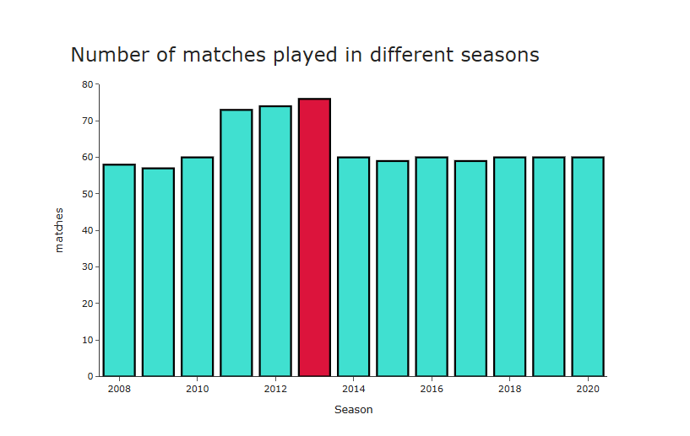
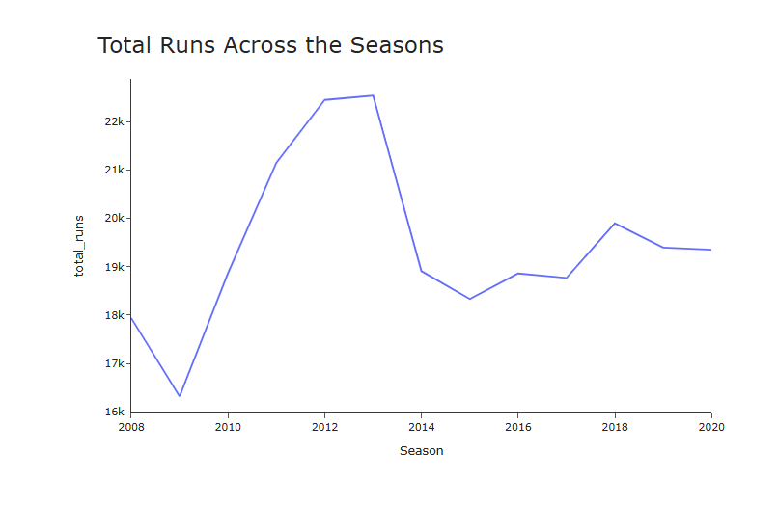
Exploratory Data Analysis
Season Overview
What was the count of matches played in each season?
How many runs were scored in each season?
Each season had around 60 matches, with a spike from 2011 to 2013 due to the addition of Pune Warriors and Kochi Tuskers, increasing teams to 10.
Season 2013 was the highest scoring season (22,541 runs), followed by 2012 (22,453 runs)
Season 2009 was the lowest scoring season (16,320 runs).

Slide 6
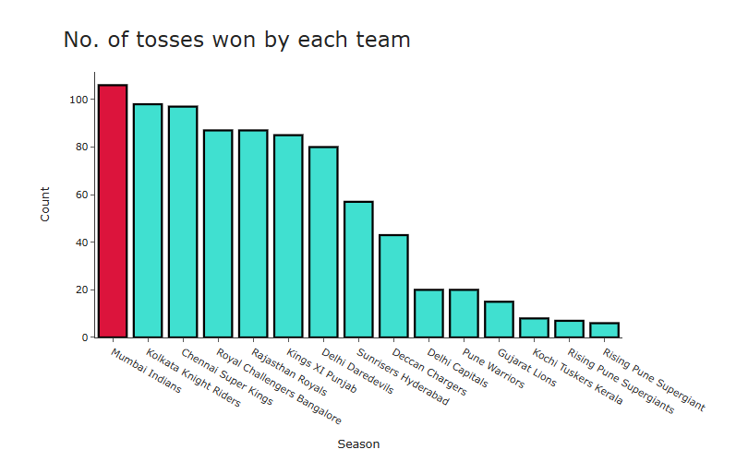
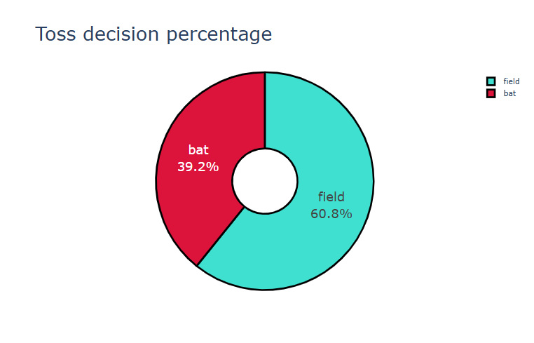
Exploratory Data Analysis
Toss Impact Analysis
Which team has won the most tosses?
What does the team decide after winning the toss?
Mumbai Indians have won the most tosses, followed by Kolkata Knight Riders.
After winning the toss, team tends to field first

Slide 7
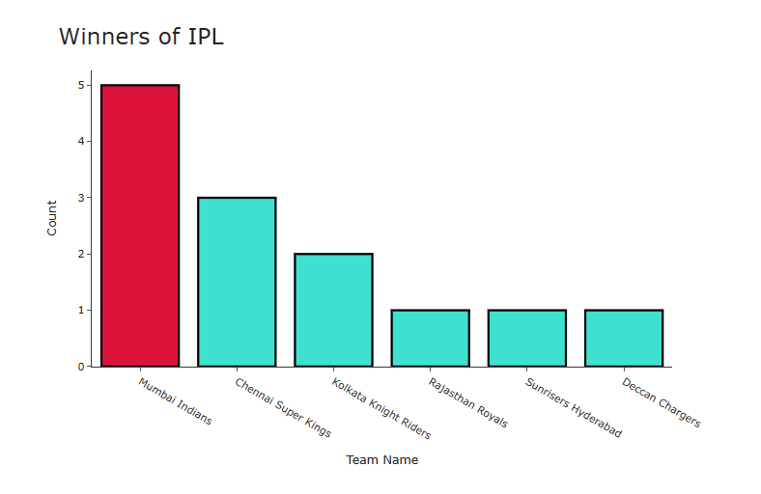
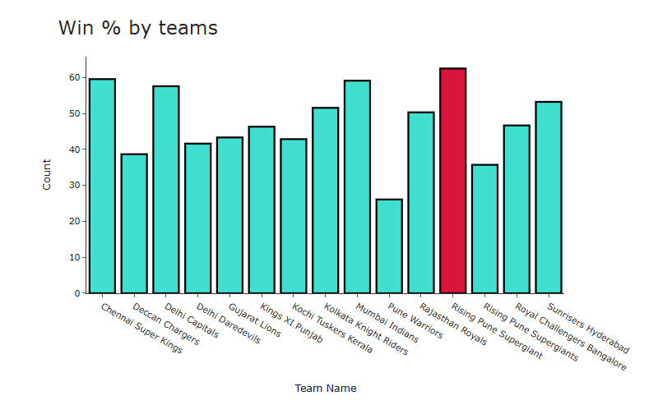
Exploratory Data Analysis
Team Performance Summary
Which team has won the most number of times?
Which team has the highest winning percentage?
Mumbai Indians had won the IPL 5 times while Chennai Super Kings had won it 3 times.
Rising Pune Supergiants have the highest win % of 62.50, followed by Chennai Super kings and Mumbai Indians. This is largely due to the fact that they had played really few matches.

Slide 8
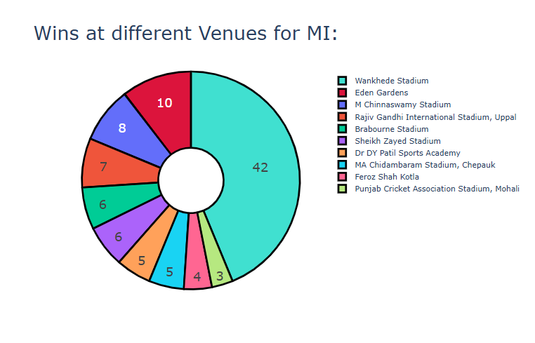
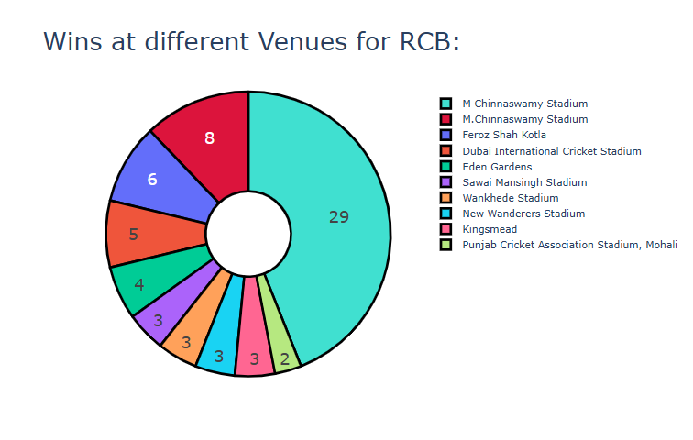
Exploratory Data Analysis
Lucky Venues
Mumbai Indians
Royal Challengers Bangaluru
It can be easily seen that team have won the most of its matches at their home venues.

Slide 9
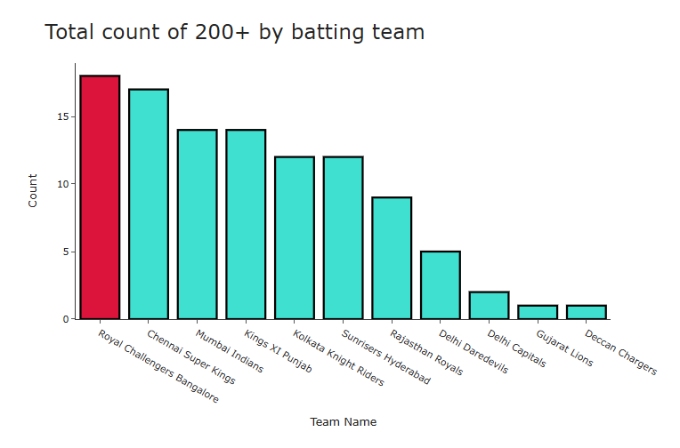
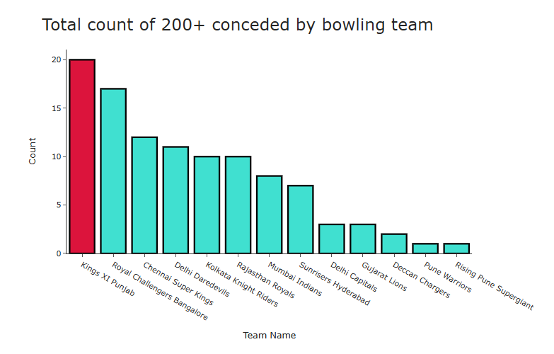
Exploratory Data Analysis
High-Scoring Match Insights
Scored 200+ runs
Conceded 200+ runs
Royal Challengers Bangalore had scored the most 200+ score (18 times), followed by Chennai Super Kings who had scored 17 times.
Kings XI Punjab has conceded 200+ runs 20 times, followed by Royal Challengers Bangalore (17)

Slide 10
Model Overview
Objective: To predict the winning team of an IPL match using key match factors before or during the match.
Input Features (X):
Venue
Toss Winner
Toss Decision (bat/field)
Powerplay Runs
Is Home Team? (Yes/No)
Batting First or Second
Output (Y):
Predicted Winner of the match (Binary: 1 = Team A wins, 0 = Team B wins)
We used a Logistic Regression model to predict the outcome of IPL matches based on a mix of categorical and numerical features such as venue, toss winner, toss decision, powerplay runs, and whether the team is playing at home. The model estimates the probability of a team winning the match using these key match context inputs.

Slide 11
Sample I/O
Input Features:
Venue: Wankhede Stadium
Toss Winner: Chennai Super Kings
Toss Decision: Field
Powerplay Runs: 57
Is Home Team: Yes
Batting First: Mumbai Indians
Model Output:​
​
Predicted Winner: Chennai Super Kings
Based on strong powerplay performance (57 runs) and favorable chasing conditions at Wankhede, the model predicts CSK to win. Historically, teams chasing here have a better win rate, especially when powerplay momentum is high.

Slide 12
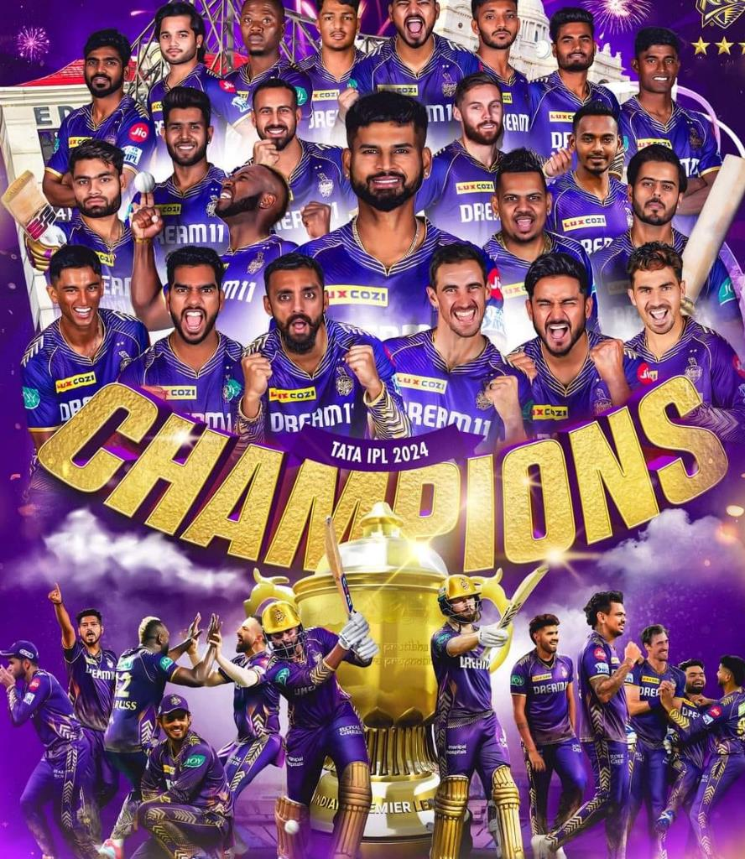

Conclusion
This analysis highlights key patterns in IPL match dynamics, including the impact of toss decisions, venue conditions, and powerplay performance. Consistent trends in team strategies and individual performances reveal critical success factors. Such insights can support data-driven decisions in team selection, match tactics, and player auctions.

Slide 13
Thank You!

