Slide 1
SYNOHYDRO-
Industrial Water Leak & Loss Detection
TEAM NO : 305
TEAM NAME : INOVIQ
TEAM SIZE : 3 MEMBERS

Slide 2
SYNOHYDRO
Industrial Water Leak & Loss Detection
Problem Statement: SU-03
Mentor Round 2 Review
Our Focus
Real-time water monitoring
Production-aware leak detection
Water loss estimation

Slide 3
Problem Statement
The Problem
Industrial water usage changes with production activity, making leaks difficult to identify.
High water consumption does not always mean a leak.
Undetected leaks can cause significant water wastage.
Abnormal usage may remain unnoticed in normal production fluctuations.
It is difficult to identify where the leak is likely to occur and how severe the loss is.
Our Challenge
Differentiate normal production-related water usage from abnormal water loss.
The problem statement requires analysing flow, pressure, consumption, production schedules and historical usage patterns.

Slide 4
Proposed Solution
What We Monitor
Flow
Pressure
Production activity
Water consumption
Historical usage patterns
What We Provide
Potential leak detection
Probable leak location
Leak severity
Estimated water loss
Financial impact
Key Idea
“We don't rely on water consumption alone. We consider production activity and multiple sensor readings to identify abnormal water usage.”

Slide 5
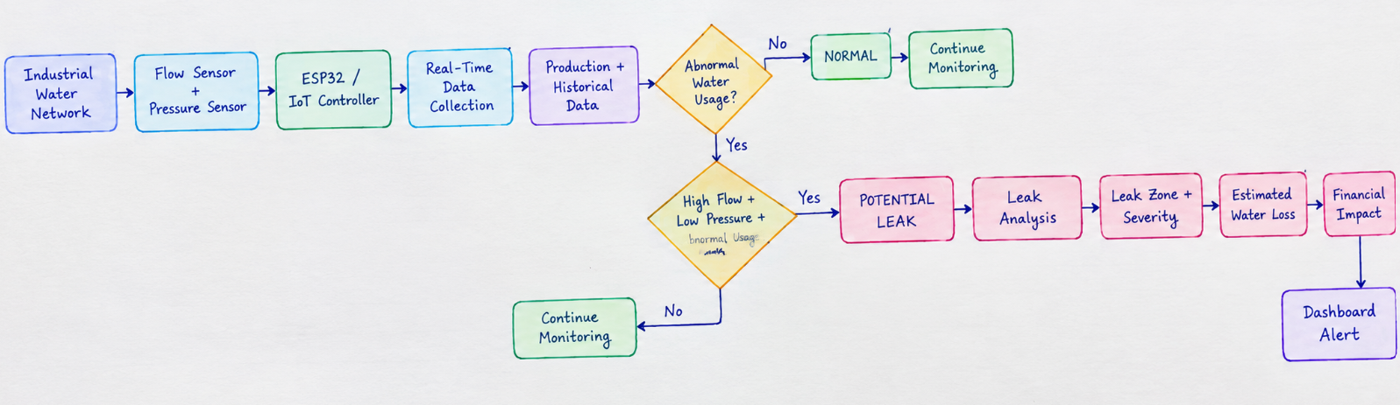
FLOW DIAGRAM

Slide 6
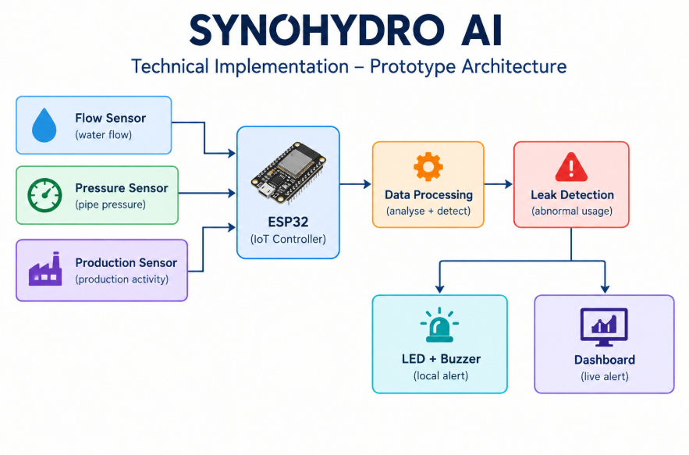
PROTOTYPE ARCHITECTURE

Slide 7
PROTOTYPE FUNCTIONALITY
ESP32 Simulation
Flow, Pressure and Production values are simulated.
ESP32 continuously reads these values.
High Flow + Low Pressure indicates a potential leak.
Red LED and Buzzer provide an immediate alert.
Sensor values and system status are displayed in real time.
Demo Output
Normal → System continues monitoring
Abnormal → Leak detected → LED + Buzzer ON
Key Point
“Our prototype demonstrates real-time sensor monitoring and immediate leak detection.”

Slide 8
Dashboard Integration
Real-Time Dashboard
Displays Flow, Pressure & Production
Shows Normal / Leak Status
Gives instant leak alerts
Shows probable leak zone
Displays water loss & financial impact
Flow
Wokwi → ESP32 → Dashboard
“Detect the leak. Understand the impact. Take action.”

Slide 9
What Makes SYNOHYDRO AI Different?
Key Differentiators
Production-Aware Detection
Understands whether water usage is due to production or leakage.
Multi-Parameter Analysis
Uses Flow + Pressure + Production + Historical data.
Probable Leak Zone
Identifies the area where the leak is likely occurring.
Water Loss Estimation
Estimates the quantity of water being lost.
Financial Impact
Calculates the approximate cost of water loss.

Slide 10
THANK YOU

