Slide 1
From Bioeconomy Promise to Biodiversity Ceiling
The role of forest biomass in Finnish decarbonisation —
and the next phase: coupling G4M, disturbances and the forest carbon sink
Matthieu Bordenave
University of Pisa · IIASA · UCLouvain
Working meeting with IIASA — 9 October 2026

Slide 2
ROADMAP
What we will cover today
— 1. Context & motivation — forest biomass as Finland's main domestic decarbonisation lever
— 2. Paper 1 (near-complete) — method, stepwise wood supply curves, 3×3 scenario matrix, headline results
— 3. Two methodological gaps — static curves · no forest carbon sink
— 4. Research questions for the next phase
— 5. Proposal to IIASA — G4M supply curves · disturbance shocks · sink coupling · European/BeWhere extension
— 6. The IIASA model landscape — G4M, PICUS/PREBAS, FLAM, BeWhere, ForestNavigator D3.4
— 7. Path forward & open questions — what we need from the G4M / ForestNavigator teams
M. Bordenave · Forest–Energy coupling for Finland · IIASA meeting, 9 Oct 2026
1

Slide 3
CONTEXT & MOTIVATION
Why forest biomass, why supply curves
— Forest biomass supplies ~25% of Finland's primary energy — the main domestic lever for deep decarbonisation.
— But availability is not a single fixed number: it depends on forest management, competing industrial uses (pulp, paper, sawnwood), ecological limits, and — increasingly — natural disturbances.
— Colla et al. (2022) showed for Belgium that representing wood as a multi-step marginal-cost supply curve materially changes its optimal allocation under deep decarbonisation.
— Paper 1 applies and extends this to Finland — a structurally richer, more policy-contested case (bioeconomy vs biodiversity vs climate).
— Next step: make the curves endogenous to forest dynamics, so management intensity and disturbance shocks propagate into the energy system through both wood availability and the forest carbon balance.
M. Bordenave · Forest–Energy coupling for Finland · IIASA meeting, 9 Oct 2026
2

Slide 4
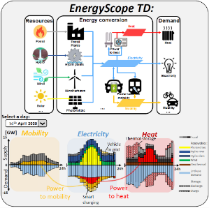
THE TOOL
EnergyScope — whole-energy-system optimisation
— EnergyScope TD (Limpens et al. 2019): open-source LP that co-optimises investment and hourly operation of the whole energy system — electricity, heat, mobility, non-energy demand — to minimise total annual cost under a GHG constraint.
— Typical-days representation keeps the hourly detail tractable (12 typical days here).
— Multi-cell version (ESMC) places Finland inside a pan-European grid; this study is the Finnish national deep-dive.
— Biomass enters as resources with a yearly availability cap, a marginal cost and an embedded (supply-chain) GHG factor — exactly where the supply-curve representation lives.
Binding climate constraint (today): Σ_r CO₂_net[r] ≤ gwp_limit — energy-system combustion emissions only. Biomass combustion is carbon-neutral by assumption; there is no term for the forest sink.
M. Bordenave · Forest–Energy coupling for Finland · IIASA meeting, 9 Oct 2026
3

Slide 5
PAPER 1 — WHAT IS DONE
Three building blocks, results are stylised
Calibrated 2017 baseline
Stepwise wood supply curves (2035)
3 × 3 scenario matrix
• Reproduces the national energy balance to ~1.2% weighted error over 14 indicators
• CO₂ within 0.1% (41.2 MtCO₂)
• Residuals documented: district heat +43%, gas-CHP +37% (aggregation artefacts)
• Single WOOD resource → 4 domestic steps + import backstop
• Dispatched in merit order (cheapest first)
• Three forest-management scenarios S1 / S2 / S3
• {S1, S2, S3} × {unconstrained, −95% GHG, −95% no-nuclear}
• 9 canonical runs, reproducible (tag paper1-finland-forest-v1.0)
• Headline findings → next slides
M. Bordenave · Forest–Energy coupling for Finland · IIASA meeting, 9 Oct 2026
4

Slide 6
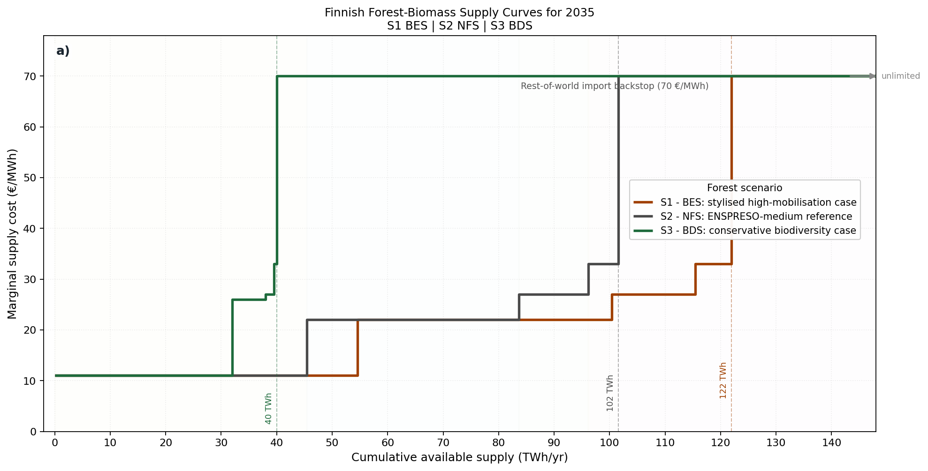
PAPER 1 — SUPPLY CURVES
Stepwise Finnish wood supply, by management scenario
Five merit-order steps (€/MWh)
FI1 Industrial by-products — black liquor, bark, sawdust — 11
FI2 Logging residues (branches, tops) — 22 (26 S3)
FI3 Secondary woodchips / sawdust — 27
FI4 Fuelwood + landscape-care wood — 33
FI5 Import backstop (Baltic / Nordic) — 70
Domestic ceilings: S1-BES ~122 TWh · S2-NFS ~102 TWh · S3-BDS 40 TWh (S1 +20% and S3 40 TWh are stylised/revised, not raw ENSPRESO).
Note: FI1 proxies Finland's captive by-product stream, dominated by black liquor (~43 TWh, 2017) — absent from ENSPRESO; flagged for IIASA.
M. Bordenave · Forest–Energy coupling for Finland · IIASA meeting, 9 Oct 2026
5

Slide 7
PAPER 1 — RESULTS
The 2035 scenario × GHG matrix
Scenario | GHG case | Cost (bn€/y) | CO₂ (Mt/y) | Reduction vs 2017 | Wood used (TWh)
S1 BES | Unconstrained | 22.40 | 13.02 | 68% | 54.5
S1 BES | −95% (nuclear) | 22.92 | 2.06 | 95% | 74.2
S1 BES | −95% (no nuke) | 22.94 | 2.06 | 95% | 100.4
S2 NFS | Unconstrained | 22.46 | 12.57 | 70% | 45.4
S2 NFS | −95% (nuclear) | 23.02 | 2.06 | 95% | 74.2
S2 NFS | −95% (no nuke) | 23.12 | 2.06 | 95% | 96.2
S3 BDS | Unconstrained | 22.62 | 13.10 | 68% | 32.0
S3 BDS | −95% (nuclear) | 23.56 | 2.06 | 95% | 40.0 ✦
S3 BDS | −95% (no nuke) | 23.90 | 2.06 | 95% | 40.0 ✦
Three headline messages
1. 2035 is already ~70% below 2017 even unconstrained — a structural floor (coal phase-out + brownfield renewables).
2. Under −95%, S3 (conservation) saturates its 40 TWh ceiling and becomes the most expensive configuration.
3. Removing nuclear sharply raises the value of biomass in S1/S2 (up to ~100 TWh) — but S3 physically cannot expand (✦ = ceiling binding).
M. Bordenave · Forest–Energy coupling for Finland · IIASA meeting, 9 Oct 2026
6

Slide 8
TWO METHODOLOGICAL GAPS
What Paper 1 cannot yet represent
1 · Static & exogenous curves
2 · The forest carbon sink is absent
— Curves are read from ENSPRESO potentials and published papers, not from a forest model.
— Scenarios differ only in availability and cost — no forest growth dynamics, age structure or disturbances.
— S1 (+20%) and S3 (40 TWh) are stylised / revised — the cross-scenario volume differences rest largely on assumptions.
— The binding constraint counts energy-system combustion CO₂ only; biomass is carbon-neutral by assumption.
— The model sees the S1-vs-S3 climate difference only through supply-chain GHG.
— It cannot represent the dominant effect of harvest intensity: lower harvest raises standing stock and the sink; intensive harvest depletes it.
— Finnish/EU literature treats this as first-order (e.g. Blattert: NFS sink up to ~80, BES ~28 MtCO₂/yr; BDS starts highest then collapses).
M. Bordenave · Forest–Energy coupling for Finland · IIASA meeting, 9 Oct 2026
7

Slide 9
NEXT PHASE
Research questions
RQ1 — Management — How do contrasting management regimes reshape the dynamic Finnish wood supply curve (quantity, quality, marginal cost, 2025–2050) when derived from G4M rather than a static database?
RQ2 — Sink coupling — When the forest carbon balance (sink/source + HWP) enters the national GHG budget, how does the optimal energy mix and the cost of deep decarbonisation change — and does the S1/S2/S3 climate ranking change?
RQ3 — Shocks — How does a compound disturbance (windstorm → bark-beetle) propagate into the energy system — calamity-wood pulse, multi-year deficit, sink loss — and does it strand biomass-conversion assets?
RQ4 — Policy framing — If the 'neutral' baseline becomes a sink-maximising / LULUCF net-zero scenario, what does economy-wide net-zero (energy + land) imply vs energy-only net-zero?
RQ5 — Scaling — Can the same supply-curve representation scale to Europe and to competing end-uses (construction / HWP) with BeWhere?
M. Bordenave · Forest–Energy coupling for Finland · IIASA meeting, 9 Oct 2026
8

Slide 10
PROPOSAL TO IIASA — A
G4M management-scenario supply curves
— Replace the hand-built curves with physically modelled, assortment-level harvest from G4M for Finland, 2025–2060, under each regime × climate pathway (GWL2 / GWL3).
— Extract per year: harvestable volume by assortment (sawlogs, pulpwood, logging residues, fuelwood, stumps); ecologically-available fractions; net forest + HWP carbon flux.
— Derive the energy-available volume as the residual after industrial roundwood demand under each regime — exactly the step we now assume.
— Map assortments → existing WOOD_FI1…FI4 steps (volume→energy factors, costs from Finnish statistics / RED II). EnergyScope implementation unchanged.
— Structural question to settle: FI1 is a captive industrial by-product stream (black liquor, bark, sawdust) driven by processing throughput, not forest-gate harvest — keep from statistics, or bridge from G4M roundwood?
M. Bordenave · Forest–Energy coupling for Finland · IIASA meeting, 9 Oct 2026
9

Slide 11
PROPOSAL TO IIASA — B
Disturbance-shock supply curves
— Use G4M's disturbance-aware runs (+ ForestNavigator FLAM / bark-beetle / wind) to build time-profiled curves around a compound event, not a single lower ceiling.
— A disturbance scenario superimposes three effects:
  · Calamity-wood pulse — a large, cheap, time-limited (~18–24 mo) salvage volume, quality-penalised (blue-stain, moisture, LHV −10…−25%).
  · Structural supply deficit — reduced availability for 10–15 years from depleted cohorts and damaged area out of rotation.
  · Sink loss — an immediate LULUCF emission from killed biomass and foregone growth.
— Energy-system response studied as a pre-shock → post-shock pair with constrained re-optimisation (inherited lower bounds on installed capacity) to expose stranded-asset and transition-delay risk.
M. Bordenave · Forest–Energy coupling for Finland · IIASA meeting, 9 Oct 2026
10

Slide 12
PROPOSAL TO IIASA — C
Coupling the forest carbon sink into EnergyScope
Make the national target a land–energy coupled budget — a small, transparent AMPL change:
Σ_r CO₂_net[r] − S_forest(scenario, year, disturbance) ≤ gwp_limit
S_forest = exogenous net forest + HWP CO₂ flux from G4M (one national parameter per scenario-year; <0 when a sink).
— Harvest intensity and disturbances now act on the energy system through the sink, not only through wood availability.
— RQ2: does deep decarbonisation become cheaper under conservation (large sink credit), or does the energy-only penalty dominate?
— RQ4 / new S0 scenario: define net-zero over energy + land (Σ_r CO₂_net ≤ S_forest) — a sink-maximising baseline replacing the 'neutral' S2 framing.
— Scope control: S_forest is an exogenous input, not endogenised. EnergyScope responds to forest management; it does not optimise it. One-way coupling, tractable for a first paper.
M. Bordenave · Forest–Energy coupling for Finland · IIASA meeting, 9 Oct 2026
11

Slide 13
PROPOSAL TO IIASA — D
European, cross-sectoral extension with BeWhere
— Parallel / follow-on track with Fabian Schipfer & Shubham Tiwari (IIASA).
— Scale the quality- and cost-differentiated supply-curve representation from Finland to Europe, and from energy to competing end-uses (construction / engineered wood / HWP).
— Division of view: EnergyScope-Finland provides the national energy-system deep dive; BeWhere provides the spatially explicit, multi-sector, European allocation.
— Shared object: a transferable, disturbance- and management-aware biomass supply-curve interface.
— Open: is there a Schipfer/Tiwari BeWhere capability for construction / HWP supply chains, and on what timeline for a joint output (paper / proposal)?
M. Bordenave · Forest–Energy coupling for Finland · IIASA meeting, 9 Oct 2026
12

Slide 14
THE IIASA MODEL LANDSCAPE
What each tool does — and the key caveat for us
Model | What it does | Key caveat for this coupling
G4M | Geographically explicit economic forest model (NPV). Afforest/deforest/manage from wood prices; harvest, carbon pools, LULUCF flux. | Assortment split lives in GLOBIOM, not G4M. 0.5° / SimU — Finland resolved as a country but reported EU-27. No deadwood pool found.
PICUS / PREBAS | Stand/patch growth models with disturbance modules. | In ForestNavigator the native PICUS disturbance modules were off; for Northern Europe the growth model is PREBAS — clarify which underlies Finland.
FLAM | Process-based daily wildfire model (burned area). | No Finland application yet (closest: Sweden 2022). Wildfire is secondary for Finland — treat as sensitivity.
BeWhere | Spatially explicit MILP for biomass supply chains and plant siting. | Finland precedent exists (Natarajan 2014). No Schipfer HWP/construction paper located — ask directly.
ForestNavigator D3.4 | FLAM + G4M + PICUS-derived beetle/wind, 5 arc-min over EU-27 incl. Finland. | Disturbances modelled as biomass loss only — salvage-wood recovery NOT yet implemented. The ready-made disturbance curve does not exist yet.
M. Bordenave · Forest–Energy coupling for Finland · IIASA meeting, 9 Oct 2026
13

Slide 15
PATH FORWARD
Who does what
[IIASA — G4M team] Confirm G4M can deliver for Finland (2025–2060 × regime × GWL2/GWL3): assortment-level harvest, ecologically-available fractions, net forest + HWP flux, disturbance mortality/salvage. Spatial resolution & format.
[M. Bordenave] Prototype the sink-coupling AMPL term against the existing 2035 matrix using literature sink values (Blattert) as a placeholder — demonstrate the mechanism before G4M data arrive.
[M. Bordenave + IIASA] Map G4M assortments → WOOD_FI1…FI4; settle the FI1 by-product/black-liquor treatment; adopt best Finnish cost data.
[All] Agree scenario definitions (incl. the new S0 sink-max / net-zero) and the disturbance event design (compound windstorm → beetle, GWL2 primary).
[IIASA — Schipfer / Tiwari] Scope the BeWhere European extension as a follow-on; identify the shared supply-curve interface and a target joint output.
M. Bordenave · Forest–Energy coupling for Finland · IIASA meeting, 9 Oct 2026
14

Slide 16
OPEN QUESTIONS FOR IIASA
What we need to settle today
Q1. Does G4M run for Finland at a resolution usable for national supply curves, and output assortment-level harvest + net carbon/HWP flux per management scenario? G4M alone, or via GLOBIOM?
Q2. Does G4M output a separate, quantified deadwood carbon pool per scenario-year? (Needed for the sink term and the BDS narrative.)
Q3. How do you endogenise the industry-vs-energy split, so energy-available residue is what remains after industrial roundwood demand? What industrial-demand trajectory?
Q4. Are ecological availability fractions (deadwood/residue retention, set-aside) applied inside G4M per scenario, or must we post-apply them?
Q5. For Finland, is growth/disturbance driven by G4M, PREBAS, or PICUS in your setup?
Q6. D3.4 models disturbance as biomass loss only — is a salvage-wood recovery extension available or planned, or do we build the post-processing?
Q7. How should calamity-wood carbon be treated in Finland's LULUCF / forest reference level for the coupled GHG budget?
Q8. Is there a BeWhere capability for construction / HWP supply chains (Schipfer / Tiwari), and on what timeline?
M. Bordenave · Forest–Energy coupling for Finland · IIASA meeting, 9 Oct 2026
15

Slide 17
From a static biomass ladder …
… to a dynamic, disturbance- and sink-aware forest–energy coupling for Finland
Discussion — thank you

Slide 18
BACKUP
Data provenance & the FI1 / black-liquor flag
— Wood volumes: ENSPRESO (JRC) commodity codes → 4 steps; S2 = ENS_Med 2035 (interpolated), S1 = S2 ×1.2, S3 = ENS_Low 2030 revised to 40 TWh (LUKE + Mönkkönen audit). All reproduce exactly (1 PJ = 277.78 GWh).
— Costs / GHG: model assumptions; GHG from RED II Annex VI via Colla (2022). FI2 = 22 €/MWh matches observed Finnish forest-chip prices.
— FI1 flag (for IIASA): ENSPRESO formally labels the FI1 commodity as stemwood chips; we re-purpose its volume as a proxy for the captive by-product stream (black liquor dominant, 43 TWh in 2017) because black liquor is absent from ENSPRESO. Cost 11 €/MWh is conservative; flagged for a physically grounded G4M split.
— Reproducibility: git tag paper1-finland-forest-v1.0; 9 canonical runs; audit script check_forest_supply_traceability.py (ALL PASS).
M. Bordenave · Forest–Energy coupling for Finland · IIASA meeting, 9 Oct 2026
16

