Slide 1

Recognizing a client in under a second
Claire Test
AUDENCIA · COURSE PROJECT · 2026
A client recognition prototype for a fictional luxury boutique, running entirely in the browser.
Rim Middi · Felix Chevalier · Jean-Baptiste Caron · Mathis Lacombe
Live demo mathos34.github.io/reconnaissance-equipe
Faces are pixelated in every screenshot.
Notes:
Hook: in a luxury boutique, the welcome is decided in the first few seconds. We built a prototype that recognizes a registered client and shows their card to the advisor, with nothing but a webcam and a browser. The demo is live: anyone can try it from the link. Plan: the project, the numbers, a four-minute demo, then the limits, which are the most interesting part.

Slide 2
In a luxury boutique, the welcome happens in seconds
THE IDEA
« Bonjour Madame Test, un café glacé sans sucre, comme d'habitude ? »
01
Recognize without asking
A registered client is identified as soon as they step into the camera's view.
02
Remember preferences
Drink, sugar, milk, style, recent purchases, advisor notes.
“Good morning Mrs Test, an iced coffee with no sugar, as usual?”
The welcome line the app writes from the client card and the time of day.
03
Fit the moment
The suggestion changes before and after noon and recalls the last visit.
Our question: how far can AI help a sales advisor, and where does it stop?
Notes:
The setting: a fictional boutique, Maison Test. The clients are team members with invented client cards. The goal is not to sell a product but to test a concept: is it feasible, how fast is it, and what gets in the way?

Slide 3
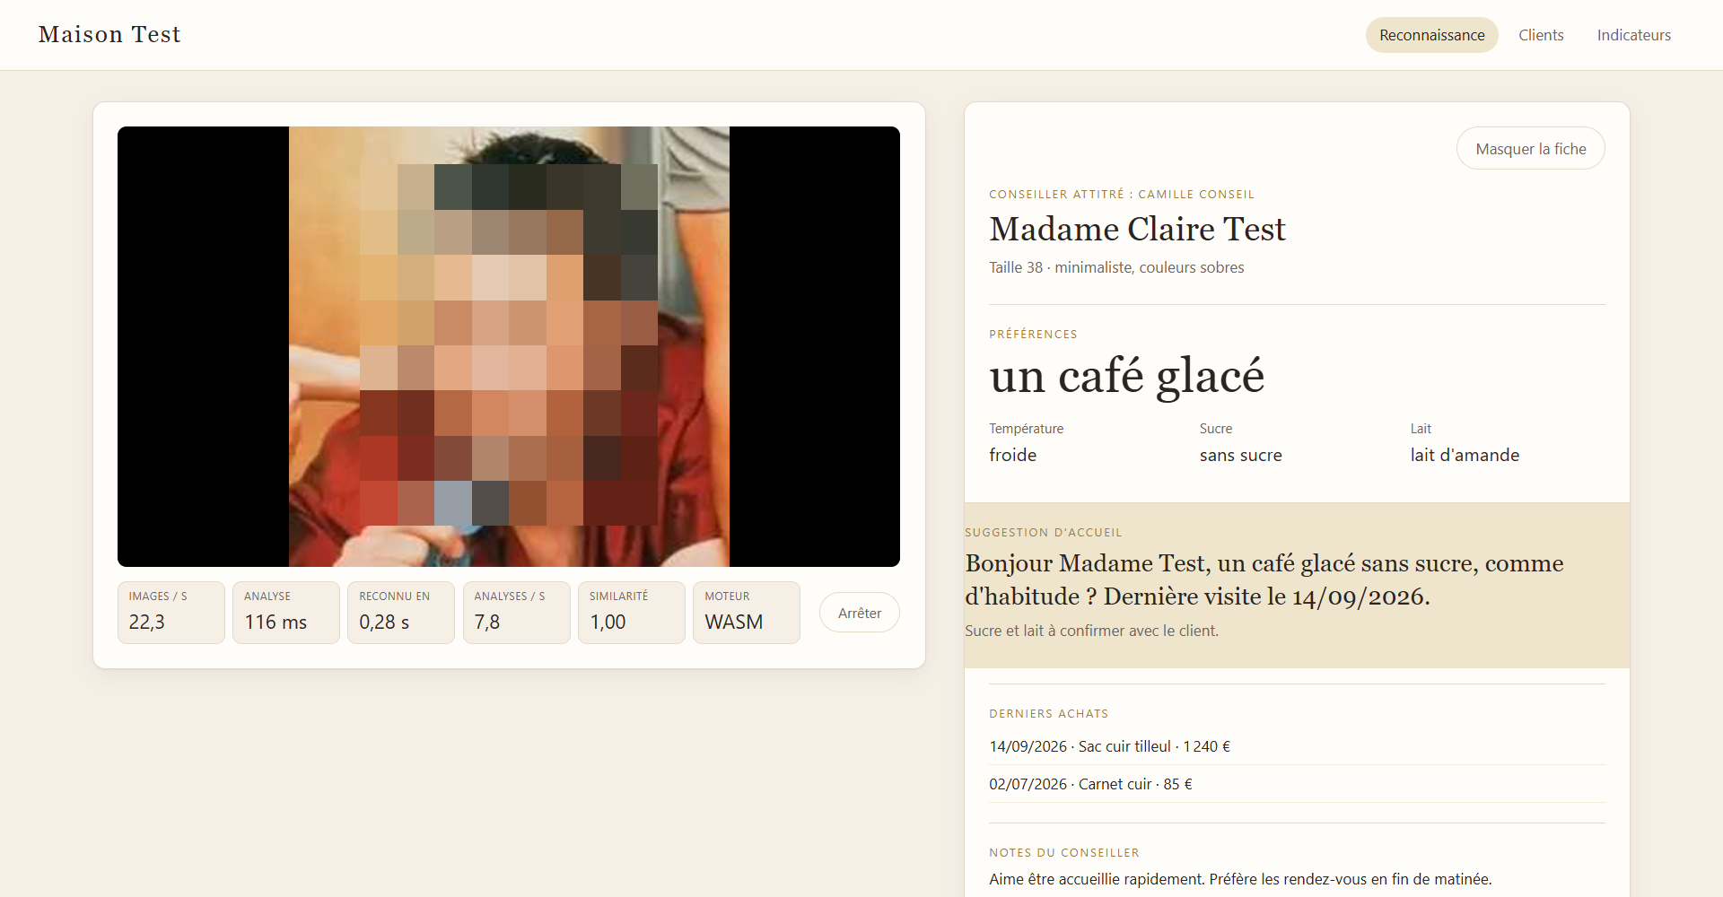
A complete app, published and usable from a link
WHAT WE BUILT
1
Live recognition
1
Claire Test
A frame and a name on each face, “Inconnu” (unknown) otherwise.
3
2
Live indicators
Speed, delay and similarity, measured while it runs.
3
Client card
4
Preferences, purchases, advisor notes, next appointment.
2
4
Welcome line
Written from the card and the time of day.
Two more pages: Clients (consent, guided capture, card) and Indicators (dashboard). The interface is in French.
Notes:
Three pages: Recognition for the advisor, Clients for sign-up, Indicators for monitoring. The site is hosted on GitHub Pages: no server and nothing to install. Faces in the screenshots are pixelated; the frame and label are what the app draws.

Slide 4
No server: all the AI runs in the browser
HOW IT WORKS
Camera
Detection
Recognition
Tracking
Client card
1 frame in 3 analyzed
SCRFD, 2.4 MB
MobileFaceNet, 13 MB
3 of 5 decisions must agree
Time-of-day suggestion
0 images leave the device
15.4 MB of models
512 numbers per client
Unknown faces are processed in memory and never stored.
Downloaded once, then cached. ONNX Runtime Web, on WebGPU or WebAssembly.
The only biometric data kept, after typed consent. No photo is stored.
Same models as our first Python version (InsightFace buffalo_s), ported to JavaScript and checked against it: faces within 0.17 px, signatures at 0.9985 similarity.
Notes:
The key technical point: nothing goes to a server. The browser downloads two models, 15 MB in total, and does all the computing. We first built a Python version, then ported the pipeline to JavaScript and checked that both give the same results to within a fraction of a pixel. The station colors are the ones used in the timing chart two slides later.

Slide 5
The numbers, measured by the app itself
RESULTS
Median delay
Time per analysis
108 ms
132 ms on CPU only
0.20 s
24 fps
Display rate
8.1 analyses per second
Enrolling a client
18.7 s
25 valid images across 5 poses
False accepts at threshold 0.35
0%
6 identities, 7 degraded conditions
From a face entering the frame to the client card on screen, on the demo PC. 0.34 s on CPU only.
Reliable range
2.0 m
83% still identified at 3.9 m
JavaScript vs Python gap
0.17 px
0.9985 signature similarity
Automated tests
133
45 web, 88 Python, plus end to end
Edge 156 · Ryzen 7 5800H · RTX 3060 · medians of 5 sessions of 12 s
Notes:
These numbers come from reproducible measurements (the evaluation folder of the repository): performance in Edge on a Ryzen 7 5800H with an RTX 3060, robustness with the same models. The delay, time per analysis and display rate are for the demo setting (hybrid mode, dedicated GPU); the public site uses the CPU by default. The delay includes smoothing: three matching decisions are needed before a name is shown, to avoid mistakes.

Slide 6
Measuring changed our engine choice
RESULTS · SPEED
1
Recognition is 3 to 4 times slower on the graphics card, whichever card (149 to 161 ms vs 41 ms).
2
Detection only speeds up on the dedicated card (57 ms vs 77 ms).
3
So: CPU by default, hybrid on the demo PC. 108 ms per analysis, 0.20 s to the card.
Without measuring, we would have concluded “the GPU makes everything faster”. The browser was in fact using the integrated GPU.
Notes:
An analysis has three stages, each timed separately by the app. First surprise: the browser was using the processor's integrated GPU, not the RTX. Second surprise: even on the RTX, recognition is slower than on the CPU, probably because some of the model's operations are not supported by WebGPU. Hence a safe default (CPU) and a hybrid mode for the demo PC, once the dedicated card is enabled for Edge in the Windows graphics settings.

Slide 7
Reliable up to about 2 m from the camera
RESULTS · RANGE
READING
1
100% up to 2.0 m, still 83% at 3.9 m.
2
Beyond 4 m the face is under 35 px wide and is no longer detected.
3
Every detected face was recognized: detection is the limit.
4
Takeaway: camera near the entrance, at face height.
Distance estimated for an HD webcam with a 70° field of view and a 15 cm face. 6 identities, same source photo.
Notes:
We simulated distance by shrinking the face inside an HD frame. Converting to meters is a geometric estimate. The message for a store: placement matters, and the useful range is about two meters.

Slide 8
Handles light well, struggles with blur and covered faces
RESULTS · ROBUSTNESS
Correct identification rate at threshold 0.35, 6 identities, one point per level. Degradation increases to the right, except exposure: 1 = normal, darker to the left, brighter to the right.
Notes:
Six kinds of degradation, from mild to severe. The model copes very well with dim or bright light and with compression. It breaks down with heavy blur, a head tilted 90 degrees, or more than half of the face covered. Caveat: enrollment and test start from the same photo, so real conditions will be less favorable.

Slide 9
At threshold 0.35: 0% false accepts, 11.7% false rejects
RESULTS · ACCURACY
The two groups are well apart: other people never go above 0.24 similarity. Threshold 0.35 favors never showing the wrong card: better an “Inconnu” than the wrong name.
Indicative evaluation: 6 identities, same source photo for enrollment and test, all degraded conditions combined.
Notes:
The threshold sets the trade-off: too low and we show someone else's card; too high and we stop recognizing clients. In luxury retail, showing the wrong name is worse than showing nothing, hence a cautious threshold. The 11.7% of false rejects come mostly from extreme conditions (heavy blur, covered face).

Slide 10
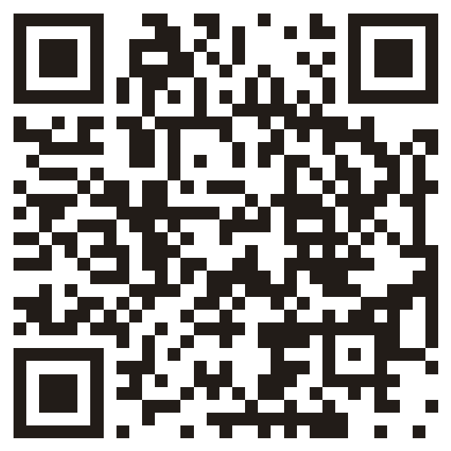
From sign-up to welcome in four minutes
LIVE DEMO
Try it
0:00
Sign up a client
Clients page: the person types J'ACCEPTE, then 25 images are captured across 5 poses.
1:15
Fill in the card
Drink, sugar, milk, style, recent purchases, next appointment.
2:15
Recognize them
Recognition page: the person steps in and the card appears. Another team member stays “Inconnu”.
Open the demo on your phone while we run it.
3:15
Read the indicators
Delay, time per stage, enrollment quality.
PLAN B
4:00
Open with ?moteur=wasm to use the CPU.
Import the prepared JSON backup.
Next slide: the same flow in screenshots.
Questions
Notes:
Before the session: in Windows, Settings, Display, Graphics, set Microsoft Edge to High performance (RTX 3060); this is already done on the demo PC. Open the site once with ?moteur=hybride (the choice is remembered), allow the camera, check that the light falls on the person's face, and load the models once (15 MB) to avoid waiting. Keep a JSON export with an enrolled client. During the demo, also show the Hide card button, and bring in someone who is not registered to show “Inconnu”.

Slide 11
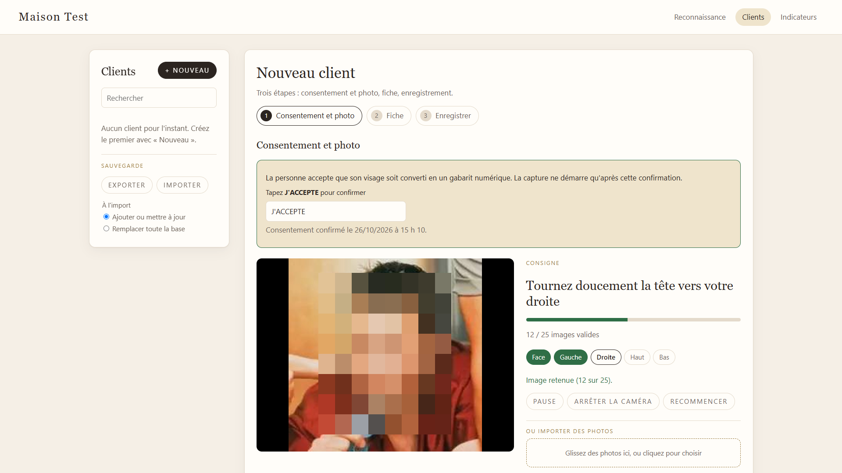
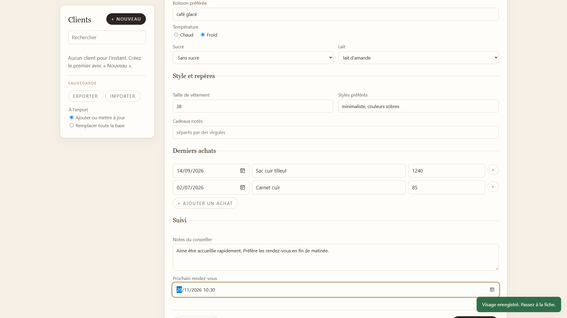
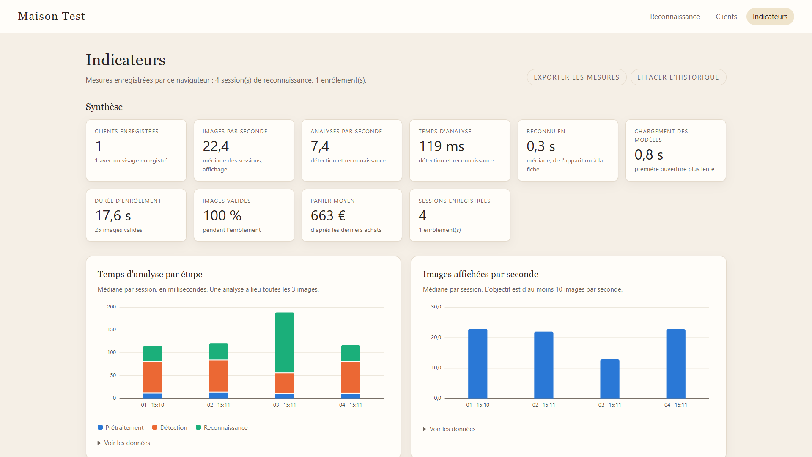
The same flow in screenshots
DEMO · BACKUP
2. Card: preferences, purchases, appointment
1. Consent first, then guided capture in 5 poses
Recognition itself is on slide 3. Simulated camera, faces pixelated.
3. Indicators measured during the demo
Notes:
Backup slide: if the camera or the network fails, walk through the flow from these screenshots.

Slide 12
Technical limits, and what we would do next
LIMITS · TECHNICAL
WHAT WE SAW
WHAT WE WOULD DO
01
Evaluated on 6 identities, one photo per person
Test with a volunteer panel over several days, with glasses and different hairstyles
02
No spoofing detection: a photo of a photo works
Add liveness detection (blinking, depth)
03
Database stored in a single browser
Shared, encrypted database across the boutique's devices
04
Poses are guided but not checked during enrollment
Check head angle from the facial landmarks
05
132 ms per analysis, on a single CPU core
Enable multithreading (site headers) and an optimized model
06
Usable range about 2 m, sensitive to blur
Better placed, higher resolution camera, front lighting
Notes:
We would rather be upfront: a proof of concept shows feasibility, not reliability in real conditions. The first limit matters most: our evaluation is small and optimistic. The second is a real risk in production.

Slide 13
Legally, biometrics is the real issue
LIMITS · LEGAL
REGULATION (EU) 2016/679
REGULATION (EU) 2024/1689
GDPR, Article 9
EU AI Act
Biometric data is prohibited by default. The usable exception is explicit, freely given consent, so a face-free alternative must exist.
Remote biometric identification is listed as high risk (Annex III). The obligations were pushed back to 2 December 2027 by the June 2026 Omnibus agreement.
CNIL, FRENCH DATA PROTECTION AUTHORITY
INSIGHTFACE
Consent and impact assessment
Model license
Walking into a shop is not consent. A data protection impact assessment is required before any deployment.
The models we used are for non-commercial research only. A real deployment needs commercially licensed models.
What we applied: dated “J'ACCEPTE” consent before any capture, no photo stored, unknown faces never saved, deletion on request. Not an exhaustive analysis; to be reviewed by a lawyer.
Notes:
Sources: GDPR Article 9; AI Act, Annex III point 1(a); Omnibus agreement voted by Parliament on 16 June 2026 and approved by the Council on 29 June 2026, Official Journal publication to be checked; CNIL positions on smart cameras in stores as reported in the press. This is not legal advice.

Slide 14
The camera matters as much as the model
LIMITS · HARDWARE
Camera
HD webcam at least. Beyond 2 m or with motion blur, recognition drops.
Lighting
Copes with dim light, but backlight or strong side light hurts detection.
Placement
At the entrance, at face height, facing the flow. Several people at once: one card shown.
Computer
A recent PC: 132 ms per analysis on a Ryzen 7 5800H. An older PC or a tablet will be slower.
Browser and network
Recent Chrome or Edge. 15 MB to download on first launch, then everything runs locally.
Order of magnitude per entrance: a €50 to €150 webcam and an existing PC are enough for the prototype. No server, no subscription.
Notes:
The main message: measured performance depends as much on the hardware and the installation as on the model. The price range is an order of magnitude, not a quote.

Slide 15
Commercially, technology is not the main obstacle
LIMITS · COMMERCIAL
01
Acceptability
A realistic positioning
In luxury, discretion comes first. Being recognized without asking can feel like surveillance.
02
An opt-in program for loyal clients who ask for it, never on by default.
The advisor stays in control: a Hide card button, no automatic action.
A face-free alternative: loyalty card or app.
Success metric: the share of invited clients who opt in, and their satisfaction.
Real consent
Service must be just as good without face recognition, or consent is not freely given.
03
Costly mistakes
Showing another client's card exposes their purchases and notes. Rare, but serious.
04
Integration
The value is in the client card, so it has to plug into the existing CRM.
Notes:
The prototype shows the technology is within reach: a few hundred euros of hardware and a browser. The real business question is whether clients accept it, and a legal framework that requires a genuine choice.

Slide 16
What this project says about AI today
TAKEAWAYS
Already good at
Still hard
Recognizing a known face in a fraction of a second, on an ordinary PC.
Running without a server, in a plain browser, with 15 MB of models.
Staying stable in dim light or with a compressed image.
Real conditions: distance, blur, covered or turned faces.
Spoofing, fairness across profiles, evaluation at scale.
The framework: consent, biometrics law, client acceptance.
SKILLS WE USED
Product framing · On-device AI · Measurement and KPIs · Digital law · Software quality
Notes:
The message to remember: face recognition has become technically accessible, which makes the questions of framework all the more important. The project made us work on measurement, law and product as much as on AI.

Slide 17
It works. Now it needs a framework.
NEXT STEPS
Try it
1
Test with a volunteer panel, in a real boutique, over several days.
2
Add spoofing detection and switch to commercially licensed models.
3
Run the impact assessment and design the client opt-in journey.
Thank you. Demo mathos34.github.io/reconnaissance-equipe · Code github.com/Mathos34/reconnaissance-equipe
Rim Middi · Felix Chevalier · Jean-Baptiste Caron · Mathis Lacombe
Notes:
Close on the balance: technically feasible today, but a real deployment first needs a framework. Open the floor to questions.

